Slide 1
Using Blockly in Jupyter Notebooks
How to Write Code Without Writing Code

Slide 2


What is Blockly?
Block-based programming editor
Users place interlocking, graphical blocks representing code concepts
Blockly generates equivalent Python code
Notes:
Learning to program is hard. Even knowing concepts, difficult to master syntax. Syntax is wrong it wont run.

Slide 3
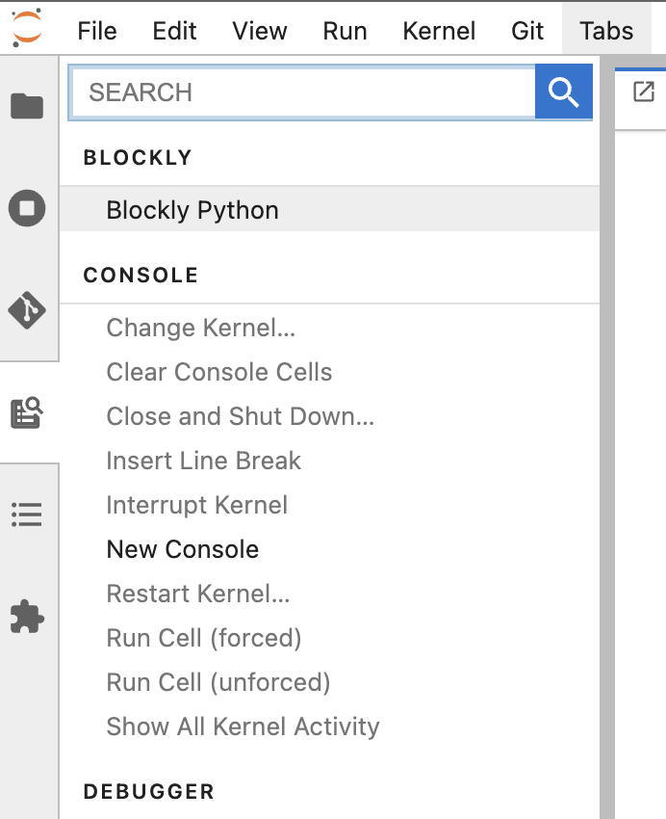
How-to: Open Blockly Interface (1)
Open Commands
Click Blockly Python
This will open a Blockly tab.

Slide 4
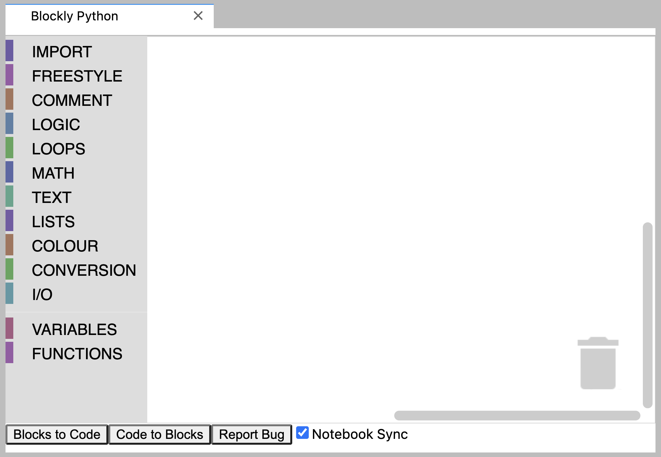
How-to: Open Blockly Interface (2)
This is how the Blockly Editor should look…
But sometimes it may not render correctly…

Slide 5
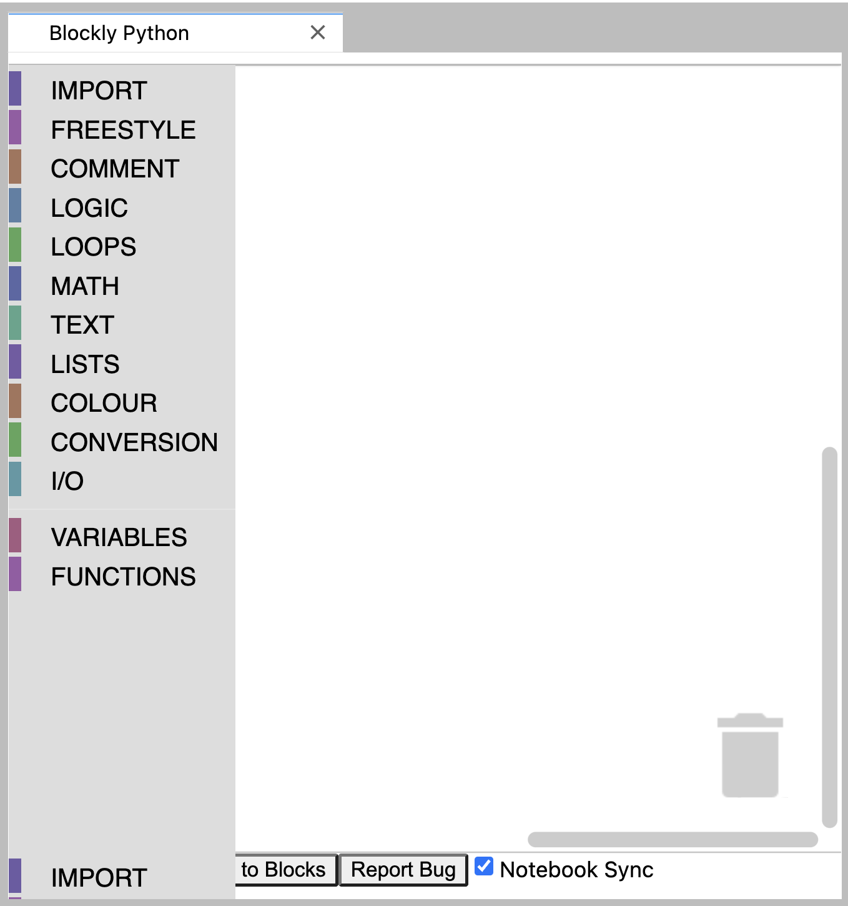
How-to: Fix Blockly Interface Render Issues
Solution: Reload the page.
To avoid render errors:
Open the Blockly Editor
Close the Blockly Editor
Reload this page
Open the Blockly Editor
Notes:
Instructor Demo

Slide 6
Activity 1: Open Blockly Editor
Close all open tabs (except pdf)
Reload the page
Open Blockly Editor & confirm rendered correctly
Close Blockly Editor
Open Blockly Editor & confirm rendered incorrectly
Reload the page
Confirm Blockly Editor rendered correctly
Notes:
Instructor demo then intern copy

Slide 7
Blockly Interface
Blockly Toolbox
Blockly Workspace
Blockly Trash Can
1
2
3
Notes:
Toolbox is where provided blocks live. Divided into color-coded sections based on use.
Trying to identify block category by color – some have almost same color, just have to remember where to find.

Slide 8
Blockly Interface
Blockly Toolbox
Blockly Workspace
Blockly Trash Can
Demo!
1
2
3
Notes:
Instructor Demo
Opening toolbox submenus (color codes)
Click to select block from menu and drag & drop
Enter text in block
Connect blocks
Move block to trash can

Slide 9

Activity 2: Playtime with Blocks
Open Blockly Editor (if not already open)
Click the Text section of Blockly Toolbox
Find the “print text” block
Hover over the block to see a description
Click or drag the block into the Blockly Workspace
Replace ”abc” with your name
Take a screenshot of your block and upload to Discord
Drag the block to the Blockly Trash Can
Notes:
Give 5 minutes.

Slide 10
Blockly Interface
Blockly Toolbox
Blockly Workspace
Blockly Trash Can
4. JupyterLab Blockly Integration Toolbar
1
2
3
4
Notes:
Instructor Demo

Slide 11
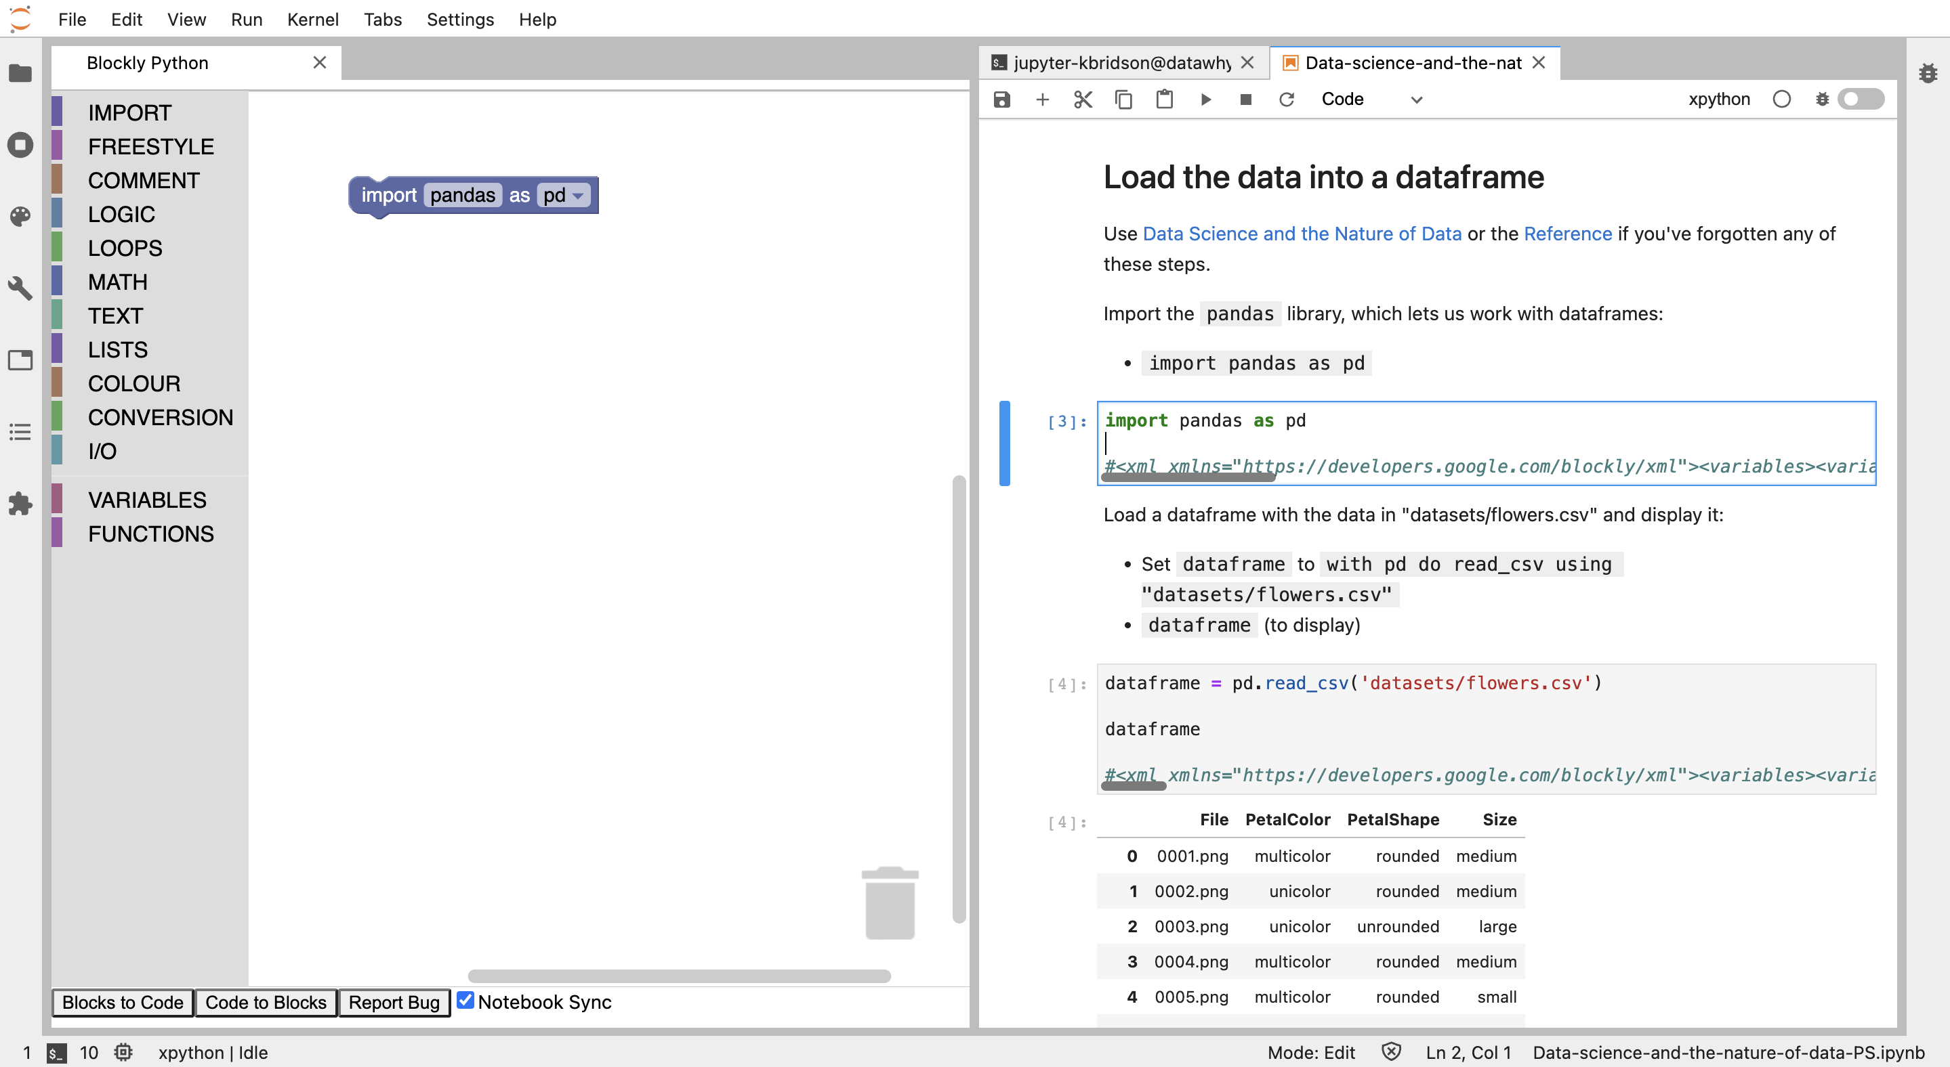
Using JupyterLab with Blockly
Notes:
Usual jupyterlab configuration
Integration via 2 buttons Blocks to Code and Code to Blocks.

Slide 12
JupyterLab Blockly Integration
Blocks to Code
Active Code Cell
Code to Blocks
Blockly Workspace

Slide 13
JupyterLab Blockly Integration
Python code
Blocks
Blocks to Code
Active Code Cell
Blockly XML Tag
Code to Blocks
Blockly Workspace
Blocks
Blockly XML Tag
Notes:
Explain Blocks to code as start with set of blocks in workspace, click Blocks to Code, overwrites content of active code cell with auto generated python code and Blockly XML tag that describes blocks.
Explain code to blocks as start with Blockly xml tag in active cell, click Code to Blocks, removes any blocks currently in workspace and applies blocks from XML string.
One extra interaction. When you change currently active code cell to one with XML tag and blockly panel is open, it will automatically attempt to make blocks for that cell So code to blocks is generally only needed to overwrite/reset.

Slide 14
Blocks to Code
Python code
Blocks
Blocks to Code
Active Code Cell
Blockly XML Tag
Code to Blocks
Blockly Workspace
Notes:
Explain Blocks to code as start with set of blocks in workspace, click Blocks to Code, OVERWRITES content of active code cell with auto generated python code and Blockly XML tag that describes blocks.

Slide 15
Code to Blocks
Blocks to Code
Active Code Cell
Code to Blocks
Blockly Workspace
Blocks
Blockly XML Tag
Notes:
Explain code to blocks as start with Blockly xml tag in active cell, click Code to Blocks, REMOVES any blocks currently in workspace and builds blocks from XML string.

Slide 16
Activity 3: Code to Blocks, Blocks to Code
Open blockly_integration.ipynb
Copy/paste the provided Blockly XML tag into the indicated empty code cell
Click Code to Blocks & observe the Blockly Workspace
Click Blocks to Code & observe the code input of the active cell
Run the active cell
Take a screenshot that includes both the code input & code output and save and show to the mentor
Notes:
Give 5 minutes.

Slide 17
Summary
Blockly Interface
Blocks to Code and Code to Blocks
How to add code to notebook cell with Blockly

