Slide 1
Introduction to Plotting
Understanding Data Through Visualizations

Slide 2
Think-Share Activity
What is a graph? What kinds of things do you think of as a graph?
What is a chart? What kinds of things do you think of as a chart?
What is a plot? What kinds of things do you think of as a plot?
Notes:
Discussion about checking word association with familiar terms which learners may or may not relate to stats or data science concepts

Slide 3
Data Science Terminology
A chart is a broad term for any type of data visualization.
A graph is a type of chart showing the relationship of quantities, especially such a diagram in which lines, bars, or proportional areas represent how one quantity depends on or changes with another.
We can plot a dataset into one or more types of chart.
Notes:
The general consensus on definitions that we use in data science.

Slide 4
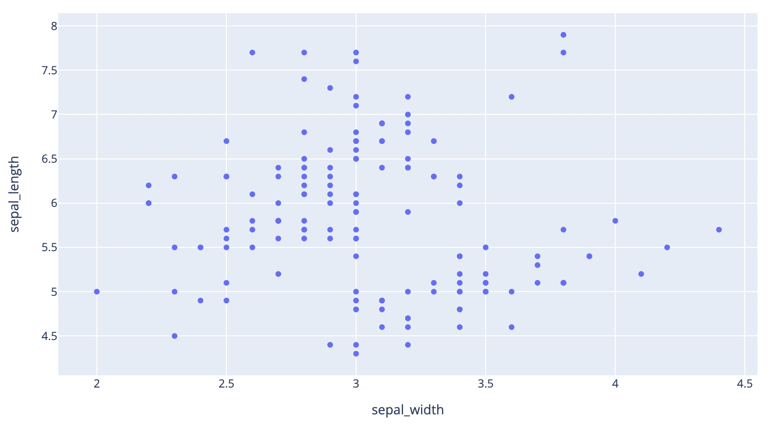
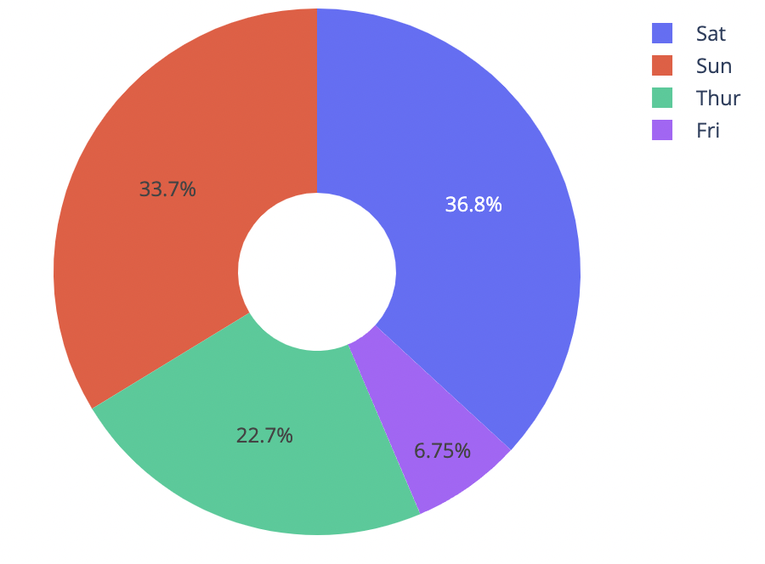
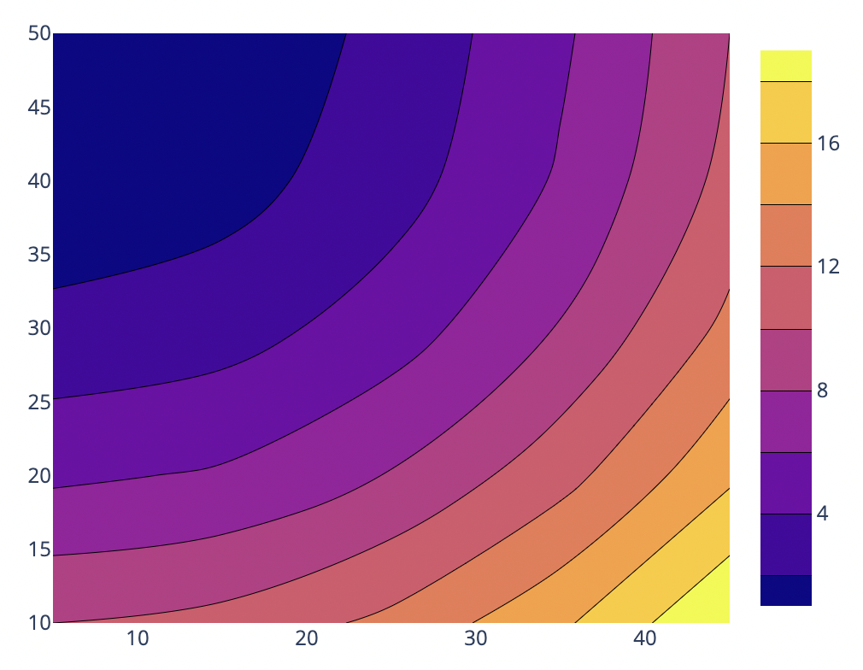
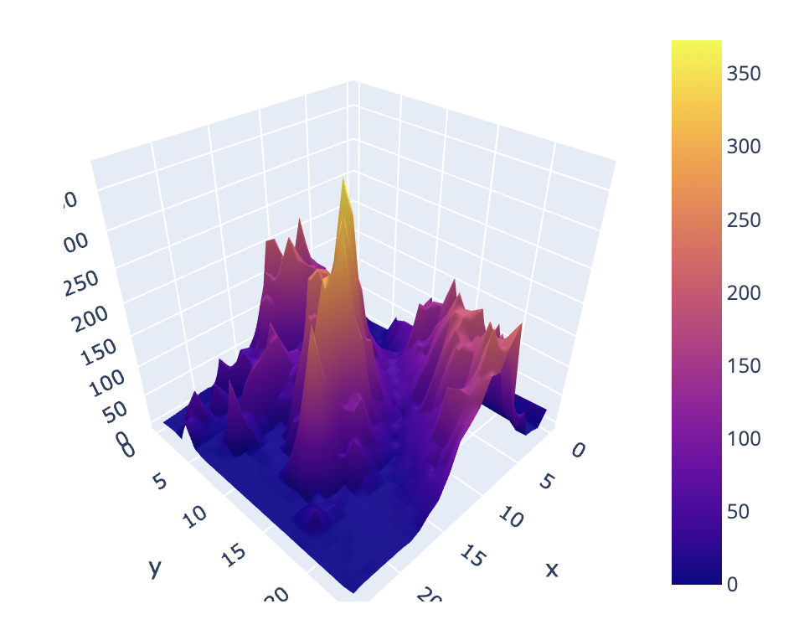
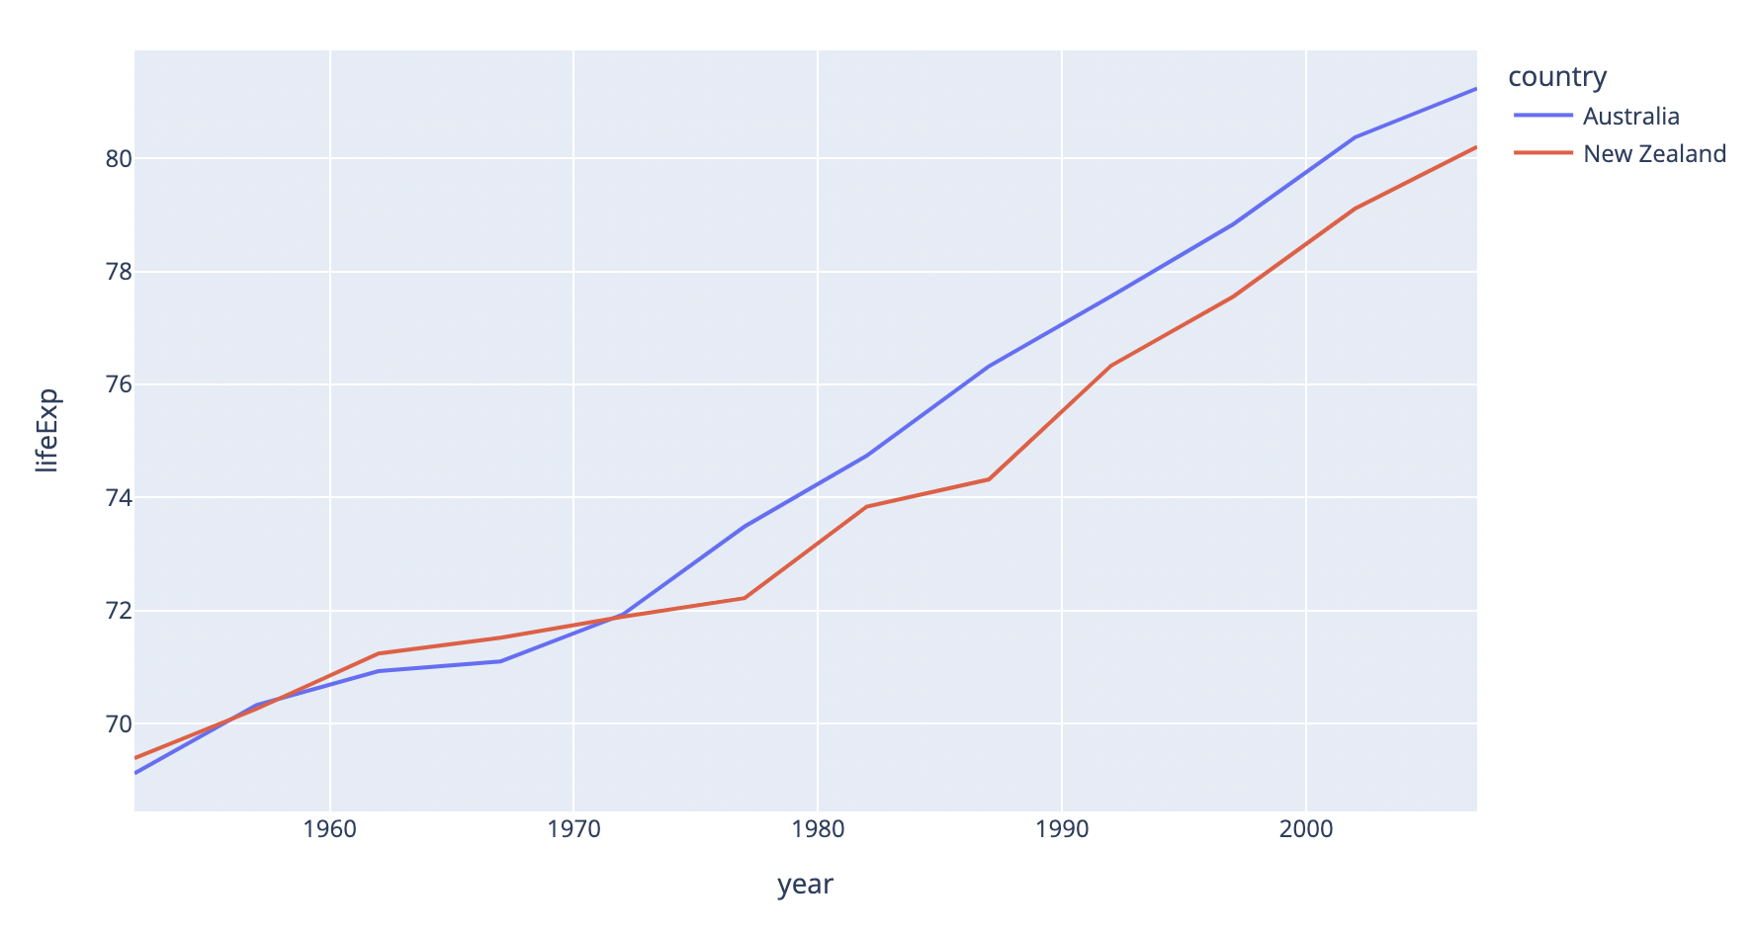
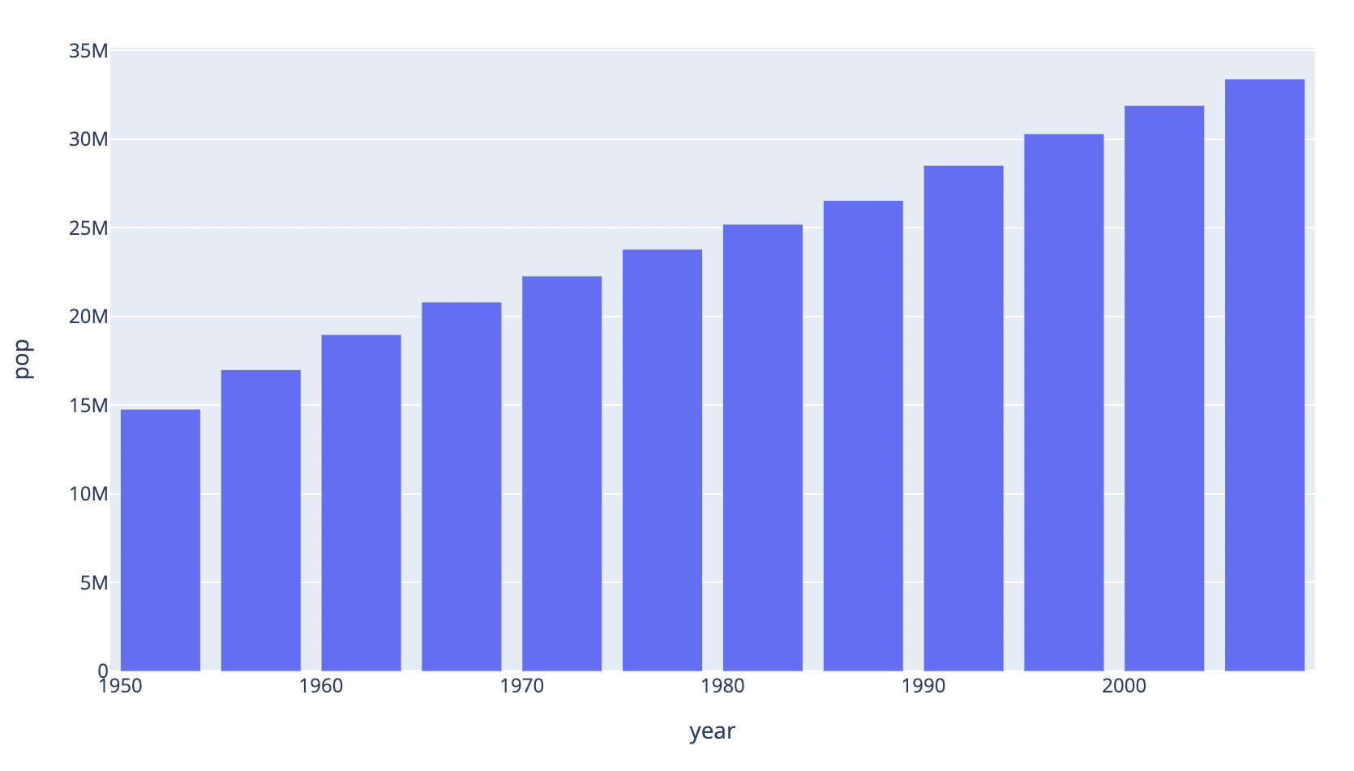
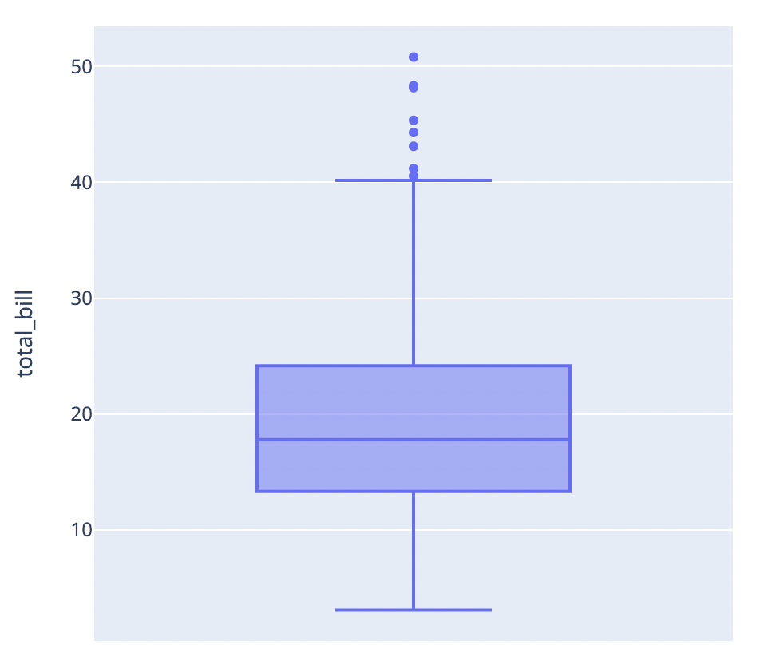
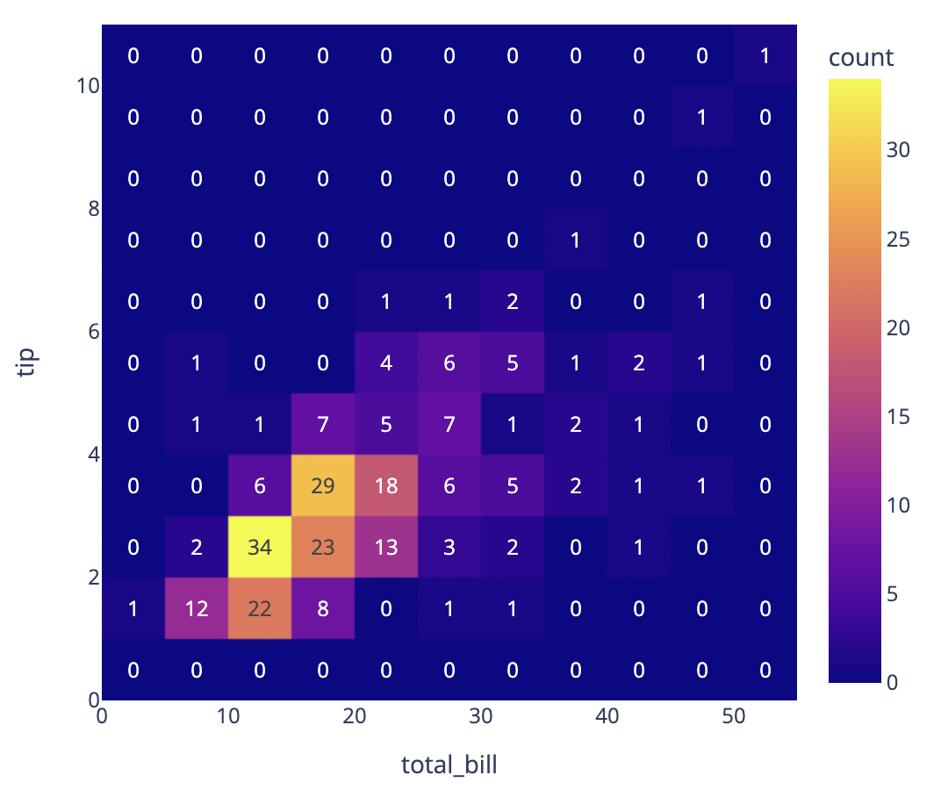
Think-Share Activity
These are all charts but you might know them by other names!
Can you name these?
Notes:
Note use of “plot”, “chart” and “graph” in names of each type of chart.
From left to right:
Scatter plot, pie chart, contour plot, 3d surface plot
Line chart, bar chart or maybe a histogram, box plot, 2d histogram or heatmap

Slide 5
Charts
Scatter Plot
Pie Chart
Notes:
Ask Katie if some descriptions are needed for each type

Slide 6
Charts
Contour Plot
3D Surface Plot

Slide 7
Charts
Line Chart
Bar Chart or Histogram

Slide 8
Charts
Box Plot
2D Histogram or Heatmap

Slide 9
Think-Share Activity
What were your first experiences with graphs in school?

Slide 10
Think-Share Activity
What were your first experiences with graphs in school?
Do you remember plotting equations?

Slide 11
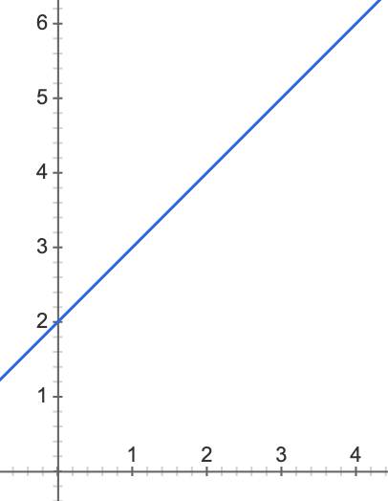
Think-Share Activity
What were your first experiences with graphs in school?
Do you remember plotting equations?
?
y = x + 2

Slide 12
Plotting Equations
Given y = x + 2, how do we plot?

Slide 13
Plotting Equations
x | y
0 | 2
1 | 3
2 | 4
3 | 5
y
Given y = x + 2, how do we plot?
How-to Plot Equations:
1. Choose a few (2+) values of x and calculate y
2. Draw the x-axis and y-axis, with ticks
3. Plot each datapoint (x, y)
4. Draw a line that goes through all points
x
Notes:
How to calculate y?
What’s a point?
Add something about the datapoints in the notes!!!!!!!

Slide 14
Demo: Plot y = x - 1
Notes:
How to calculate y?
What’s a point?

Slide 15
Activity 1: Plotting Equations
Plot y = 2x + 1
On scratch paper:
1. Choose a few values of x and calculate y
2. Draw the x-axis and y-axis, with ticks
3. Plot each datapoint (x, y)
4. Draw a line that goes through all points
5. When done, call a mentor over to check your work.
Notes:
How to calculate y?
What’s a point?

Slide 16
Plotting Equations vs Plotting Datasets
Plotting Equations:
Relationship between x & y is known
It is given by the equation!
We make datapoints to cleanly illustrate the relationship
Plotting Datasets:
Relationship between x & y is unknown
It is what we are looking for!
We have datapoints which may or may not illustrate the relationship
Notes:
How to calculate y?
What’s a point?

Slide 17
Summary
Plotting terminology in data science
Plotting equations
Plotting equations vs plotting datasets

