Slide 1
Scatter Plots
How We Visualize Correlation Between Variables

Slide 2
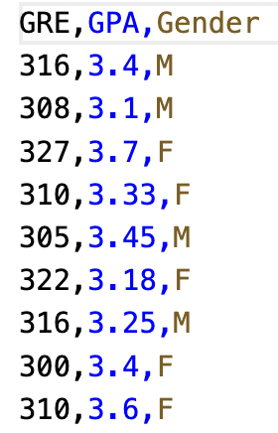
Plotting Datasets
We’ve imported the CSV into a dataframe.
Now what?
We can plot the dataset to look for patterns between variables – what effect does one variable have on another.
Q & A: What are the variables in the CSV shown?

Slide 3
Plotting Datasets
We’ve imported the CSV into a dataframe.
Now what?
We can plot the dataset to look for patterns between variables – what effect does one variable have on another.
Q & A: What are the variables in the CSV shown?
GRE, GPA, Gender

Slide 4
Detecting Correlations
Datasets usually come out of research studies which have a goal.
Remember rows are observations!
Q & A: What could have been the original goal for the shown dataset?

Slide 5
Detecting Correlations
Datasets usually come out of research studies which have a goal.
Remember rows are observations!
Q & A: What could have been the original goal for the shown dataset?
Does a student’s GPA depend on GRE or Gender?

Slide 6
Detecting Correlations
To determine correlation, classify variables as independent or dependent based on the goal.
Independent variables are what dependent variables depend on.
For “Does a student’s GPA depend on GRE or Gender?”:
Dependent: GPA
Independent: GRE and Gender

Slide 7
Detecting Correlations
“Does a student’s GPA depend on GRE or Gender?”
Possible charts:
GPA vs GRE
GPA vs Gender
When you have two variables with numeric values, you can make a scatter plot.

Slide 8
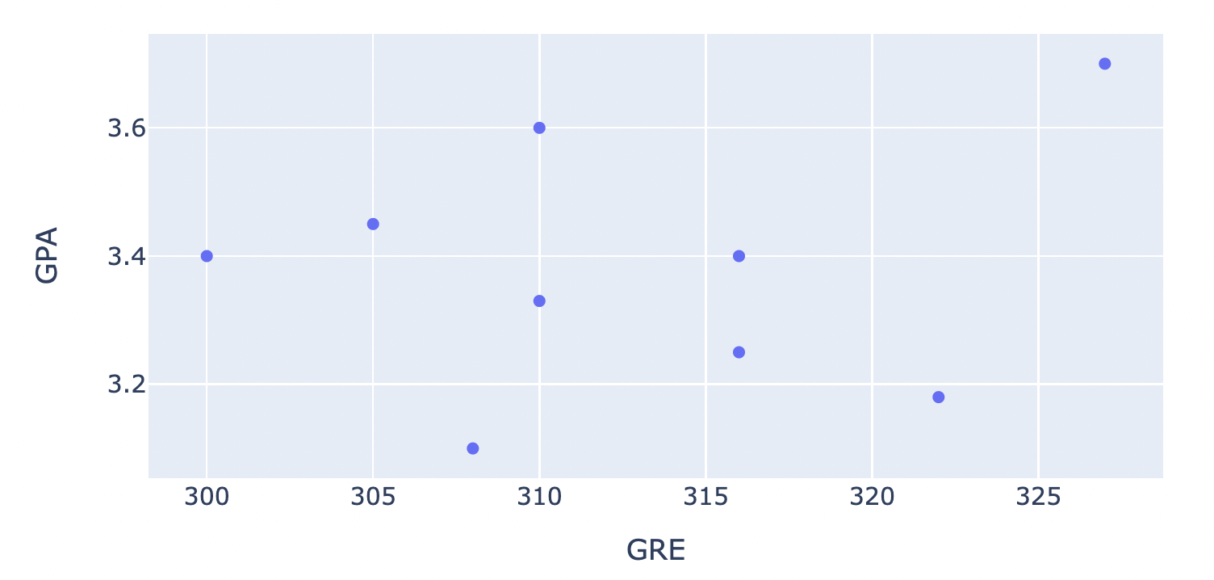
Scatter Plots
Plot each datapoint
Independent variable on x-axis
Dependent variable on y-axis
(x, y) is now (GRE, GPA)
Let’s find (316, 3.4)
Look! Points are not in order on graph

Slide 9
How-to: Design Scatter Plots
Given dataset and goal/question:
Identify variables relevant to goal
Classify variables as independent or dependent
Set up the axes and plot each datapoint
Observe the distribution of points and determine correlation
Step 4 is hard. We will cover it in a later session.

Slide 10


How-to: Make Scatter Plots in Jupyter & Blockly
Step 1: Read CSV Data into Pandas Dataframe This step creates a Dataframe and stores the content of the dataset into a variable so that we can use this in later steps.
Substep: Import pandas Library
Python: Blockly:
To read from a csv file, first we will import the pandas library. It has a read_csv function which we will use to automatically parse the csv file and load it into the notebook.

Slide 11
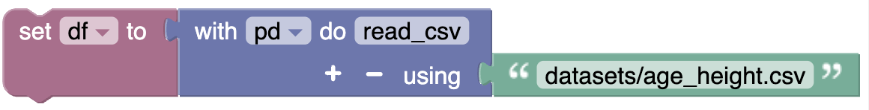
How-to: Make Scatter Plots in Jupyter & Blockly (Step 1 Cont.)
Substep: Read CSV data and Save in Variable
Python: Blockly:
The read_csv function requires us to supply the relative path to the csv file. It returns a Pandas Dataframe object which we will store in a variable df so we can use it later in the notebook.

Slide 12

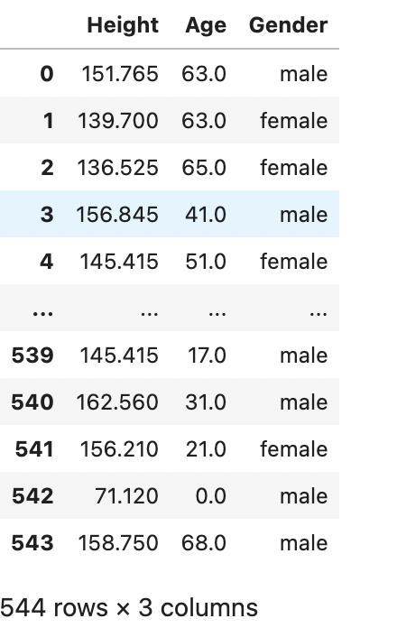

How-to: Make Scatter Plots in Jupyter & Blockly (Step 1 Cont.)
Substep: Display Dataframe Contents
Python: Output: Blockly:
Calling the variable in a cell by itself will print the contents of the dataframe to the screen so we can confirm the dataset was imported correctly.

Slide 13


How-to: Make Scatter Plots in Jupyter & Blockly
Step 2: Generate Plotly Scatter Plot This step uses the content of the dataframe to generate a scatter plot.
Substep: Import plotly.express Library
Python: Blockly:
To make a scatter plot, first we will import plotly.express library. It has a scatter function which we will use to make the scatter plot.

Slide 14

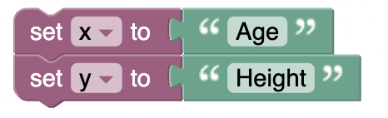
How-to: Make Scatter Plots in Jupyter & Blockly (Step 2 Cont.)
Substep: Set Columns as x and y
Python: Blockly:
The scatter function requires us to supply the names of the columns for the independent (x) and dependent (y) variables. Here “Height” is dependent on “Age” so we will set a variable x to “Age” and a variable y to “Height.”

Slide 15

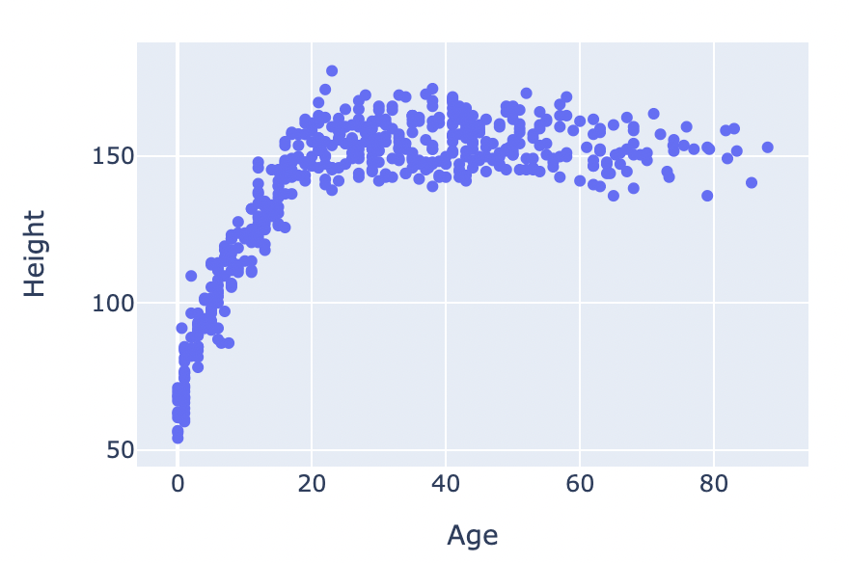
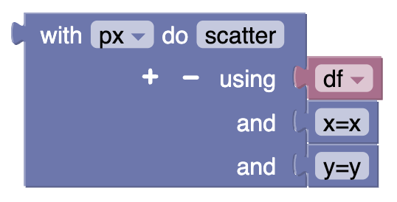
How-to: Make Scatter Plots in Jupyter & Blockly (Step 2 Cont.)
Substep: Generate scatter plot:
Python: Output: Blockly:
The scatter function requires us to supply the dataframe variable and column names for the x axis and y axis which we previously stored in variables x and y.
This function returns a scatter plot.

Slide 16
Reference Notebook
scatterplots_ex.ipynb

Slide 17
Summary
Plotting datasets
Independent and dependent variables
Scatter Plots
Making scatter plots with Blockly

