Slide 1
Styling Plotly Charts
How to Add Extra Options to Customize Plotly Charts

Slide 2
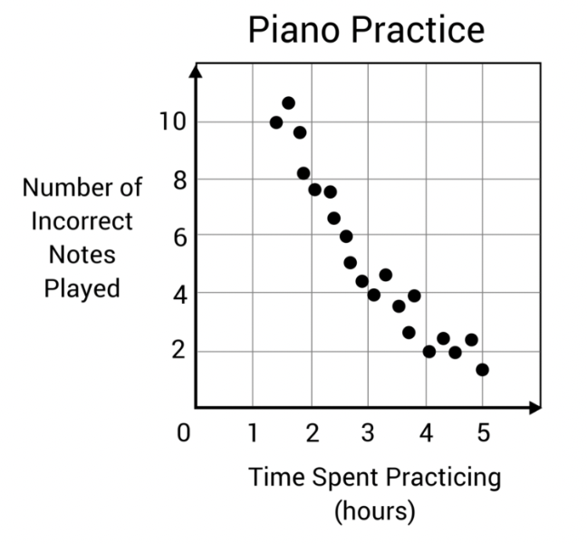
Think Share Activity
What are the parts of a chart?

Slide 3
Parts of a Chart
Title
Chart body
Axes
Coordinate space
Points, lines
Axis labels
Color legend

Slide 4
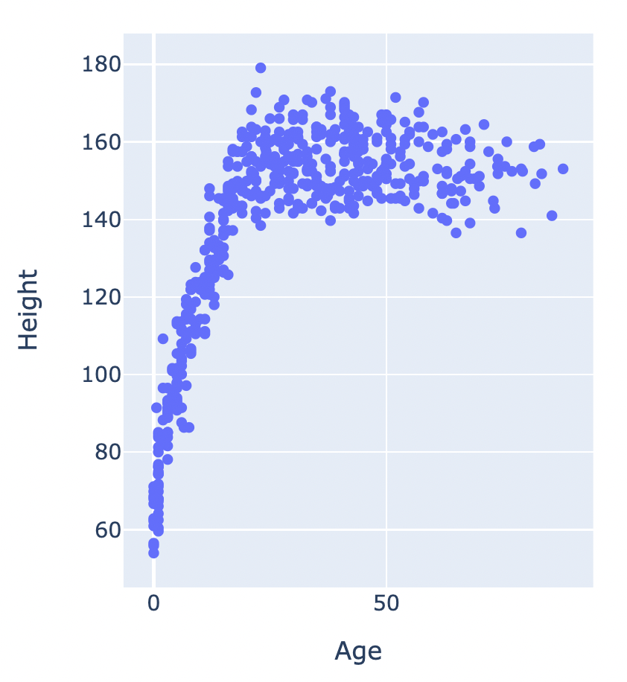
Default Plotly Chart Styling
For this dataset column names were:
Age
Height
Gender
Axis labels depend on column names
Looks pretty good, except no title

Slide 5
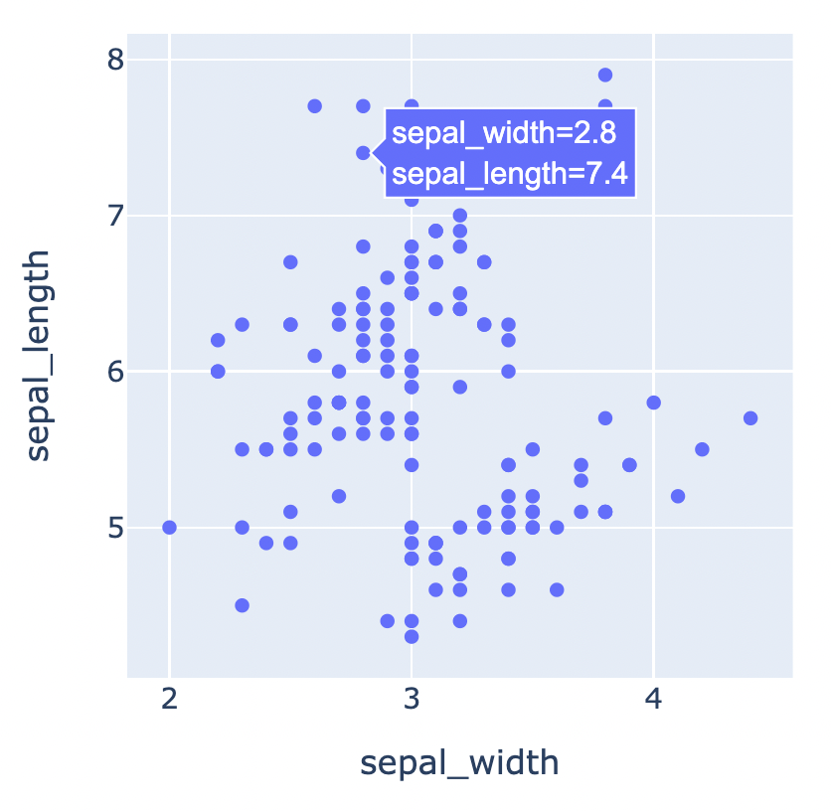
Default Plotly Chart Styling
For this dataset column names were:
sepal_length
sepal_width
Doesn’t look so nice…
But we can customize!

Slide 6
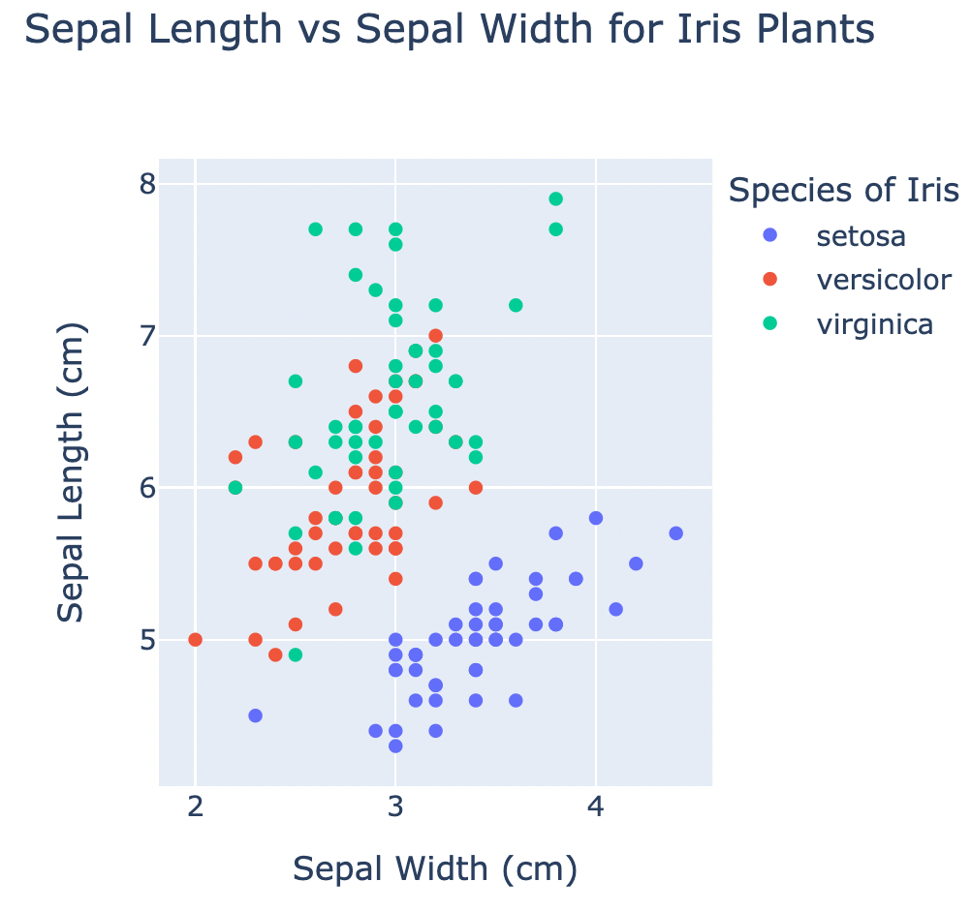
Plotly Chart Options: Before & After

Slide 7
Plotly Chart Options
Many options to change!
Set title
Set color of each point based on an additional variable
Change chart labels

Slide 8

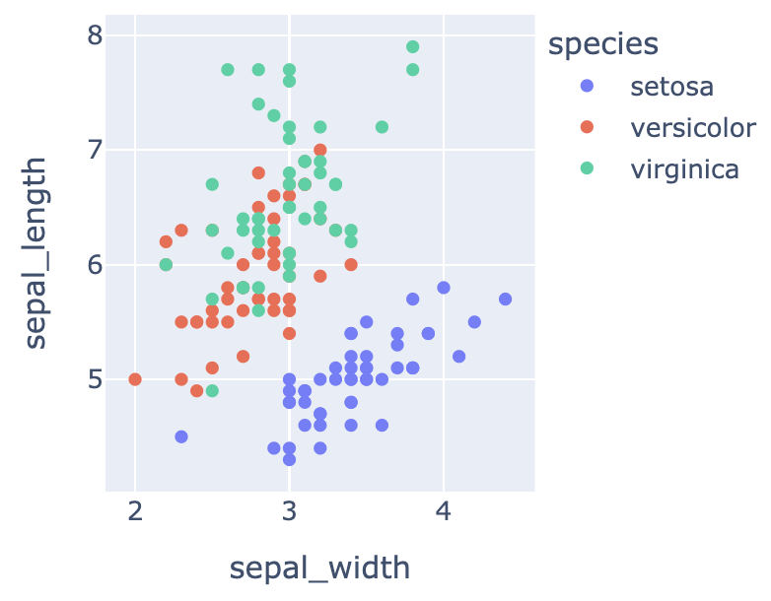

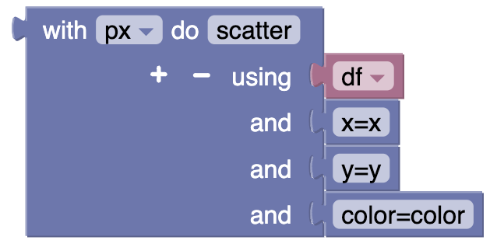
How-to: Set Color of Points w/ Variable
Add an extra option to px.scatter

Slide 9
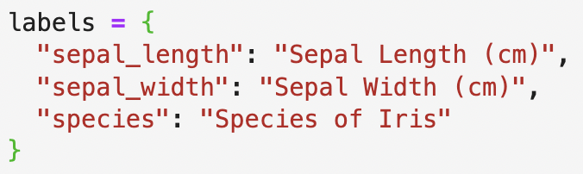
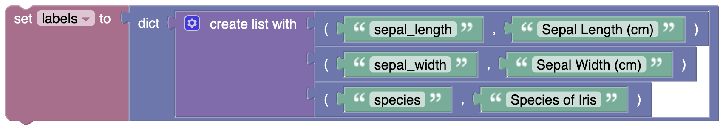
How-to: Change Label Text Dictionaries in Blockly
This is a dictionary, a kind of key-value storage.
Blockly doesn’t always generate code that is easy to read.

Slide 10
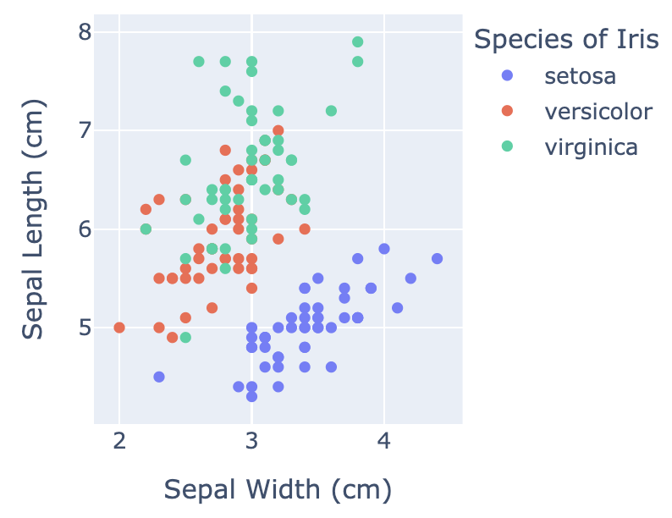
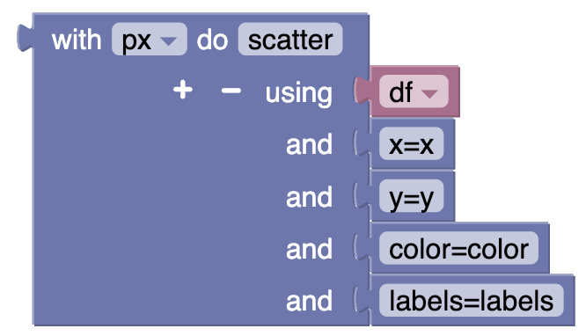
How-to: Change Label Text (cont.)
Add an extra option to px.scatter

Slide 11
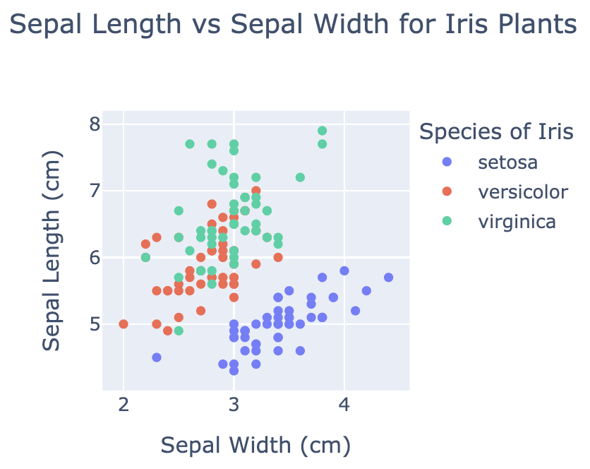
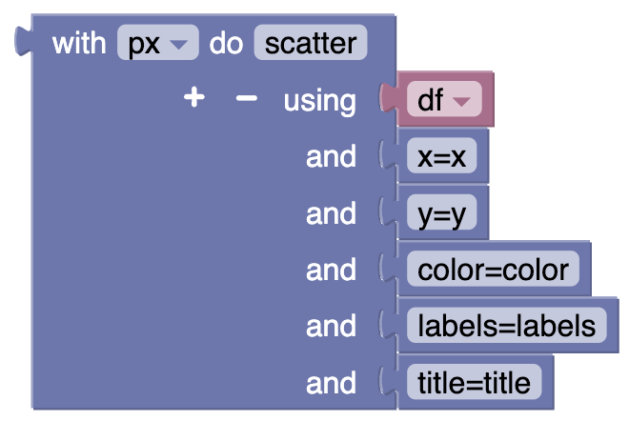
How-to: Add Chart Title
Add an extra option to px.scatter

Slide 12
Summary
Parts of a chart
Some ways to customize Plotly charts
Plotly chart options with Blockly

