Slide 1
Line Charts
How to Plot Change Over Time

Slide 2
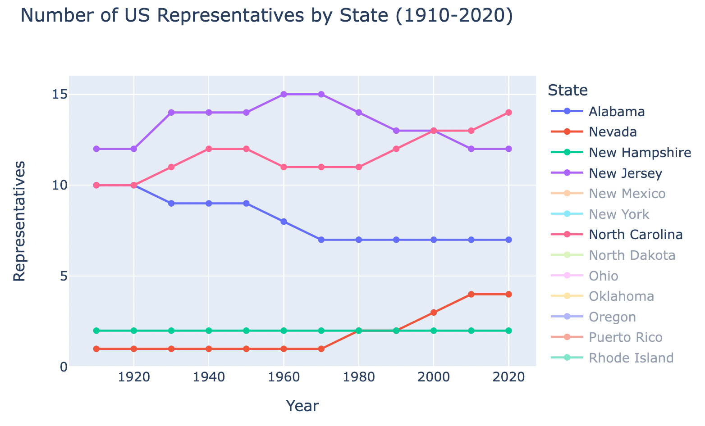
Think Share Activity
What are the parts of the chart?

Slide 3
Parts of a Chart
Title
Chart body
Axes
Coordinate space
Points, lines
Axis labels
Color legend

Slide 4
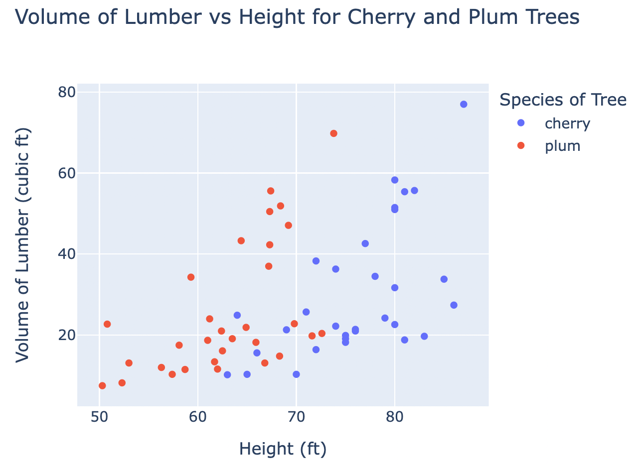
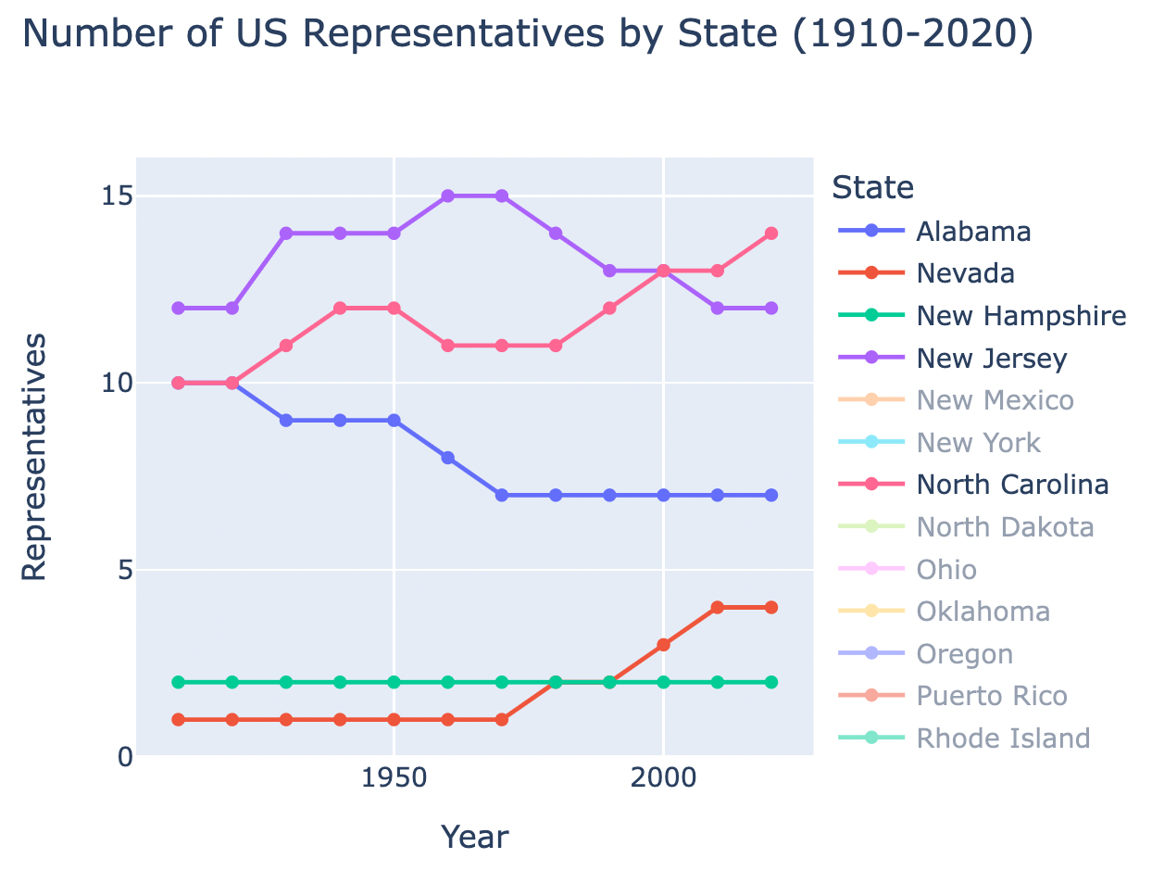
Think Share: Scatter Plots vs Line Charts
Notes:
Similarities & Differences

Slide 5
Scatter Plots vs Line Charts
Independent variable
Scatter: any numerical value
Line: unit of time
Number of y values for each x
Scatter: as many as have been observed
Line: only one y for each x
Connected points
Scatter: no connections
Line: connected by line
Notes:
Similarities & Differences

Slide 6
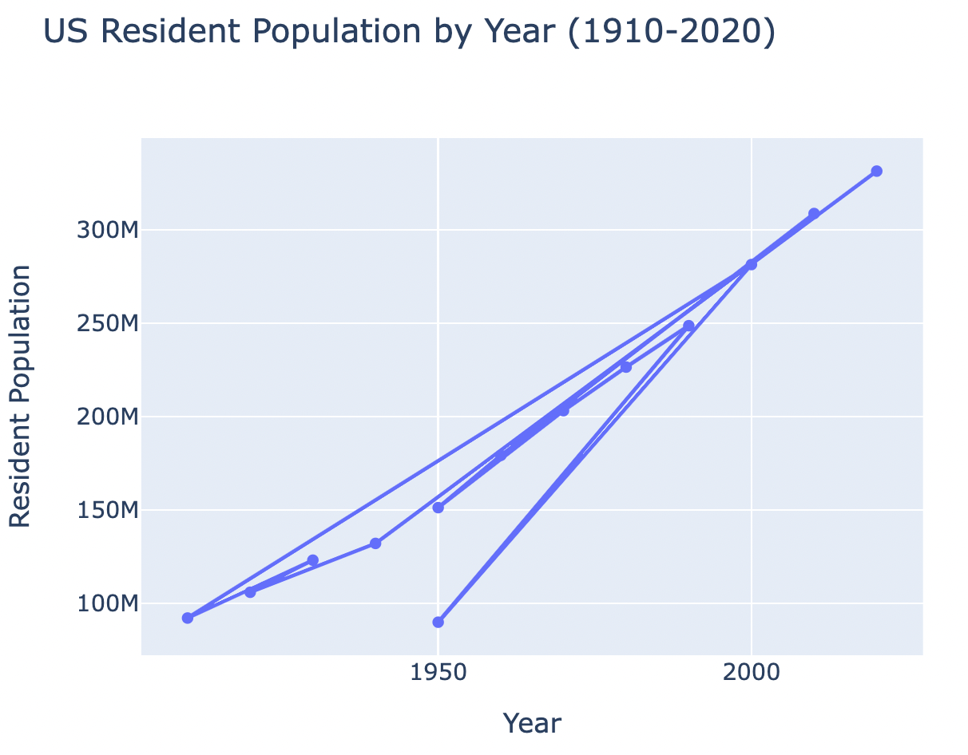
Line Charts
Important! Lines should connect points in order by x axis value so the data must be sorted first!
If we have unsorted data … yikes
Notes:
Note: it will also draw weird lines if more than one y for each x. We will explain more about what to do in this case later, but for now, we won’t give you any datasets with this problem.

Slide 7
How-to: Make Line Charts in Jupyter
Read CSV Data into Pandas Dataframe
Import Pandas Library
Read CSV data and Save in Variable
Sort Data
Display Dataframe Contents
Generate Plotly Line Chart
Import Plotly Express Library
Set Columns as x and y
Set Additional Plot Options (Optional)
Generate Chart

Slide 8

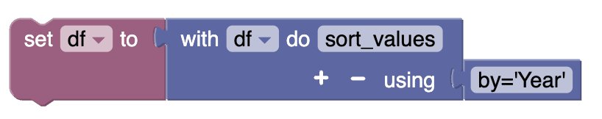
How-to: Sort Data with Blockly

Slide 9
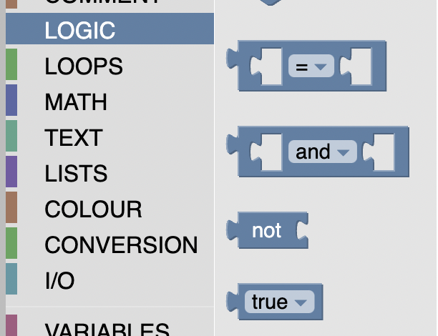


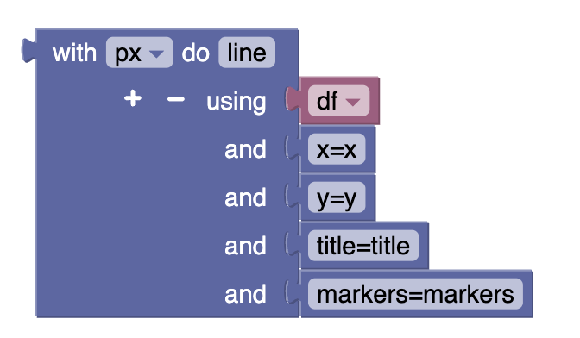
How-to: Adding Datapoints on Line Chart

Slide 10
Summary
Parts of a chart
Line charts
Line charts vs scatter plots
Plotly line charts with Blockly

