Slide 1
Reading a CSV data file

Slide 2
Objective
Become familiar with libraries in python
Become familiar with pandas library and dataframes
Read a csv file
Display a csv file

Slide 3
Library
Collection of predefined code that can be used for specific purpose
Eliminates the need to write the code from scratch.
Built by developers and are made available for others to use.
Used to make frequently used tasks more efficient.
Different types of Libraries in python:
Statsmodels: For different statistical analysis
Pandas: working with csv
Math: for different mathematical operation
To Use a library you can simply import a library (after installing the library)

Slide 4
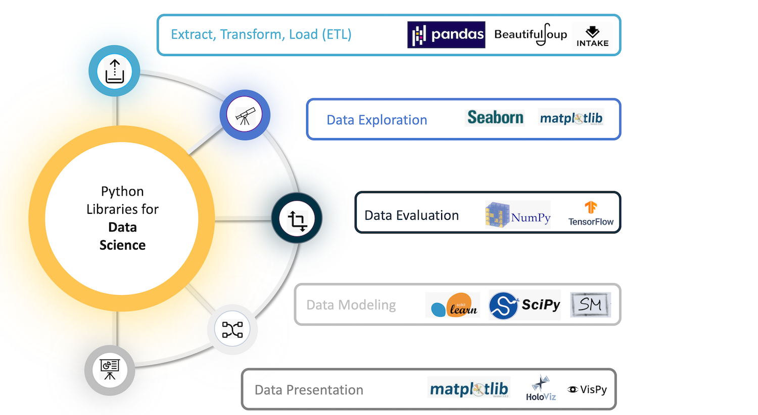
Libraries in Python for Data Science
Python has a vast ecosystem of libraries that cover a wide range of domains, such as
data analysis,
web development,
machine learning, and more.

Slide 5
Pandas
Powerful and widely used library in Python for data manipulation and analysis.
Provides high-performance data structures, such as the DataFrame, that allows you to work with structured data effectively.

Slide 6
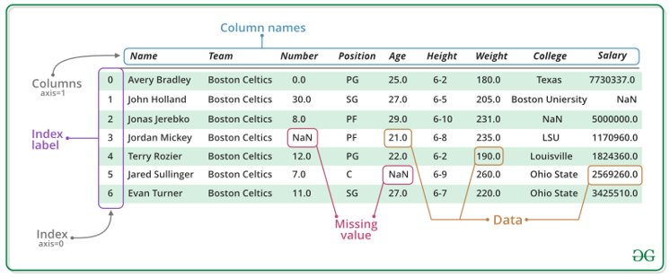
Dataframes:
Two-dimensional tabular data structure, similar to a table in a spreadsheet or a SQL database.
Consists of rows and columns
Each column can have a different data type (e.g., numbers, strings, dates, etc.).

Slide 7
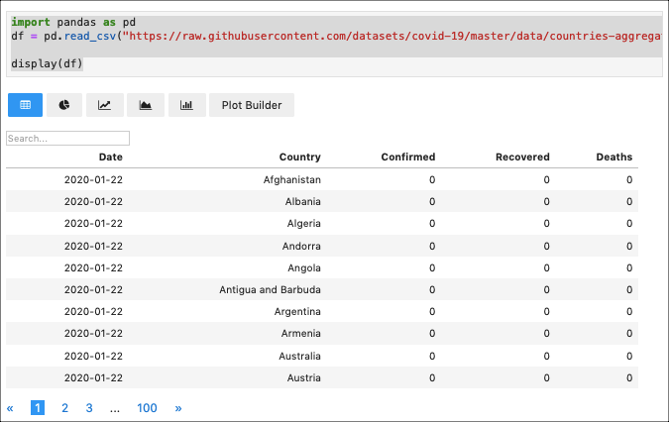
Dataframes:
In Python Notebooks, dataframes are commonly used to work with the CSVs
Dataframes provides various functionalities for indexing, selecting, filtering, transforming, plotting, and analyzing data
Usually effective in reusing the same data for different tasks

Slide 8
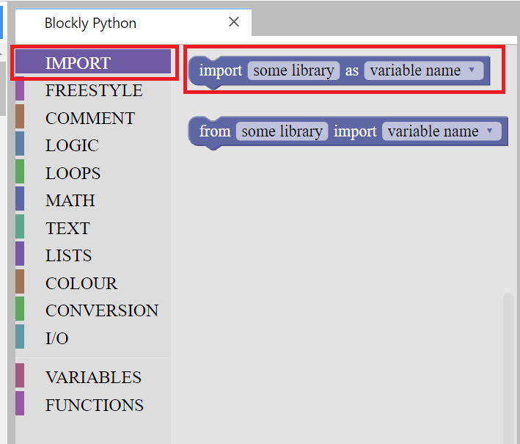
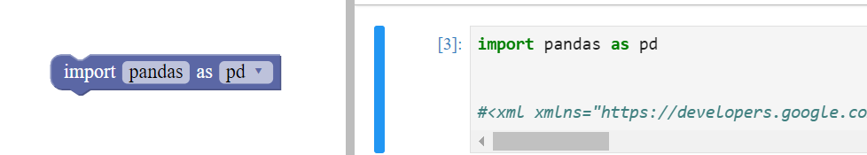
Read a dataset using pandas: Importing pandas using Blockly :
To work with pandas, you can import it in Python using the import statement.
We import pandas and give it the alias pd, which is a common convention used by the pandas community.
The alias is then used while using its functions instead of the pandas name.
Steps:
Go to import
Import pandas as pd

Slide 9
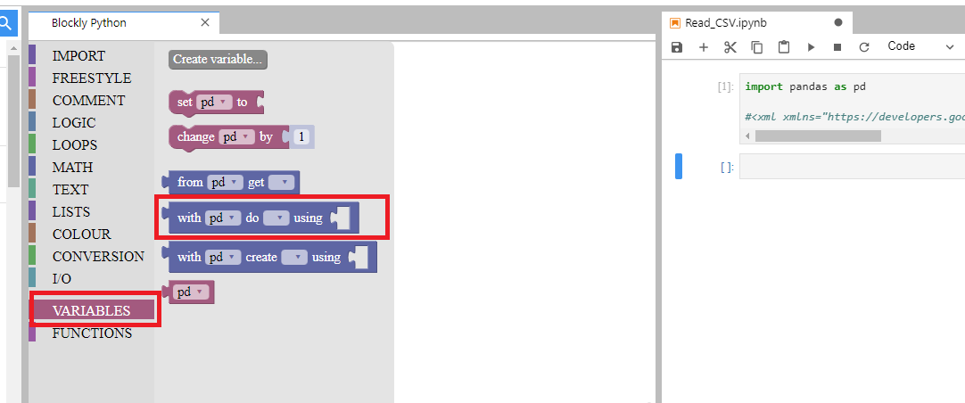
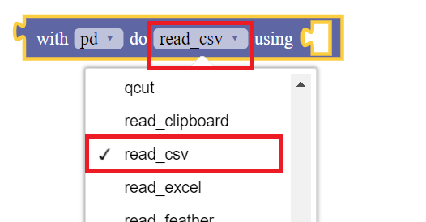
Using pandas to read the CSV data...
We will now read a csv file gre_data with GPA, gender and GRE score information using pandas.
To read a csv, we will use the pandas library we've already imported
We use the read_csv method in pandas which allows us to read a csv file
Steps:
Goto Variables
Create a variable pd
Select the option "with pd do..."

Slide 10
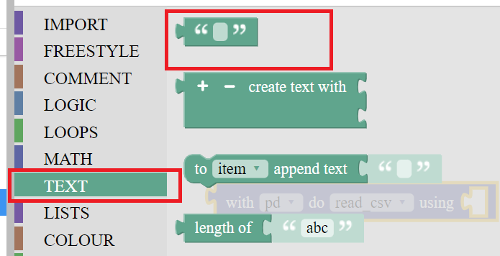
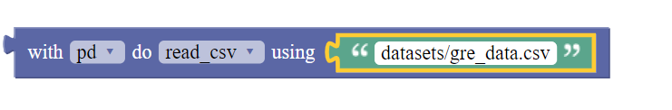
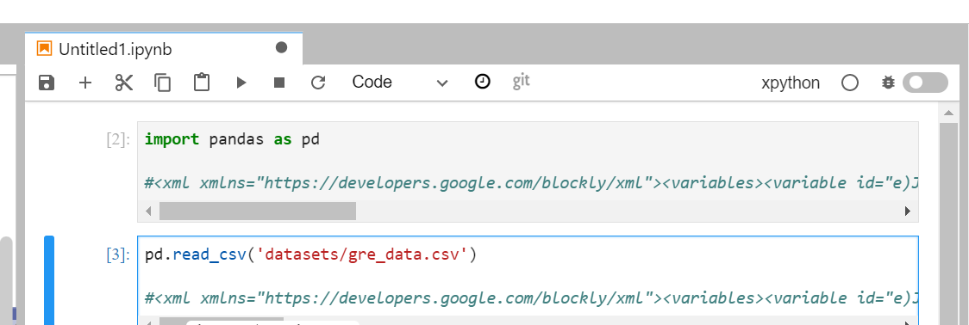
Using pandas to read the CSV data
Steps continued...
Go to Variable
Select the option "with pd do…"
Select the option read_csv (Make sure to execute the import pd first)
Go to text option
Set the text as the path to your csv file
Put the text block with filepath inside the "using …" block
Convert blocks to code
Execute the cell

Slide 11
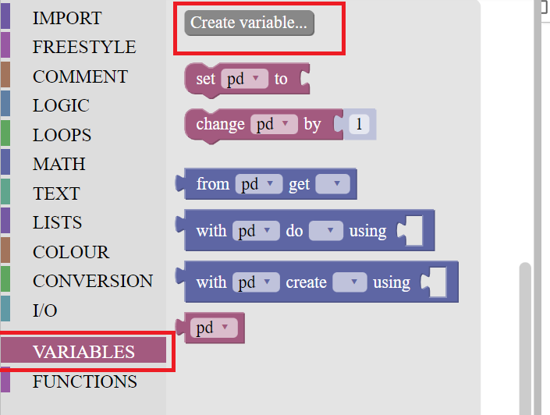
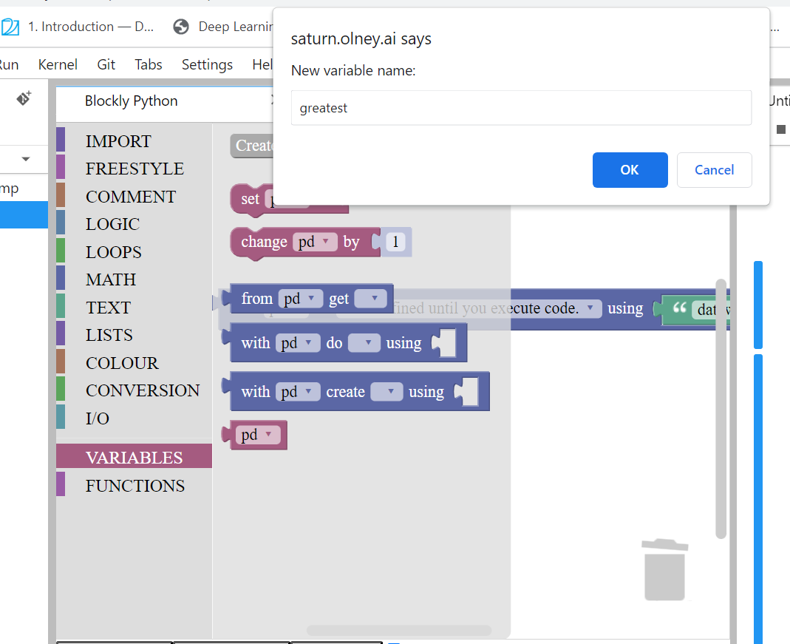
Create the dataframe:
We will now store the read data into a dataframe so that we can refer to the dataframe for data manipulation
We will name the dataframe greatest
Steps:
Go to Variables
Create a new Variable as greatest

Slide 12
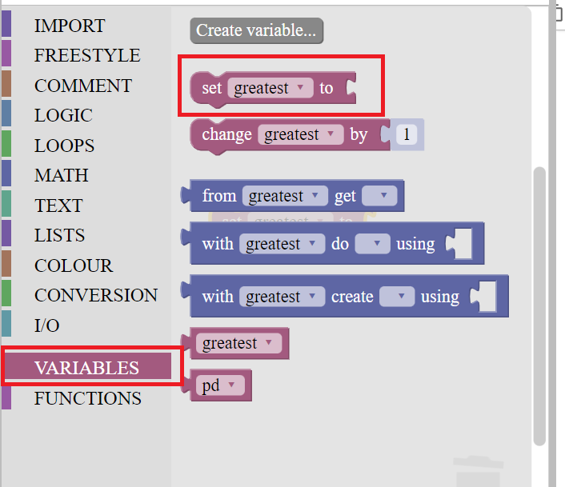
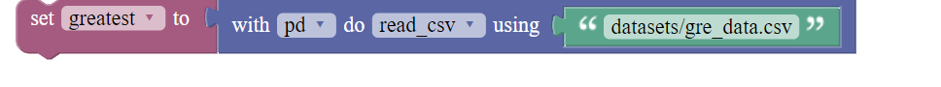
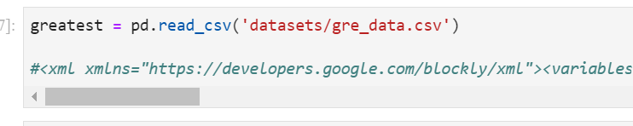
Set the dataframe to read data:
Steps:
Go to Variables and select "set greatest to .." option
Set the variable greatest to the previously read data by combining the two blocks as shown in the fig.
Use blocks to code and execute the code cell

Slide 13
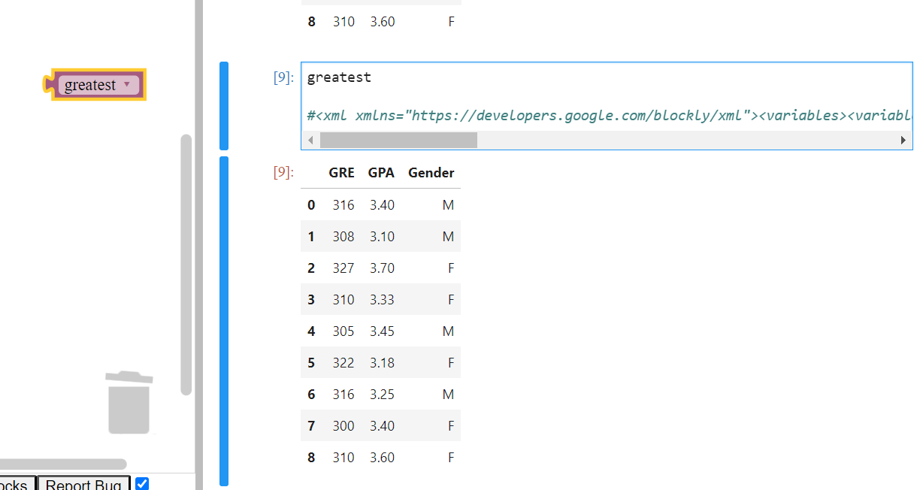
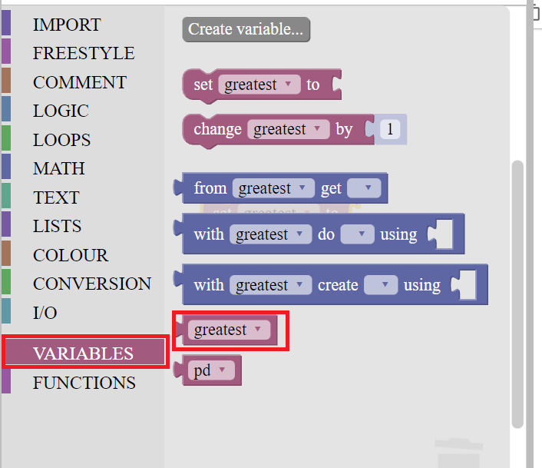
View the dataframe:
We will now print/view the dataframe greatest which stored our data i.e. the tabular data containing GRE, GPA and Gender
Steps:
Go to Variables
Select greatest
Convert blocks to code and execute the code cell

