Slide 1
Tabular Data & CSVs
How Data in Data Science Are Commonly Organized and Packaged

Slide 2
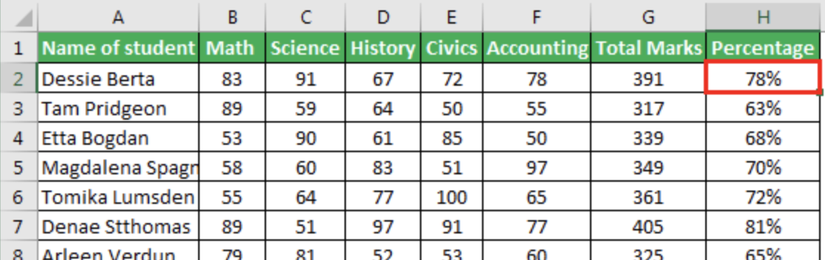
Think-Share Activity
Think of a typical spreadsheet.
What are the various parts of a spreadsheet?
What purpose does each part serve?
Notes:
The pictured spreadsheet is just an example of what a spreadsheet looks like in case there’s any confusion.
Learners take 4 minutes to think of their answers and to make notes.
In random order, each learner shares something they came up with.

Slide 3
Tabular Data
A spreadsheet is an example of tabular data.
Tabular data is the most common type of data in data science.
Tabular data is structured as a table with rows and columns.
Each row represents an observation.
Each column represents a different variable.
The first row often contains column headings.

Slide 4
Q&A Activity
What application do we commonly use to create tabular data, and what kind of file is the tabular data saved in?
Notes:
Ask the question.
Learners type their answer into a Discord text channel, but don’t hit enter yet.
After a few seconds, have everyone hit enter on the count of 3.

Slide 5
Q&A Activity
What application do we commonly use to create tabular data, and what kind of file is the tabular data saved in?
Microsoft Excel is probably the most commonly used application.
Excel spreadsheets are commonly saved as XLSX Excel Spreadsheet files.
Notes:
Ask the question.
Learners type their answer into a Discord text channel, but don’t hit enter yet.
After a few seconds, have everyone hit enter on the count of 3.

Slide 6
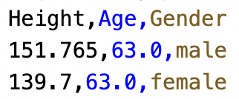
CSV Files
Surprise! We often don’t use XLSX files for our tabular data in data science.
XLSX files are proprietary to Microsoft and contain lots of formatting information which is designed to be read by Microsoft Excel.
Instead we use CSV files.
CSV stands for Comma-Separated Values.
CSV files are plain text files with the .csv file extension.
Each line of the file is a row.
Each column value in a row is separated by a comma character.
CSV files are convenient for us to read in and process using computational notebooks.
Notes:
The reason we don’t try to read xlsx is that the read function has to be able to distinguish between the Excel specific formatting and the actual data.

Slide 7
How to Make a CSV File in JupyterLab
Open the Launcher.
Launch the Text File app.
Edit the text file with rows of comma-separated values.
No spaces around commas.
Text values with embedded spaces must be surrounded by quotes.
Make sure that you have the right number of values in each row.
Rename the file, changing the .txt file extension to .csv.
Right click on CSV file in file explorer to either open with CSVTable app (for viewing only) or with Editor app.
Demo Video: https://youtu.be/NVr8Wf0GS80

Slide 8
Activity: Creating a CSV File
🐶

Slide 9
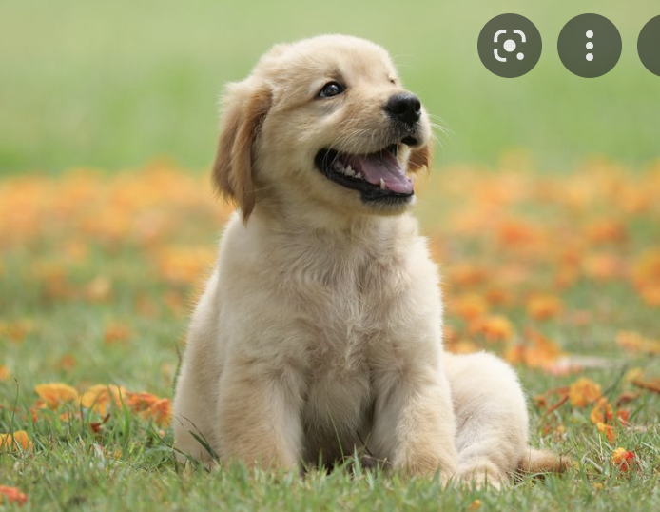
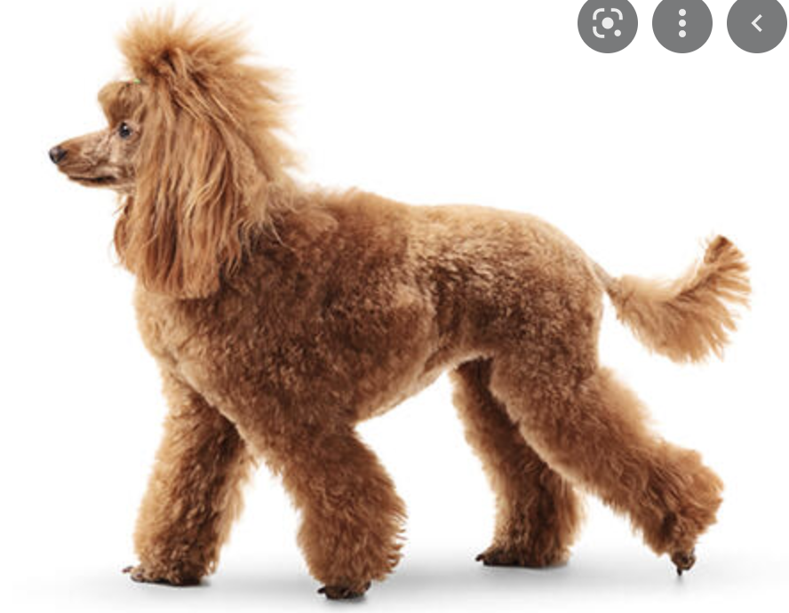
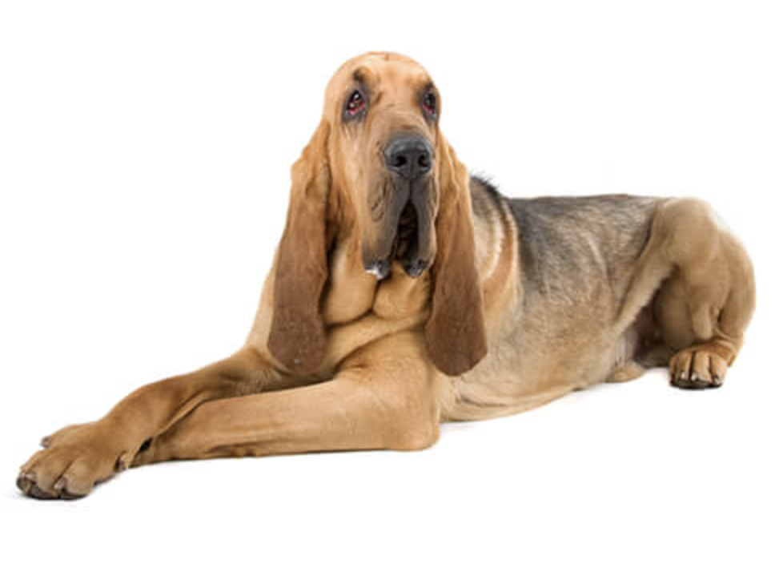
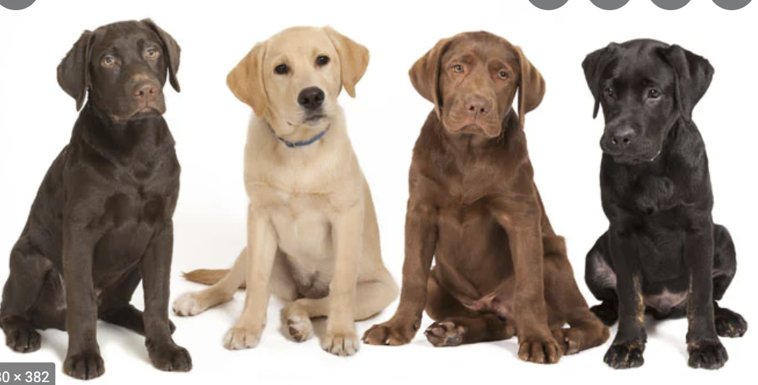
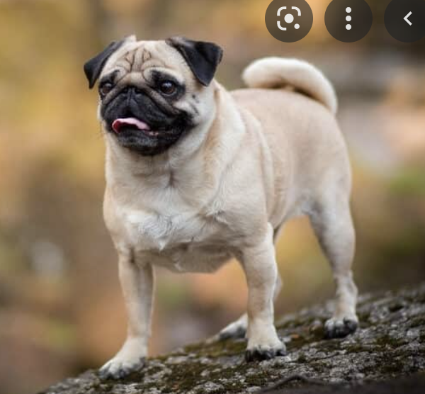
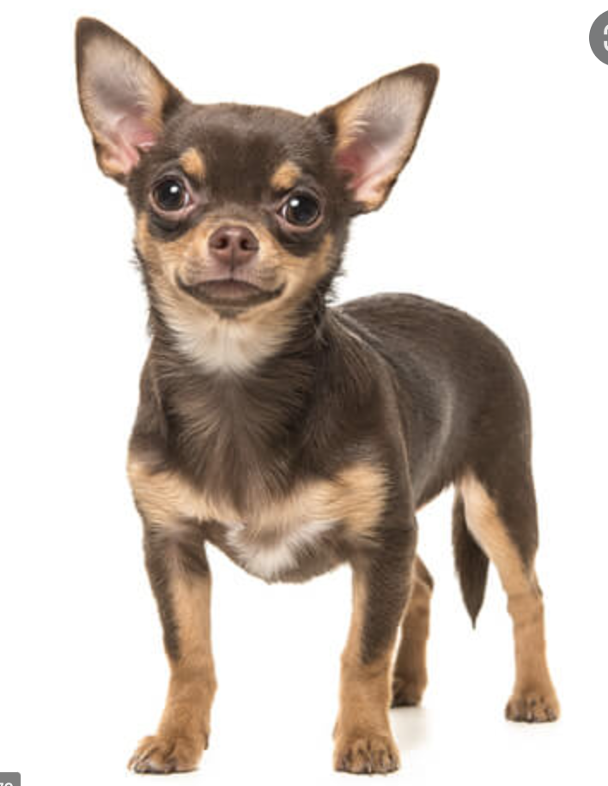
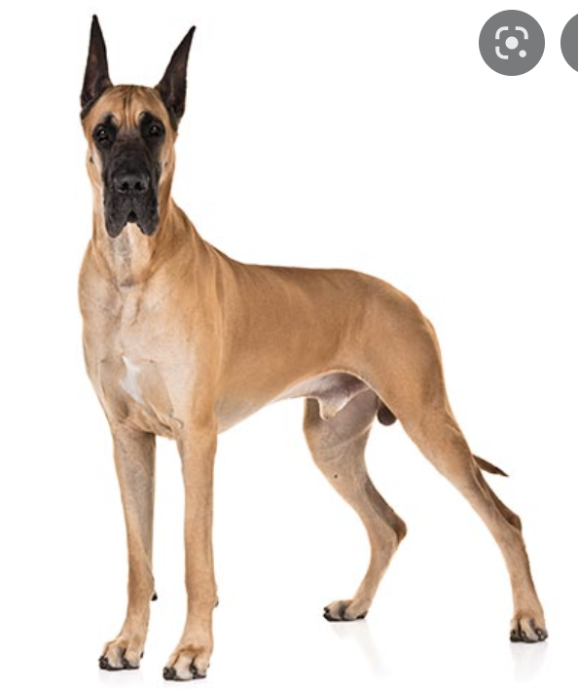
Think of 5 variables related to dogs that might be interesting
Notes:
Do as Q&A activity.
Decide on 5 variables that we will use moving forward.
Make sure that the 5 have a variety of types (numbers, strings).
At the end, list in Discord the 5 chosen variable labels with an example value for each.

Slide 10
Creating a CSV File
Create a CSV file in JupyterLab
Include a column heading row.
Include the 5 variables we agreed upon.
Make up at least 10 observations.
Name the file dogs.csv
When done, call a mentor over to check your work.
Notes:
Give 15 minutes to complete task.
**Learners may need to be shown how to do the upload/download thing.
At the end, demonstrate merging the CSVs into a single CSV.
Correct any mistakes along the way.
Share the merged CSV with the students and have the students upload the merged CSV to JupyterLab.
Have the students take a screenshot of the CSVTable for the merged CSV and share the screenshot in Discord.
This merged CSV can be used in the upcoming activities on reading in and displaying data.

Slide 11
Activity: Create a CSV from Your Own Observations
Find something nearby or familiar to you of which you have at least 10.
Create another CSV by collecting data on that something.
At least 3 variables.
At least 10 observations.
Include a header row.
When done, call a mentor over to check your work.
Notes:
**This activity should be considered optional if time allows.
Give 20 minutes to complete.
These CSV files can also be used in upcoming activities.

Slide 12
Summary
Tabular data
Variables and observations
CSV Files
How to create CSV files in JupyterLab

