Slide 1
Introduction to Jupyter Notebooks
A Tool for Interactively Developing and Presenting Data Science Projects

Slide 2
What is a “notebook”?
It is a computational document.
Computational documents allow users to create a single file with:
Prose elements
Images
Embedded code fragments
Code execution outputs
Formulas
Charts
How are these elements combined?

Slide 3
Cells
Each notebook is made up of distinct cells
Each cell is executable
Each cell has a cell-type
Cells of different types can be used to make different document elements
Two main types of cells:
Markdown cells
Code cells

Slide 4
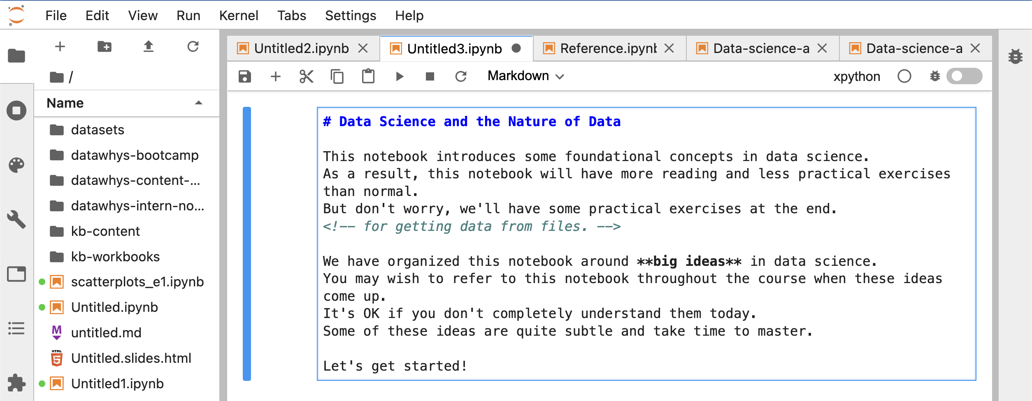
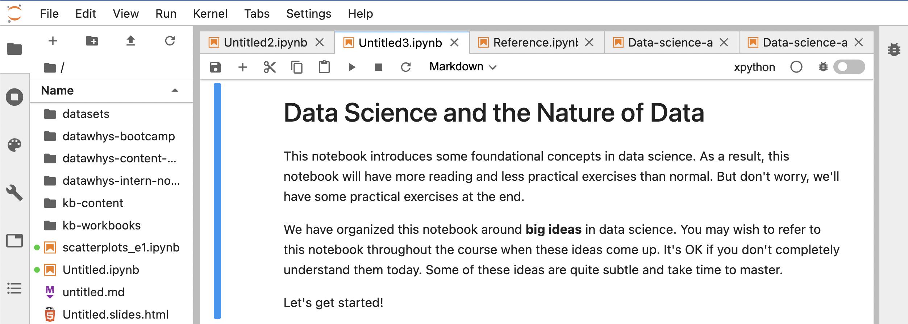
Markdown Cells
Contain:
Prose in Markdown syntax
HTML
LaTeX formulas
Editor View
Rendered View
Notes:
What is Markdown syntax? Quick way to write html without messing around with tags
What is HTML?
What is LaTeX?
Reference Guides:
https://medium.com/analytics-vidhya/the-ultimate-markdown-guide-for-jupyter-notebook-d5e5abf728fd
https://www.ibm.com/docs/en/watson-studio-local/1.2.3?topic=notebooks-markdown-jupyter-cheatsheet

Slide 5
How-to: Switch Between Editor & Render View
Render to Editor:
Double-click inside cell
Editor to Render:
Run the cell
Notes:
Recall that all cells are “executable” meaning they can be run.
For markdown, run means to render the markdown into html.
We’ll talk about how to run a cell later.

Slide 6
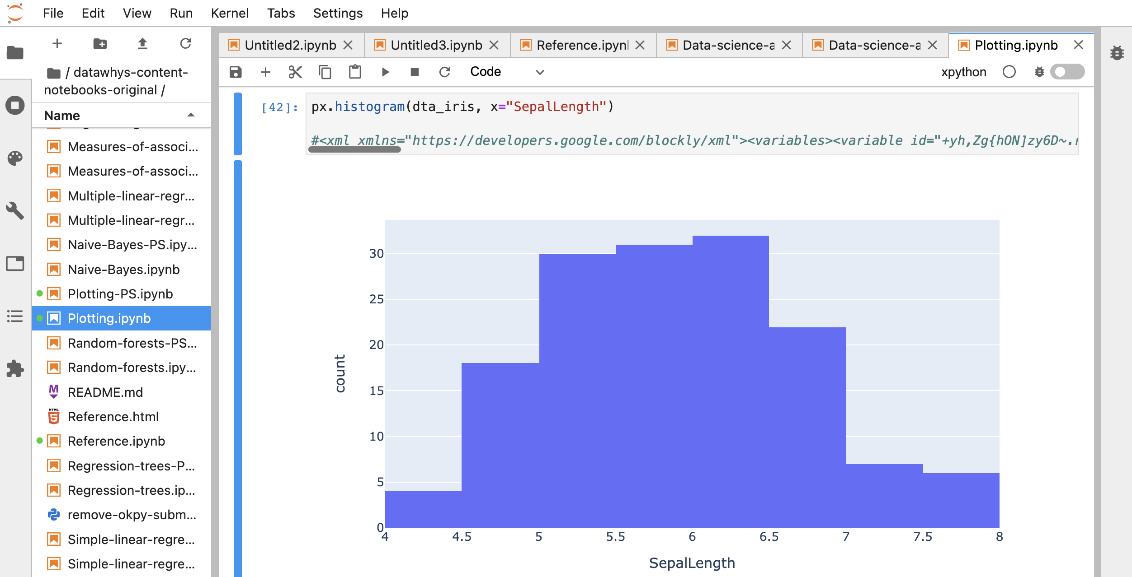
Code Cells
Code Input
Python code
Blockly xml tag
Code Output
Code cells in same notebook have shared memory stack (Kernel)
Notes:
Green dot next to file in File Browser means a kernel is running for that file.
What does this separate kernels thing mean for us? Put data in memory in one cell, then access it in any other code cell.
This lets us break up our code logic with text explanations so we can explain the code/output.

Slide 7
Currently Active Cell
Indicated by blue bar to left of cell
Click inside cell or surrounding area to make a cell active
Only one cell is ever “active” at a time
Notes:
Might have noticed this blue bar…
Becomes very important when you try to work with your own notebooks.

Slide 8
Activity 1: Print Your Name
Open provided file your_name.ipynb
Observe current value of variable your_name in cell 1
Select “Run All Cells” from Run Menu
Observe outputs of cells 2 and 3 match preset your_name value
Change value of your_name in cell 1
Select “Run All Cells” from Run Menu
Observe the changes to the cell outputs
Take a screenshot and show to the mentor
Notes:
Demo first by instructor
Then have students replicate and screenshot output to Discord pod #text channel.
I added the interns pods to roles so you can double check.
Give 5 minutes
DO NOT USE BLOCKLY AT THIS POINT

Slide 9
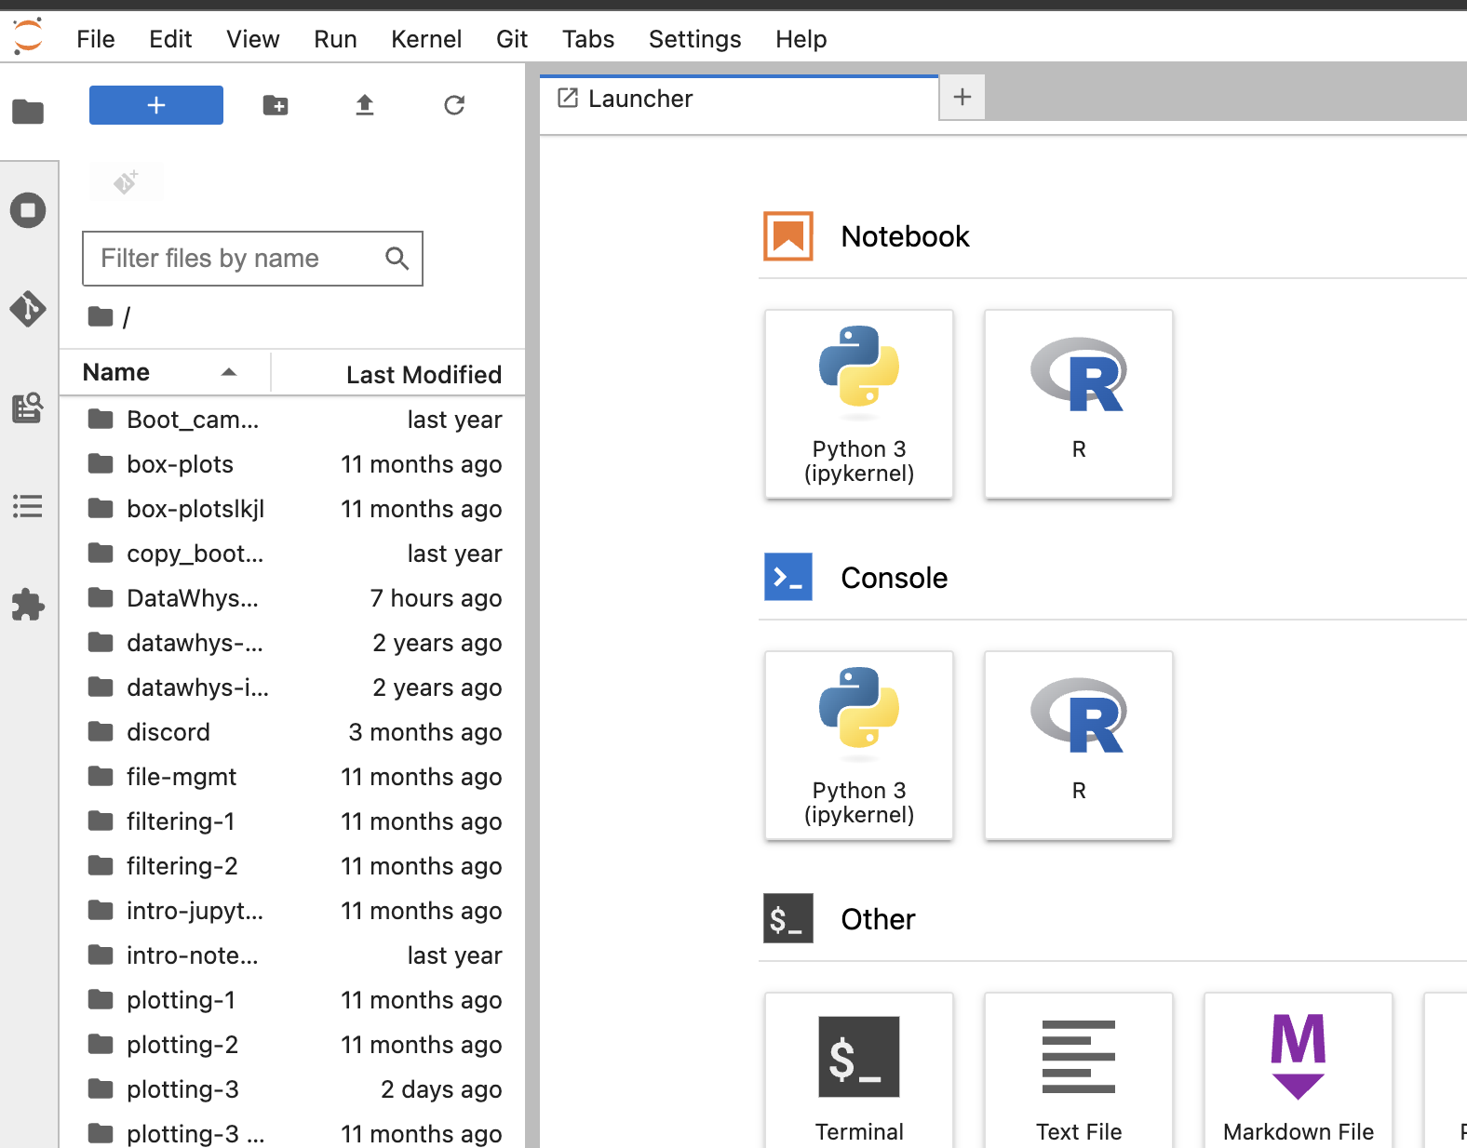
How-to: Create a Notebook
Open File Browser
Open Launcher
Select python3
Notes:
Instructor Demo

Slide 10
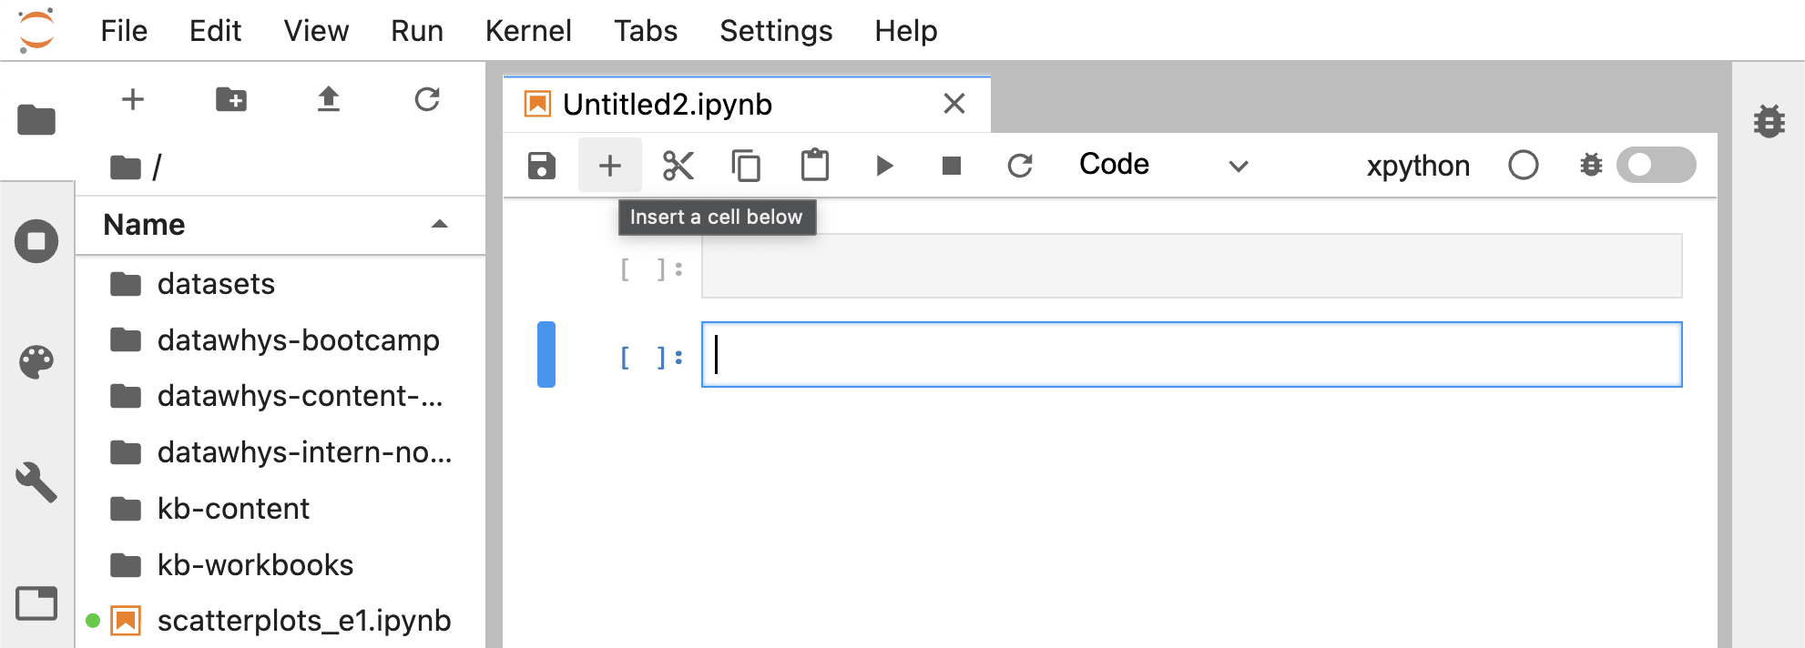
How-to: Create a Cell
From .ipynb file editor:
Click to insert a new cell
This will insert a Code-type cell below the currently active cell.
Notes:
Instructor Demo
Notice that we made a code type cell. There is no way to create a markdown cell afaik. Can only make code cell then change type.

Slide 11
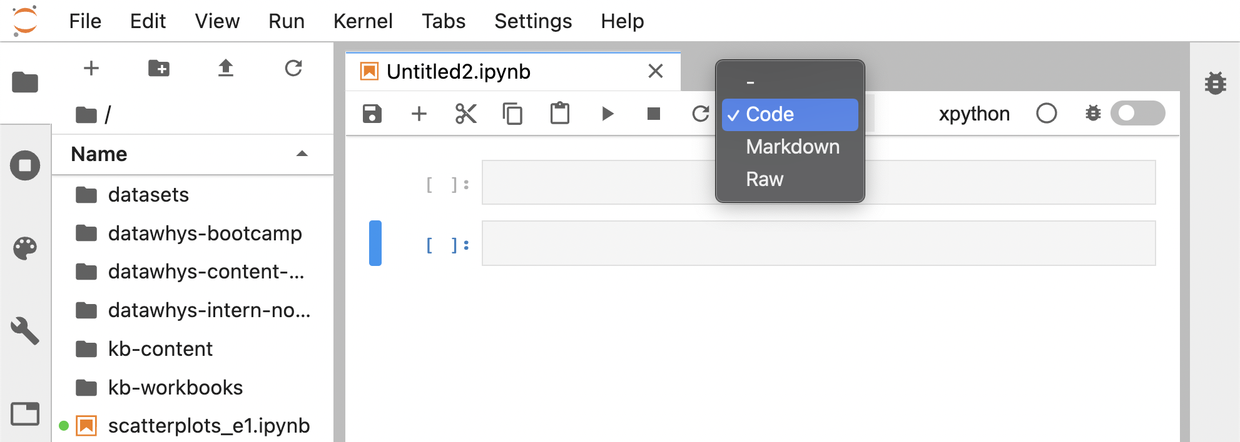
How-to: Change Cell-type
From .ipynb file editor:
Open cell-type dropdown
Select new cell-type
This will change the type of the currently active cell.
Notes:
Instructor Demo
Tell them not to make raw cells. They should only ever need code and markdown.

Slide 12
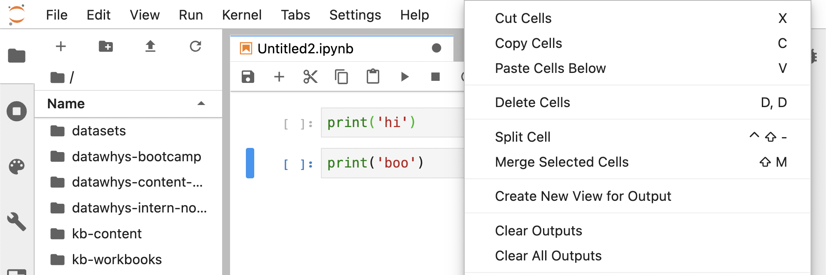
How-to: Delete a Cell
From .ipynb file editor:
Right-click inside cell area
Select “Delete Cells”
This will delete the currently active cell.
Notes:
Instructor Demo
Demo shortcut DD

Slide 13

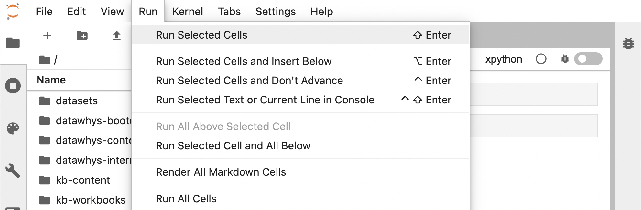
How-to: Run Currently-Active Cell
From .ipynb file editor:
Key press SHIFT-Enter
OR
1. Click the button
OR
Open Run Menu
Click “Run Selected Cells”
Notes:
Instructor Demo

Slide 14
Activity 2: Create a Notebook
Create a new notebook
Rename the new notebook age_to_seconds.ipynb
Edit the notebook so it contains only the following 2 cells (in order):
A Markdown cell with # Age in Seconds Calculator
A Code cell with <your age> * 365.25 * 24 * 60 * 60
(e.g. 75 * 365.25 * 24 * 60 * 60)
*You can use a fake age, but not same as example (75).
Run both cells
Take a screenshot and show it to the mentor
Notes:
Split into pods for 10 minutes.
Students should attempt to complete this activity on their own first and alert instructor in Discord when complete

Slide 15
Summary
Computational documents
Cells and cell-types
How to perform basic operations in a Jupyter Notebook

