Slide 1
Bar Charts
One Way to Plot Categorical Data

Slide 2
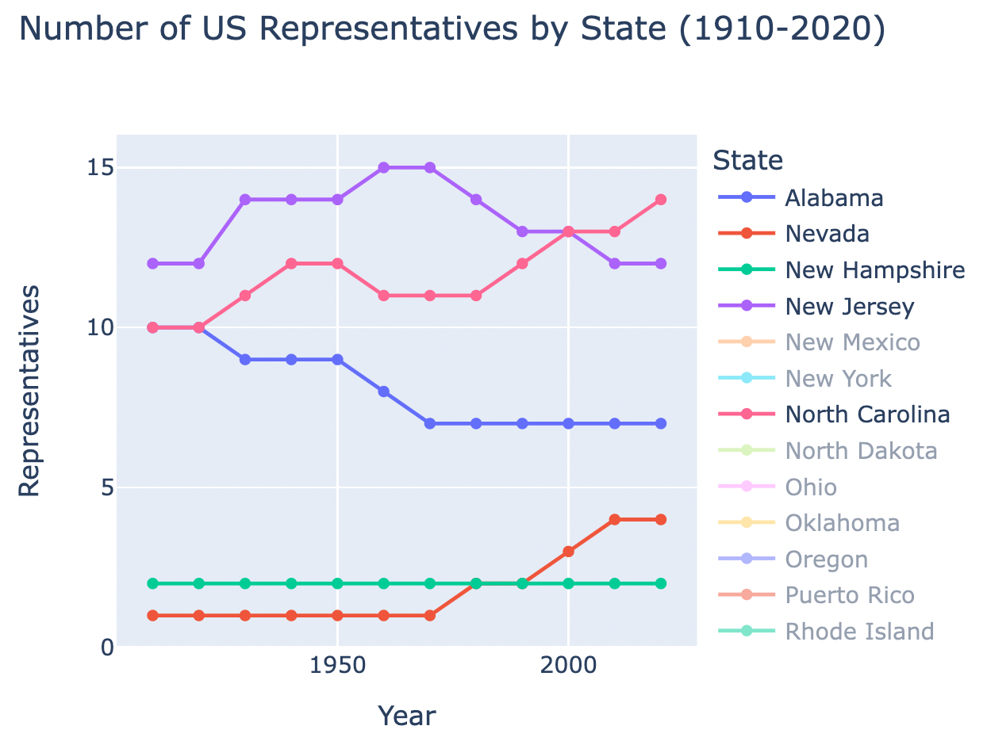
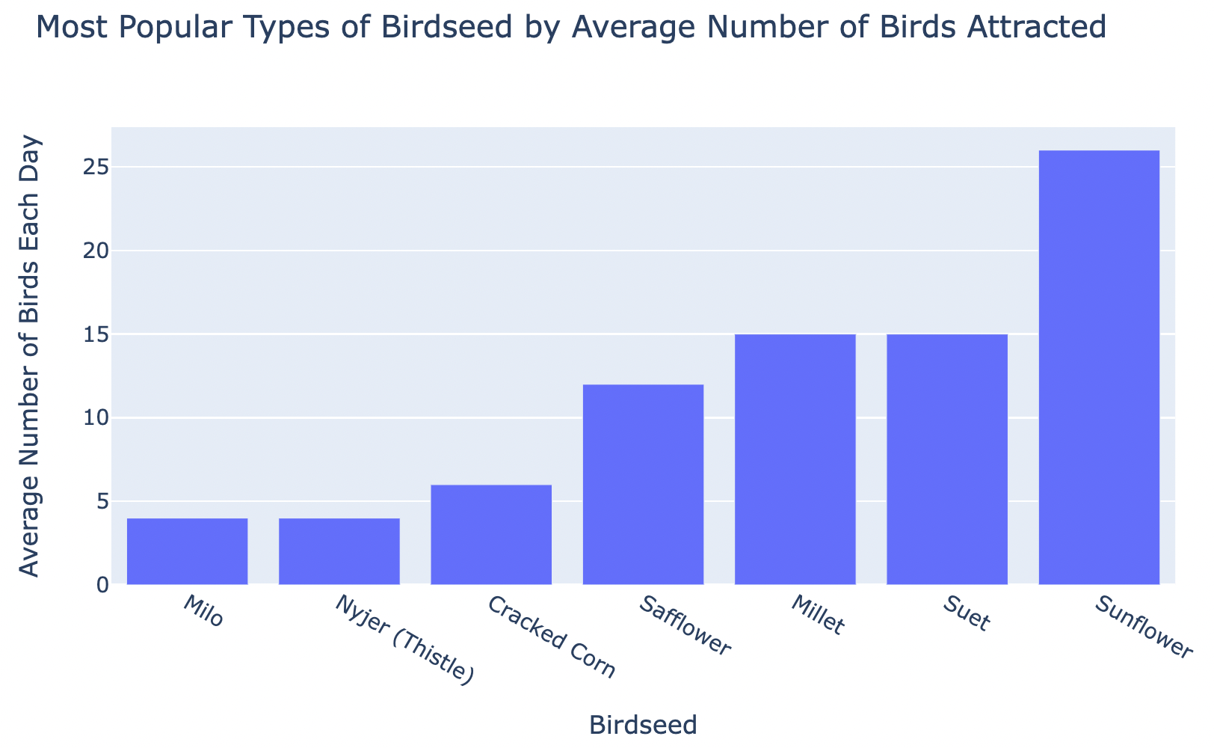
Think Share: Line Charts vs Bar Charts
Notes:
Similarities & Differences

Slide 3
Line Charts vs Bar Charts
Independent variable
Line: unit of time
Bar: any categorical data (or binned numerical data)
Number of y values for each x (Same!)
Line: only one y for each x
Bar: only one y for each x
Representation
Line: points connected by line
Bar: separate rectangles for each category where size indicates category’s value
Notes:
Similarities & Differences

Slide 4
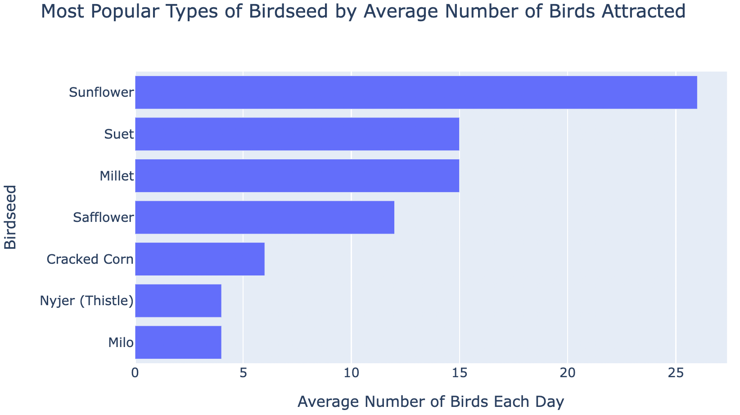
Bar Charts
Orientation can be vertical or horizontal!
Still have independent and dependent variables but no longer synonymous with x and y
Independent is the category, dependent is the category’s value
Notes:
Note: it will also draw weird lines if more than one y for each x. We will explain more about what to do in this case later, but for now, we won’t give you any datasets with this problem.

Slide 5
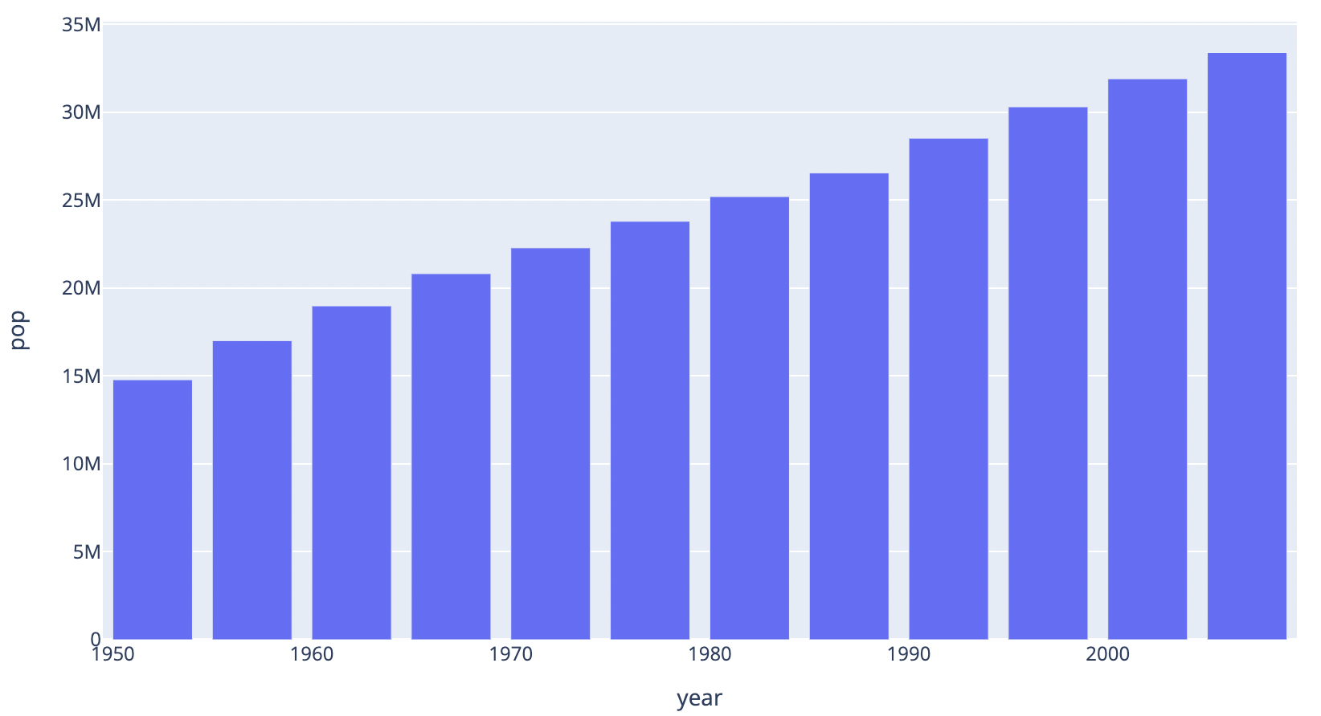
Bar Charts: Sorting
In most cases, we want to sort the data to be able to show the strongest conclusions.
We can sort by either category or values!
If category has implicit ordering, we sort by that, otherwise by category values.
Notes:
Note: it will also draw weird lines if more than one y for each x. We will explain more about what to do in this case later, but for now, we won’t give you any datasets with this problem.

Slide 6
How-to: Make Bar Charts in Jupyter
Read CSV Data into Pandas Dataframe
Import Pandas Library
Read CSV data and Save in Variable
Sort Data
Display Dataframe Contents
Generate Plotly Line Chart
Import Plotly Express Library
Set Columns as category and value
Set Additional Plot Options (Optional)
Generate Chart

Slide 7
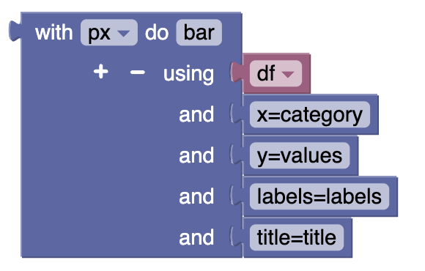
How-to: Switch Orientation of Bar Chart
Vertical Orientation

Slide 8
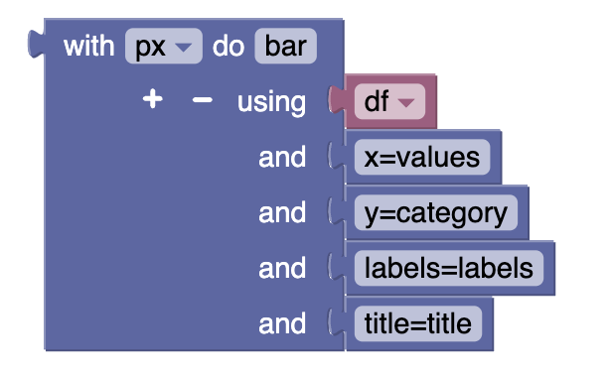
How-to: Switch Orientation of Bar Chart
Horizontal Orientation

Slide 9
Summary
Bar charts
Line charts vs bar charts
Plotly bar charts with Blockly

