Slide 1
Exploring Dataset
How We Visualize the Dataset and Know More

Slide 2
Catch Up
We’ve
Learnt about CSV file
Learnt about Dataframe
Learnt about Libraries
Imported the CSV into a dataframe
Q & A: Do you remember which library we used to import csv into a dataframe?
Notes:
Type answer in Discord and don’t hit enter.

Slide 3
Catch Up
We’ve
Learnt about CSV file
Learnt about Dataframe
Learnt about Libraries
Imported the CSV into a dataframe
Q & A: Do you remember which library we used to import csv into a dataframe?
pandas
Notes:
Type answer in Discord and don’t hit enter.

Slide 4
Exploring Datasets
We’ve imported the CSV into a dataframe.
Now what?
Now that we have stored our data in the dataframe, let's get some more information from it.
Each row represents an observation (an instance)
Each column represents a characteristic (feature) of each observation.
Notes:
Type answer in Discord and don’t hit enter.

Slide 5
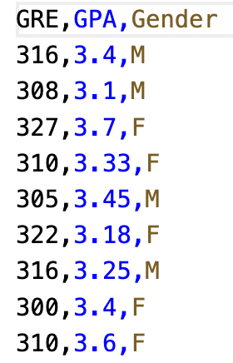
Exploring Datasets
We can see how many rows are present in the dataset.
Each row represents an observation (an instance). Here each row represents a student
Q & A: How many rows are shown in the CSV?
Notes:
Type answer in Discord and don’t hit enter.

Slide 6
Exploring Datasets
We can see how many rows are present in the dataset.
Q & A: How many rows in the CSV shown?
9
Notes:
Type answer in Discord and don’t hit enter.

Slide 7
Exploring Datasets
Usually, before starting working in a dataset, we need to know the features (columns) in it.
Each column represents a characteristic (feature) of each observation
We can see how many columns are present in the dataset.
Q & A: What are the columns shown in the CSV?
Notes:
Type answer in Discord and don’t hit enter.

Slide 8
Exploring Datasets
We can see how many columns are present in the dataset.
Q & A: What are the columns in the CSV shown?
GRE, GPA, Gender
Notes:
Type answer in Discord and don’t hit enter.

Slide 9
Know the Dataset
How to know how many columns and rows are there in a dataset?
To know the dataset we have to first read the csv data and store the content into a dataframe

Slide 10


Know the Dataset Read the CSV data
First, we create a dataframe and store the content of the dataset into the dataframe
Import pandas Library
Python code: blockly block:
Read CSV data and Save in Variable
Python code:
Blockly block:
To read from a csv file, first we will import pandas library because it has a read_csv function which we will use to automatically parse the csv file and load it into the notebook.
The read_csv function requires us to supply the relative path to the csv file and returns a Pandas Dataframe object which we will store in a variable so we can use it later in the notebook.

Slide 11
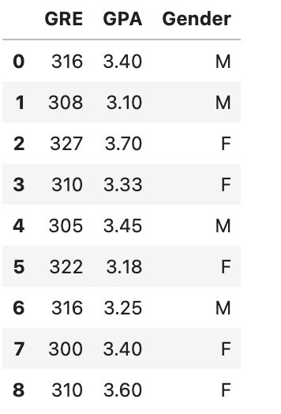


Know the Dataset Displaying the dataframe content:
By displaying the dataset content, we can know about the columns and rows.
In previous slide, we've already stored the csv data in "gredata" dataframe
Now we display dataframe content
Python code:
Blockly code:
Calling the dataframe variable in a cell by itself will print the contents of the dataframe to the screen so we can confirm the dataset was imported correctly.

Slide 12



Know the Dataset shape of the dataset
Sometimes, we need to know the size of the dataset for analysis convenience. And by size, we mean the number of rows and columns in the dataset. We can know the size of the dataset (rows and columns) by using the `shape` function.
Use shape method
Python code:
Blockly block:
Syntax: dataframe_variable_name.shape
Output
Crosscheck with our csv data

Slide 13
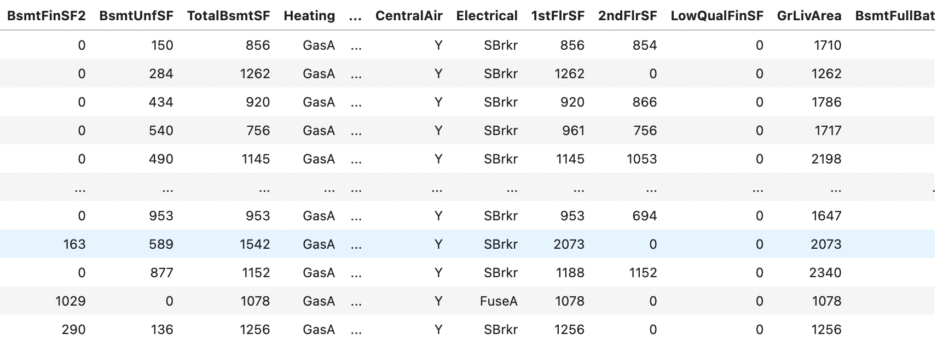
Know the Dataset
Datasets usually come out of research studies and most often they are Very Large.
For large datasets we often can’t see all the rows or columns in notebook

Slide 14


Know the Dataset Column names of the dataset
We can know the column names of the dataset by using the `columns` function.
Use columns function
Python code:
Blockly block:
Syntax: dataframe_variable_name.columns
Output
Crosscheck with our csv data

Slide 15
Select Any Specific Data in Dataset
We can use the dataframe data mainly in 2 ways
Row wise
Column wise
Each row can be defined as datapoint
Each column can be defined as a feature/attribute of each datapoint

Slide 16
Select Any Specific Data in Dataset
In our gre_data.csv dataset each row represents a student
And each column represents a student’s various attributes/features
except the first one with no column name – known as index number

Slide 17
Select Any Rows in Dataset
Index:
Each row is assigned with an index number
Usually starts from 0 and increase by 1 for each additional row
Index number of n^{th} row is n-1
Q&A: What will be the index number of 5th row?

Slide 18
Select Any Rows in Dataset
Index:
Each row is assigned with an index number
Usually starts from 0 and increase by 1 for each additional row
Index number of n^{th} row is n-1
Q&A: What will be the index number of 5th row? 4

Slide 19

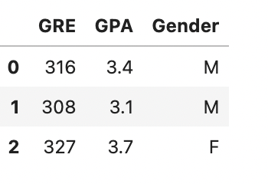
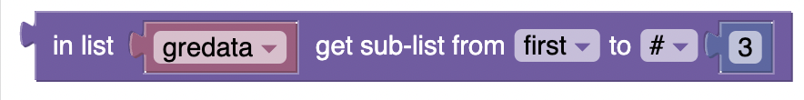
Select Any Rows in Dataset
Select and view first x rows from our gre_data.csv dataset?
To accomplish this we can use the index number. The syntax for selecting 1st x rows is: "dataframe_variable_name[ :x]"
Suppose we want see 1st 3 rows of the dataset. We have to use “dataframe_variable_name[ :3]" :
Python code:
Blockly block
Output
Crosscheck with our csv data

Slide 20
Select Any Column in Dataset
Selecting columns is a bit different from selecting rows.
Unlike rows, dataset columns have their own names.
The values under a column are presented as a list. So, we can think of a column as a list of values.
The syntax for selecting any specific column is: "dataframe_variable_name[['column_name']]"

Slide 21
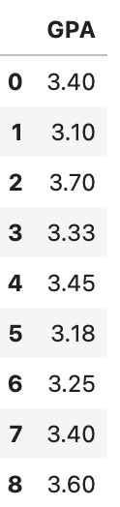

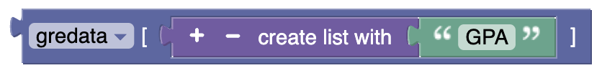
Select Any Column in Dataset
The syntax for selecting any specific column is: "dataframe_variable_name[['column_name']]"
Suppose, we want to see "GPA" column of our gre dataset. We can use gredata[['GPA']]
Python code:
Blockly block
Output

Slide 22
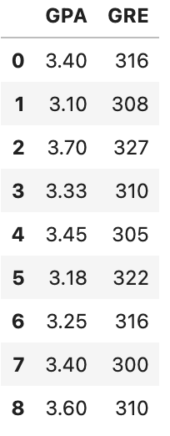

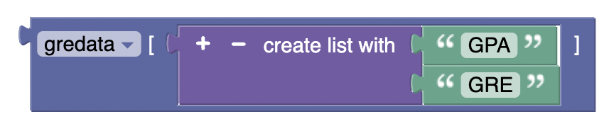
Select Multiple Columns in Dataset
Just like selecting a single colum, we can also select multiple columns from a datframe.
For selecting multiple columns, we follow the same process as selecting a single column.
The syntax for selecting multple specific column is: "dataframe_variable_name[['column_1_name'],['column_2_name'],…, ['column-n_name ']]"
Suppose, we want to see "GPA" and "GRE" column of our gre dataset. We can use gredata[['GPA'],['GRE']]
Python code:
Blockly block
Output

Slide 23
Reference Notebook:
ReadCSVdata2.ipynb

