Slide 1
Music genre distribution in the world
Université Côte d’Azur, MSc DSAI 2022-2023
MEMUDU Alimatou Sadia
LEE Hyelim

Slide 2
Introduction
Users
People who are interested in the distribution of music genres by country according to the year.
Goal
Users get a general repartition of wasabi data in terms of genre of music per country and continent in the group from 1980 to 2015.
Dataset
The WASABI Song Corpus is a large corpus of songs enriched with metadata extracted from music databases on the Web, and resulting from the processing of song lyrics and from audio analysis. A summary of the data contained in The WASABI Song Corpus is as follows.
- Album Data : (7798, 27)
- Artist Data : (3000, 50)
- Song Data : (76027, 60)

Slide 3
Data Preprocessing Work Flow
Our project is composed to 3 files, 1 csv files (final data) and 2 r files( used for data preprocessing) with 3048 rows and 14 columns

Slide 4
Data Preprocessing Feature Selection
Album
id_artist
id_album
genre
publicationDate
deezerFans
Song
id
gender
lifeSpan.ended
locationInfo
Artist
id
id_album
publicationDate
availableCountries
(7798 rows, 5 columns)
(47595 rows, 4 columns)
(3000 row, 4 columns)

Slide 5
Data Preprocessing Data Cleaning
Album
Splitting locationInfo column into 3 column – country, state, and city
Replacing name of some contries for easy geographical location
Rename several columns with tag from artist data
Song
Extract year from publication data and rename column
Create new column for number of availableCountries
Rename several columns with tag from song data
Album
Rename several columns with tag from album data

Slide 6
Data Preprocessing Merging Data
After merging the data, the missing values of some columns(gender) were changed to Unknown. In addition, after merging the data, the data including missing values in the country and publication Date columns were deleted. After that process, 41,129 rows of data remained.

Slide 7
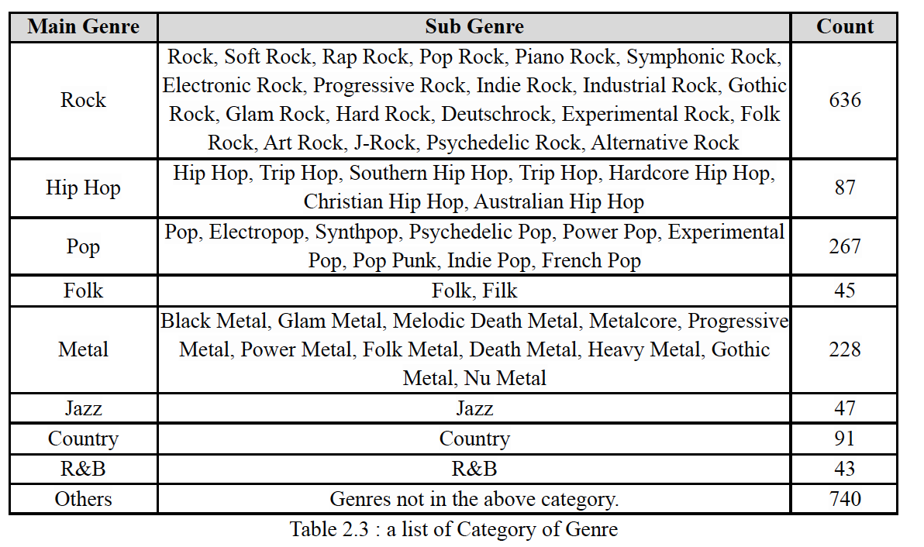
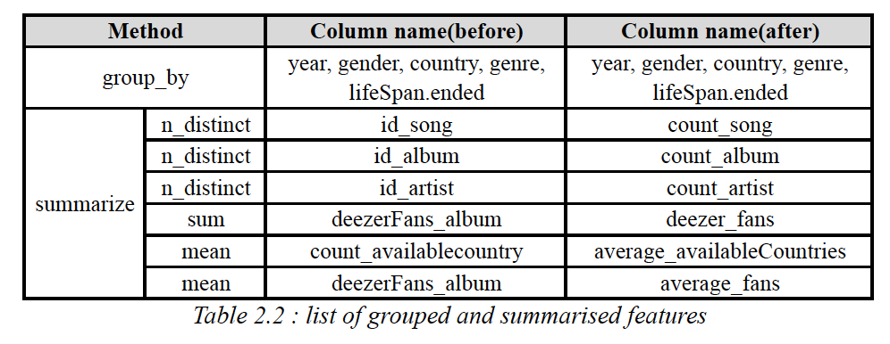
Data Preprocessing Transforming Data
Group and summarize data by year, gender, country, genre_album, lifeSpan.ended
Create New column – lat, lon, continent
Categorize values of genre – 182 to 9
Re-Categorize values of continent – Central America to North America

Slide 8
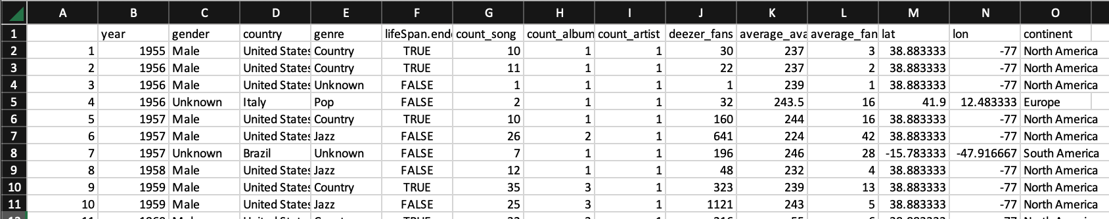
Data Preprocessing Final Data
At the end we are left with a csv file named final_data composed of 3048 rows and 14 columns

Slide 9
Data Visualization (Memudu Alimatou Sadia) Overview
Users
people who are interested in digging up the distribution of genres of music and the number of Deezer fans during a certain period in the world to acquire knowledge about music in the World.
Goal
To provide useful information about the repartition of wasabi dataset in terms of genre of music by continent in the world, from 1980 to 2015.
Visualization Techniques
Bubble Map and Stacked Bar Graph
Environment : R

Slide 10
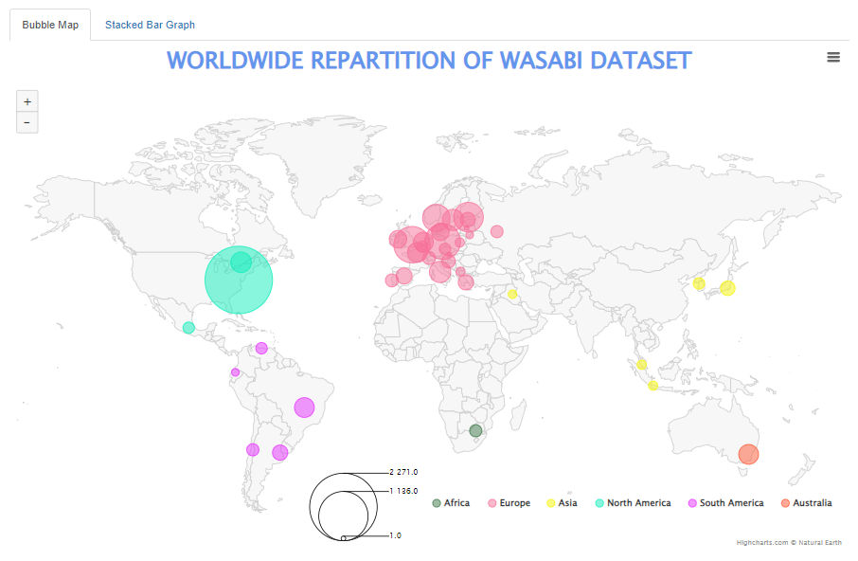
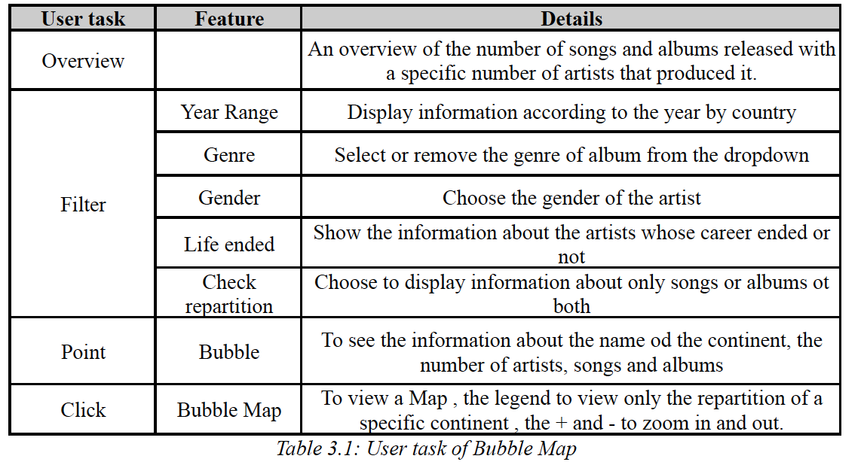
Data Visualization (Memudu Alimatou Sadia) Bubble Map visualization
User Task

Slide 11
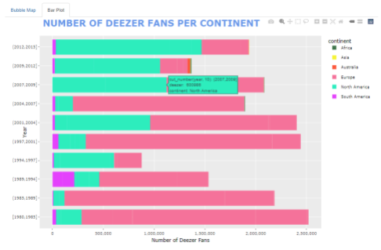
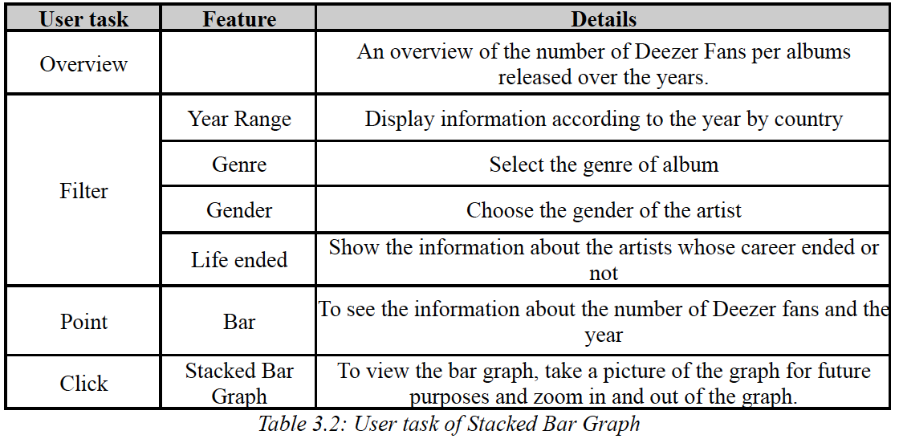
Data Visualization (Memudu Alimatou Sadia) Stacked Bar Graph visualization
User Task

Slide 12
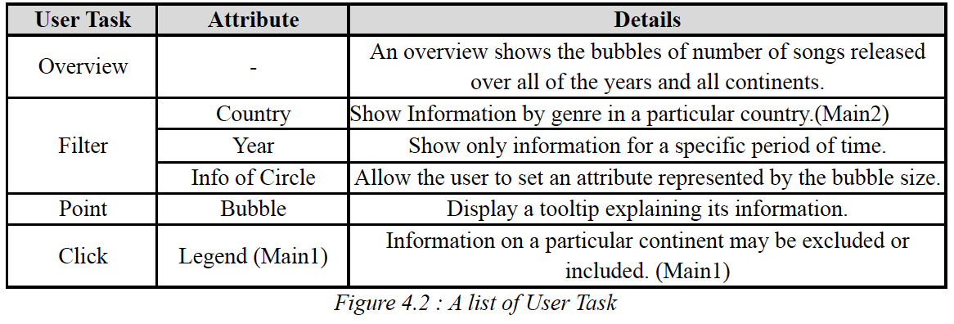
Data Visualization (Lee Hyelim) Overview
Users
People who are interested in music preferences by country according to the year.
Goal
To show the preference for music by country according to the year.
Information about preferences of songs are represented by the number of songs released, the average of available countries, and the average number of fans.
Visualization Techniques
Circular Packing
User Task

Slide 13
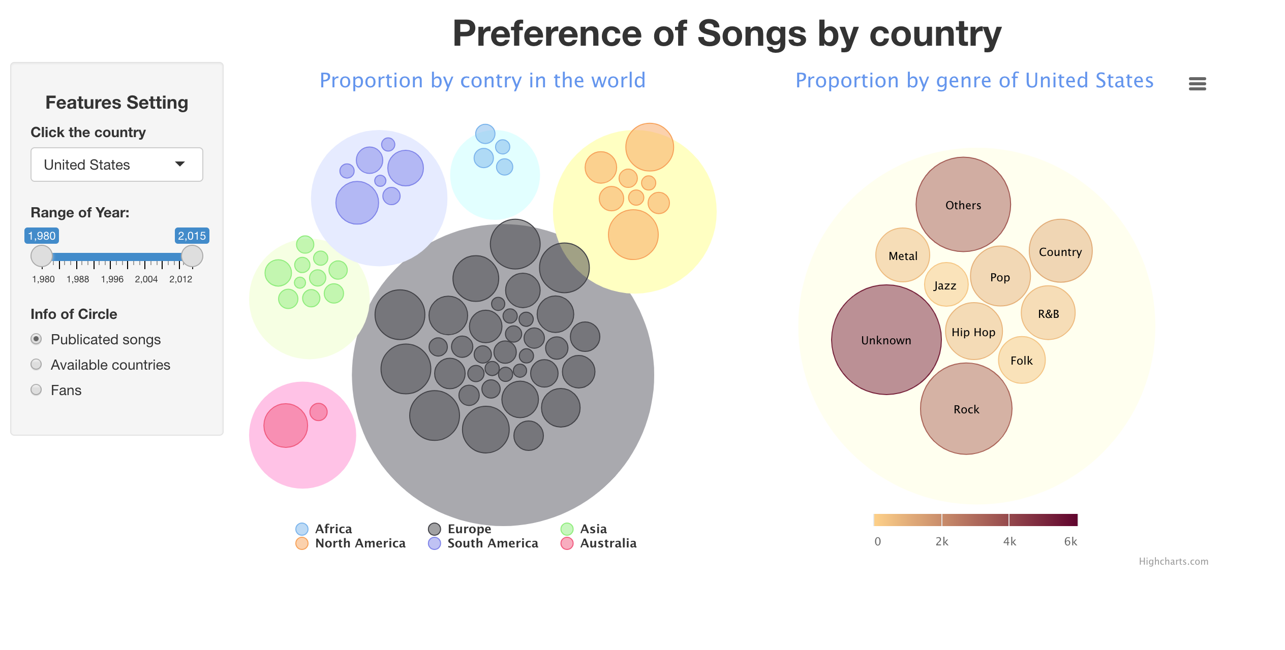
Data Visualization (Lee Hyelim) Circular packing visualization

Slide 14
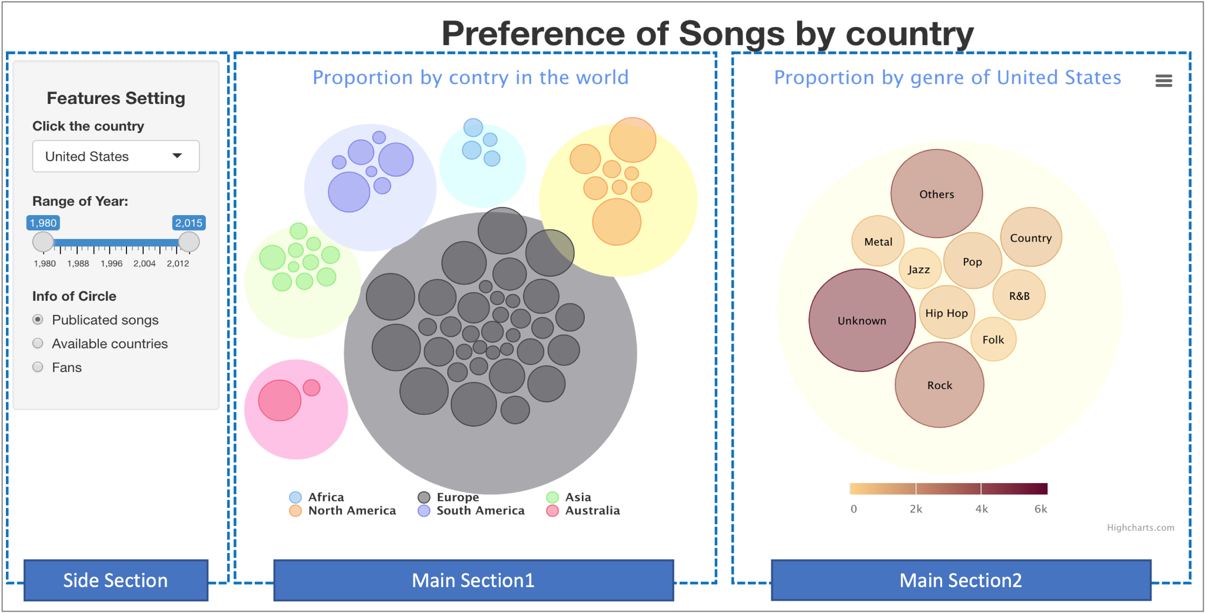
Data Visualization (Lee Hyelim) Circular packing visualization

Slide 15
THANK YOU

