Slide 1
M28 Site
Enterprise Network
Depi project

Slide 2
TEAM Name: M28-Site Members:
Adham Hussien Mohamed
Kareem Omar Abdelaziz
Mohammed Ahmed Ismail
Ahmed Galal al-din Elsayed
Mena Adel Makram
Mostafa El-sayed Khalil

Slide 3
Intro of Project:
This project represents a comprehensive enterprise network topology designed and implemented using Cisco Packet Tracer. The network is structured based on the hierarchical model, incorporating core, distribution, and access layers to enhance scalability, manageability, and performance. The primary goal of this topology is to simulate a realistic enterprise environment with multiple departments and enforce robust network segmentation, redundancy and security . At the access layer, four switches are configured to connect end devices across different departments. Each switch is assigned VLANs based on department roles—Sales (VLAN 10), IT (VLAN 20), HR (VLAN 30), and Management (VLAN 40)

Slide 4
Port security, PortFast, and BPDU Guard are applied to enhance security and protect against Layer 2 attacks.The distribution layer includes two switches configured with EtherChannel (PAgP) for load balancing and redundancy. Spanning Tree Protocol (STP) is optimized by assigning DSW1 as the root bridge for VLANs 1, 10, and 20, and DSW2 as the root bridge for VLANs 30 and 40, ensuring loop-free and efficient traffic paths.At the core of the network, three routers provide inter-VLAN routing and dynamic IP address assignment via DHCP for all VLANs. Sub-interface configuration is used for routing between departments, and standard security practices are enforced, including encrypted passwords, banners, and VTY access controls.This project demonstrates a well-structured enterprise network capable of supporting departmental segmentation, redundancy, secure access, and dynamic IP addressing—all reflecting industry-standard network design practices.

Slide 5
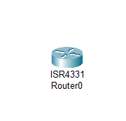
Router (R1, R2, R3):
Router (R1, R2, R3) – Core LayerPurpose:Routers serve as the backbone of the network, enabling inter-VLAN communication and acting as DHCP servers for different departments (Sales, IT, HR, and Management). Each router is configured with IP addresses, sub-interfaces, and essential security features to ensure reliable and secure routing across the entire topology.
Key Configurations:
Basic setup: Hostname, enable/VTY passwords, welcome bannerSub-interface configuration for inter-VLAN routingIP addressing for interfacesDHCP configuration for multiple VLANs

Slide 6
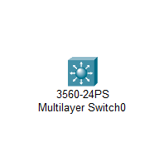
Distribution Switches (DSW1, DSW2):
Distribution LayerPurpose:Distribution switches act as an intermediary between the access switches and routers. They manage VLAN traffic, enhance redundancy, and optimize traffic flow through spanning tree configurations and EtherChannel links.Key Configurations:VLANs: 10 (Sales), 20 (IT), 30 (HR), 40 (Management)EtherChannel using PAgPTrunk port configuration.
Stp roles:
DSW1 – root bridge for Vlans 1, 10, 20
DSW2 – Root bridge for Vlans 30, 40
Port security and BPDU Guard on access-facing interfaces

Slide 7
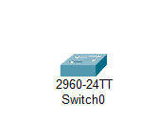
Access Switches (asw1–asw4):
Access LayerPurpose :Access switches provide direct connectivity to end-user devices and apply basic network security policies at the edge. They ensure that devices are assigned to the correct VLANs and implement port-based security to prevent unauthorized access.
Key Configurations:
VLAN assignment per portAccess port
configuration with security features:
PortFast, BPDU GuardPort security (restricting MAC addresses)
Trunk port to distribution switch
Secure access (VTY password, encrypted passwords, banner message)

Slide 8
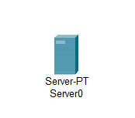
Server DHCP: A DHCP (Dynamic Host Configuration Protocol) server automatically assigns IP addresses and other network configuration settings to devices on a network, eliminating the need for manual setup. When a device connects to the network, the DHCP server provides it with an IP address, subnet mask, default gateway, and DNS server information. This helps streamline network management, especially in environments with many devices, and reduces the chance of IP conflicts or configuration errors. Internet: The Internet is a global network of interconnected computers and servers that allows users to access and share information, communicate, and conduct transactions across vast distances. It operates using standardized communication protocols like TCP/IP, enabling devices around the world to connect and interact seamlessly. Through the Internet, people can browse websites, send emails, use social media, stream content, and access a wide range of online services.
Dhcp server
Virtual internet

Slide 9
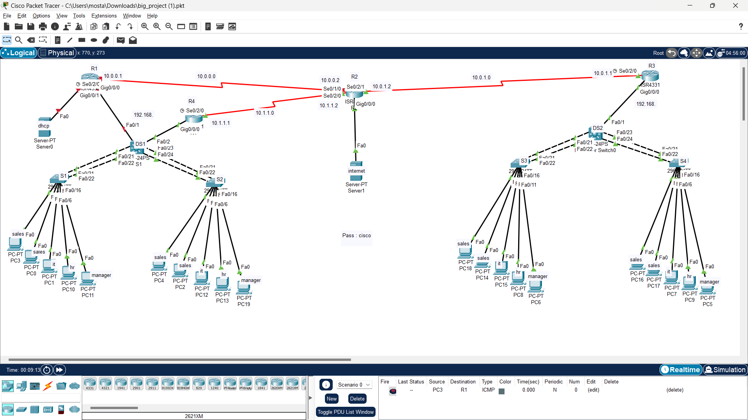

Slide 10
THANKS
M28-Site

