Slide 1
Return of Investment : Residential Housing Market in the Knoxville Metro Area
Mathew Menachery
Opportunity Insights

Slide 2
Overview
Time Series Forecasting
Zillow Data
Top 5 Zip Codes
Return on Investment (ROI)

Slide 3
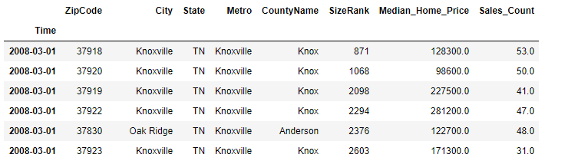
Description Data
Date Range
Monthly Median Housing Price
Monthly Home Sales

Slide 4
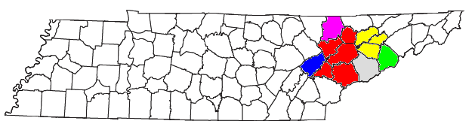
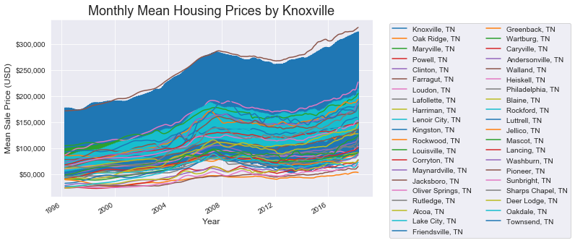
Knoxville Area
63th largest metro area
5% growth since 2010

Slide 5
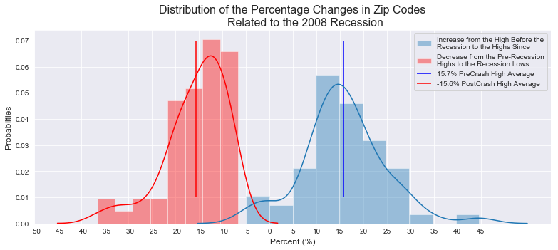
Recession

Slide 6
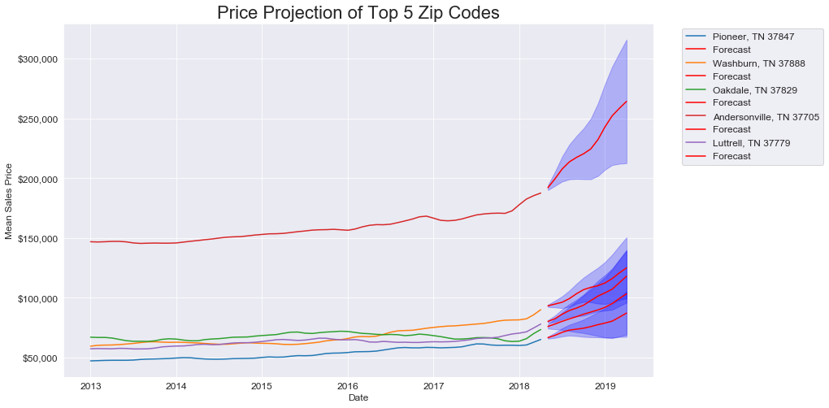
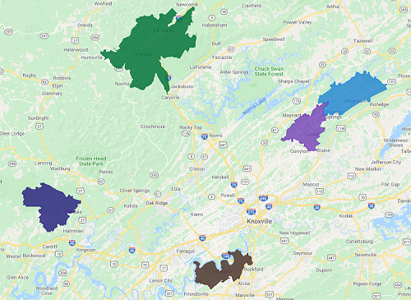
Results
Notes:
After looking at the map of the zip codes and with my knowledge of the area, I noticed that they we are in rural areas. The areas were all on the outskirt in the city centers. As you can see below the select zip code had small numbers of annual sales.

Slide 7
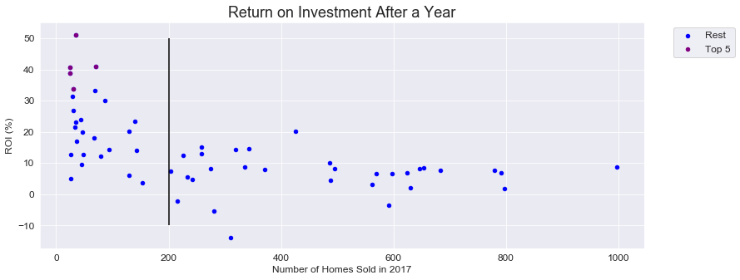
Result

Slide 8
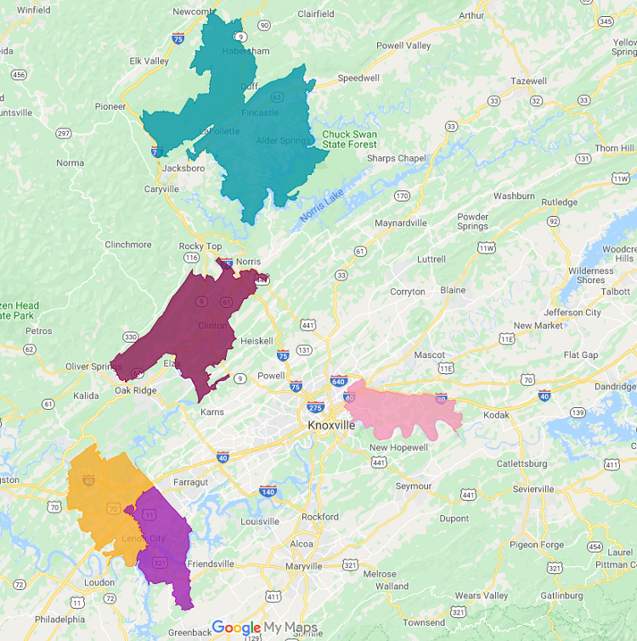
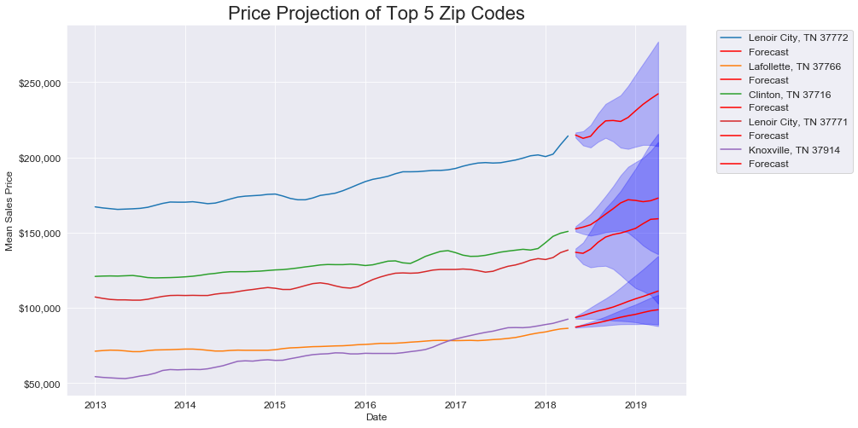
Over 200 Sales

Slide 9
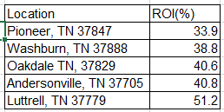
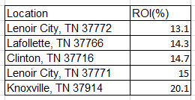
Results

Slide 10
Recommendation
High growth for all
Caution with rural areas (cabin)
Future Work
School Zones
Zoning Maps
Neighborhood Divisions
Thank You

