Slide 1
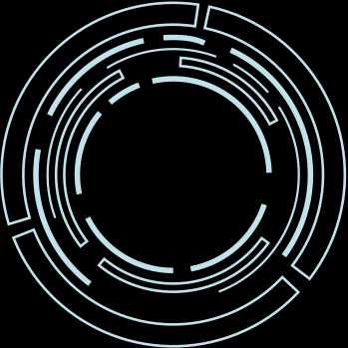
Understanding the Motherboard
The Central Component of Any Computer System
Mena Emad
8/10/2024

Slide 2

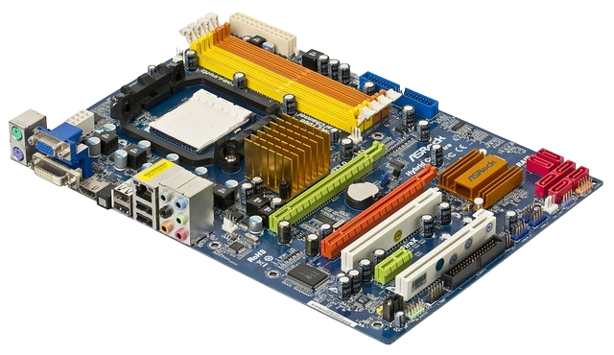
What is a Motherboard?
The motherboard houses and connects all critical components of a computer system. It provides electrical pathways for communication between these components.
It acts as the central hub of the computer. Every component, from the CPU (processor) to RAM, storage drives, and even input/output devices, communicates through the motherboard.

Slide 3
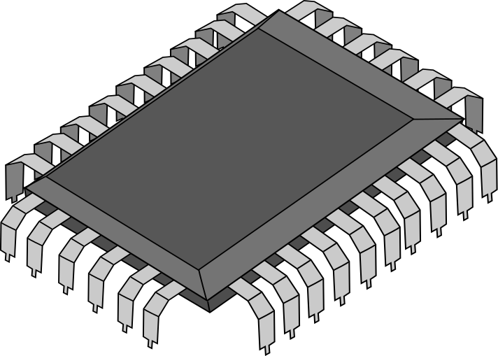

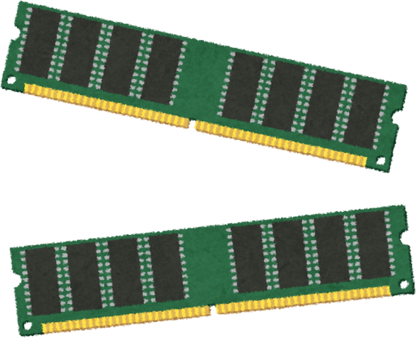
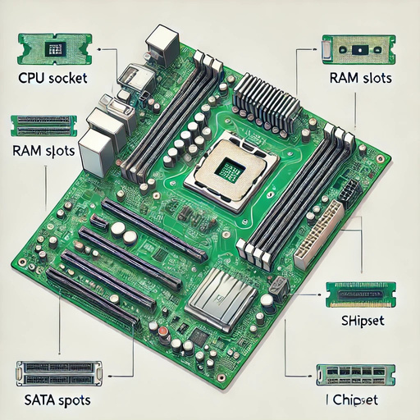

Key Components of a Motherboard
CPU SOCKET
RAM SLOTS
CHIPSET
This is where the processor (the brain of the computer) is placed.
These are slots for installing memory modules (RAM), the temporary memory of the computer.
Acts as a communication hub between the CPU, memory, and other components.
PCIE SLOTS
SATA CONNECTORS
These slots allow for adding expansion cards like graphics cards (GPUs), network cards, etc.
For connecting storage devices like hard drives (HDD) and solid-state drives (SSD).

Slide 4
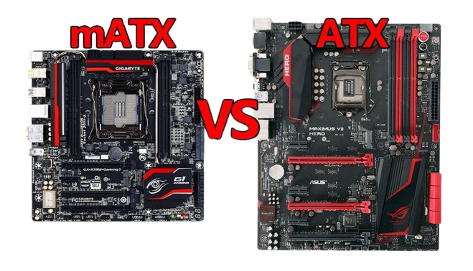
Types of Motherboards
Compact boards for small builds, such as mini-PCs
The most common, full-size board found in desktop computers.

Slide 5
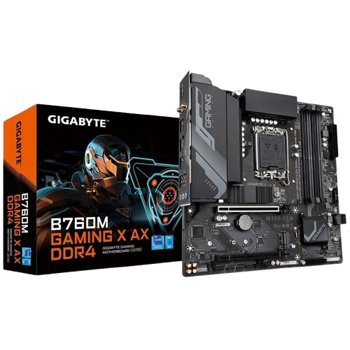
Motherboard Evolution
Earlier Models: Required multiple add-on cards for features like sound and networking.
Modern Motherboards: Many features are now integrated, such as Wi-Fi, Bluetooth, and even basic graphics.

Slide 6
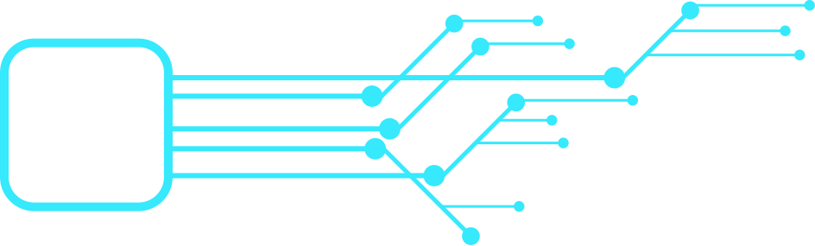
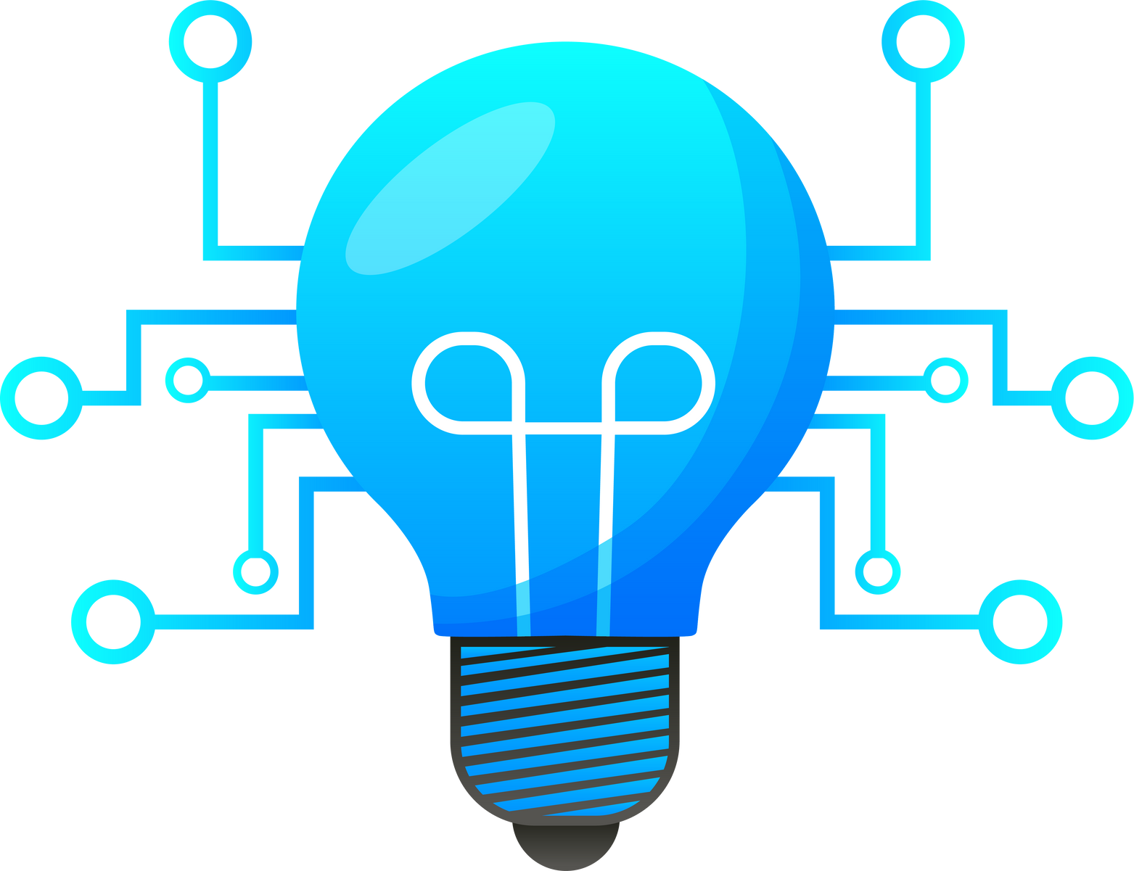
Conclusion
Recap: The motherboard is the central hub that connects all hardware components, enabling the computer to function.
Final Thought: Whether building or upgrading a computer, understanding the motherboard is key to making informed decisions.

Slide 7


Thank You!
menaemadnasef@gmail.com
www.mina-emad.netlify.app

