Slide 1
Programming in C

Slide 2
Style
Code style is something students do not like.
It is often left until AFTER the program is finished as an extra added chore.
Style is about being sensitive to how easy it is for a co-worker to read and update your code.
To most organizations, if you write the best code possible, but no one can read it or understand it, it is not worth anything.
In many cases, badly formatted, hard to read, hard to understand code is worse because instead of modifying your great code when needed, they end up having to throw it out and restart.
I personally feel style is AS IMPORTANT as the code itself.
And after working with others and having to modify other peoples code, you will eventually come to that same conclusion.

Slide 3
Using style
Style should not be an afterthought.
Do it as you type.
Put spaces between things.
Put braces in the right place.
Tab as you go along.
Name things correctly according to convention
You will become used to it. It will become second nature. Once you get used to it, you will find it doesn't take any more time.
If you use a style checker, you will still need to make a few modifications at the end, but they will be minor.

Slide 4
Why use style
It is professional.
Employers usually have large code bases. What matters most to them is maintainability. Sloppy code is not maintainable code.
Sloppy coders are lazy coders. You can do both with a minimum of effort. The fact that you choose not to be neat as you type says something about your work ethic.
It makes troubleshooting much, much easier.
Finding a missing bracket in sloppy code is a guessing game.
There may be multiple places you can put a bracket that will satisfy the compiler but be logically incorrect.
If you have ever played the "maybe the bracket goes here" game, that is the sign of a noob programmer. If you're not a noob, then stop acting like one.
Properly indent and where brackets go isn't ever a guessing game. You either simply will not make the error, or it will be very, very obvious where the bracket goes when you do forget one.

Slide 5
Style in this class
I don't care too much about which conventions get used.
But I do expect you to select one and stick with it.
You MUST use indention on every single one of these programs.
I will count off on your grade if you don't indent correctly and consistently.
Brackets must be used consistently, or you will lose points.
If you like brackets on the same line as a statement, then do that always.
If you like brackets on their own line, then do that consistently.
You should not write single huge functions. Break functions into logical pieces and move those to other functions and call them.
Comments are extremely important. But for the purposes of testing, I wont generally require them since the time on the test is limited.

Slide 6
Break and continue and multiple returns
These have their place, but they should be used extremely sparingly inside of a loop. (Break in a switch is fine.)
You should always arrange your loops in such a way as to remove break and continue.
The code on the left obscures the fact that code1, code2, and code3 only get run if x >= 0.
The code on the right makes it more clear through indention when code1, code2, and code3 get executed.
Multiple returns have the same effect.
int x = 0;
while (x > 0) {
scanf("%d", &x);
if ( x < 0) break;
code1;
code2 ;
code3;
}
int x = 0;
while (x > 0) {
scanf("%d", &x);
if ( x >= 0) {
code1;
code2;
code3;
}
}

Slide 7
More obscurity
What will the following print?
If you look at the for-loop control, you would think it runs 10 times.
It is easy to see the break in the code below, but the more code there is inside the for-loop, the less easy it will be to pick out the break.
You shouldn't have to scour the code to see how many times the for-loop runs. The point of a for-loop is to do something a specific number of times.
int z = 5;
int y = 1;
for (int x = 0; x < 10; x++) {
printf("%d ", x);
if (x + y < z) break;
}

Slide 8
More obscurity better
What will the following print?
int z = 5;
int y = 1;
for (int x = 0; x <= (z-y); x++) {
printf("%d ", x);
}

Slide 9
Using goto
Don’t use goto.
There ARE some very, very specific places where goto is a good solution. But those specific places almost never show up in regular programming.
If you think goto is necessary in your program, it almost always means you have bad logic in your code.
My suggestion is to forget goto even exists.
The Web-CAT tests will fail if you use goto.

Slide 10
Goto, continue, break, multiple returns
The issue with these instructions is that in most cases they obscure code that could have been written more cleanly.
Throwing in a break when you are done with a loop might make you get through a little quicker, but when someone comes behind you to update that code it will make it slower for them.
Businesses want good code, but they also want easily modifiable code. If you show up to an interview with lots of breaks and continues in your example code or you use those to answer interview questions, when a simple if would have been clearer and just as effective will reflect negatively on you.
Break, continue, multiple returns, and even goto have their place, BUT you will have cleaner, more logical code without them and their use should be minimized as much as possible. In this class it is always possible, and Web-CAT will fail if you use them.
So, just to give you more practice at eliminating these items that cause a reduction in code clarity, for the C programs in this class you will not be allowed to use them.

Slide 11
Hello World
#include <stdio.h>
int main(void)
{
printf("Hello world!!\n");
}

Slide 12
Compiling on CS2450.cs.appstate.edu
What do you need to run "Hello World"?
Access to computer with a compiler
Computer
cs2450.cs.appstate.edu
Connect with terminal software.
Compiler
GCC The Gnu Compiler Collection

Slide 13
Alternatives to using student
ASNI C is a standard version of C. Any compiler which adheres to ANSI C should give the same output.
Any LINUX or Mac can install GCC/G++.
Most implementations of LINUX have it already installed
Windows has many C compilers.
Visual C++ will compile C code.
mingw is an excellent command line based, windows implementation of gcc or g++.
Dev-C++ is a good development environment.
Use bash on Ubuntu on Windows (See additional slide).
There are various web pages that let you enter code, compile, and run right on the web page.
Not being able to get your own computer to compile programs will not be an excuse for not getting assignments completed. I expect you to at least be able to use student; make sure you can.

Slide 14
Connecting to student
Open a terminal or shell window
Use the ssh command using your AsULearn user id.
Type the following
ssh your_user_name@cs2450.cs.appstate.edu
Type your password as you log onto AsULearn

Slide 15
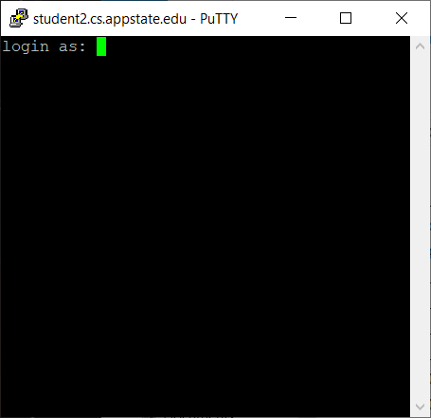
Getting logged in
Use your username exactly as you use on other systems at ASU.
Contact the system administrator if you forget your password.
https://compsci.appstate.edu/chg-password
When you are typing your password, note that no characters show up. This is normal on UNIX system.

Slide 16
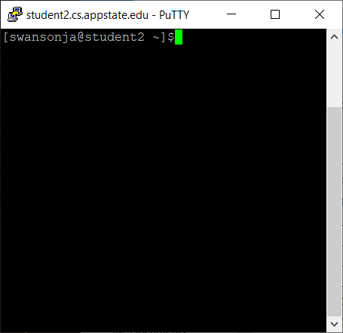
Logged in
If you see a window like this, you are logged in.
The text on the screen is a command prompt and it is waiting for a command to be entered.

Slide 17
Some UNIX commands
pwd shows you the current folder you are in. The present working directory (pwd).
ls list all files in the pwd.
mkdir create a new directory or folder in the pwd.
cd change to a different folder. That folder must be in the pwd.
cd ~ change back to your home directory.
rm filename removes a file named filename from the pwd.
rmdir directoryname removes an EMPTY directory.
rm dirname –rf removed directories and EVERYTHING in that directory
mv oldfilename newfilename - Rename a file.
ctrl – c will kill an out of control process (i.e. infinite loop).
exit – exits the terminal. Quit putty this way, don’t use x at top of window. Always exit your editor and exit putty using exit.
man – Get help (manual pages) on a command.
For example, man g++ will show you all the g++ command line options.

Slide 18
Example Hello World
Log into student.
Make a new directory for your program.
Change into that directory.
Open an editor and type in the hello world program from slide 2.
Save the program as hello.cc and exit the editor.
Compile the program.
Run the program.

Slide 19
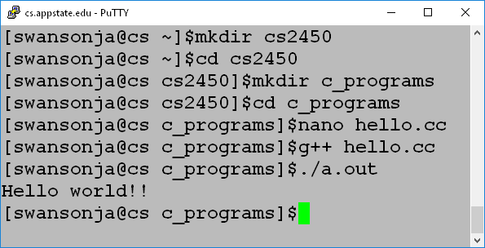
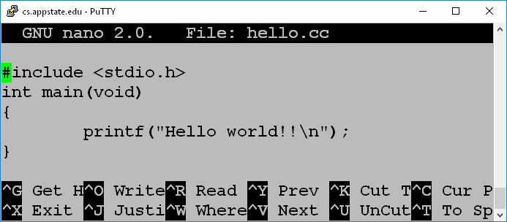
Example implemented
I used nano as an editor. Feel free to use vi/vim, emacs, or any other text editor you are comfortable with.
Control-O (WriteOut) saves from nano. Make sure it is named hello.cc.
Control-X exits.
The default name of the executable file created by gcc is a.out.
You can change the output file name by using the –o option
The above uses gcc to compile. gcc and g++ do the same thing.

Slide 20
Compiling a program
g++ hello.cc
Creates an executablefile named a.out
Run by typing a.out or ./a.out on the command line
g++ -o hello hello.cc
Creates an executable file named hello.
Run by typing hello or ./hello on the command line
g++ -Werror -Wall -o hello hello.cc
Creates an executable file named hello and treats all warnings as errors.
-Werror : Treat warnings as error
-Wall : Show all warnings
-o : Name the output file
(-Werror WILL BE TURNED ON FOR WEB-CAT).

Slide 21
Warnings and Errors
#include <stdio.h>
int main()
{
double a;
printf("Enter a double: ");
scanf("%f", &a); //error should be %lf
printf("%f\n", a);
}
The above will give a warning and compile.
Typing 1.2 at the prompt will result in 0.00000 as output.
-Werror will make sure this doesn’t happen.

Slide 22
Warnings and Errors 2
#include <stdio.h>
int main() {
int x = 3;
int y = 0;;
y = (++x) + (x++);
printf ("%d", y);
return 0;
}
//Compile with and without –Wall -Werror

Slide 23
Assignments
Assignments will be broken into two parts.
You will create a file named main.cc with a main method in it. Sometimes I will give you this file.
You will create separate file with your program code. The program code will be a series of functions. DO NOT PUT A MAIN IN YOUR CODE FILE.
Web-CAT uses a main method to test your code. If your code already has a main method, it will fail.
Note that we are learning C even though we are using C++ to compile.
For this class you are NOT allowed to use the C++ language.
Most specifically you are not allowed to use CIN or COUT.
You are only allowed to use code as shown in my slides or the book.
COMPILE WITH
g++ -Werror -Wall -o assign main.cc assign.cc
Where:
assign.cc is your functions created for
Main.cc is the file with a main function used to test your program.

Slide 24
Use two files: main.cc and cloops.cc
//main.cc
void printRectangleFor(int, int);
void printTriangleWhile(int);
void printFormat(int, int, int);
int main()
{
printRectangleFor(10, 6);
printTriangleWhile(7);
printFormat(30, 5, 4);
}
#include <stdio.h> ; Don’t for get this if you use printf.
//cloops.cc
void printRectangleFor(int width, int height)
{
//Put your code here
}
void printTriangleWhile(int height)
{
//Put your code here
}
void printFormat(int end, int columns, int skip)
{
//Put your code here
}
COMPILE WITH:
g++ -Werror -Wall -o cloops main.cc cloops.cc

Slide 25
Submitting to Web-CAT
Submitting
Go to the Web-CAT web page
http://webcat.cs.appstate.edu
Select the assignment
Upload
Grading
You will be graded according to the number of tests that you pass.
You will lose points for excessive submissions
You will lose points for every day the assignment is late.
You will receive a 0 if the assignment is more than 2 days late.

Slide 26
Webcat warning
Web-CAT can be frustrating and cryptic at times.
You are given a deadline for submitting your programs to Web-CAT.
It is your responsibility to get your program fully completed and uploaded to Web-CAT before that deadline.
If you do not understand some of the instructions in the assignment document or understand the errors you are getting on Web-CAT, you must ask questions.
If you do not give yourself enough time to ask questions and get those questions answered before the due date, then you have not completed the assignment and will receive a bad grade or possibly a zero.
I will not manually grade your programs. The grade you receive from Web-CAT will be your grade in all but the most extreme cases.

Slide 27
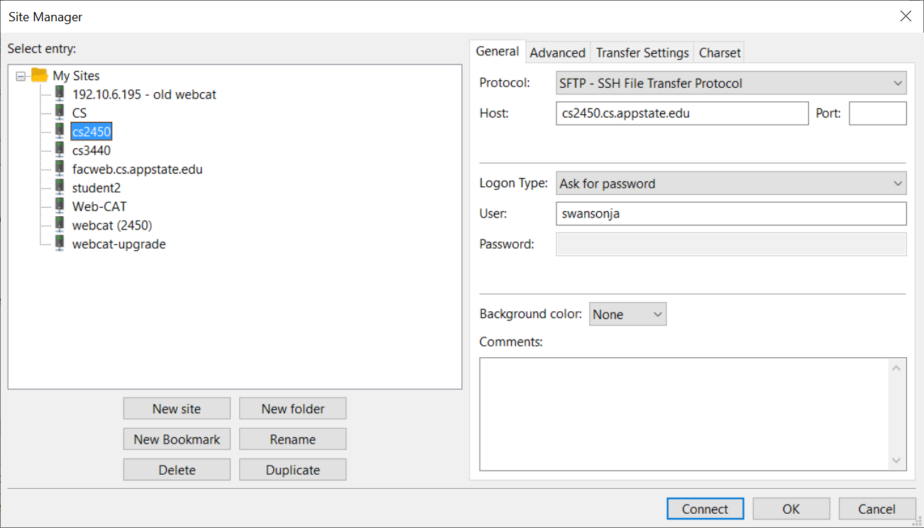
Getting files from Student
Use Filezilla SFTP (Secure File Transfer Protocol)
Host name: cs2450.cs.appstate.edu
Enter your username and password.
Note that your password is your password on the student server and NOT your AsULearn password.

Slide 28
Using SCp with a folder
Assuming
I have a folder named cloops with a file named cloops.cc inside on cs2450.
My PWD is my Desktop directory on the local machine
Copy cloops.cc FROM cs2450 TO the local machine
scp swansonja@cs2450.appstate.edu:cloops/cloops.cc assign1.cc
Copy file TO cs2450 FROM the local machine.
scp cloops.cc swansonja@cs2450.cs.appstate.edu:cloops/cloops.cc

Slide 29
Using SCp from my home directory
Assuming
I create cloops.cc in my home directory on sc2450.
My PWD is my Desktop directory on the local machine
Copy cloops.cc FROM cs2450 TO the local machine
scp swansonja@cs2450.appstate.edu:cloops.cc assign1.cc
Copy file TO cs2450 FROM the local machine.
scp cloops.cc swansonja@cs2450.cs.appstate.edu:cloops.cc

Slide 30
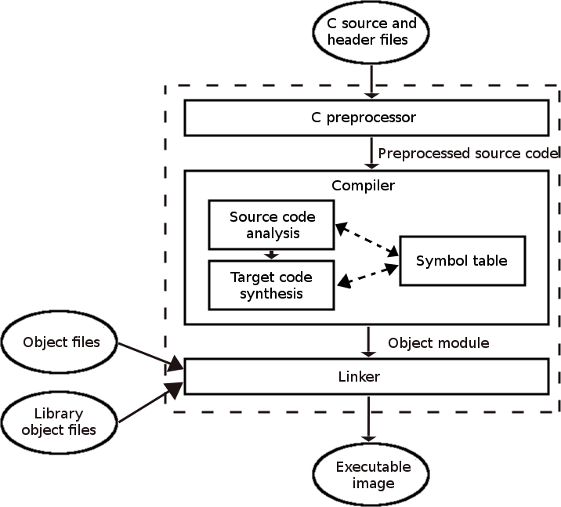
Compiling Details

Slide 31
Part of the compiler
Preprocessor – Processes directives
Directive start with the # symbol.
#include will copy the named file into the source code buffer.
#define will replaced any instance of the constant with the value specified in the entire source code buffer.
Output is preprocessed source code.
Compiler – Convert code to assembly language and track variable names in the symbol table. This portion will attempt to optimize code. The symbol table is a mapping of the variable names to memory locations actually used.
Output object code – Not all addresses resolved.
Linker – Determines and inserts the addresses for any external code that is needed such as code for building and displaying windows.
Output is executable code ready to be executed by the hardware.
GCC seems to do all of the above in one step, but it actually performs each step separately.

Slide 32
C and Java
I am assuming you know Java.
Java and C are similar in syntax.
Methods are called functions but are otherwise declared and used the same. There is no public or private, however.
The "main" function is where code operation begins.
if, while, and for work the same.
Operators all act the same.
for loops act the same (In older versions of C you must declare loop control variables before the loop).

Slide 33
Loops and shapes Assignment
Since most of the statements and concepts from this first assignment are almost exactly the same as Java you should be able to figure it out.
You will need to print. Print in C using printf.
printf("+");
printf("-");
printf(" "); //Space
printf("\n"); //Newline
printf("\t"); //Tab
printf("%d", a) //Print variable a where a is an integer.
If you can't figure it out, ask.

Slide 34
Variables
Three basic primitive types – work the same as java
int
char
double
No String as a type.
Local variables – defined in methods.
Global variables – defined outside of methods. Similar to fields in that they are available to all functions. Global variables, however, are available to the entire program, like a public field, and should be used sparingly.
ALWAYS use local variables and parameter passing where possible instead of global variables.
ALWAYS initialize your variables. Local variables are NOT initialized to zero in C.

Slide 35
Integer types
Type | Size | Range
char | 1 byte | -128 to 127 or 0 to 255
unsigned char | 1 byte | 0 to 255
signed char | 1 byte | -128 to 127
short | 2 bytes | -32,768 to 32,767
unsigned short | 2 bytes | 0 to 65,535
int | 4 bytes | -2,147,483,648 to 2,147,483,647
unsigned int | 4 bytes | 0 to 4,294,967,295
long | 8 bytes | -9223372036854775808 to 9223372036854775807
unsigned long | 8 bytes | 0 to 18446744073709551615
long long | 8 or 16 | Long longs can be the same as long or
unsigned long long | 8 or 16 | will be twice as big.

Slide 36
Floating Point Types
Type | Size | Range | Decimal Places
float | 4 byte | 1.2E-38 to 3.4E+38 | 6
double | 8 byte | 2.3E-308 to 1.7E+308 | 15
long double | 16 byte | 3.4E-4932 to 1.1E+4932 | 19

Slide 37
Odd character issues
#include <stdio.h>
int main()
{
char b = 1;
printf("%d\n", b); //Prints 1
b = -1;
printf("%d\n", b); //Prints -1
b = 128;
printf("%d\n", b); //Prints -128
b = 0xff;
printf("%d\n", b); //Prints -1
b = 0xf0;
printf("%d\n", b); //Prints ____?
b = 165;
printf("%d\n", b); //Prints -91
b = 1.5;
printf("%d\n", b); //Prints 1
b = 'c';
printf("%d\n", b); //Prints 99
}

Slide 38
Declaring variables
The same as Java
double width;
double pType = 9.44;
double mass = 6.34E2;
double verySmall = 0.1094E-31;
int average = 12;
int windChill = -21;
int unknownValue;
char initial = 'A';
char num4 = '4';

Slide 39
Declaring constants as #define
Constants
#define LETTER '1'
#define ZERO 0
#define NUMBER 123
Constants do not have a type.
The text will simply replace the constant identifier in the source code during the preprocessor phase before compiling begins.
You could also use the const keyword, but it is simply a global variable you can't change and has all the same name sharing issues as any other global variable.
const int number = 123;
#define doesn't have global naming issues because the preprocessor runs separately on individual source code files.

Slide 40
Operators same as Java
The following are the same as Java.
Operators and Expressions. (+, -, *, /, %, a + b)
Assignment (x = a + b)
Parenthesis ((a+b)*x)
Increment and decrement (++, --)
Combined operators (+=, -=, *=, etc…)

Slide 41
Order of Operation
Precedence | Associativity | Operators
1 | L to R | () (function call) [ ] (array index) ->
2 | R to L | ++ -- (postfix versions)
3 | R to L | ++ -- (prefix versions)
4 | R to L | *(indirection) &(address of) +(unary) –(unary) ~ ! sizeof
5 | R to L | (type) (type cast)
6 | L to R | * (multiplication) / %
7 | L to R | + (addition) - (subtraction)
8 | L to R | << >>
9 | L to R | < > <= >=
10 | L to R | == !=
11 | L to R | &
12 | L to R | ^
13 | L to R | |
14 | L to R | &&
15 | L to R | ||
16 | L to R | ? : (conditional expression)
17 | R to L | = += -= *= /= %= &= |= ^= <<= >>=

Slide 42
Relational and Conditional Operators
DIFFERENT THAN JAVA
C has no Boolean data type.
Technically
0 is false
anything not zero is true
3 == 5 evaluates to 0
3 != 5 evaluates to 1

Slide 43
Tricky Error
The following code will print the word same.
In java it would have produced an error.
Be careful about accidentally using = instead of ==
int x = 5;
int y = 7;
if ( x = y )
{
printf("Same");
}

Slide 44
Tricky Logical Operators
int f = 7;
int g = 8;
int h;
h = f & g;
h = f && g;
h = f | g;
h = f || g;
h = ~f | ~g
h = !f && !g;
h = 29 || - 52;

Slide 45
If and While
The following work the same as Java.
if
if-else
if-else-if
if-else-if-else
while
do-while

Slide 46
printf
No print or println, only printf
Similar to Java printf
%[flags][width][.precision][length]specifier
Specifiers (some of them)
c – character (Display the character for an ASCII value)
d or i – Signed integer
e or E – Scientific notation
f – floating point
s – string of characters (null terminated)
u – unsigned integer
x or X – unsigned hexadecimal (lower or upper case)
p – pointer address
n - nothing

Slide 47
printf flags and width
%[flags][width][.precision][length]specifier
Flags
- Right justify
+ Include plus sign for positive numbers
0 Left pad number with zeros. Only for numbers with width specified.
Width Minimum number of spaces
* specify width as an additional integer value argument

Slide 48
printf precision and length
%[flags][width][.precision][length]specifier
.precision
.num The number of decimal points to display.
.* The number of decimal points is specified as an additional integer value argument
length used for different sizes of integers or doubles (i.e. long or short)
h, l, or L

Slide 49
Functions
Functions follow the same rules as Java.
No public or private though.
Return types the same.
Use void type if there is no return.
Use return statement to return values and exit the function.
Passing parameters is the same except
Pointers allow call by reference for primitive types.
More on this later.
Creating functions
int get2Times (int x) {
return x * 2;
}
void print2Time(int x) {
printf("%dx2=%d\n", x, x * 2);
}
Using functions
int y = get2Times(5);
print2Times(4); //Prints 4x2=8

Slide 50
Pointers
In Java, object variables reference the object they are storing.
The variable holds the memory location or reference of the position in memory where the object was created.
In C, we can have references to any variable.
Using pointers incorrectly can have unpredictable results and cause hard to diagnose errors.
Java does not allow user created reference variables.

Slide 51
Pointer operations
Declare a variable named ptr which is a pointer to an integer.
* - dereference - Read as "star" or "splat"
& - "address of" operator
int count = 5;
int *ptr;
ptr = &count;
*ptr = *ptr + 1;
printf("%i", count);

Slide 52
Dereference (*) And Address of (&)
* has two uses
Declare a pointer variable.
int *ptr;
Dereference a pointer variable.
*ptr = 5;
ONLY USE * ON POINTER VARIABLES
& is the "address of" operator.
We NEVER want the address of a pointer. So & SHOULD NOT be used on pointer variables.
& should be used on non pointers to get an address to assign to a pointer.
ptr = &y; (ptr SHOULD be a pointer. y SHOULD NOT be a pointer.
Note that
*ptr is used to modify the thing that ptr is pointing at
ptr=&y;
ptr DOES NOT have * on it (i.e., this is wrong *ptr = &y;).
We want the address of y IN ptr.
We do not want the address of y in the thing ptr is pointing at.

Slide 53
Getting an address
& returns the address of a variable.
int count = 5;
&count - returns the address that C has allocated to the variable count.

Slide 54
Pointer Example
int count1 = 1;
int count2 = 3;
int count3 = 5;
int *ptr;
int main() {
ptr = &count1;
printf("%i - %i - %i\n", count1, count2, count3);
for (int i = 0; i < 3; i++) {
*ptr = *ptr + 1; // could use (*ptr)++;
printf("%d - %d - %d\n", count1, count2, count3);
ptr = ptr + 1;
}
}

Slide 55
Scanf
Input – Similar to printf with formats
%[*][width][modifiers]type
The variable must be a reference or pointer.
int x;
scanf("%d", &x);

Slide 56
Scanf Format
%[*][width][modifiers]type
Formats should be simple.
Don't print prompts using the scanf format.
PROMPT LIKE THIS THIS:
int x = 0;
printf("Enter an integer: ");
scanf("%d", &x);
DON’T PROMPT LIKE THIS:
int x = 0;
scanf("Enter an integer: %d", &x);

Slide 57
Scanf and Spaces
scanf uses any whitespace character (tabs, spaces, newlines) as a delimiter.
That means scanf will not read past a space unless you tell it to.
The following will read 99 characters into test and will not stop until a newline (enter) is reached.
char test[100];
char c = ' ';
scanf("%99[^\n]", test); or scanf("%99[^\n]s", test);
Scanf("%c", &c); //Get rid of newline for next scanf if needed.

Slide 58
Use multiple Scanf
Good advice is to keep your scanfs as simple as possible.
Get multiple variables with multiple scanfs
int x, y;
printf("Enter an integer: ");
scanf("%d", &x);
printf("Enter another integer: ");
scanf("%d", &y);
Don't do this:
int x, y;
printf("Enter two integers: ");
scanf("%d %d", &x, &y);

Slide 59
Scanf Example
int i = 0;
float f = 0;
double d = 0.0;
char c = ' ';
printf("Enter an integer: ");
scanf("%d", &i);
printf("Enter a float: ");
scanf("%f", &f);
printf("Enter a double: ");
scanf("%lf", &d); //Note lf (long float)
printf("Enter a character: ");
scanf("%c", &c);
scanf("%c", &c); //Why two scanfs?
printf("%i - %f - %f - %c\n", i, f, d, c);

Slide 60
Another scanf example
int num1 = 0;
double num2 = 0;
printf("I will sum two numbers for you.\n");
printf("Enter an integer: ");
scanf("%d", &num1);
printf("Enter a double: ");
scanf("%lf", &num2); //note the lf (long float for doubles)
printf("%d + %.2f = %.2f\n", num1, num2, num1 + num2 );
return 0;

Slide 61
Warnings and Errors revisited
#include <stdio.h>
int main()
{
double a;
printf("Enter a double: ");
scanf("%f", &a); //error should be %lf
printf("%f\n", a);
}
The above will give a warning and compile.
Typing 1.2 at the prompt will result in 0.00000 as output.

Slide 62
Arrays
Logically you can think of arrays in C the same way as you think of them in Java.
The reality is that arrays are objects in Java and simply a large group of declared variables in C.
int grid[4];
double scores[2];
char name[4];
In the above examples grid, scores, and name are simply pointers to the first element in the array
Unlike pointers, however, grid, scores and name cannot be reassigned.
Array size MUST be known at compile time. You cannot use an undefined variable to create an array.
You can initialize arrays using {} (Bracket initialize)
int grid[] = {1,2,3,6, 4, -3};
double scores[] = {67.0, 88.5, 21.7, 100.0, 99.2};
//This would be weird. No null termination unless you put it in.
char name[] = {'H', 'e', 'l', 'l', 'o', '\0'}; //DON’T DO THIS!
//Just use quotes: char name[] = "Hello"

Slide 63
Array indexing
[] is an operator like multiplication or addition.
grid[index] means calculate an address like this:
(address of grid) + index * ( sizeof the type of grid)
grid[3] = 5;
5 in 32 bits is 00000000 00000000 00000000 00000101
Address = 1000 + 4 * 3 = 100C
Put 00000000 in 100C
Put 00000000 in 100D
Put 00000000 in 100E
Put 00000101 in 100F

Slide 64
Array Length
There is no way to determine the number of items in an array once it is created so it is vitally important to keep track.
A good practice is to use a constant for the number of items you wish to store.
#include <stdio.h>
#define NUM_GRADES 10
int main()
{
int grades[NUM_GRADES];
for (int i=0; i < NUM_GRADES; i++)
{
printf("Enter grade #%2d: ", i+1);
scanf("%d", &grades[i]);
}
double avg = getIntArrayAverage(grades, NUM_GRADES);
printf("Average: %.2f\n", avg);
}

Slide 65
getIntArrayAverage
double getIntArrayAverage(int grades[], int num)
{
}
//You could use NUM_GRADES here, but don't.
//For my assignments, always pass in the number of items
//and use the parameter. Don’t assume I will use the same constant.

Slide 66
Passing Arrays as Parameters
Note the important pieces of the last two slides.
In main:
int grades[NUM_GRADES];
//fill in the grades with some code of course
double avg = getIntArrayAverage(grades, NUM_GRADES);
In getIntArrayAverage:
//Note the brackets [ ] are left empty.
double getIntArrayAverage(int grades[], int num)
or
//Variable grades here is actually an int pointer.
double getIntArrayAverage(int *grades, int num)

Slide 67
MULTI-dimensional Arrays
Just like in Java we can have multi dimensional arrays.
int grid[row][column];
int grid[3][4] ; //This is really an array of arrays
Stored in row major order, which means each row is stored sequentially.
You can use the bracket initializer BUT you MUST specify the array dimensions for all but first dimension.
int arr[][4] = { {1, 2, 3}, {4, 5, 6}, {7, 8, 9}, {10, 11, 12} };

Slide 68
2d array ADDRESS calculation
int arr[][4] = { {1, 2, 3}, {4, 5, 6}, {7, 8, 9}, {10, 11, 12} };
arr[1][2] = 99;
arr is x4000
x4000 + 1 * 12 + 2 * 4
x4000 + 20
x4000 + x14
x4014
arr[0] | x4000 | 1
 | x4004 | 2
 | x4008 | 3
arr[1] | x400C | 4
 | X4010 | 5
 | X4014 | 6
arr[2] | X4018 | 7
 | x401C | 8
 | x4020 | 9
arr[3] | x4024 | 10
 | x4028 | 11
 | x402C | 12
 | C0 | C1 | C2
R0 | 1 | 2 | 3
R1 | 4 | 5 | 6
R2 | 7 | 8 | 9
R3 | 10 | 11 | 12

Slide 69
Accessing multi dimensional array data
The following will print 1 2 3 4 5 6 7 8 9 on a single line
int arr[][3] = { {1, 2, 3}, {4, 5, 6}, {7, 8, 9} };
for (int i = 0; i < 3; i++) {
for (int j = 0; j < 3; j++) {
printf("%d ", arr[i][j]);
}
}

Slide 70
Passing multi-dimensional arrays
You still need to know the sizes
You need the correct brackets in the parameter.
You MUST specify a dimension for all but first bracket.
int arr[][3] = { {1, 2, 3}, {4, 5, 6}, {7, 8, 9} };
printArray(arr, 3, 3);
void printArray(int **test, int x, int y) {
for (int i = 0; i < x; i++) {
for (int j = 0; j < y; j++) {
printf("%d ", test[i][j]);
}
}
}

Slide 71
DO NOT RETURN ARRAYS FROM functions
VERY BAD CODE!!!
arr is a local variable and will be deallocated.
Use a static array (gets created on the heap)
Use a dynamic array (malloc or calloc / preferred)
int *getArray()
{
int arr[5]; //static int arr[5]; //static will save in global space
printf("Enter the elements in an array : ");
for(int i=0;i<5;i++)
{
scanf("%d", &arr[i]);
}
return arr;
}

Slide 72
Dynamic Arrays are created with calloc and malloc
void *calloc(size_t num, size_t size)
reserves num * size bytes of memory
initializes memory to zero.
void *malloc(size_t size)
reserves size bytes of memory
DOES NOT initializes memory to zero.
void free(void *ptr) – gives the memory back
You are in charge of the memory used. Make sure to free anything you don’t need.

Slide 73
Dynamic Arrays example
// Allocate and return an array of 'n' integers
// Returns NULL on failure
// MUST RETURN A POINTER TO THE NEW MEMORY
int *myFunc(int n) {
int i;
// allocate block of memory
int *x = (int*) malloc(n * sizeof(int));
// test allocation for success
if (x == NULL) {
return NULL;
}
// fill it with random values
for (i=0; i<n; i++) {
x[i] = rand();
}
// return the pointer
return x;
}

Slide 74
Using Dynamic Arrays
int checkGetIntArrayAverageRandom()
{
int n = rand() % 8 + 5;
int *a = (int*) calloc(n, sizeof(int));
for (int i = 0; i < n; i++)
{
a[i] = rand() % 25 - 5;
}
double exp = getIntArrayAverageAns(a, n);
int retVal = checkGetIntArrayAverage(a, n, exp);
free(a);
return retVal;
}

Slide 75
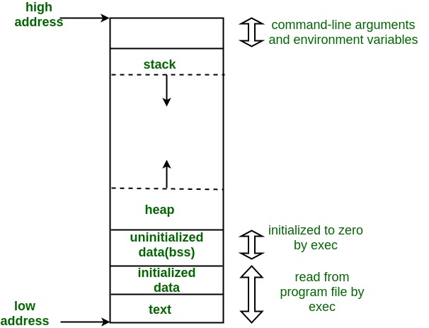
MEMORY in a c program
Text segment - Instructions
Initialized data segment - global variables, static variables, string literals. Things that are initialized.
Uninitialized data segment (bss) Uninitialized global and static data or global variables set to zero.
Heap - Dynamic memory
Stack - Local variables, parameters, function return values, function arguments.

Slide 76
Strings
Strings in C are arrays of characters.
You must know the maximum length before creating a string so the array can be created of the correct size.
Strings in C must be null terminated. That is the last character must be a null or zero (\0).
You must reserve space for the null zero.

Slide 77
String example
char name1[10] = "BILL"; //Null zero added
char *name2 = "BILL"; //Null zero added
B
I
L
L
\0
name
name is a char pointer
which contains the address
of the first char in the array
Not the character 0.
The number zero is
stored here.

Slide 78
Some Differences
char a[10] = “aaaaa”;
char *b = “bbbbb”; //C++ requires: const char *b = "bbbbb";
a = “ccccc”; //Not allowed. Compile error.
b = “ccccc”; //Allowed
a++; //Not allowed. Compile error.
b++; //Allowed
a[5] = ‘x’; //Allowed
b[5] = ‘x’; //Runtime error in C. Compile error in C++.
The last one will compile but will give segmentation fault in C since string literals are stored as read only. It will be a compile error in C++ due to the const keyword requirement in the declaration.

Slide 79
String Pointers
Strings literals are stored in their own special memory.
char *b =“123”;
char c = ‘X’;
b = “9999999999”;
printf(“%c\n”, c);

Slide 80
Reading Strings with scanf
char first[15];
char middle[15];
char last[20];
printf("Enter your first name: ");
scanf("%14s", first); //The number tells scanf how many chars to read.
printf("Enter your middle name: ");
scanf("%14s", middle);
printf("Enter your last name: ");
scanf("%19s", last);
printf("%s, %s %s\n", last, first, middle);

Slide 81
Scanf Overflow Protection
#include <stdio.h>
#include <string.h>
char a[6] = "Hello";
char b = 'X';
int main()
{
//Enter 12345, prints a=12345:b=X
//Enter 123456 prints a=123456:b= (X overwritten)
//Enter 123456789 prints a=123456:b= (6 chars max, X overwritten)
scanf("%6s", a); //Should use a 5 here
printf("a=%s:", a);
printf("b=%c\n", b);
}

Slide 82
String Length
Part of <string.h> library
size_t is simply an unsigned integer
size_t strlen(const char *str)
Computes the length of the string str up to but not including the terminating null character.
Can you write this function.
char a[15];
scanf("%14s", a);
int len = strlen(a); //Not including zero

Slide 83
String Copy
char *strcpy(char *dest, const char *src)
Copies the string pointed to by src to dest.
char *strncpy(char *dest, const char *src, size_t n)
Copies up to n characters from the string pointed to by src to dest.
When given a choice, always use the N version.
char a[10];
char b[10];
scanf("%9s", b);
strncpy(a, b, 9);

Slide 84
String Concatenation
char *strcat(char *dest, const char *src)
Appends the string pointed to, by src to the end of the string pointed to by dest.
char *strncat(char *dest, const char *src, size_t n)
Appends the string pointed to, by src to the end of the string pointed to, by dest up to n characters long.
When given a choice always use the N version

Slide 85
String Compare
int strcmp(const char *str1, const char *str2)
Compares the string pointed to, by str1 to the string pointed to by str2.
int strncmp(const char *str1, const char *str2, size_t n)
Compares at most the first n bytes of str1 and str2.
These functions return values that are as follows:
if Return value < 0 then it indicates str1 is less than str2.
if Return value > 0 then it indicates str1 is greater than str2.
if Return value = 0 then it indicates str1 is equal to str2.
if (strcmp(s1, s2) == 0) {
printf("Equal");
}

Slide 86
String Search
char *strstr(const char *haystack, const char *needle)
Finds the first occurrence of the entire string needle (not including the terminating null character) which appears in the string haystack.
char *strrchr(const char *str, char c)
Searches for the first occurrence of the character c (an unsigned char) in the string pointed to by the argument str.

Slide 87
String Tokenizing
char *strtok(char *str, const char *delim)
Breaks string str into a series of tokens separated by delim.
Every time you call strtok, it returns a pointer to the next character after delim.
Returns null when no more tokens are available.

Slide 88
Strtok usage exampe
int main()
{
char str[80] = "This is - www.tutorialspoint.com - website";
const char s[2] = "-";
char *token;
/* get the first token */
token = strtok(str, s);
/* walk through other tokens */
while( token != NULL )
{
printf( " %s\n", token );
token = strtok(NULL, s);
}
return(0);
}

Slide 89
String Functions Example
char *s1 = "Tomorrow";
char s2[100] = "";
char *s3;
printf("Length of \"%s\" is %ld.\n",s1, strlen(s1));
strncpy(s2, "Testing", 99);
strncat(s2, " 1 2 3", 99 - strlen(s2));
printf("Length of \"%s\" is %ld.\n",s2, strlen(s2));
s3 = strchr(s1, 'r');
printf("s3 is %s.\n",s3);
s3 = strstr(s1, "ro");
printf("s3 is %s.\n",s3);
printf("Comparing \"%s\" and \"%s\" gives %d\n",
s1, s2, strncmp(s1, s2, 100));
printf("Comparing \"%s\" and \"%s\" gives %d\n",
s2, s1, strncmp(s2, s1, 100));
printf("Comparing \"%s\" and \"%s\" gives %d\n",
s1, "Tomorrow" , strncmp(s1, "Tomorrow", 100));
Length of "Tomorrow" is 8.
Length of "Testing 1 2 3" is 13.
s3 is rrow.
s3 is row.
Comparing "Tomorrow" and "Testing 1 2 3" gives 10
Comparing "Testing 1 2 3" and "Tomorrow" gives -10
Comparing "Tomorrow" and "Tomorrow" gives 0

Slide 90
Structures
Like a class in Java, but only for data (no functions).
Use typedef struct to create outside of any method.
typedef struct {
char last[NAME_SIZE];
char first [NAME_SIZE];
double gpa;
int startYear;
} student_t;
The above sets up a new type (student_t) which can hold first name, last name, gpa, and starting year for a student.
Unlike object is Java, structures are copied when passed as parameters.

Slide 91
Alternate structure definition
Less clear.
struct Point {
int x, y;
};
Requires struct keyword on every structure declaration.
struct Point p1;

Slide 92
Using Structures
student_t s1, s2;
strncpy(s1.first, "Bill", NAME_SIZE);
strncpy(s1.last, "Gates", NAME_SIZE);
s1.gpa = 2.2;
s1.startYear = 1990;
s2 = s1;
printf("NAME: %s %s GPA: %f\n", s2.first, s2,
last, s2.gpa);

Slide 93
Pointers to Structures
student_t s1;
student_t *sptr;
strncpy(s1.first, "Bill", NAME_SIZE);
strncpy(s1.last, "Gates", NAME_SIZE);
s1.gpa = 2.2;
s1.startYear = 1990;
sptr = &s1;
*sptr.gpa = 2.3; //Wont compile
(*sptr).gpa = 2.3; //Will work
sptr->gpa = 2.3; //Will work. ALWAYS USE -> WHERE APPROPRIATE.

Slide 94
Structure example
#include <stdio.h>
#include <string.h>
#define NAME_SIZE 80
typedef struct {
char first[NAME_SIZE];
char last [NAME_SIZE];
double gpa;
int startYear;
} student_t;
int main() {
student_t s1, s2;
student_t *sptr;
strncpy(s1.first, "Bill", NAME_SIZE);
strncpy(s1.last, "Gates", NAME_SIZE);
s1.gpa = 2.2;
s1.startYear = 1990;
s2 = s1;
printf("NAME: %s %s GPA: %f\n",
s2.first, s2.last, s2.gpa);
sptr = &s1;
//*sptr.gpa = 2.3;
(*sptr).gpa = 2.3;
printf("NAME: %s %s GPA: %f\n",
s2.first, s2.last, s2.gpa);
sptr = &s2;
sptr->gpa = 2.4;
printf("NAME: %s %s GPA: %f\n",
s2.first, s2.last, s2.gpa);
return 0;
}

Slide 95
Structure example with pointers
#include <stdio.h>
typedef struct Point {
char color[20];
int x;
int y;
} point_t;
void getPoint(point_t *p) { ← * here on structure
scanf("%19s", p->color); ← means use -> for fields. (NO & HERE)
scanf("%d", &p->x); ←NOTE & on x, y and NO & on color
scanf("%d", &p->y); ←primitive type (&) vs pointer (no &).
}
void printPoint(point_t p) { ← no * here on structure
printf("(%d, %d) %s\n", p.x, p.y, p.color); ← means use . for fields.
}
int main() {
point_t p;
getPoint(&p);
printPoint(p);
return 0;
}

Slide 96
Arrays of Structures
void getStudents(student_t students[])
{
char name[NAME_SIZE];
for (int i = 0; i < NUM_STUDENTS; i++)
{
printf("Enter first name:");
scanf("%s", name);
strncpy(students[i].first, name, NAME_SIZE);
//Other inputs
}
}
void printStudents(student_t students[])
{
for (int i = 0; i < NUM_STUDENTS; i++)
{
printf("Name: %s %s\n",
students[i].first, students[i].last);
}
}
int main()
{
student_t students[NUM_STUDENTS];
getStudents(students);
printStudents(students);
}

Slide 97
Function Order
Functions should be declared before use in a file.
In main, the call to printNum(1) causes a warning.
If functions called are in another file (like our assignments) this will be an error.
void printNum(int n) {
printf("%i\n", n);
}
int main() {
printNum(1);
}

Slide 98
Function Order Better
Functions should be declared before use in a file.
Explicit declaration of a function using a prototype
void printNum(int n); //Prototype
int main() {
printNum(1);
}
void printNum(int n) {
printf("%i\n", n);
}

Slide 99
Prototype Example
This is main.cc
printChars and printRect are two functions declared in another file.
But main has to know about them to compile correctly.
#include <stdio.h>
void printChars(int n, char c);
void printRect(int l, int w, char c);
int main()
{
printChars(7,'X');
printf("\n");
printRect(5,8,'O');
return 0;
}

Slide 100
Functions and Parameters
Pass by value
Argument is copied to new variable.
Changes in function do not affect original variable.
Pass by reference
Argument is reference to the argument.
Changes refer to original variable and therefore changes are seen in the original.

Slide 101
By Value vs By Reference
int main() {
int x = 5;
decArg1(x);
printf("%d", x);
decArg2(&x);
printf("%d", x);
}
void decArg1(int x) {
x = x - 1;
}
void decArg2(int *x) {
*x = *x - 1;
}

Slide 102
stdlib.h
int atoi(const char *str)
converts string to integer.
double atof(const char *str)
converts string to double
int rand(void)
Returns a number from 0 to RAND_MAX
void srand(unsigned in seed)
Seeds the random number generator
void *malloc(size_in_bytes) and void *calloc(#items, size_of_one_item)
Assign or allocate dynamic memory
free(void *ptr)
Deallocate memory
void exit(int status)
Causes a normal program termination
void abort(void)
Causes an abnormal program termination

Slide 103
Random Numbers
#include <stdio.h>
#include <stdlib.h>
#include <time.h>
int main() {
int i, n;
time_t t;
n = 5;
srand((unsigned) time(&t));
for( i = 0 ; i < n ; i++ ) {
printf("%d\n", rand() % 50);
}
return(0);
}
}

