Slide 1
Chapters 8, 9, and 10 I/O Interrupts The Stack

Slide 2
Two I/O Methods
Special instructions
Add instruction to ISA for input and output
Limited (sometimes) number of instructions
Memory Mapped I/O
Make reading the keyboard (and other input) like reading from memory.
Make writing to the display (and other output) like writing to memory.
Preferred to special instructions by most designers.
Makes some memory unusable as memory.

Slide 3
LC3 Memory Mapping
Memory Addresses xFE00 to xFFFF are reserved for I/O devices.
xFE00 – Keyboard status register KBSR
xFE02 – Keyboard data register KBDR
xFE04 – Display status register DSR
xFE06 – Display data register DDR
xFFFE – Machine control register MCR
When you read from memory location xFE02, instead of reading memory, you end up reading the last key typed.
When you try to write to memory location xFE06, instead of going to memory, the value goes to the display.
xFE00 and xFE04 look regular like memory, but it is treated differently when accessed.

Slide 4
Keyboard Interaction
Keyboard Status Register:
KBSR
Memory Address: xFE00
KBSR[15] is the "Ready Bit"
Keyboard Data Register:
KBDR
Memory Address: xFE02
When a key is pressed
Bit 15 of the KBSR gets set to 1. (How does the LC3 view the value?)
The ASCII code for the key is placed into KBDR.
The keyboard stops keypresses as long as KBSR[15] is 1.
When the value is read from the KBDR, the hardware sets KBSR[15] back to 0 and the keyboard will accept key presses again.

Slide 5
USE GETC WHEN PROGRAMMING
Often students will use the KBSR and KBDR when getting values from the keyboard on the final exam.
DO NOT USE KBSR or KBDR to read from the keyboard on the final exam.
ALWAYS use GETC to read a character in programs.
ONLY USE KBSR AND KBDR WHEN ANSWERING QUESTIONS SPECIFICALLY ABOUT THE TWO REGISTERS AND HOW THEY WORK.

Slide 6
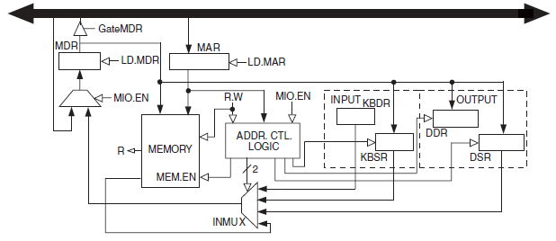
Reading KBSR
START LDI R1, KBSR
BRzp START ;Why zp?
LDI R0, KBDR
… more code …
KBSR .fill xFE00
KBDR .fill xFE02
The Address Control Logic recognizes xFE00 and kicks in.

Slide 7
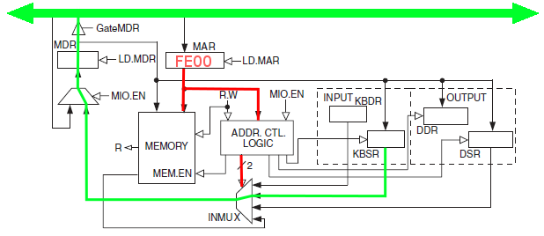
Reading KBSR
START LDI R1, KBSR
BRzp START ;Why zp?
LDI R0, KBDR
… more code …
KBSR .fill xFE00
KBDR .fill xFE02
The Address Control Logic recognizes xFE00 and kicks in.

Slide 8
Reading KBDR
START LDI R1, KBSR
BRzp START
LDI R0, KBDR
… more code …
KBSR .fill xFE00
KBDR .fill xFE02
The Address Control Logic recognizes xFE02 and kicks in.

Slide 9
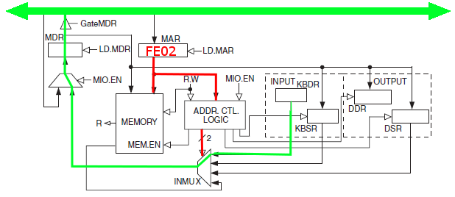
Reading KBDR
START LDI R1, KBSR
BRzp START
LDI R0, KBDR
… more code …
KBSR .fill xFE00
KBDR .fill xFE02
The Address Control Logic recognizes xFE02 and kicks in.

Slide 10
Display Interaction
Display Status Register
DSR
Address: FE04
DSR[15] is the "Ready Bit".
Display Data Register
DDR
Address: FE06
When a character is written to DDR
DSR[15] is set to 0
The hardware begins transfer of character to the Display
When the hardware is finished displaying the character DSR[15] is set to 1.

Slide 11
Reading DSR
START LDI R1, DSR
BRzp START
STI R0, DDR
… More code …
DSR .fill xFE04
DDR .fill xFE06
The Address Control Logic recognizes xFE04 and kicks in.

Slide 12
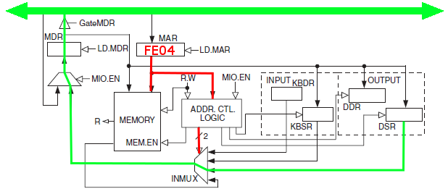
Reading DSR
START LDI R1, DSR
BRzp START
STI R0, DDR
… More code …
DSR .fill xFE04
DDR .fill xFE06
The Address Control Logic recognizes xFE04 and kicks in.

Slide 13
Writing DDR
START LDI R1, DSR
BRzp START
STI R0, DDR
… More code …
DSR .fill xFE04
DDR .fill xFE06
The Address Control Logic recognizes xFE06 and kicks in.

Slide 14
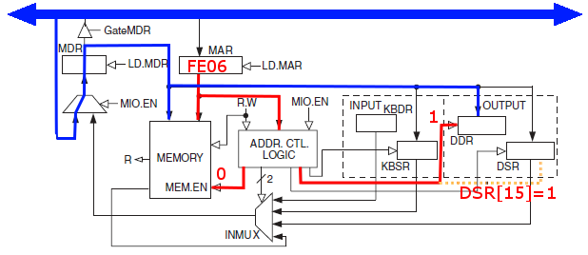
Writing DDR
START LDI R1, DSR
BRzp START
STI R0, DDR
… More code …
DSR .fill xFE04
DDR .fill xFE06
The Address Control Logic recognizes xFE06 and kicks in.

Slide 15
Interrupts
Why interrupt?
Processors are fast. I mean really fast. Think of the fastest thing you can think of seeing in the real world and computers are faster than that. Car crash? Faster.
Imagine a pitch at a baseball game. It seems to take many, many centuries to a computer for the ball to get to home plate.
So it is immensely boring to the computer (and wasteful) for it to sit around for centuries and wait for you to decide what key to hit next on the keyboard. Even if you type 100 words per minute, you would be boring your computer to tears (electronic tears of course).

Slide 16
Interrupts are Better
So, instead of waiting for you to type a key, the computer runs and does all the stuff it needs to keep your software running; games, music, spreadsheets, word documents, memory updates, temporary file storage, email checking, calendar checking, twitter updates, facebook updates, etc… AND when you type that key (finally!) you do the electronic version of tap the processor on the shoulder and say, "here is the next key I need you to process".
And it goes "Oh, OK" puts the key where it needs to go in a billionth of a second and goes on with its busy life until the next key.
So INPUT and OUTPUT (two very slow operations for the computer) are handled normally with interrupts.

Slide 17
What is an interrupt exactly?
An interrupt request is a special condition asking for attention.
The request is for the currently executing program to be suspended so that some OTHER code of importance can be run.
You are interrupting the normal execution cycle, turning execution over to a brand new program to do something specific like read a character.
Then, when the interrupt condition has been satisfied, the original, interrupted code will resume operation.
It is similar to a subroutine, but the current code could be interrupted ANYWHERE and the current code usually has no clue that it was in any way interrupted.
An interrupt has two parts
The interrupt signal.
The interrupt service routine.

Slide 18
Program A Interrupted
Program A is executing instruction n.
Program A is executing instruction n+1.
Interrupt detected
Program A suspended.
I/O program is executing instruction n.
I/O program is executing instruction n+1.
I/O program is executing instruction n+2.
I/O program is executing instruction n+3.
I/O program done.
Program A is reactivated. Program A has no clue it was interrupted.
Program A is executing instruction n+2.
Program A is executing instruction n+3.
Program A is executing instruction n+4.

Slide 19
Synchronicity and Polling
Asynchronous vs Synchronous
Synchronous
Type a character
Process a character
Type next character
Process next character
Etc…
Asynchronous
Get it done take as much time as you need.
Type a character and process it when ready.
Some way to communicate "done" needed (handshaking)
Polling vs Interrupt
Polling is when the processor repeats "Are you done yet" to the keyboard every few nanoseconds.
Interrupt is when the processor does its own thing and the keyboard will tell the processor "I am done" when it is ready.

Slide 20
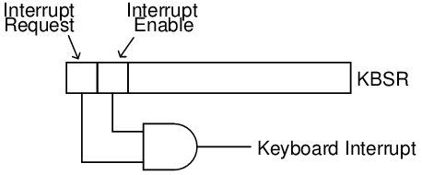
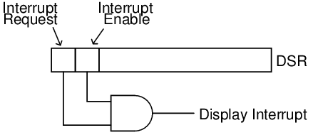
Enabling Interrupts
You must enable the interrupt.
Usually this means writing a 1 to the interrupt enable bit.
How can you set the interrupt enable bit without affecting anything else? How can you clear it?

Slide 21
Interrupt Priority
Some interrupts are more important than others.
An interrupt routine is a program like any other and can be interrupted.
How to prevent an important routine from interrupting a less important one?
Assign a priority.
Check to see if the interrupt request is of higher priority than the currently executing code.
If not continue with the current code.
If it is a higher priority, start executing the new interrupt code.

Slide 22
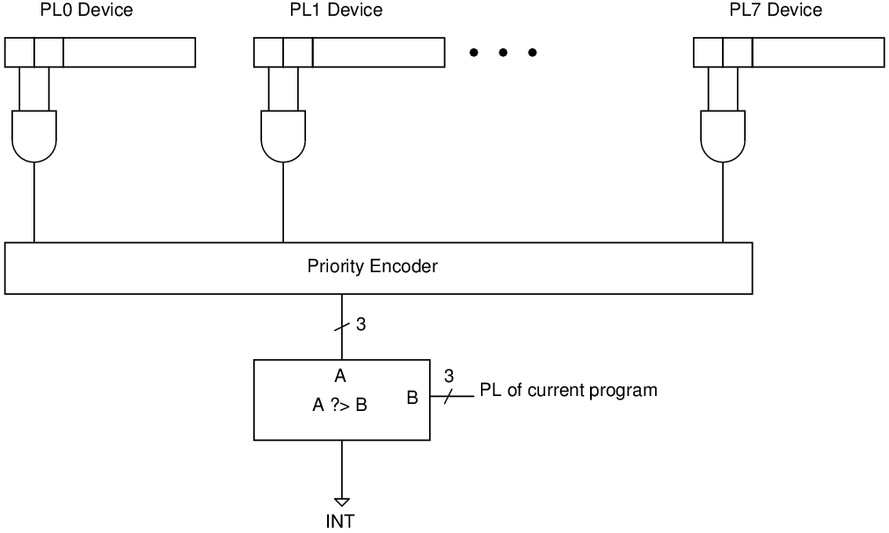
Interrupt Circuit

Slide 23
The Stack
A stack is a FILO storage medium.
Like coins in a coin storage device on a car.
You push the coin into the device.
When you pull a coin off of the device you get the last one you put in.
A stack is like that except the items don't move, only the pointer or address of the top of the stack moves.
We will use two stacks. One for general programs and one for supervisory programs.
The Supervisory Stack is needed for interrupts.

Slide 24
Stack Definitions
Stack pointer – the address of the last item added.
Most of the examples from the book reserve R6 for the stack pointer.
The stack starts at x4000 and moves up in memory.
Data is store in locations x3FFF to x3FFB
Push – Putting something on the stack.
Decrement the stack pointer.
Store data from R0 to memory references by the pointer.
Pop – Removing something from the stack
Take the value in the memory address of the stack pointer and put it into R0.
Increment the stack pointer.
Overflow – Trying to push too many things onto the stack.
Trying to put something past position x3FFB.
Underflow – Trying to pop too many things off of the stack.
Trying to pop memory location x4000.

Slide 25
Pushing and Popping (simple)
;Whatever address is in R6 will be where the stack
;is stored. The book uses x4000 -
PUSH ADD R6, R6, #-1
STR R0, R6, #0
RET
POP LDR R0, R6, #0
ADD R6, R6, #1
RET

Slide 26
Pushing 1
LD R0, A
JSR PUSH
LD R0, B
JSR PUSH
HALT
A .fill 45
B .fill 55
PUSH ADD R6, R6, #-1
STR R0, R6, #0
RET
Memory
Address | Data
3FFC
3FFD
3FFE
3FFF
4000
R0=45
R6=4000

Slide 27
Pushing 2
LD R0, A
JSR PUSH
LD R0, B
JSR PUSH
HALT
A .fill 45
B .fill 55
PUSH ADD R6, R6, #-1
STR R0, R6, #0
RET
Memory
Address | Data
3FFC
3FFD
3FFE
3FFF | 45
4000
R0=45
R6=3FFF

Slide 28
Pushing 3
LD R0, A
JSR PUSH
LD R0, B
JSR PUSH
HALT
A .fill 45
B .fill 55
PUSH ADD R6, R6, #-1
STR R0, R6, #0
RET
Memory
Address | Data
3FFC
3FFD
3FFE
3FFF | 45
4000
R0=55
R6=3FFF

Slide 29
Pushing 4
LD R0, A
JSR PUSH
LD R0, B
JSR PUSH
HALT
A .fill 45
B .fill 55
PUSH ADD R6, R6, #-1
STR R0, R6, #0
RET
Memory
Address | Data
3FFC
3FFD
3FFE | 55
3FFF | 45
4000
R0=55
R6=3FFE

Slide 30
Popping 1
JSR POP
JSR POP
HALT
POP LDR R0, R6, #0
ADD R6, R6, #1
RET
Memory
Address | Data
3FFC
3FFD
3FFE | 55
3FFF | 45
4000
R0=55
R6=3FFE

Slide 31
Popping 2
JSR POP
JSR POP
HALT
POP LDR R0, R6, #0
ADD R6, R6, #1
RET
Can I pop again?
Memory
Address | Data
3FFC
3FFD
3FFE | 55
3FFF | 45
4000
R0=45
R6=3FFE

Slide 32
Pop with Underflow
;R0 will contain data item popped
;R5 will contain 0 if pop OK and will contain 1 on underflow.
;Note caller must save R0 and R5 if needed.
;Also note that for brevity, the following code does not (but should) save and restore R1 and R2.
POP LD R1, EMPTY ;load –x4000
ADD R2, R6, R1 ;if R6 == x4000 nothing to pop.
BRZ POPFAIL
LDR R0, R6, #0 ;Move data from stack to R0
ADD R6, R6, #1 ;Increment stack pointer
AND R5, R5, #0 ;Set status to 0 for OK
RET
POPFAIL AND R5, R5, #0 ;Clear status register R5
ADD R5, R5, #1 ;Set status to 1 for underflow
RET
EMPTY .FILL xC000 ;xC000 = -x4000

Slide 33
Push with Overflow
;R0 will contain data item to store on stack
;R5 will contain 0 if push OK and will contain 1 on overflow.
;Note caller must save R5 if needed.
;Also note that for brevity, the following code does not (but should) save and restore R1 and R2.
PUSH LD R1, MAX
ADD R2, R6, R1
BRZ PUSHFAIL
ADD R6, R6, #-1
STR R0, R6, #0
AND R5, R5, #0
RET
PUSHFAIL AND R5,R5, #1
ADD R5, R5, #1
RET
MAX .FILL XC005 ;xC005 = -x3ffb (max stack address)

Slide 34
Push and Pop and R0
Notice that push and pop only save R0.
That means to save all registers, they must be moved to R0 one at a time then pushed.
To reload all registers you must pop, then clear the specific register then move the data from R0 to the reloaded register.
A memory consuming, but easier process would be to have a push and pop for each register.
PUSHR0, POPR0, PUSHR1, POPR1, etc…

Slide 35
Back to Interrupts
An interrupt has two pieces.
The interrupt request and process switch. This part is controlled by the processor.
Save PC.
Save program state.
Start the interrupt service routine.
The code that will handle the interrupt also known as the Interrupt Service Routine.

Slide 36
PSR – Process Status Register
Since the interrupted program doesn't even know it was interrupted, what does that mean for the NZP flags?
The PSR
Contains the NZP flags.
Contains current programs priority.
Contains privilege bit.
This information must be saved and restored by the interrupt routine as well as registers.
15 | 14 | 13 | 12 | 11 | 10 | 9 | 8 | 7 | 6 | 5 | 4 | 3 | 2 | 1 | 0
PR |  |  |  |  | PL |  |  |  |  |  |  |  | N | Z | P

Slide 37
Switching Processes
A process is a separate program running in memory, like running a word processor and playing music.
The computer switches between the processes very fast to give the illusion of continuity, but it only runs one process at a time.
A "context switch" is saving ALL of the information about one process before starting another so that the first can be returned to with no ill effects.
An interrupt is a separate process.
We must save the state of the interrupted program.
Save PC (push onto stack)
Save PSR (push onto stack)
Other registers should be saved inside of the service routine for the interrupt.

Slide 38
Process Switching Vulnerability
If any process has access to other process saved data, there is a chance for shenanigans.
A process could pop another processes data from the stack, modify it, and push it back.
Elevated privilege (supervisor or administrator mode) prevents these issues.
Process switching uses a special supervisor stack that can only be accessed if the elevated privilege bit (PR) is set in the PSR.

Slide 39
Two Stacks
User Stack – General use by programs.
Supervisor Stack –
Used any time that PR is set. When running as administrator you never want to share a stack with general program.
Can only be accessed in administrator mode.
R6 is used for both stack pointers. So they have to be switched when elevating privileges.

Slide 40
Process Privilege
Interrupt processing
Saves current PSR & PC.
Sets PR bit.
User Stack Pointer - Saves R6 to special register (Saved.USP)
(Service Stack Pointer) Loads R6 from special register (Saved.SSP) into R6.
Saves interrupted PSR to Service Stack
Saves interrupted PC to Service Stack
Returning from interrupt must restore PC and PSR as an elevated program.
RTI instruction – Return from interrupt handles restoring of PC and PSR
This is why we need RTI and cant use RET.

Slide 41
Returning
Uses RTI instead of RET
Need to restore flags
Need to restore previous priority level
Need to restore program counter

Slide 42
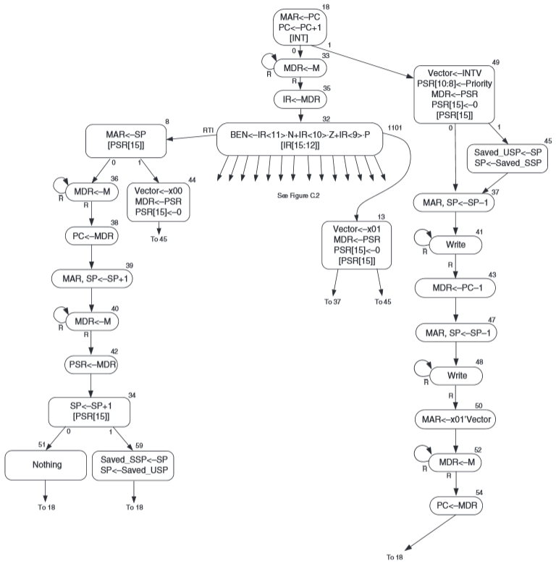

Slide 43
Vectors
Trap Vectors |  |  |  | Interrupt Vectors
Memory Location | Value Stored |  |  | Memory Location | Value Stored
x0020 | x0400 |  |  | X0101 | Keyboard Routine Address
x0021 | x0430 |  |  | X0102 | Mouse Routine Address
x0022 | x0450 |  |  | X0103 | Display Routine Address
x0023 | x04A0 |  |  | X0104 | Memory Routine Address
x0024 | x04E0 |  |  | X0105 | Hard Drive Routine Address
x0025 | xFD70
A vector is an array of addresses.
There is some way to figure out which one to use depending on the application.

Slide 44
Add your own traps
In the instruction TRAP x20 or F020 the hex value 20 is the trap vector.
x20 is the address of the address of the start of the subroutine for handling the trap.
If you want to add a new trap do the following
Assume we want to add TRAP x30
Write your subroutine and store it in memory somewhere.
Put the address of the start of your subroutine into memory location x30
Use F030 as an assembly instruction. It will run the subroutine you created.
Note that the subroutine and the trap vector should be added to the operating system file (lc3os.obj) to ensure it is always present.

Slide 45
External Libraries and Linking
Rewriting code is wasteful and sometimes hard.
Example: Square Roots – Wouldn't it be nice to use someone else's code?
External libraries are a normal part of programming.
How does it work in machine language?

Slide 46
.EXTERNAL
Assembler directive or pseudo-op which tells the assembler an external reference is being made.
The value for SQRT will be filled in later
.EXTERNAL SQRT
… code
… code
… code
LD R4, BASE
JSRR R4
… code
… code
HALT
;Data
BASE .fill SQRT

Slide 47
The Linker
The object files are assembled independently
The linker builds the executable image from the object files.
User programs included
Library files included
The linker inserts all of the .EXTERNAL references.

Slide 48
Build an Executable
Module A
Object Code
Link
Executable
Image
Symbol Table
for Module A
Initialization
.EXTERNAL SQRT
… code
… code
… code
LD R4, BASE
JSRR R4
… code
… code
HALT
;Data
BASE .fill SQRT
Module A
Math Library
Object Code
Math Library
Symbol Table
for Math
Other
Other
Object Code
Symbol Table
for Other

Slide 49
Linking Example
Module A starts at x3000.
Module A is x140 words long.
The label BASE in Module A is at position x3135.
SQRT is x310 words into the Math Library.
SQRT address in the executable image is x3450
The linker will put x3450 at memory location x3135

Slide 50
Activation Records
Parameter passing and returns using the stack.
Every time a method is called a new activation record is created.
An activation record stores
arguments
local variables
return values
return address

Slide 51
A simple C program
int main(){
int a = 1;
int b;
b = watt(a);
b = volta(a, b);
}
int watt(int a){
int w;
w = volta(w, 10);
return w;
}
int volta(int q, int r) {
int k;
int m;
return k;
}
The Stack
Activation Record for main

Slide 52
A simple C program
int main(){
int a;
int b;
b = watt(a);
b = volta(a, b);
}
int watt(int a){
int w;
w = volta(w, 10);
return w;
}
int volta(int q, int r) {
int k;
int m;
return k;
}
The Stack
Activation Record for watt
Activation Record for main

Slide 53
A simple C program
int main(){
int a;
int b;
b = watt(a);
b = volta(a, b);
}
int watt(int a){
int w;
w = volta(w, 10);
return w;
}
int volta(int q, int r) {
int k;
int m;
return k;
}
The Stack
Activation Record for volta
Activation Record for watt
Activation Record for main

Slide 54
A simple C program
int main(){
int a;
int b;
b = watt(a);
b = volta(a, b);
}
int watt(int a){
int w;
w = volta(w, 10);
return w;
}
int volta(int q, int r) {
int k;
int m;
return k;
}
The Stack
Activation Record for watt
Activation Record for main

Slide 55
A simple C program
int main(){
int a;
int b;
b = watt(a);
b = volta(a, b);
}
int watt(int a){
int w;
w = volta(w, 10);
return w;
}
int volta(int q, int r) {
int k;
int m;
return k;
}
The Stack
Activation Record for main

Slide 56
A simple C program
int main(){
int a;
int b;
b = watt(a);
b = volta(a, b);
}
int watt(int a){
int w;
w = volta(w, 10);
return w;
}
int volta(int q, int r) {
int k;
int m;
return k;
}
The Stack
Activation Record for volta
Activation Record for main

Slide 57
A simple C program
int main(){
int a;
int b;
b = watt(a);
b = volta(a, b);
}
int watt(int a){
int w;
w = volta(w, 10);
return w;
}
int volta(int q, int r) {
int k;
int m;
return k;
}
The Stack
Activation Record for main

Slide 58
Activation Record Details
The top of the stack is stored in R6
Caller
Push arguments onto stack
JSR to Subroutine
Callee starting
Save space on stack for return value (but only if needed)
Push a copy of the return address (R7)
Push a copy of the callers frame pointer (R5)
A frame pointer is the start of the local variables
Push local variables onto the stack
Callee ending
Write the return value to the activation record if necessary
Pop all local variables
Restore the dynamic link (R5)
Restore the return address (R7)
Return
Caller
Pop return value
Pop parameters

Slide 59
Frame Pointer
R5 is used as the Frame Pointer or Dynamic Link.
This is the first local variable stored in the activation record.
Must be saved so it can be restored when returning from another function.

Slide 60
Calling volta from watt
;w = volta(w, 10)
AND R0, R0, #0 ;R0 <- 0
ADD R0, R0, #10 ;R0 <- 10
ADD R6, R6, #-1 ;Move stack pointer
STR R0, R6, #0 ;Push 10
LDR R0, R5, #0 ;Why R5?
ADD R6, R6, #-1 ;Move stack pointer
STR R0, R6, #0 ;Push w
JSR volta

Slide 61
At the top of volta
volta
ADD R6, R6, #-1 ;Save space for ret
ADD R6, R6, #-1 ;
STR R7, R6, #0 ;Save caller return addr
ADD R6, R6, #-1 ;
STR R5, R6, #0 ;Save caller FP
ADD R5, R6, #-1 ;Set new FP
ADD R6, R6, #-2 ; save space for 2 locals

Slide 62
End of volta
LDR R0, R5, #0 ; load local k
STR R0, R5, #3 ; write to return
ADD R6, R5, #1 ; POP local vars
LDR R5, R6, #0 ; POP FP
ADD R6, R6, #1
LDR R7, R6, #0 ; POP return address
ADD R6, R6, #1
RET

Slide 63
watt after volta
JSR volta
LDR R0, R6, #0 ; Load the return value
STR R0, R5, #0 ; save to w (why R5?)
ADD R6, R6, #1
ADD R6, R6, #2 ; pop arguments

Slide 64
A simple C program
The Stack
int main(){
int a = 1;
int b;
b = watt(a);
b = volta(a, b);
}
int watt(int c){
int w;
w = volta(w, 10);
return w;
}
int volta(int q, int r) {
int k;
int m;
return k;
}
ADD R5, R6, #-1
ADD R6, R6, #-2
AND R0, R0, #0
ADD R0, R0, #1
STR R0, R5, #0
R6
b
a(1)
R5
Original R6

Slide 65
A simple C program
The Stack
int main(){
int a = 1;
int b;
b = watt(a);
b = volta(a, b);
}
int watt(int c){
int w;
w = volta(w, 10);
return w;
}
int volta(int q, int r) {
int k;
int m;
return k;
}
ADD R5, R6, #-1
ADD R6, R6, #-2
AND R0, R0, #0
ADD R0, R0, #1
STR R0, R5, #0
ADD R6, R6, #-1
STR R0, R6, #0
JSR watt
R6
c(1)
b
a(1)
R5
Original R6

Slide 66
A simple C program
The Stack
int main(){
int a = 1;
int b;
b = watt(a);
b = volta(a, b);
}
int watt(int c){
int w;
w = volta(w, 10);
return w;
}
int volta(int q, int r) {
int k;
int m;
return k;
}
ADD R6, R6, #-1
ADD R6, R6, #-1
STR R7, R6, #0
ADD R6, R6, #-1
STR R5, R6, #0
ADD R5, R6, #-1
ADD R6, R6, #-1
R6
w
watt AR
R5
old FP
return addr
return value
Orig R6
c(1)
b
main AR
a(1)
R5 Orig

Slide 67
A simple C program
The Stack
int main(){
int a = 1;
int b;
b = watt(a);
b = volta(a, b);
}
int watt(int c){
int w;
w = volta(w, 10);
return w;
}
int volta(int q, int r) {
int k;
int m;
return k;
}
AND R0, R0, #0
ADD R0, R0, #10
ADD R6, R6, #-1
STR R0, R6, #0
LDR R0, R5, #0
ADD R6, R6, #-1
STR R0, R6, #0
JSR volta
R6
q(value of w)
r(10)
Orig R6
w
watt AR
R5
old FP
return addr
return value
c(1)
b
main AR
a(1)
R5 Orig

Slide 68
A simple C program
R6
m
ADD R6, R6, #-1
ADD R6, R6, #-1
STR R7, R6, #0
ADD R6, R6, #-1
STR R5, R6, #0
ADD R5, R6, #-1
ADD R6, R6, #-2
volta AR
int main(){
int a = 1;
int b;
b = watt(a);
b = volta(a, b);
}
int watt(int c){
int w;
w = volta(w, 10);
return w;
}
int volta(int q, int r) {
int k;
int m;
return k;
}
k
R5
old FP
return addr
return value
Orig R6
q(value of w)
r(10)
w
watt AR
R5 Orig
old FP
return addr
return value
c(1)
b
main AR
a(1)

Slide 69
A simple C program
R6
m
ADD R6, R6, #-1 ;OrigR6 space for return value
ADD R6, R6, #-1 ;Return address
STR R7, R6, #0
ADD R6, R6, #-1
STR R5, R6, #0
ADD R5, R6, #-1
ADD R6, R6, #-2
volta AR
k
R5
old FP
return addr
return value
Orig R6
q(value of w)
r(10)
w
watt AR
R5 Orig
old FP
return addr
return value
c(1)
b
main AR
a(1)

Slide 70
A simple C program
R6
m
ADD R6, R6, #-1
ADD R6, R6, #-1
STR R7, R6, #0
ADD R6, R6, #-1
STR R5, R6, #0
ADD R5, R6, #-1
ADD R6, R6, #-2
LDR R0, R5, #0
STR R0, R5, #3
ADD R6, R5, #1
LDR R5, R6, #0
ADD R6, R6, #1
LDR R7, R6, #0
ADD R6, R6, #1
RET
volta AR
int main(){
int a = 1;
int b;
b = watt(a);
b = volta(a, b);
}
int watt(int c){
int w;
w = volta(w, 10);
return w;
}
int volta(int q, int r) {
int k;
int m;
return k;
}
k
R5
old FP
return addr
return value
Orig R6
q(value of w)
r(10)
watt AR
w
R5 Orig
old FP
return addr
return value
c(1)
b
main AR
a(1)

Slide 71
A simple C program
R6
m
ADD R6, R6, #-1
ADD R6, R6, #-1
STR R7, R6, #0
ADD R6, R6, #-1
STR R5, R6, #0
ADD R5, R6, #-1
ADD R6, R6, #-2
LDR R0, R5, #0 ;R0 <-Value stored in k (m?)
STR R0, R5, #3 ;Put k value into return value
ADD R6, R5, #1 ;Pop all local variables
LDR R5, R6, #0 ;Restore watt FP
ADD R6, R6, #1 ;Pop
LDR R7, R6, #0 ;Load return address
ADD R6, R6, #1 ;Pop
RET ;Note that top of stack is now
;return value. Watt can read
;value and then Pop it and
;also pop voltas parameters.
volta AR
k
R5
old FP
return addr
return value
Orig R6
q(value of w)
r(10)
watt AR
w
R5 Orig
old FP
return addr
return value
c(1)
b
main AR
a(1)

Slide 72
A simple C program
R6
m
volta AR
k
R5
volta variables
k = R5, #0 (first declared variable)
m = R5, #-1(second dec variable)
? = R5, #-2 (_____________)
other values
old FP = R5, #1
return address = R5, #2
return value = R5, #3
old FP
return addr
return value
Orig R6
q(value of w)
r(10)
watt AR
w
R5 Orig
old FP
return addr
return value
c(1)
b
main AR
a(1)

Slide 73
A simple C program
R6
m
ADD R6, R6, #-1
ADD R6, R6, #-1
STR R7, R6, #0
ADD R6, R6, #-1
STR R5, R6, #0
ADD R5, R6, #-1
ADD R6, R6, #-2
LDR R0, R5, #0
ADD R0, R5, #-1
STR R0, R5, #3
ADD R6, R5, #1
LDR R5, R6, #0
ADD R6, R6, #1
LDR R7, R6, #0
ADD R6, R6, #1
RET
volta AR
int main(){
int a = 1;
int b;
b = watt(a);
b = volta(a, b);
}
int watt(int c){
int w;
w = volta(w, 10);
return w;
}
int volta(int q, int r) {
int k;
int m;
return k + m;
}
k
R5
old FP
return addr
return value
Orig R6
q(value of w)
r(10)
watt AR
w
R5 Orig
old FP
return addr
return value
c(1)
b
main AR
a(1)

Slide 74
Show all of the values in memory after the program finishes.
main starts at x3000
fun1 is at x300A
fun2 is at x300D
the stack is at x4000
int main()
{
int a = 1;
a = fun1(1, 2, 3);
}
int fun1(int a, int b, int c)
{
int x = 5;
fun2(b);
return x + a + b + c;
}
void fun2(int m)
{
int a = m;
int b = a + m;
}
X3FF1
X3FF2
X3FF3
X3FF4
X3FF5
X3FF6
X3FF7
X3FF8
X3FF9
X3FFA
X3FFB
X3FFC
X3FFD
X3FFE
X3FFF | (a from main) 1
X4000

Slide 75
Show all of the values in memory after the program finishes.
main starts at x3000
fun1 is at x300A
fun2 is at x300D
the stack is at x4000
int main()
{
int a = 1;
a = fun1(1, 2, 3);
fun2(5);
}
int fun1(int a, int b, int c)
{
int x = 5;
return x + a + b + c;
}
void fun2(int m)
{
int a = m;
int b = a + m;
}
X3FF1
X3FF2
X3FF3
X3FF4
X3FF5
X3FF6
X3FF7
X3FF8
X3FF9
X3FFA
X3FFB
X3FFC
X3FFD
X3FFE
X3FFF | (a from main) 1
X4000

