Slide 1
CO Sensor Lab Evaluations - Group 1
Put in the QuantAQs, LASCARS, and BlueSkys in the Environmental Test Chamber in D566. QuantAQs maxed out at 10-12ppm so data is cut off in the concentration ramps (Test 1 & 4) and the effect of T and RH at 10ppm (Test 3). LASCARS ended up dying before the tests started so are not shown in the plots.
06/26/24 - 07/02/24
Menaka Kumar

Slide 2
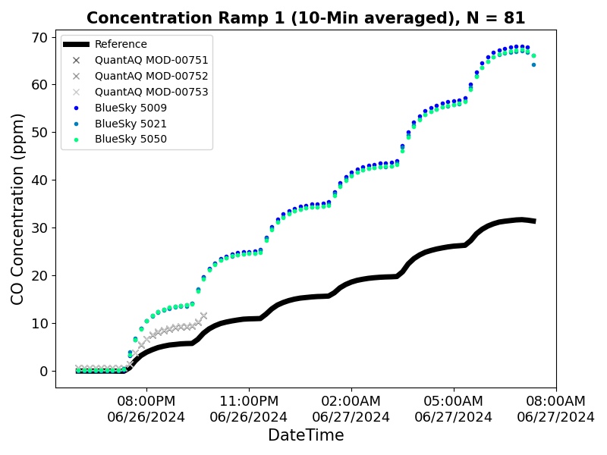
Test 1 – Concentration Ramp (0-30ppm)
Target CO Concentration (ppm)
0
5
10
15
20
25
30
T = 25°C and RH = 35%

Slide 3
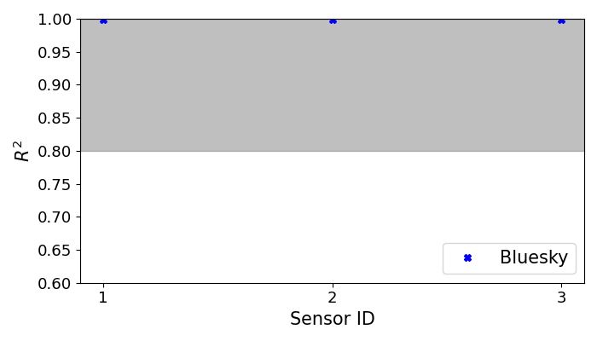
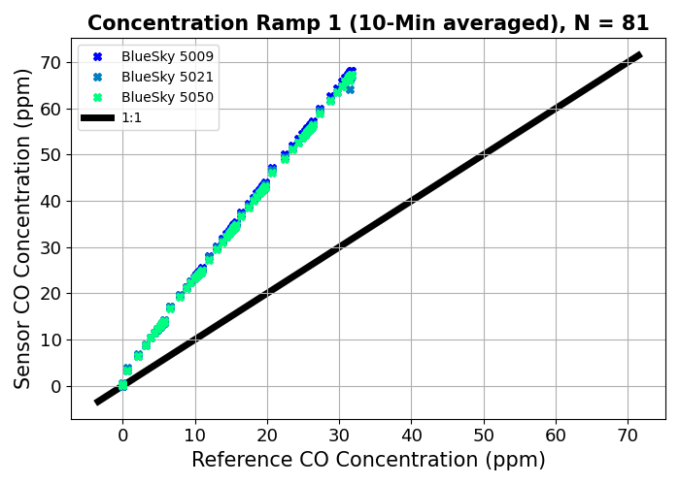
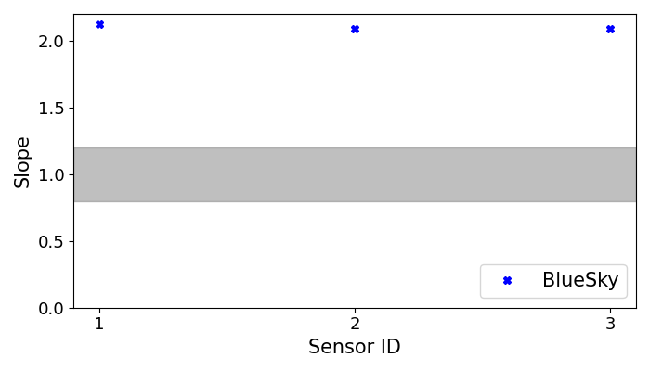
Test 1 – Concentration Ramp (0-30ppm)

Slide 4
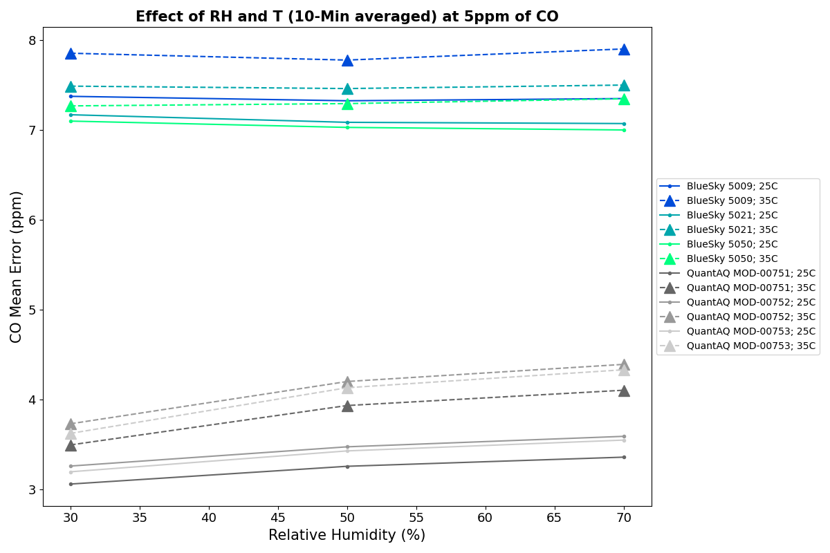
Test 2 – Effect of T and RH at 5ppm
​ | Low RH​ | Medium RH​ | High RH​
Medium T​ | 25°C​ 30%​ | 25°C​ 50%​ | 25°C​ 70%​
High T​ | 35°C​ 30%​ | 35°C​ 50%​ | 35°C​ 70%​

Slide 5
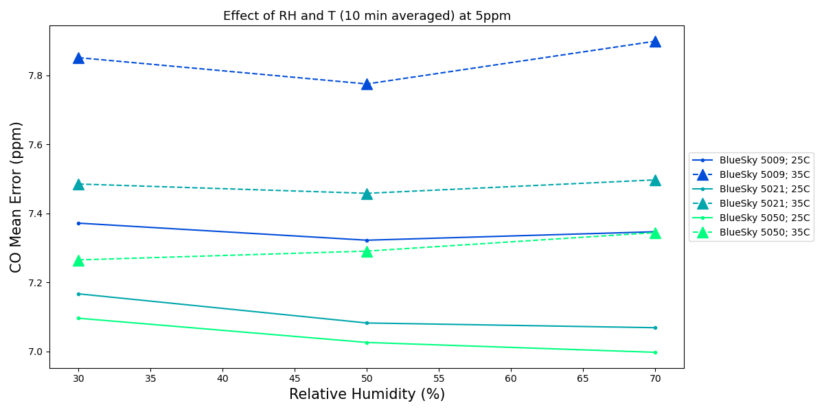
Test 2 – Effect of T and RH at ~5ppm

Slide 6
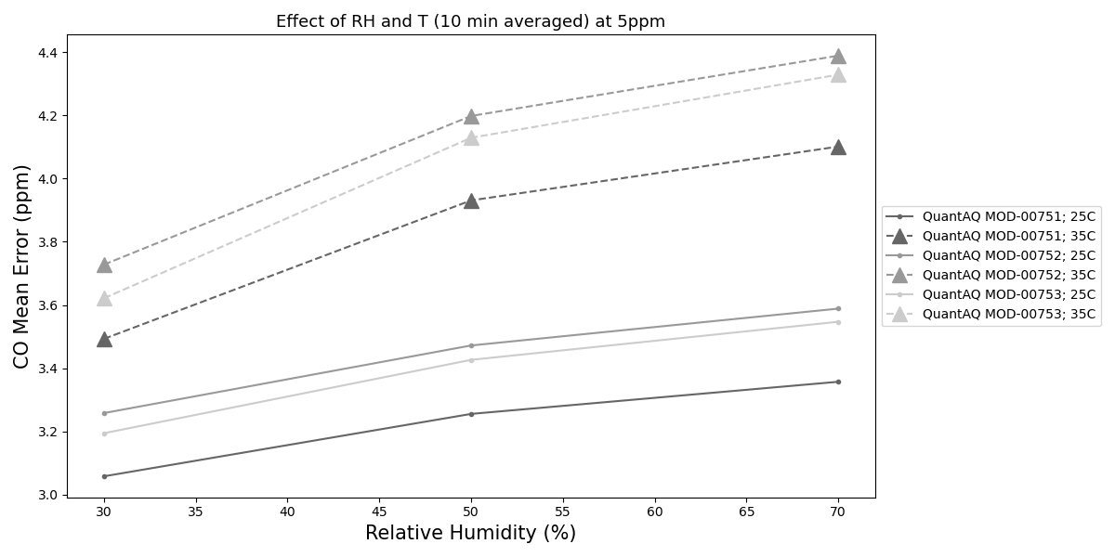
Test 2 – Effect of T and RH at ~5ppm

Slide 7
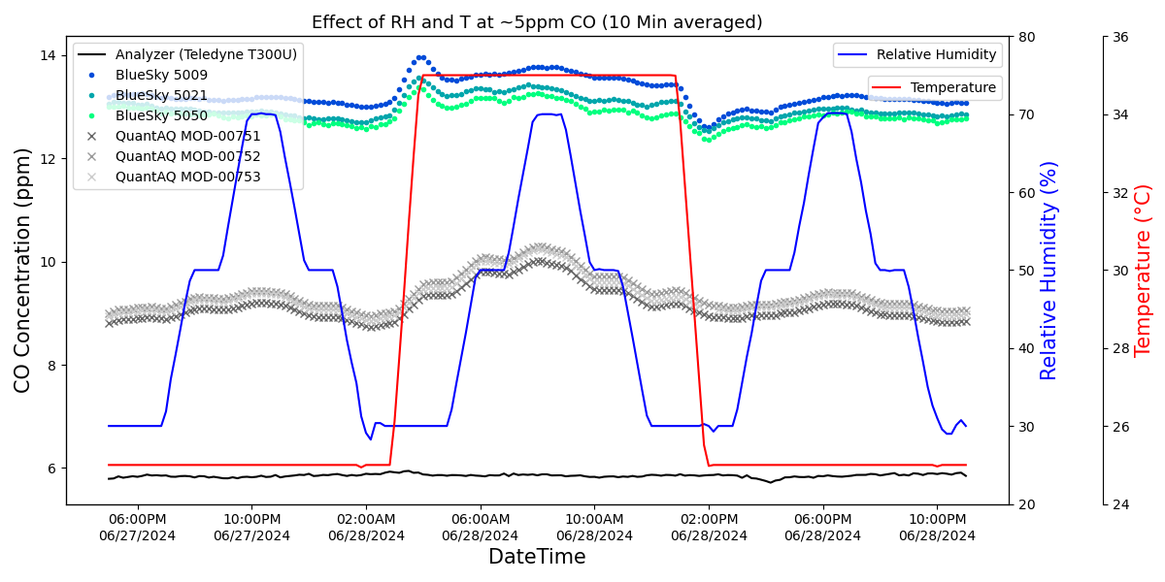
Test 2 – Effect of T and RH at 5ppm

Slide 8
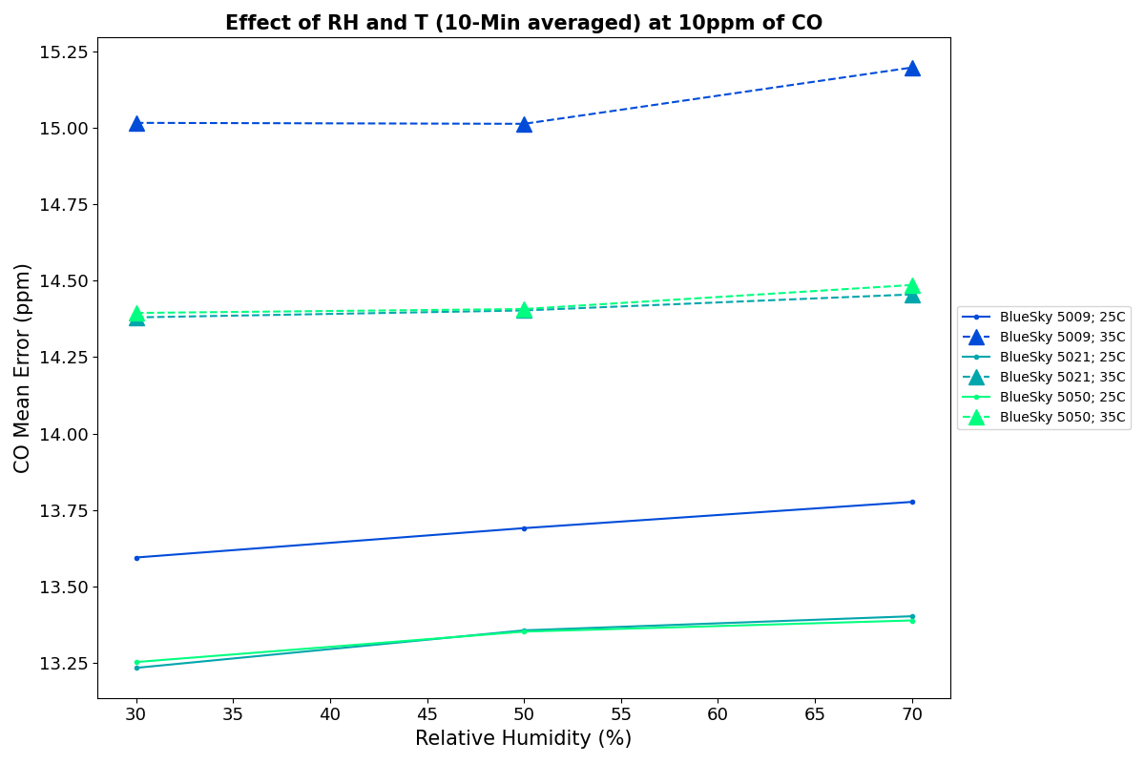
Test 3 – Effect of T and RH at ~10ppm
​ | Low RH​ | Medium RH​ | High RH​
Medium T​ | 25°C​ 30%​ | 25°C​ 50%​ | 25°C​ 70%​
High T​ | 35°C​ 30%​ | 35°C​ 50%​ | 35°C​ 70%​

Slide 9
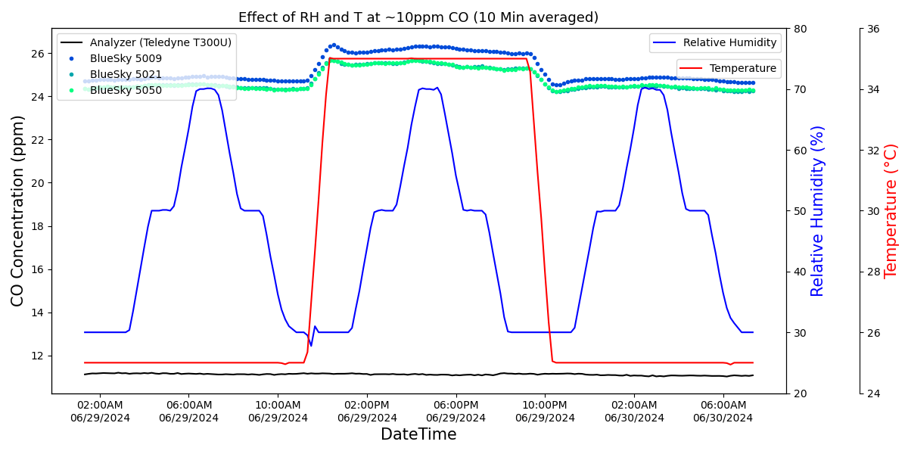
Test 3 – Effect of T and RH at ~10ppm

Slide 10
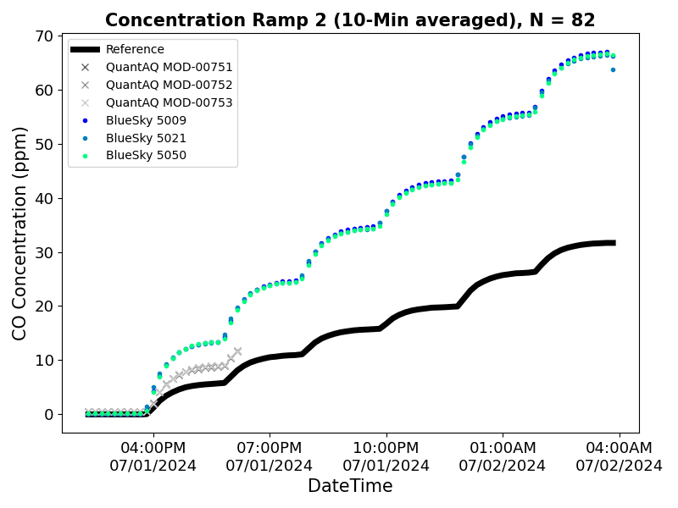
Test 4 – Concentration Ramp Repeat (0-30ppm)
Target CO Concentration (ppm)
0
5
10
15
20
25
30
T = 25°C and RH = 35%

Slide 11
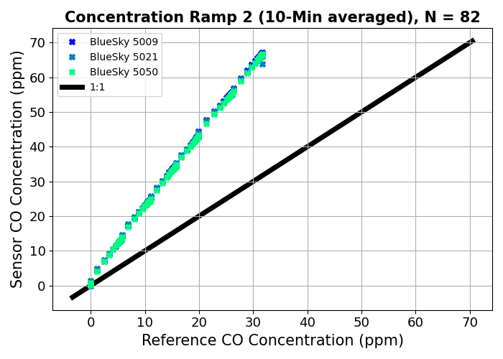

Test 4 – Concentration Ramp Repeat (0-30ppm)

