Slide 1
CO Sensor Lab Evaluations - Group 2
Put in 3 Canarys, 3 LASCARS, and 1 VAMMS in the Environmental Test Chamber in D566. Two of the Canarys were not able to get online and the data from the SD cards did not have CO data. So, only data from 1 canary is shown but it went offline before test 4 so it not shown in test 4.
07/03/24 - 07/10/24
Menaka Kumar

Slide 2
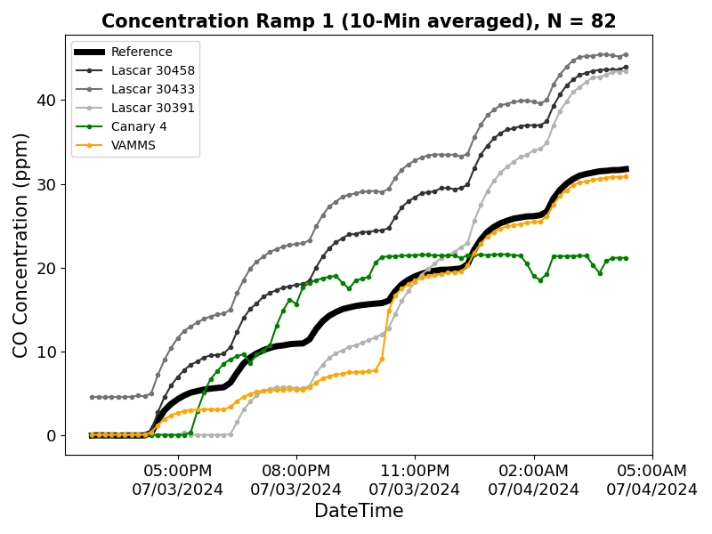
Test 1 – Concentration Ramp (0-30ppm)
Target CO Concentration (ppm)
0
5
10
15
20
25
30
T = 25°C and RH = 35%

Slide 3
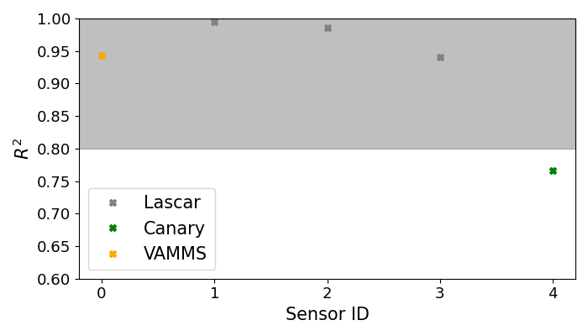
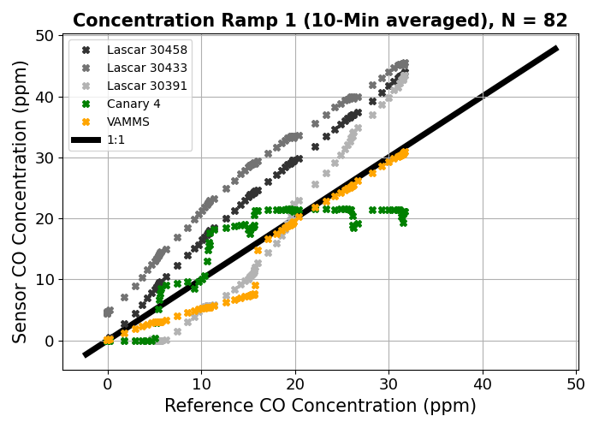
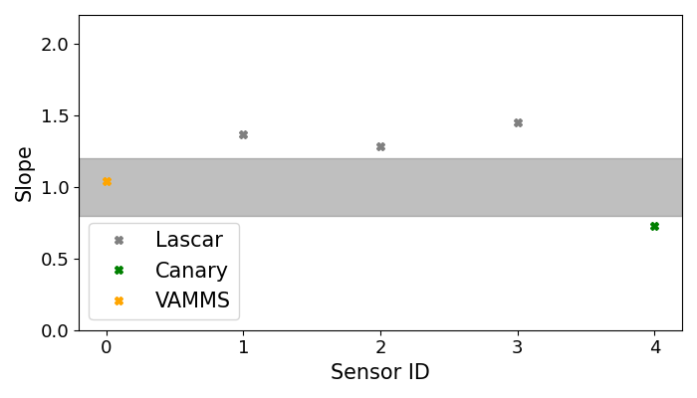
Test 1 – Concentration Ramp (0-30ppm)

Slide 4
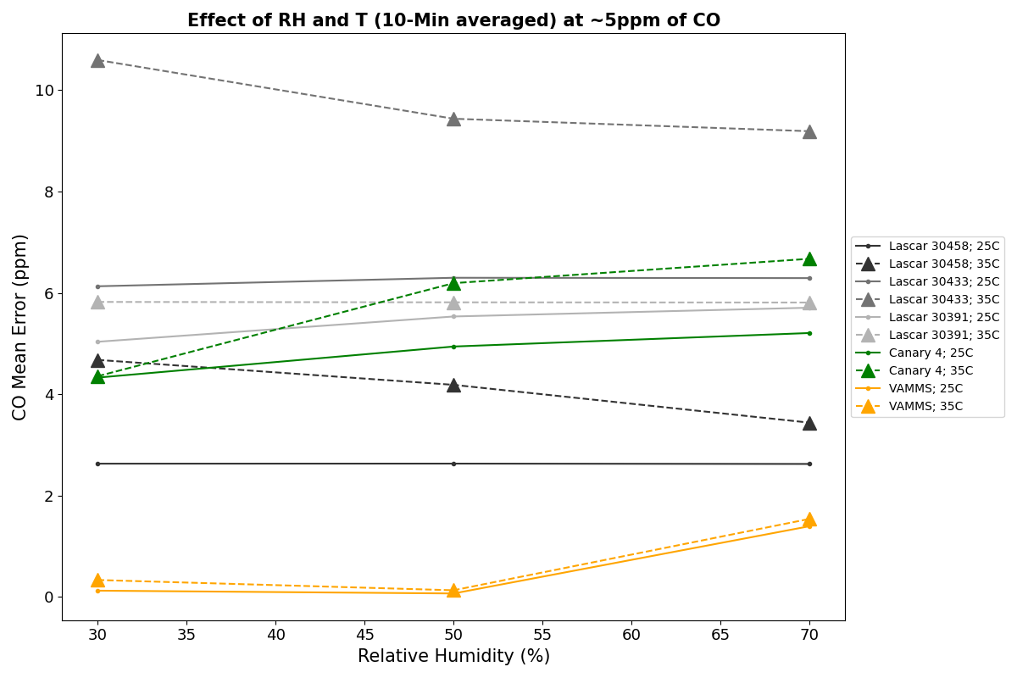
Test 2 – Effect of T and RH at ~5ppm
​ | Low RH​ | Medium RH​ | High RH​
Medium T​ | 25°C​ 30%​ | 25°C​ 50%​ | 25°C​ 70%​
High T​ | 35°C​ 30%​ | 35°C​ 50%​ | 35°C​ 70%​

Slide 5
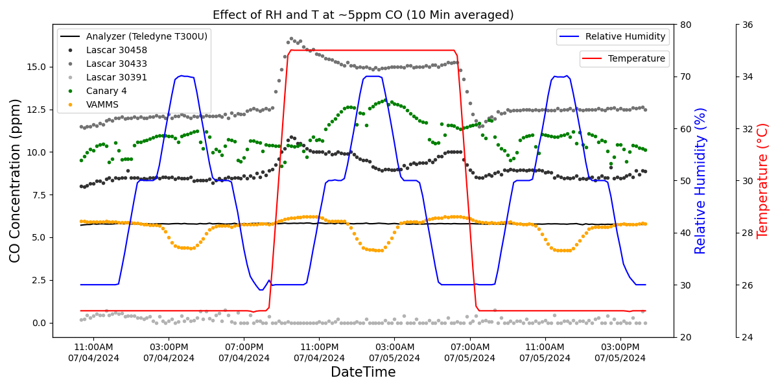
Test 2 – Effect of T and RH at ~5ppm

Slide 6
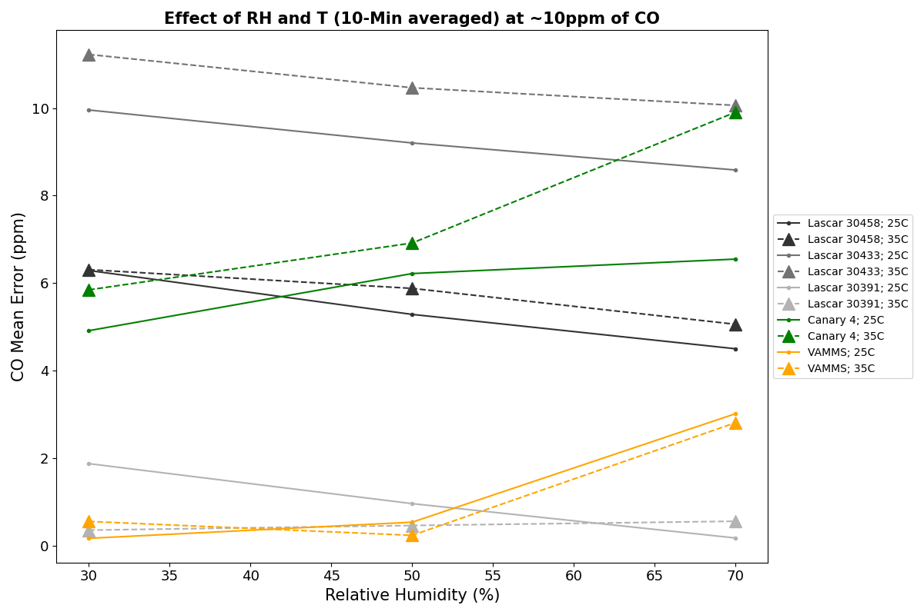
Test 3 – Effect of T and RH at ~10ppm
​ | Low RH​ | Medium RH​ | High RH​
Medium T​ | 25°C​ 30%​ | 25°C​ 50%​ | 25°C​ 70%​
High T​ | 35°C​ 30%​ | 35°C​ 50%​ | 35°C​ 70%​

Slide 7
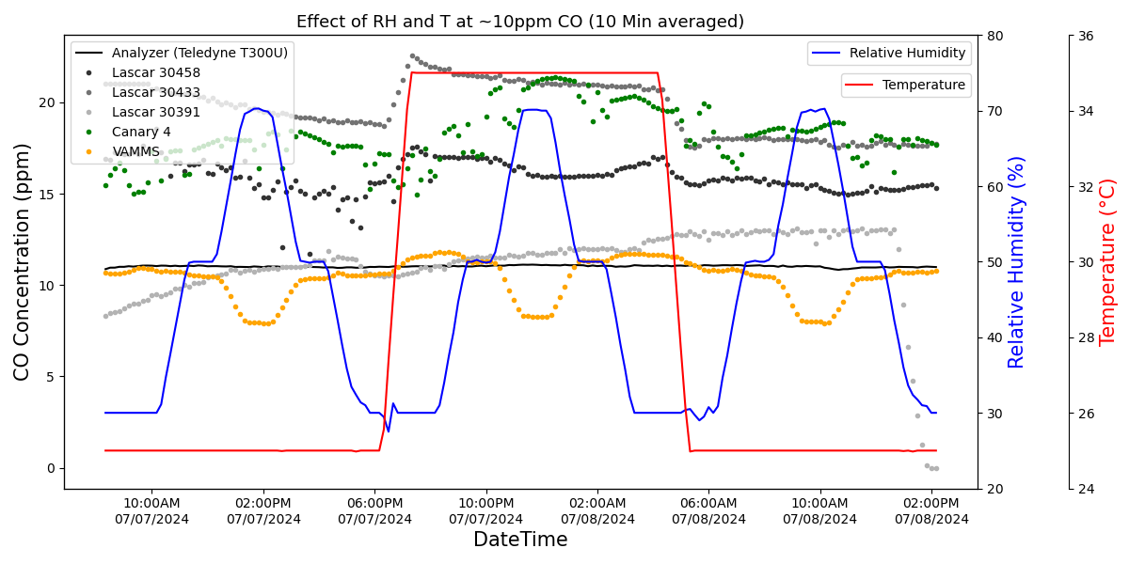
Test 3 – Effect of T and RH at ~10ppm

Slide 8
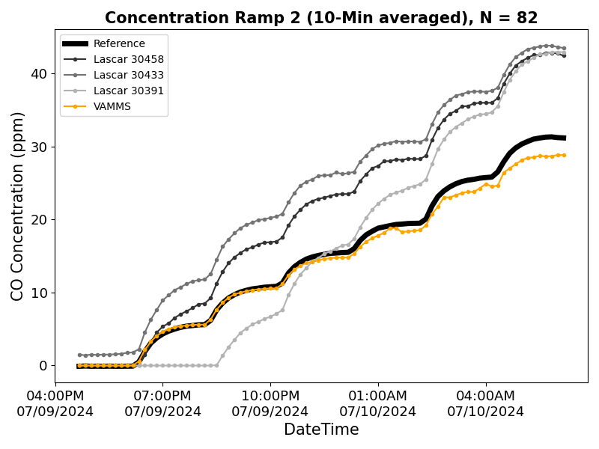
Test 4 – Concentration Ramp Repeat (0-30ppm)
Target CO Concentration (ppm)
0
5
10
15
20
25
30
T = 25°C and RH = 35%

Slide 9
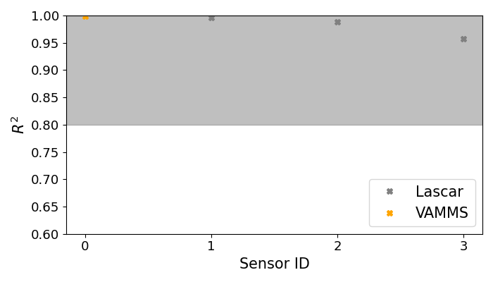
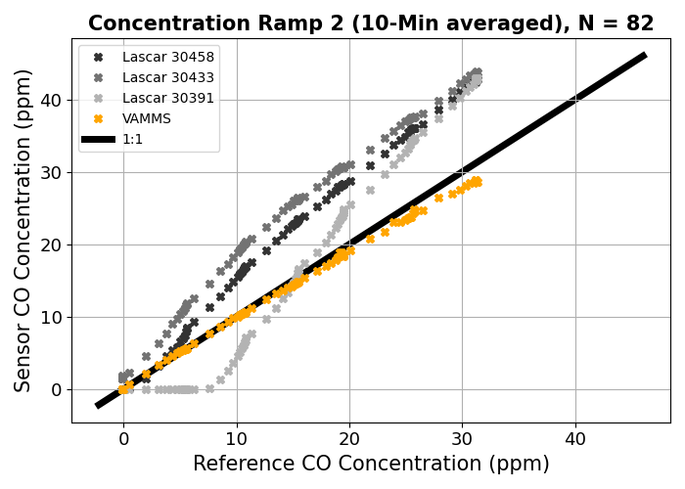
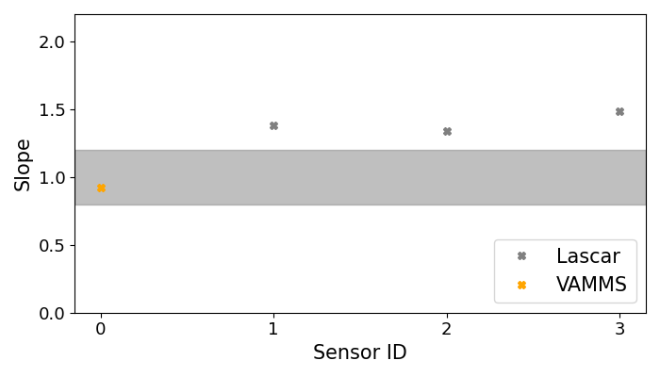
Test 4 – Concentration Ramp Repeat (0-30ppm)

