Slide 1
CO Sensor Lab Evaluations - Group 3
Put in 3 QuantAQs and ran them at lower concentrations (0-10ppm) - since from the group1 testing I saw that they maxed out at about 10-12ppm and then I would get an error on the QuantAQ dashboard that the sensor device health “needs attention” and then would not record any data during this period. Sometimes the QuantAQs would not record data and that can be seen on the plots with gaps during some periods.
08/02/24 - 08/13/24
Menaka Kumar

Slide 2
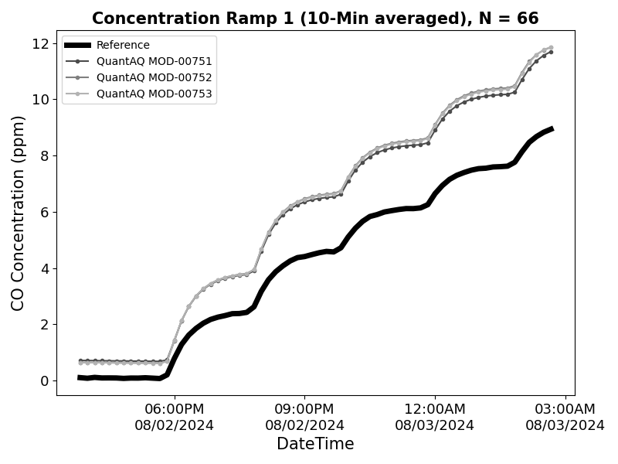
Test 1 – Concentration Ramp (0-10ppm)
Target CO Concentration (ppm)
0
2
4
6
8
10
T = 25°C and RH = 35%

Slide 3
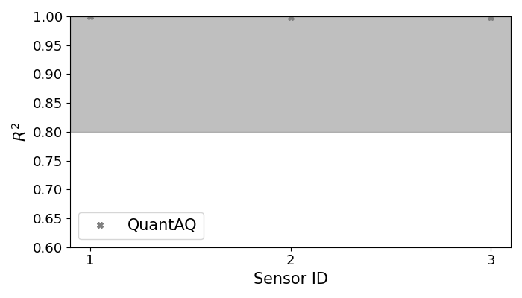
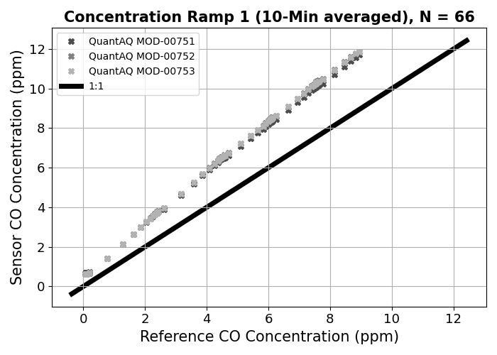
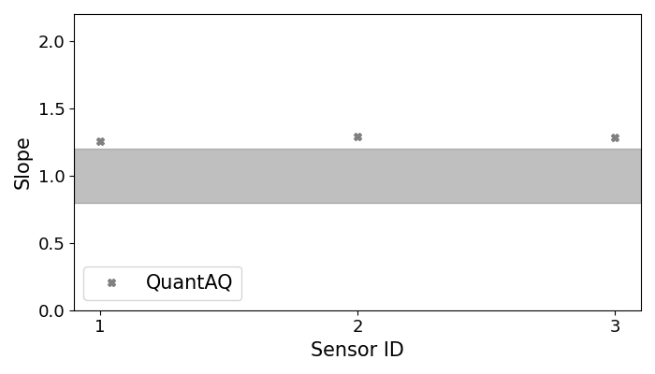
Test 1 – Concentration Ramp (0-10ppm)

Slide 4
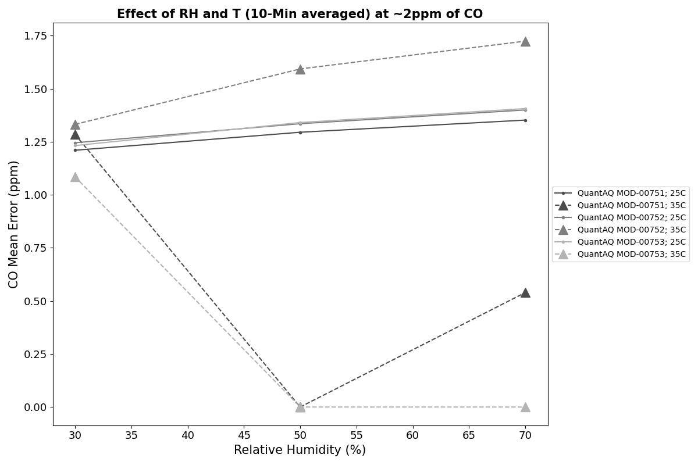
Test 2 – Effect of T and RH at ~2ppm
​ | Low RH​ | Medium RH​ | High RH​
Medium T​ | 25°C​ 30%​ | 25°C​ 50%​ | 25°C​ 70%​
High T​ | 35°C​ 30%​ | 35°C​ 50%​ | 35°C​ 70%​

Slide 5
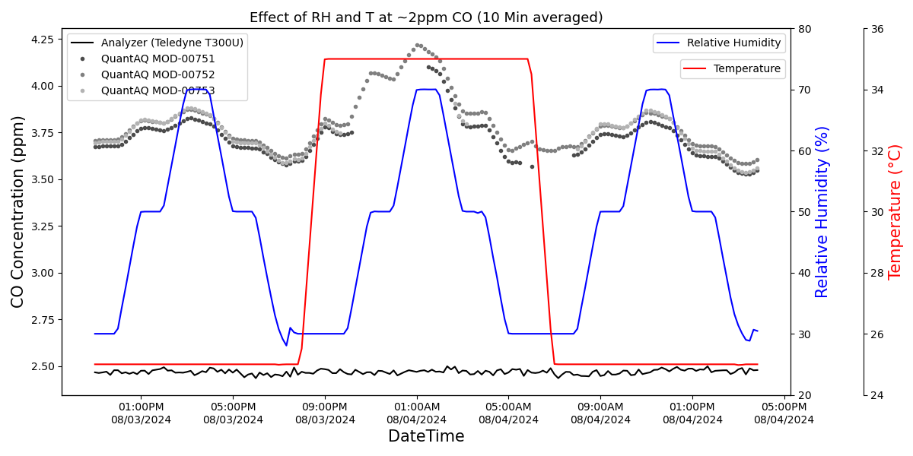
Test 2 – Effect of T and RH at ~2ppm

Slide 6
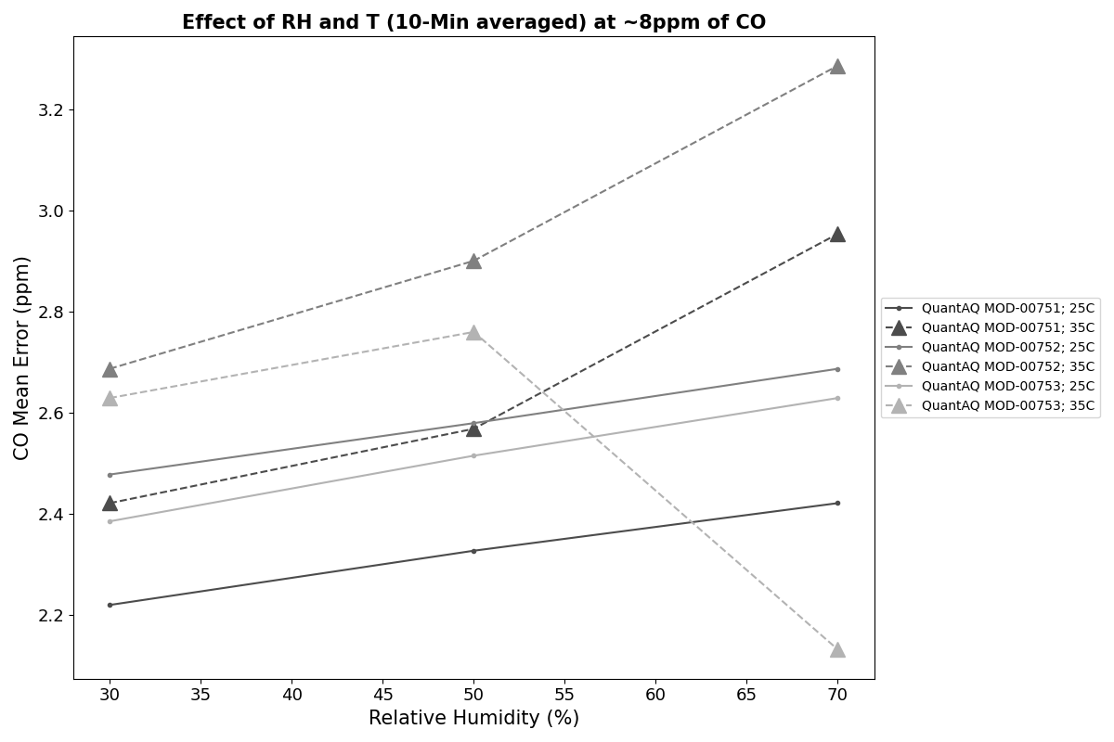
Test 3 – Effect of T and RH at ~8ppm
​ | Low RH​ | Medium RH​ | High RH​
Medium T​ | 25°C​ 30%​ | 25°C​ 50%​ | 25°C​ 70%​
High T​ | 35°C​ 30%​ | 35°C​ 50%​ | 35°C​ 70%​

Slide 7
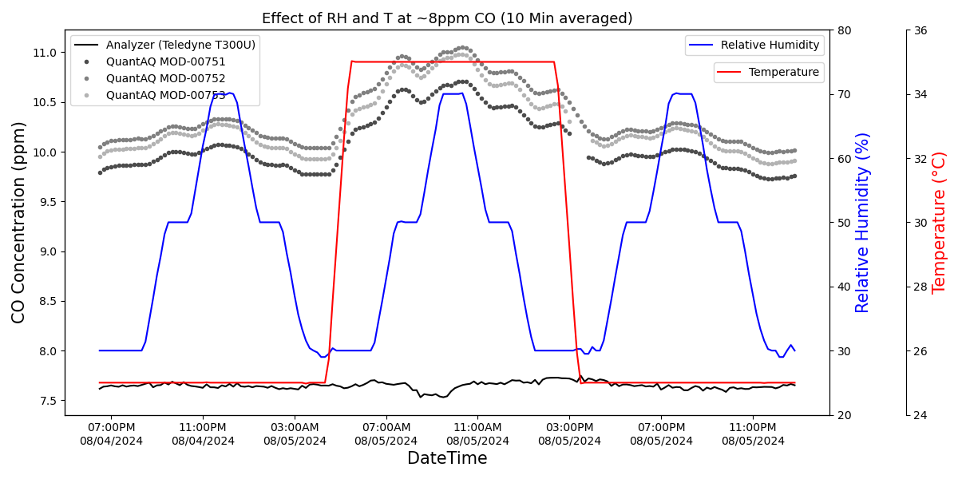
Test 3 – Effect of T and RH at ~10ppm

Slide 8
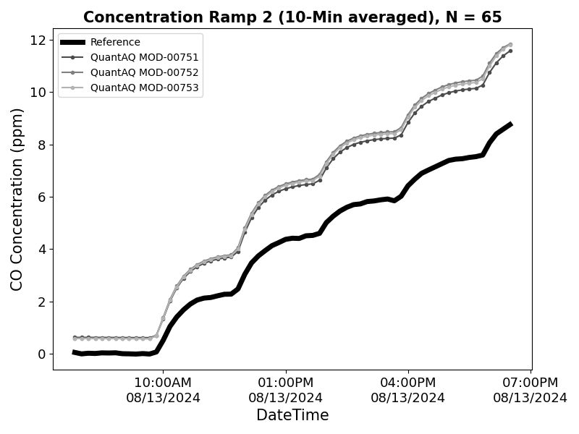
Test 4 – Concentration Ramp Repeat (0-10ppm)
Target CO Concentration (ppm)
0
2
4
6
8
10
T = 25°C and RH = 35%

Slide 9

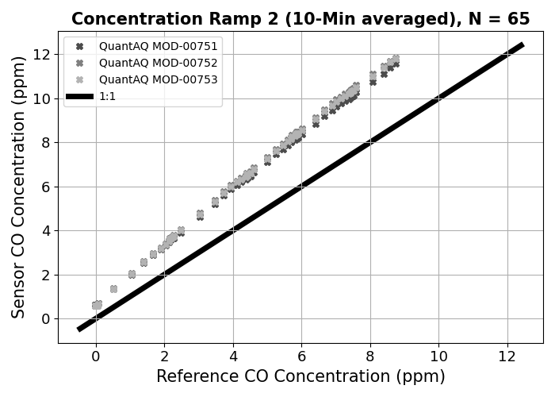

Test 4 – Concentration Ramp Repeat (0-10ppm)

