Slide 1
CST8917 Final Project
Jediael Mendoza

Slide 2
Workflow: Expense Approval Pipeline
Rule | Description
Input | An expense request with: employee name, employee email, amount, category, description, and manager email
Validation | Reject requests missing any required field or using an invalid category. Valid categories: travel, meals, supplies, equipment, software, other.
Auto-Approve | Expenses under $100 are automatically approved — no manager needed.
Manager Approval | Expenses of $100 or more require manager approval. The system waits for a manager decision.
Timeout | If no manager decision arrives within the timeout period, the expense is auto-approved and flagged as "escalated".
Notification | The employee receives an email with the final outcome (approved, rejected, or escalated).

Slide 3
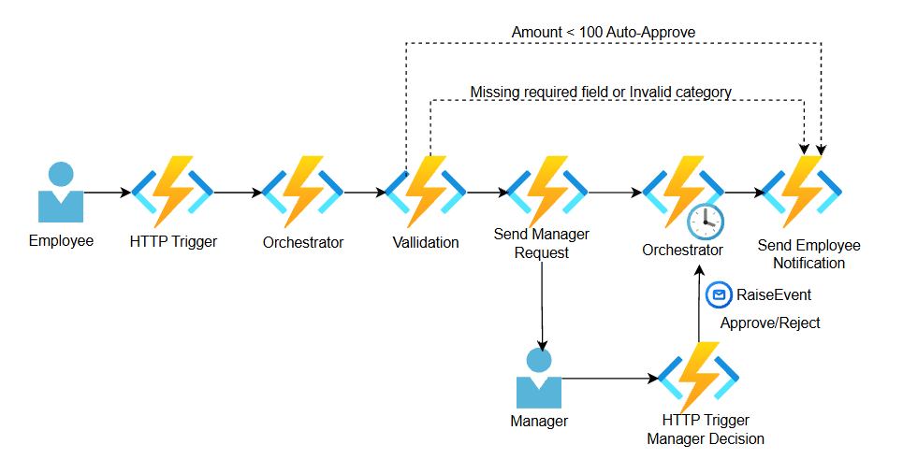
Version A — Durable Functions

Slide 4
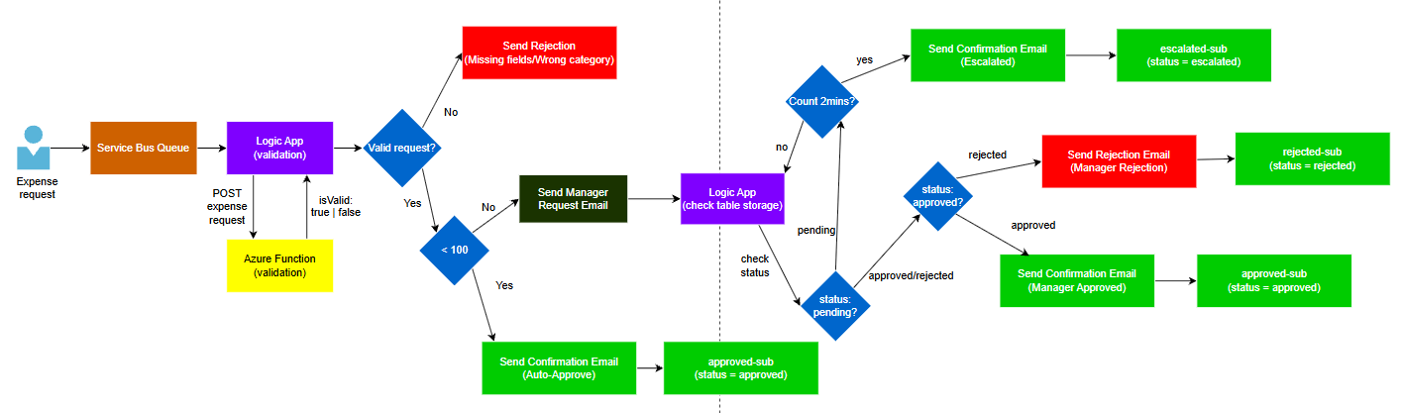
Version B — Logic Apps + Service Bus

Slide 5
Comparison
Dimension | Durable Functions (Version A) | Logic Apps + Service Bus (Version B)
Development Experience | Faster to build; single service; strong control using code; easier debugging in VS Code | Slower setup; multiple services; harder to learn initially; visual designer helps after setup
Testability | Easy to test locally with .http and runtime; supports automated testing | Harder to test locally; requires Azure resources; slower testing due to execution delays
Error Handling | More flexible; try/catch and custom retry logic; better control over recovery | Built-in retry policies; easy to configure but less control; complex for large workflows
Human Interaction | Natural support using wait_for_external_event and timers | Simulated using Table Storage, second Logic App, and polling loop; more complex
Observability | Logs and instance tracking; less visual | Strong visual monitoring in portal; easier to debug step-by-step
Cost | Very low cost; ~$0 (low usage), ~$1.10 at scale | Higher cost; ~$0 (low usage), ~$7.40 at scale due to per-action pricing

Slide 6
Recommendation
Durable Functions is the recommended solution
Better for complex workflows and human interaction
Provides more control, cleaner logic, and easier maintenance
More cost-efficient at scale
Logic Apps is useful for simple integrations and visual workflows

