Slide 1
WHAT IT DOES
JS
CSS
WEB
HTML
WHAT IT LOOKS LIKE
WHAT IT IS

Slide 2
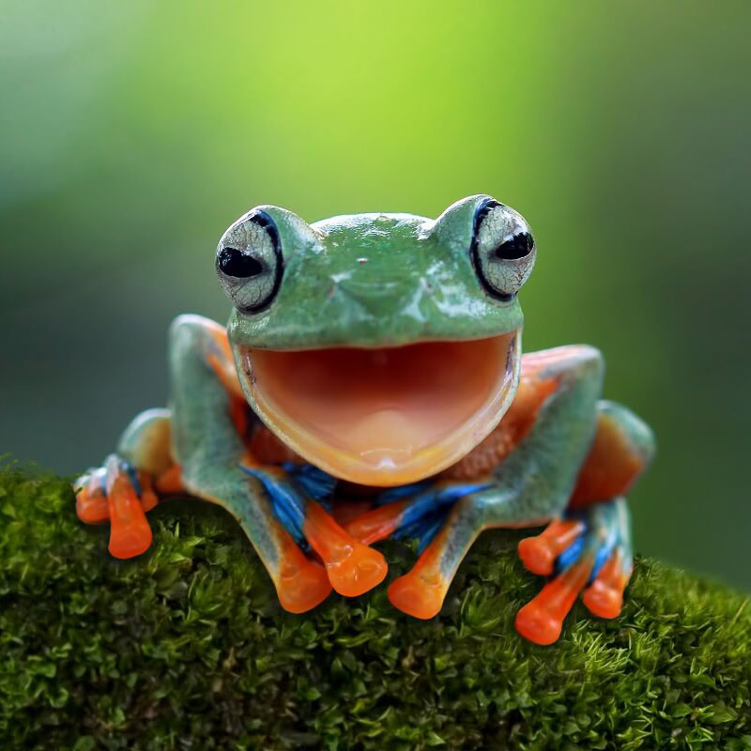
Featured Frog Friend
Felipa the Frog
Age: 2 years
Favourite Leaf: Papaya
Profile
Felipa is a friendly tree frog who enjoys spending her days sleeping and her nights chasing mosquitos for a delicious meal.
Tags
green
happy
hungry
More about frogs - Copyright 2023 Frogs Inc.

