Slide 1
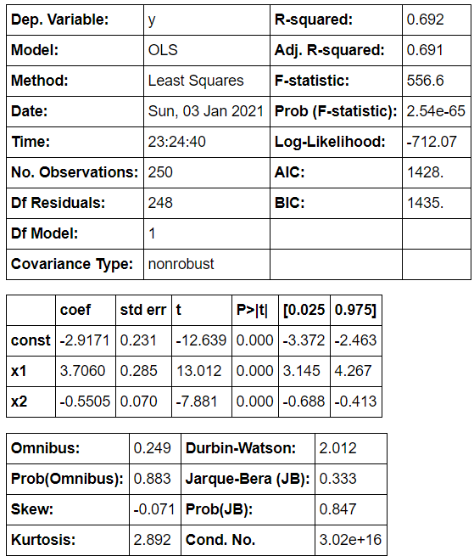
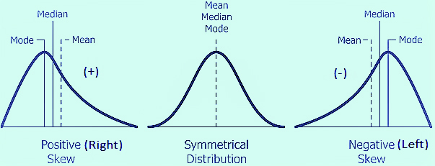
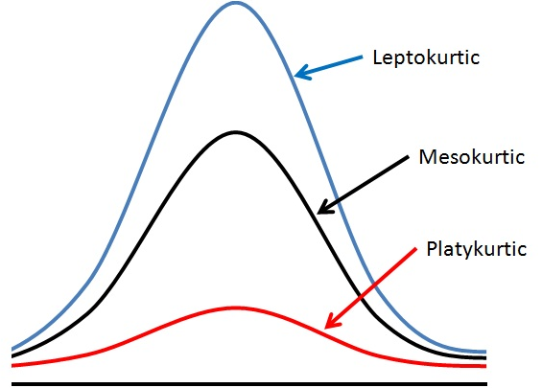
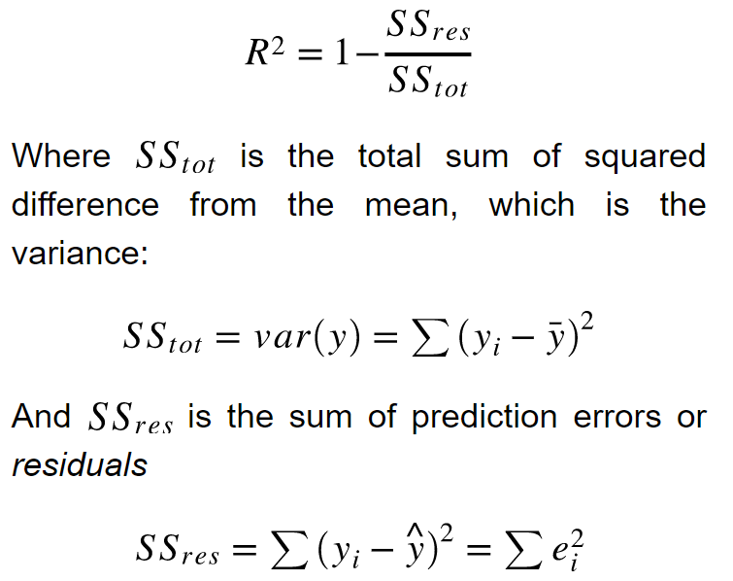
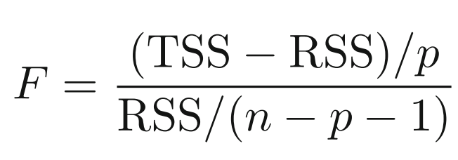
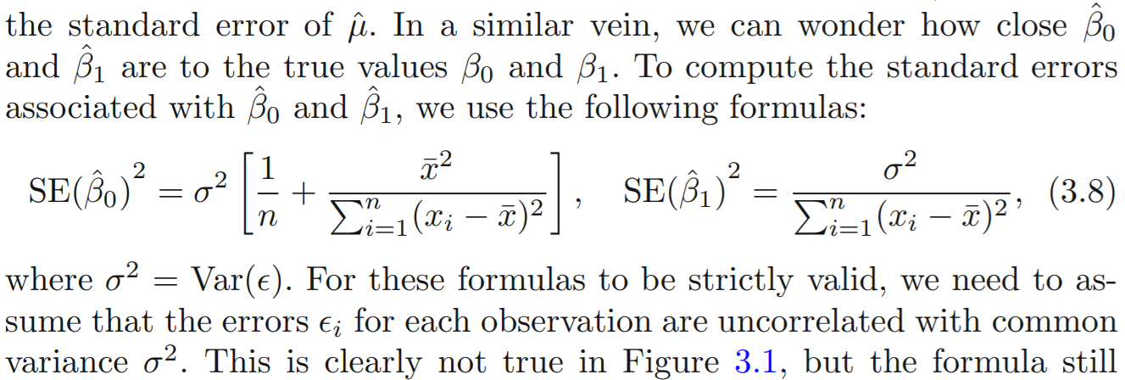
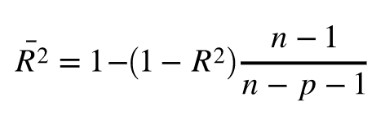
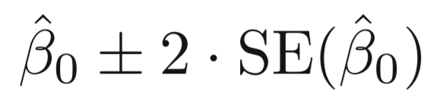
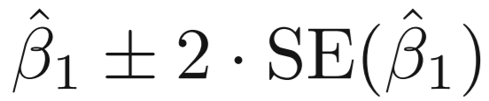

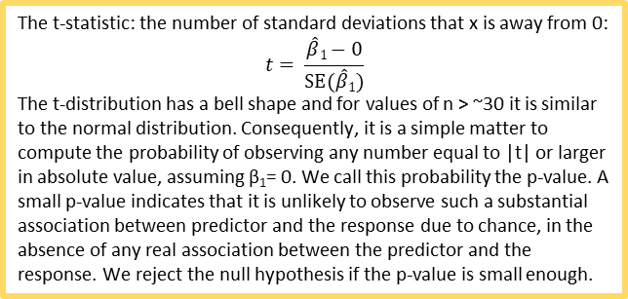
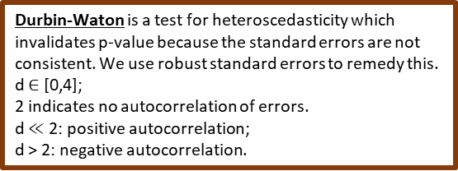
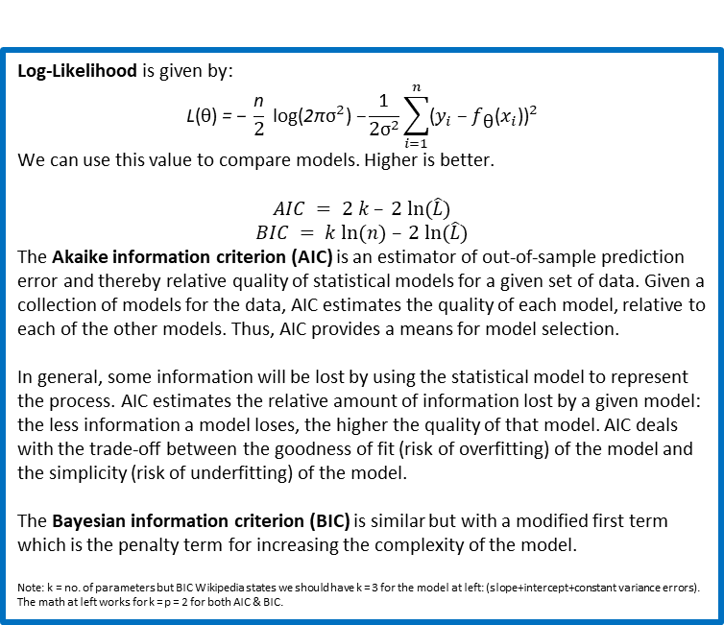
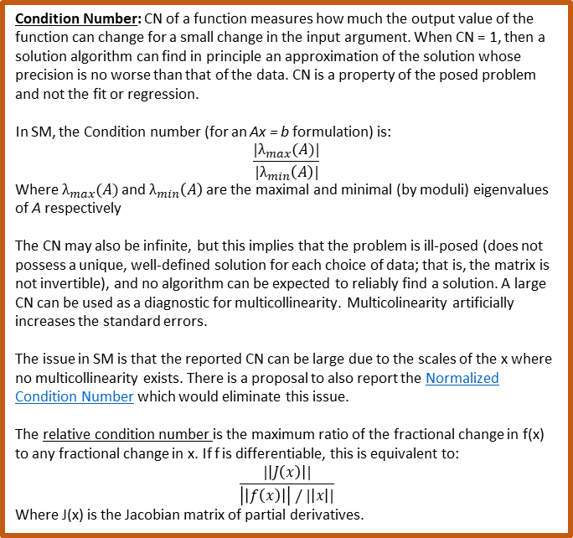
1
Condition Number: CN of a function measures how much the output value of the function can change for a small change in the input argument. When CN = 1, then a solution algorithm can find in principle an approximation of the solution whose precision is no worse than that of the data. CN is a property of the posed problem and not the fit or regression.
In SM, the Condition number (for an Ax = b formulation) is:
$$\frac{|λ_{max}(A)|}{|λ_{min}\left(A\right)|}$$
Where $λ_{max}(A)$ and $λ_{min}\left(A\right)$ are the maximal and minimal (by moduli) eigenvalues of A respectively
The CN may also be infinite, but this implies that the problem is ill-posed (does not possess a unique, well-defined solution for each choice of data; that is, the matrix is not invertible), and no algorithm can be expected to reliably find a solution. A large CN can be used as a diagnostic for multicollinearity. Multicolinearity artificially increases the standard errors.
The issue in SM is that the reported CN can be large due to the scales of the x where no multicollinearity exists. There is a proposal to also report the Normalized Condition Number which would eliminate this issue.
The relative condition number is the maximum ratio of the fractional change in f(x) to any fractional change in x. If f is differentiable, this is equivalent to:
$$\frac{|\left|J\left(x\right)\right||}{\left|\left|f\left(x\right)\right|\right| / |\left|x\right||}$$
Where J(x) is the Jacobian matrix of partial derivatives.
Log-Likelihood is given by:
$$\text{L}\text{(}\text{θ}\text{) }\text{= − }\frac{\text{n}}{2} \text{log}\text{(}\text{2}\text{π}{\text{σ}}^{2}\text{) −}\frac{\text{1}}{2{\text{σ}}^{2}}\sum_{i=1}^{n}{{\text{(}y_{i}\text{ − }f_{\text{θ}}\text{(}x_{i}\text{))}}^{2}}$$
We can use this value to compare models. Higher is better.
$$AIC = 2 k – 2 ln⁡(\hat{L})$$
$$BIC = k ln⁡(n) – 2 ln⁡(\hat{L})$$
The Akaike information criterion (AIC) is an estimator of out-of-sample prediction error and thereby relative quality of statistical models for a given set of data. Given a collection of models for the data, AIC estimates the quality of each model, relative to each of the other models. Thus, AIC provides a means for model selection.
In general, some information will be lost by using the statistical model to represent the process. AIC estimates the relative amount of information lost by a given model: the less information a model loses, the higher the quality of that model. AIC deals with the trade-off between the goodness of fit (risk of overfitting) of the model and the simplicity (risk of underfitting) of the model.
The Bayesian information criterion (BIC) is similar but with a modified first term which is the penalty term for increasing the complexity of the model.
Note: k = no. of parameters but BIC Wikipedia states we should have k = 3 for the model at left: (slope+intercept+constant variance errors). The math at left works for k = p = 2 for both AIC & BIC.
1
0
= n
= n – p
Model selection criteria
|t|>2
0
0
0
2
1
1
0
The t-statistic: the number of standard deviations that x is away from 0:
$$t= \frac{\hat{β}1−0}{SE(\hat{β}1)}$$
The t-distribution has a bell shape and for values of n > ~30 it is similar to the normal distribution. Consequently, it is a simple matter to compute the probability of observing any number equal to |t| or larger in absolute value, assuming β₁= 0. We call this probability the p-value. A small p-value indicates that it is unlikely to observe such a substantial association between predictor and the response due to chance, in the absence of any real association between the predictor and the response. We reject the null hypothesis if the p-value is small enough.
(+)
k < 3
F-test is a measure of the explained variance over the unexplained variance.
Null hypothesis = H_{o} = all coefficients are zero
(0)
k = 3
(-)
k > 3
TSS =
Omnibus: Tests that the errors are normally distributed (H_{o}). Omnibus should be ~0; Prob(Omnibus) should be ~1. Skew and Kurtosis testing is included.
Jarque-Bera: Another test akin to Omnibus.
Durbin-Waton is a test for heteroscedasticity which invalidates p-value because the standard errors are not consistent. We use robust standard errors to remedy this.
d $∈$ [0,4];
2 indicates no autocorrelation of errors.
d $≪$ 2: positive autocorrelation;
d > 2: negative autocorrelation.
Adjusted R² penalizes the R² for each coefficient you add (gap grows with R²)
RSS =
R² = $\frac{Explained variation}{Unexplained variation}$
R² = 0 indicates the regression is producing the mean

