Slide 1
Optimizations
Because no one likes slow code

Slide 2
What is an optimization?

Slide 3
An optimization is a transformation of an AST node or group of AST nodes to an AST node or group of AST nodes that is either faster to execute, smaller in generated code size, or both.

Slide 4
What?
It’s actually not all that bad. Let’s try an example…

Slide 5
Expression Simplification
assignment
a = x + 0;
a
add
x
0

Slide 6
How might that compile?
a = x + 0;
Assume a very simple, literal compiler!
move.l (x), D0
add.l #0, D0
move.l D0,(a)

Slide 7
What rule can we use to optimize this?
If either operand of an Add node is of constant value “0”, remove the add node and replace it with the other operand.
add
x
x
0

Slide 8
We can generate all of the other easy mathematical identities in the same way!
multiply (1,?) ➔ ?
multiply (?,1) ➔ ?
subtract (?,0) ➔ ?
divide (?,1) ➔ ?

Slide 9
But, wait – who would ever write that code?
Great question – no one. But, might you write something like:
x = x + STARTING_SCORE;
and somewhere else define
#define STARTING_SCORE 0

Slide 10
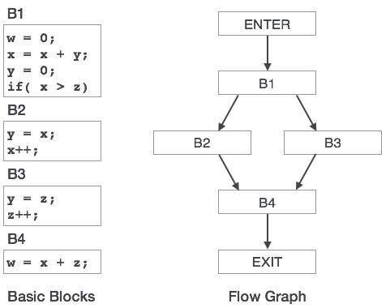
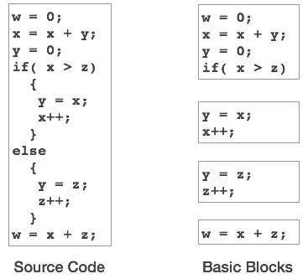
Basic Blocks
A basic block is a block of code with no loops, conditionals or ways in (labels)
Why is this important? Because they are simple, it is a lot easier to reason about them; many optimizations only work within the same basic block.

Slide 11
Dead Code Elimination
int x = 0;
x = 5;
int x = 5;
Note – these are easier to see and understand as code, but recognize that the code is NOT being changed. The AST generated from the code is being changed!

Slide 12
Multiplication and Division to bit shift
int x = 5 * 2;
int y = 16 / 4;
int x = 5 << 1;
int y = 16 >> 2;
Is there another optimization that we could do here?

Slide 13
Constant Folding
int x = 5 * 2;
int y = 16 / 4;
int x = 10;
int y = 4;

Slide 14
Instruction Combining
x++;
x++;
x+=2;

Slide 15
Constant Propagation
x=3;
y= x + 4;
x = 3;
y = 7;

Slide 16
Common Subexpression Elimination
temp = p + q;
x = temp;
y = temp + 2;
x=p + q;
y = p + q + 2;

Slide 17
Forward Store
register = sum;
for (int i=0;i<100;i++)
register += a[i];
sum = register;
for (int i=0;i<100;i++)
sum += a[i];
Consider memory bandwidth here – how often would sum get written to RAM?

Slide 18
Hoisting
register = x + y;
for (int i=0;i<100;i++)
a[i] = register;
for (int i=0;i<100;i++)
a[i] = x + y;

Slide 19
Function Inlining
int add (int x, int y)
{
return x + y;
}
int sub (int x, int y)
{
return add (x, -y);
}
int add (int x, int y)
{
return x + y;
}
int sub (int x, int y)
{
return x + -y;
}

Slide 20
Function Inlining Continued
The previous example showed a “no-brainer” inlining – it is ALWAYS better to do that inlining. However, there is a classic tradeoff of space vs time on most inlining.
int sumArray(int[] a, int count)
{
int sum = 0;
for (int i=0;i<count;i++)
sum += a[i];
return sum;
}
int[] array = getArray();
int count = array.Count();
int sum = sumArray(array,count);

Slide 21
Function Inlining Continued
Not inlined, the call to the function is short:
int sumArray(int[] a, int count)
{
int sum = 0;
for (int i=0;i<count;i++)
sum += a[i];
return sum;
}
push a
push count
jsr sumArray
sub #2,SP

Slide 22
Function Inlining Continued
Inlined, the function is copied in, making the code bigger:
int sumArray(int[] a, int count)
{
int sum = 0;
for (int i=0;i<count;i++)
sum += a[i];
return sum;
}
move.l 0,D0 // Sum
move.l array,A0
move.l count,D1
move.l 0,D2 // I
loop: add.l D2(A0),D0
add.l #1,D2
bne D1,D2,loop
move.l D0,(Sum)

Slide 23
When do you inline the function?
It depends. It is a tradeoff. Some CPUs (Pentium 4, for example) were AWFUL at jumping around. Some architectures handle it better. And sometimes, it depends on the situation. Unfortunately, it really becomes a “try it and see.”

Slide 24
Try/Catch elimination
int x = 0;
try {
x=1;
}
catch (Exception e)
{
}
int x=1;
Only for cases where the code in question can NOT throw an exception

Slide 25
New Expression Optimization
{
int a[];
a = new int [100];
}
// don’t do anything – a is never used!

Slide 26
Loop Unrolling
for (int x=0;x<10;x++) {
doSomething();
doSomething();
doSomething();
doSomething();
doSomething();
doSomething();
doSomething();
doSomething();
doSomething();
doSomething();
}
for (int x = 0;x<100;x++)
doSomething();
How many times is x incremented and checked? There is another space vs time tradeoff here…

Slide 27
Unswitching
if (x)
for (i = 0; i < N; i++)
a[i] = 0;
else
for (i = 0; i < N; i++)
b[i] = 0;
for (i = 0; i < N; i++)
if (x)
a[i] = 0;
else
b[i] = 0;
How many times is x checked? There is another space vs time tradeoff here…

Slide 28
Tail Call Recursion
Remember that every function/method call pushes and pops from the stack – there is a cost there.
What if we could “give” our stack space to the method that we are about to call, since we don’t need it anymore – we are returning whatever the function/method that we are about to call is returning?

Slide 29
Tail Recursion
int f (int i)
{
entry:
if (i > 0)
{
g (i);
i--;
goto entry;
}
else
return 0;
}
int f (int i)
{
if (i > 0)
{
g (i);
return f (i - 1);
}
else
return 0;
}

Slide 30
Many, many more
Some optimizations are CPU family specific; these usually come AFTER code generation and are called peephole optimizations (imagine looking at only a few lines of assembly through a peephole).
Example: In x86, it is faster to xor EAX,EAX than it is to mov #0,EAX
These optimizations are highly dependent on machine specifics and don’t tend to age gracefully.
Some optimizations are generational – whole generations of CPUs support some new feature
Example: CPUs now support some level of vector math.

Slide 31
Code Optimization Summary
Optimizations make your code faster
There are dozens of different code optimizations that can be done by a compiler. Not every compiler does every one.
Each optimization works on the AST to transform the nodes to generate faster code.
Each of these can be built and tested in isolation. Most compilers let you turn them on and off individually, as well.

