Slide 1
Parsing
Hooking up words and phrases and clauses.

Slide 2
When last we left our infant compiler…

Slide 3

My Program
List<lexeme>
Compiled Code!
Lexical Analyzer
Parser
Semantic Analysis
Optimization
Code Generator

Slide 4
My Program
List<lexeme>
???????
Compiled Code!
Lexical Analyzer
Parser
Semantic Analysis
Optimization
Code Generator

Slide 5
Remember in our lexer, we iterated over stream<char> to create list<lexeme> Now we will iterate over List<Lexeme> to create an AST – an abstract symbol tree.

Slide 6
What’s an AST?
An AST is a tree, much like what you might have constructed in an algorithm class.
It’s structure is NOT ordered for sorting. It’s structure mirrors the structure of the program that it represents.
A node in an AST generally represents a single lexeme, but there are exceptions to that rule.

Slide 7
Trees
Often, we only think about trees as binary trees. Each node has a left and a right.
Binary trees are great for sorting, since there are only 2 choices – something is either less than or greater than the current node.
We can, however, have non-binary trees; multiple references to descendants or neighbors, even.

Slide 8
…
A
B
C
A
B
C
D
E
A
B
C
D
E
A
B
C
D
E
Aardvark
Accept
Accede
Accident
Bad
Ball
Balance
Bell
Believe
Beyond
Bend
Cat
Caper
Cadence
Call
Camp
Cell
Cent
Ceiling
This data structure is called a trie. We use 26 first level entries and 26 second level entries.
What are some pros and cons to this data structure?
How could we modify it to make it better?

Slide 9
OK, how do we make an AST?

Slide 10
We write a parser. A parser is a “little program” that takes that list of Lexemes as input and outputs an AST.

Slide 11
This is a common pattern in compilers – a “pass” in which we loop over the input and transform it into different but related output. This pattern is very “classic Computer Science” and is very easy to implement, think about and test.
A brief aside

Slide 12
Variable = Expression while(Boolean) for (Statement; Boolean; Statement) if (Boolean)
When we think about a statement in a programming language, it is a little like a Fill In the Blank.

Slide 13
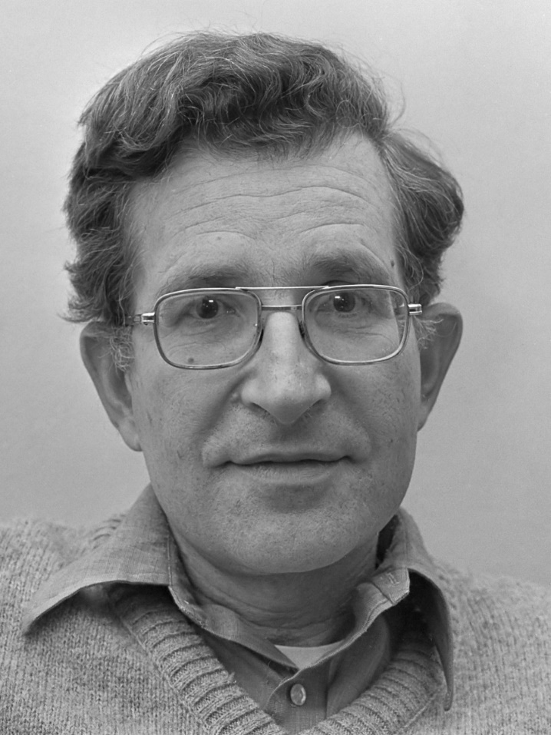
Any of this sound familiar?
Hint – Noam Chomsky!

Slide 14
Rule | Rule #
S → NP VP | 1
NP → Det Nsingular | Det Nplural | 2
Nsingular VP → Nsingular Vsingular | 3
Nplural VP → Nplural Vplural | 4
Det → the | 5
Nsingular → child | 6
Nplural → men | 7
Vsingular → runs | 8
Vplural → run | 9
The child runs
S
NP VP (1)
Det Nsingular VP (2)
Det Nsingular Vsingular (3)
the Nsingular Vsingular (5)
the child Vsingular (6)
the child runs (8)
The men run
S
NP VP (1)
Det Nplural VP (2)
Det Nplural Vplural (4)
the Nplural Vplural (5)
the men Vplural (7)
the men run (9)
Notice:
Rules 3 & 4 have 2 non-terminals on the left side
You can apply any rule at any time so long as the symbols on the left hand side match what is in your derivation

Slide 15

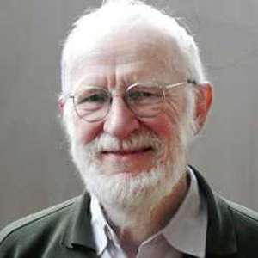
Backus Naur Form (BNF) or, more commonly the extended
version (EBNF) is used to express grammars. You have seen
some very similar formats already this semester, but it
seems appropriate to talk, briefly, about the origin.
As we talked about, Chomsky combined language and
mathematical symbols to make grammars.
Backus and Naur applied this to programming languages in FORTRAN and Algol.
A recursive example of their original form:
<integer> ::= <digit>|<integer><digit>

Slide 16
Defining a language
Computer Science is a science. An important part of science is exactness, precision, reproducibility and unambiguity. It is important to have a clear way to express a language that others can understand and use to build their own tools.
EBNF (extended Backus Naur form) is considered the standard in the Computer Science community today. Academic writing AND commercial communications both use EBNF to define programming languages today.
https://docs.oracle.com/javase/specs/jls/se7/html/jls-18.html

Slide 17
Let’s look at a tiny language EBNF example and explore how it relates to an AST

Slide 18
Consider this definition
Statements → LCURLY Statements RCURLY | Statement Statements | nothing
Statement → AssignmentStatement | ForStatement |
IfStatement | WhileStatement
AssignmentStatement → VARIABLE EQUALS Expression
ForStatement → FOR LPAREN Statement SEMI Boolean SEMI Statement RPAREN Statements
IfStatement → IF LPAREN Boolean RPAREN Statements
WhileStatement → WHILE LPAREN Boolean RPAREN Statements
All caps == Lexeme, Capitalized = Non-Terminal, | = options

Slide 19
Consider this definition
Boolean → Expression BooleanOperator Expression
BooleanOperator → LESSTHAN | GREATERTHAN | EQUAL | NOTEQUAL (etc)
Expression → VARIABLE | NUMBER | STRING | Expression MathOp Expression
MathOp → PLUS | MINUS | TIMES | DIVIDE | EXPONENT
All caps == Lexeme, Capitalized = Non-Terminal, | = options

Slide 20
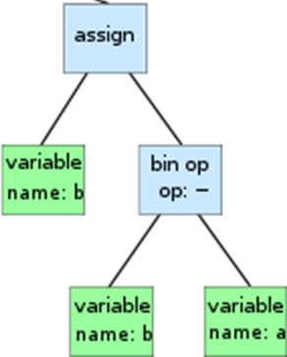
Each Terminal is a node of an AST!
AssignmentStatement → VARIABLE EQUALS Expression
Expression → VARIABLE | NUMBER | STRING | Expression MathOp Expression
MathOp → PLUS | MINUS | TIMES | DIVIDE | EXPONENT
Notice how each node of the AST is, essentially, one Lexeme? Parsing is building a tree out of the list of lexemes so that we have a different “perspective” on the lexemes - we add information derived from the order of the lexemes and the grammar of the language.

Slide 21
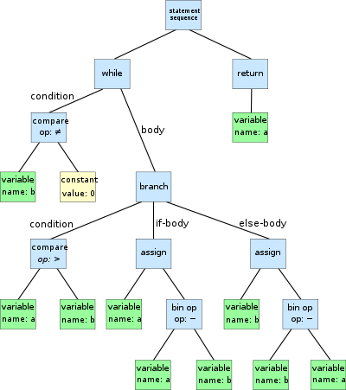
Example
{
while (b != 0)
if (a > b)
a = a − b;
else
b = b − a;
return a
}
Notice:
Each node can have any number of children
Nodes are of different types, 1 to 1 correlation between lexeme and node type
All of the order/structure of the code is embedded in the tree structure

Slide 22
So what do we know?
An AST is a data structure that holds the input program
An AST node is, essentially, 1-1 with a grammar terminal
An AST node connects to all of the “parameters” of the statement
An AST node is usually rooted in a single lexeme
Example – an “IF” node or a “variable” node or a “number” node
Exception – “statements” or “statement sequence” (rooted in LCURLY/RCURLY)

Slide 23
How do I design my AST?
An AST is a data structure that mirrors the code, so look at the code structure.
A while loop is: WHILE ( expression ) statementblock
We don’t need to store “while” (it’s in the class type) or parenthesis.
public class whileNode {
public Node expression;
public List<StatementNode> statements;
}

Slide 24
AST class hierarchy
In an object-oriented language (like Java), I make a Node that is the abstract base class for all of my AST nodes. I use it whenever I need to reference something that I can’t predict the type of.
I derive StatementNode as another abstract base class from Node. This is the parent class for all statements (while, for, function calls, etc.).
Making your AST as type specific as possible means Java can catch more of your bugs.

Slide 25
Ambiguity
Sometimes it is tricky to make your grammar completely unambiguous. Doing so is important to ensure consistent implementations of the language; otherwise you get the classic “it worked in my compiler!”
One classic example of ambiguity is called the dangling else:
a = 0;
c=0;
if (a<1) then if (b>2) then c=1 else c=2;
What is c?

Slide 26
How do we deal with ambiguity in our grammar?
One way to handle the ambiguity is to rewrite the grammar to make sure that the situation is completely clear:
matchedIfStmt -> IF expr THEN matchedIfStmt ELSE matchedIfStmt
unmatchedIfStmt -> IF expr THEN stmt |
IF expr THEN matchedIfStmt ELSE unmatchedIfStmt
Now ELSE will always “bind” to the closest IF THEN

Slide 27
How do we deal with ambiguity in our grammar?
A different way is to specify the precedence.
Exp -> Exp + Exp | Exp * Exp | number | variable
X = 5 + 3 * 4
Exp
Exp
Exp
+
Exp
Exp
*
Exp
Exp
*
Exp
Exp
+
Exp
Solution: In your grammar you include a sentence like this: let * have a higher precedence than +

Slide 28
So how do we programmatically create an AST?
Two methods – one is “recursive descent”, one is a parser generator
Sounds a lot like the hand made lexer vs Flex made lexer, doesn’t it?

Slide 29
Recursive Descent
A top-down approach
One function for every non-terminal
Each function follows a pattern:
Test to see if the next lexeme(s) match what I expect
If so, remove them from the list and add them to the AST
If not, ensure that the lexeme list is the way it was when this function started
Return the new ASTNode that I made as a result of my parsing OR null to indicate that I didn’t match
Very repetitive but not very difficult to write
Assumes a lexeme list/array and some look ahead capability

Slide 30
The magic phrase
When I face a problem that I find to be a challenge, I try to frame it in terms of “If I had X helper function(s), I could do this”.
This is my way of breaking problems down to their component parts.
If I still find myself stuck, I write pseudocode to help me. I do this in comments, then I write the code under the pseudocode comments.

Slide 31
What kind of helper functions are helpful?
Consider “while (expression)”
Our lexeme list is:
while, lparen, a,==,5, rparen
If I had some function that would look at our list of lexemes and removed a lexeme if it matched, that would be helpful here.
Let’s call it “Lexeme matchAndRemove(LexemeType)”.
It should return NULL if it doesn’t match.

Slide 32
Now we can start our “while” parser:
WhileNode ParseWhile() {
if (matchAndRemove(WHILE) == null) return null;
}
Now, after our one line, we either have removed the while or we leave.

Slide 33
Now what?
while, lparen, a,==,5, rparen
We have lparen, expression, rparen
Well, we can certainly check for lparen!
WhileNode ParseWhile() {
if (matchAndRemove(WHILE) == null) return null;
if (matchAndRemove(LPAREN) == null) throw new Exception(…);
}

Slide 34
And now?
Dealing with an expression is complex. It’s time for a new function:
ExpressionNode expression(); // Processes an expression or returns null
WhileNode ParseWhile() {
if (matchAndRemove(WHILE) == null) return null;
if (matchAndRemove(LPAREN) == null) throw new Exception(…);
ExpressionNode en = expression();
if (en == null) throw new Exception(…);
if (matchAndRemove(RPAREN) == null) throw new Exception(…);
}

Slide 35
So far…
WhileNode ParseWhile() {
if (matchAndRemove(WHILE) == null) return null;
if (matchAndRemove(LPAREN) == null) throw new Exception(…);
ExpressionNode en = expression();
if (en == null) throw new Exception(…);
if (matchAndRemove(RPAREN) == null) throw new Exception(…);
}
But we still need to deal with the { } stuff that comes after while!

Slide 36
Again, too complex:
WhileNode ParseWhile() {
if (matchAndRemove(WHILE) == null) return null;
if (matchAndRemove(LPAREN) == null) throw new Exception(…);
ExpressionNode en = expression();
if (en == null) throw new Exception(…);
if (matchAndRemove(RPAREN) == null) throw new Exception(…);
BlockNode block = ProcessBlock();
if (block == null) throw new Exception(…);
return new WhileNode(en,block);
}

Slide 37
It sort of feels like we are procrastinating…
This is the power of recursive descent, though.
We handle one thing at a time.
We don’t modify the list if we are not the right function for the job.
Let’s looks at a few more functions…

Slide 38
ParseBlock
What is a block? Any number of statements surrounded by curly braces, right?
{
int a=5;
a = a+1;
return a;
}

Slide 39
Easy!
BlockNode ParseBlock() {
if (matchAndRemove(LCURLY) == null) return null;
ArrayList<StatementNode> sns = new ArrayList<>();
do {
StatementNode sn = ParseStatement();
if (sn != null) sns.add(sn);
} while (sn != null);
if (matchAndRemove(RCURLY) == null) throw new Exception(…);
return new BlockNode(sns);
}

Slide 40
What about options?
Our statement block is a little wrong.
A statement block is EITHER { statements } OR 1 statement:
while (a<5) a++;
OR
while (a< 5) {
a++;
print a;
}

Slide 41
Let’s consider ParseStatement
What is a statement?
Well, it could be a while or a for or assignment or a method call or …
How do we handle that?

Slide 42
Basic if’s
StatementNode ParseStatement() {
StatementNode n;
n = ParseWhile();
if (n!=null) return n;
n=ParseFor();
if (n!=null) return n;
…
}

Slide 43
One More super important helper function
There are a few cases where we deal with lists in programming languages:
int a,b,c;
print(“Your name is”,name);

Slide 44
For these, we need to think about the lambda
What if we had a function that would look for a “thing” and then a comma; when it finds one, it calls a function:
bool processList(TokenType t, Consumer<TokenType> lambda) {
do {
if ( peekNextToken().type == t) {
node n = popToken();
lambda(n);
} while (MatchAndRemove(COMMA)!= null);
}

Slide 45
Don’t forget our goal!
What does our AST look like?
We have 1 “program” node – the root of the tree.
For Java: Program is a list of objects.
An object is members and methods.
A member is a type, a name and an optional initialization value.
A method is a method signature and a block of statements.
A method signature is a return type, a name and a list of parameters.
…

Slide 46
Key Takeaways from Recursive Descent
Many simple functions
Tedious but fairly easy to write
Each non-terminal becomes a function
Each function creates an AST Node
Leave the list the way that you found it if you return null
Make sure that you handle null from each function you call
Error handling and recovery can happen in code that you write, control and can debug!
You don’t have to learn another language!

Slide 47


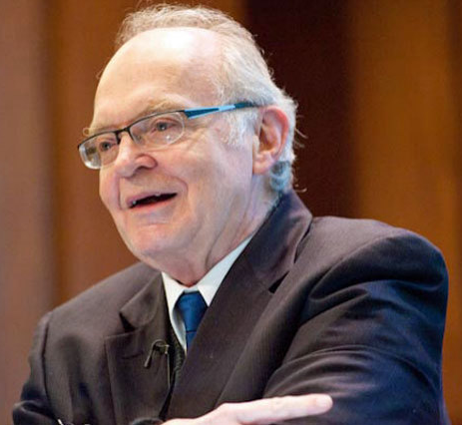
A tale of three men…
Stephen Johnson
Al Aho
Donald Knuth

Slide 48
What problem were you trying to solve? As told by Stephen Johnson to Computer World Magazine…
Dennis Ritchie had written a simple language, B, which ran on our GE (later Honeywell) system, and I started to use it to write some systems programs. When Dennis started to work on Unix, the compiler became an orphan, and I adopted it. I needed access to the exclusive-or operation on the computer, and B did not have any way to say that. So, talking to Dennis, we agreed that would be a good name for the operator, and I set out to put it into the compiler. I did it, but it was no fun.
One day at lunch I was griping about this, and Al Aho said "There's a paper by Knuth-I think he has a better way...". So Al agreed to build the tables for the B expression grammar. I remember giving him about 30 grammar rules, and he went up to the stockroom and got a big piece of paper, about 2 by 3 feet, ruled it into squares, and started making entries in it. After an hour of watching him, he said "this will take a while". In fact, it took about 2 days!
Finally, Al handed me the paper in triumph, and I said "what do I do with this?" He taught me how to interpret the table to guide the parser, but when I typed the table in and tried to parse, there were errors. Each error we found involved another hour of Al's time and some more rows in the table. Finally, after the third time I asked him "what are you doing when you make the table?" He told me, and I said "I could write a program to do that!" And I did...

Slide 49
YACC – Yet Another Compiler Compiler
%token NAME NUMBER
%%
statement: NAME '=' expression { printf("assign %s the value %d\n", $1, $3); };
| expression { printf("= %d\n", $1); } ;
expression: expression '+' NUMBER { $$ = $1 + $3; printf ("Recognized '+' expression.\n"); }
| expression '-' NUMBER { $$ = $1 - $3; printf ("Recognized '-' expression.\n"); }
| NUMBER { $$ = $1; printf ("Recognized a number.\n"); } ;
%%
int main (void) { return yyparse(); }
int yyerror (char *msg) { return fprintf (stderr, "YACC: %s\n", msg); }

Slide 50
How does it work?
YACC calls your lexer
It expects a function called yylex
It takes a lexeme and pushes it onto a stack
This is called shifting – you are shifting the
It then looks to see if the current stack matches any of the rules
If so, execute the rule; $$ means push this result back onto the stack
This is called reducing – you are reducing the stack by popping off all of the related lexemes
Repeat until yylex() returns EOF

Slide 51
state 2
rhyme : sound_place
DELL shift 5
. error
place goto 4
state 3
sound : DING_DONG
DONG shift 6
. error
state 4
rhyme : sound place_ (1)
. reduce 1
state 5
place : DELL_ (3)
. reduce 3
state 6
sound : DING DONG_ (2)
. reduce 2
%token DING DONG DELL
%%
rhyme : sound place
;
sound : DING DONG
;
place : DELL
;
----------------------------------------------------
state 0
$accept : _rhyme $end
DING shift 3
. error
rhyme goto 1
sound goto 2
state 1
$accept : rhyme_$end
$end accept
. error
Notes:
Notice that, in addition to the actions for each state, there is a description of the parsing rules being processed in each state. The _ character is used to indicate what has been seen, and what is yet to come, in each rule.
Initially, the current state is state 0. The parser needs to refer to the input in order to decide between the actions available in state 0, so the first token, DING, is read, becoming the lookahead token. The action in state 0 on DING is is ``shift 3'', so state 3 is pushed onto the stack, and the lookahead token is cleared. State 3 becomes the current state. The next token, DONG, is read, becoming the lookahead token. The action in state 3 on the token DONG is ``shift 6'', so state 6 is pushed onto the stack, and the lookahead is cleared. The stack now contains 0, 3, and 6. In state 6, without even consulting the lookahead, the parser reduces by rule 2.
sound : DING DONG This rule has two symbols on the right hand side, so two states, 6 and 3, are popped off of the stack, uncovering state 0. Consulting the description of state 0, looking for a goto on sound, sound goto 2 is obtained; thus state 2 is pushed onto the stack, becoming the current state. In state 2, the next token, DELL, must be read. The action is ``shift 5'', so state 5 is pushed onto the stack, which now has 0, 2, and 5 on it, and the lookahead token is cleared. In state 5, the only action is to reduce by rule 3. This has one symbol on the right hand side, so one state, 5, is popped off, and state 2 is uncovered. The goto in state 2 on place, the left side of rule 3, is state 4. Now, the stack contains 0, 2, and 4. In state 4, the only action is to reduce by rule 1. There are two symbols on the right, so the top two states are popped off, uncovering state 0 again. In state 0, there is a goto on rhyme causing the parser to enter state 1. In state 1, the input is read; the endmarker is obtained, indicated by ``$end'' in the y.output file. The action in state 1 when the endmarker is seen is to accept, successfully ending the parse.

Slide 52
Lex and YACC work together!
Notice this:
%token NAME NUMBER
YACC generates a file (y.tab.h) filled with #defines (remember that C doesn’t have an “enum”). If you use Lex with YACC, you can do this: %{
#include "y.tab.h"
%}
%%
[0-9]+ return NUMBER;
y.tab.h is generates by YACC from the %token statements and those definitions are used by Lex!

Slide 53
Lex and YACC work together!
The parser that YACC generates calls yylex(). You might remember that Lex generates a function called yylex().
Make sure that you call YACC in your Make script before you call Lex or your token list could get out of date/mismatch.
With these two tools, the “easy” part of building a compiler is semi-automated for you.
Notice that the YACC file is very similar to EBNF; it is pretty easy to go from a grammar to a YACC file.

Slide 54
How does this make an AST, though?
In our example, we called printf() every time we completed a reduction.
What if, instead, we created a new node and added it to the AST?
YACC has the ability to add to the datatype of the stack in a C union
What if we put a pointer to the current AST node in that union?

Slide 55
YACC Alternatives
YACC is over 40 years old!
But it is still just as good as ever – code doesn’t really rot
Bison is a GNU version of YACC (pun intended)
ANTLR is a Java alternative that generates parsers in many different languages
Dozens more…

