Slide 1
Objective-C and Smalltalk

Slide 2
“Plain” C was very popular in the late 70’s and 80’s, partially because it was associated with UNIX

Slide 3
Two different groups of people wanted to add objects to C

Slide 4

Bjarne Soustrup, from Bell Labs (home of UNIX and C) created C++
Focused on small size and fast execution

Slide 5
Objective-C

Slide 6
Designed by a company in the 80’s (Stepstone), Obj-C was adopted by NeXT and, consequently, Apple

Slide 7
Obj-C focuses on a more “pure” object oriented paradigm at the expense of memory and speed

Slide 8
Originally, Obj-C was a pre-processor for C – the “compiler” took in Obj-C and output C

Slide 9
C has a concept called “header files” – definition without an implementation
MyHeader.h
int AddNumbers (int x, int y);
typedef char* mystring;
mystring Concatenate (mystring string1, mystring string2);
Lets the compiler know that these types & methods are not syntax errors but will be explained later.

Slide 10
Obj-C has header files as well; they define classes as well as the procedural types and functions

Slide 11
enum { GKLeaderboardTimeScopeToday = 0, GKLeaderboardTimeScopeWeek = 1, GKLeaderboardTimeScopeAllTime = 2};
typedef uint32_t GKLeaderboardTimeScope;
@class NSArray;
@class NSError;
Defined elsewhere
“C standard” enum and typedef
@commands indicate to the compiler that Obj-C code is coming up

Slide 12
enum { GKLeaderboardTimeScopeToday = 0, GKLeaderboardTimeScopeWeek = 1, GKLeaderboardTimeScopeAllTime = 2};
typedef uint32_t GKLeaderboardTimeScope;
@class NSArray;
@class NSError;
@interface GKLeaderboard : NSObject
@property (nonatomic, retain) NSString* category;
@property (nonatomic, assign) GKLeaderboardTimeScope timeScope;
@property (nonatomic, assign) NSRange range;
@property (nonatomic, readonly, retain) NSArray* scores;
@property (nonatomic, readonly, retain) GKScore* localPlayerScore;
@property (readonly, getter=isLoading) BOOL loading;
Class definition
Derived From
Properties indicate thread safety and have
memory management directives for the compiler

Slide 13
enum { GKLeaderboardTimeScopeToday = 0, GKLeaderboardTimeScopeWeek = 1, GKLeaderboardTimeScopeAllTime = 2};
typedef uint32_t GKLeaderboardTimeScope;
@class NSArray;
@class NSError;
@interface GKLeaderboard : NSObject
@property (nonatomic, retain) NSString* category;
@property (nonatomic, assign) GKLeaderboardTimeScope timeScope;
@property (nonatomic, assign) NSRange range;
@property (nonatomic, readonly, retain) NSArray* scores;
@property (nonatomic, readonly, retain) GKScore* localPlayerScore;
@property (readonly, getter=isLoading) BOOL loading;
+ (void)loadCategoriesWithCompletionHandler:(void (^)(NSArray* categories, NSArray* titles, NSError* error))
completionHandler;
- (id)initWithPlayerIDs:(NSArray*)playerIDs;
- (void)loadScoresWithCompletionHandler:(void (^)(NSArray* scores, NSError* error))completionHandler;
@end
Class methods can be called without an instance of the class, but can not use instance variables
Callbacks in this case allow asynchronous method calls
Class Method
Callback/Lambda
Instance Method

Slide 14
Implementations in Obj-C happen in the “.m” file
@implementation MyClass
+ int getSomeNumber { return 5;}
- (void)sayHello {
[self saySomething:@"Hello, world!"];
}
- (void)saySomething:(NSString *)greeting {
NSLog(@"%@", greeting);
}
@end
In Obj-C, you “send a message” to an object (call a method) and “receive a message” in an object (when the method executes)

Slide 15
Implications of Messages
All methods are “virtual”
A class can override a “forward” method and send any unhandled messages elsewhere
A message is an object and can be captured, archived, sent over a network, etc.
The runtime silently ignores messages sent to the nil (NULL in Java) object – no more null reference exceptions! Silent failure is better?!?!

Slide 16
Obj-C has “protocols” – same as Java interfaces
@protocol XYZPieChartViewDataSource
- (NSUInteger)numberOfSegments;
- (CGFloat)sizeOfSegmentAtIndex:(NSUInteger)segmentIndex;
@optional
- (NSString *)titleForSegmentAtIndex:(NSUInteger)segmentIndex;
- (BOOL)shouldExplodeSegmentAtIndex:(NSUInteger)segmentIndex;
@required
- (UIColor *)colorForSegmentAtIndex:(NSUInteger)segmentIndex;
@end

Slide 17
Obj-C has “blocks” – same as Java lambdas
int anInteger = 42;
void (^testBlock)(void) = ^{
NSLog(@"Integer is: %i", anInteger);
};
anInteger = 84;
testBlock();
What value is logged? Why?

Slide 18
The value printed is 42; the value of anInteger is “bound” – captured – when the block is defined.

Slide 19
Extending classes in Obj-C
You can add new properties and methods to classes even if you don’t have the source code!
@interface MyClass(MyClassAdditions)
- (void)sayGoodBye;
@end
@implementation MyClass(MyClassAdditions)
- (void)sayGoodBye {
[self saySomething:@“Goodbye, world!"];
}
@end
Sometimes this makes more sense than making a derived class. Especially for “small” changes to existing classes.

Slide 20
All memory management in Obj-C was/is manual, but conventions help
If you allocate it, you own it and are responsible to free it.
When an object is freed, any members are freed as well, if no one else points to them (reference counted)
This can cause memory leaks when multiple objects point to the same object; “weak references” are a reference without “ownership”

Slide 21
That’s all pretty intense. Let’s do something easier.

Slide 22
SmallTalk

Slide 23
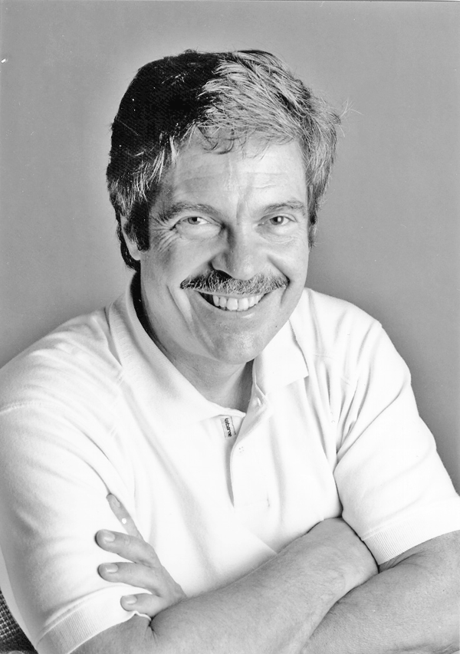
Invented by Alan Kay at Xerox PARC – written in “a page of code” - 1971

Slide 24
The basis for much of Objective-C’s objects and messaging
Objective-C ran on smaller, slower computers, so it optimizes the simpler Smalltalk model

Slide 25
Smalltalk is a language, a virtual machine AND a development environment.
Makes deployment challenging.

Slide 26
Object subclass: Human [
| name age |
setName: aName [ name := aName. ]
getName [ ^name ]
setAge: anAge [ age := anAge. ]
getAge [ ^age ]
introduceYourself [ Transcript show: 'Hello, my name is ', name, ' and I''m ', age printString,
' years old.'; cr. ]
> aHuman [ ^age > aHuman getAge ]
< aHuman [ ^age < aHuman getAge ]
= aHuman [ ^age = aHuman getAge ]
]
^ = return
| names | = instance variables
:= assignment
[] – blocks

Slide 27
| me myBrother |
me := Human new.
me setName: 'Canol Gökel'.
me setAge: 24.
myBrother := Human new.
myBrother setName: 'Gürol Gökel'.
myBrother setAge: 27.
me introduceYourself.
myBrother introduceYourself.
(me < myBrother) printNl.
Hello, my name is Canol Gökel and I'm 24 years old.
Hello, my name is Gürol Gökel and I'm 27 years old.
true

Slide 28
Some things to notice
No types on declaration
AKA Duck Typing
No “main” or “start here”
Ravioli code
Not very readable

Slide 29
Some other ‘small’ things
You can send messages to the result of a message through chaining:
(x foo: 1) bar: 2.
foo returns some object which is then sent “bar”
You can send multiple messages to the same object with cascade:
myCollection add:1; add:2; add:3; add:4.
myCollection gets 4 messages

Slide 30
Definitions
Special Identifiers (builtin names)
nil
The one-and-only instance of the UndefinedObject class.
true false
The two boolean truth values.
self
The receiver within a method.
super
Like self, but with different message lookup semantics if used as a message receiver.
thisContext
The stackFrame object of the currently executing method or block as an object. Holds the receiver, message selector, arguments and local variables.

Slide 31
Blocks are powerful
|someBlock|
someBlock := [:a :b :c |
Transcript show:a.
Transcript show:' '.
Transcript show:b.
Transcript show:' '.
Transcript show:c.
Transcript cr
].
someBlock value:1 value:2 value:3
1 2 3

Slide 32
They drive conditionals
(someVariable > 0)
ifTrue:
[(someVariable < 10)
ifTrue:
[Transcript showCR:'between 1 and 9']
ifFalse:
[Transcript showCR:'positive']]
ifFalse:
[Transcript showCR:'zero or negative'].

Slide 33
and loops
|someVar|
someVar := 1.
[someVar < 10] whileTrue:[
Transcript showCR:someVar.
someVar := someVar + 1.
]

Slide 34
Do on a collection
|anArray|
anArray := #( 'one' 'deux' 'drei' 'quatro' 5 6.0 ).
anArray do:[:eachElement |
Transcript showCR:eachElement
].

Slide 35
|function measureData|
function := [
1000000 timesRepeat:[
'abcdefxghijklxmn' occurrencesOf:$x
] ].
measureData := (1 to:30)
collect:[:n |
Time millisecondsToRun: function.
].
CodingExamples_GUI::HistogrammView new
extent:750@400;
labels:nil;
values:measureData;
open.
Final
Example
$x = literal character ‘x’

Slide 36
Summary
Some object oriented languages compile to machine language (like Objective C), others run in a virtual machine (SmallTalk, Java)
“Pure” object oriented languages have few keywords, if any
Some languages like SmallTalk run in a runtime environment, others run outside of one (like Java)
Some languages are combinations of others (Objective-C == C + Smalltalk)

