Slide 1
Parsing Theory

Slide 2
We talked about how state machines can be used to process text and confirm or deny that it fits a particular pattern

Slide 3
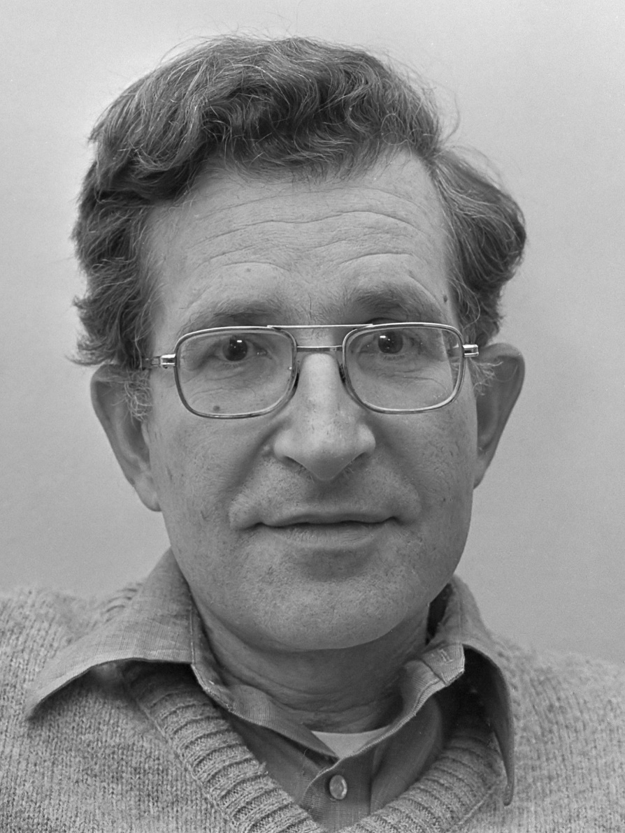
In the 1950’s, linguistics became its own field of study thanks to this man. While his interest was in natural (spoken/written) language, his work happened along at the same time as the first compilers…
Noam Chomsky

Slide 4
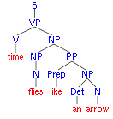
Chomsky was interested in a way to talk about language as a formal construct. He realized that languages fit certain patterns and that you could define a grammar as a set of patterns that you could then use to construct sentences.

Slide 5
Does this sound familiar?
It’s similar to what we did with regular expressions!

Slide 6
Unfortunately, regular expressions are (usually) too weak to define programming languages.
Cannot define a regular expression matching all expressions with properly balanced parentheses.
Cannot define a regular expression matching all functions with properly nested block structure.
We need a more powerful formalism.

Slide 7
A little bit of vocabulary…
Symbol
an “item” in a grammar
Rule
an allowable transformation
Terminal Symbol
“Final” symbol – no more rules apply
Non-Terminal Symbol
Symbol with more rules to apply
Production
Applying a rule to “produce” different symbols

Slide 8
A convention is that non-terminals start with a capital letter and terminals are lower case.
Let’s try an example.
S → NP VP
NP → Det Nsingular | Det Nplural
Nsingular VP → Nsingular Vsingular
Nplural VP → Nplural Vplural
Det → the
Nsingular → child
Nplural → men
Vsingular → runs
Vplural → run
Parses:
The child runs
The men run
S for sentence, NP for noun-phrase, VP for verb-phrase, N for noun, V for verb, and Det for determiner

Slide 9
Rule | Rule #
S → NP VP | 1
NP → Det Nsingular | Det Nplural | 2
Nsingular VP → Nsingular Vsingular | 3
Nplural VP → Nplural Vplural | 4
Det → the | 5
Nsingular → child | 6
Nplural → men | 7
Vsingular → runs | 8
Vplural → run | 9
The child runs
S
NP VP (1)
Det Nsingular VP (2)
Det Nsingular Vsingular (3)
the Nsingular Vsingular (5)
the child Vsingular (6)
the child runs (8)
The men run
S
NP VP (1)
Det Nplural VP (2)
Det Nplural Vplural (4)
the Nplural Vplural (5)
the men Vplural (7)
the men run (9)
Notice:
Rules 3 & 4 have 2 non-terminals on the left side
You can apply any rule at any time so long as the symbols on the left hand side match what is in your derivation

Slide 10
This sort of grammar is called context sensitive, meaning that the left hand side of any rule has context - the rule only applies when all of the symbols on the LHS match up.
This type of grammar is very general, but are harder to work with and program for. They work better for natural (human) languages.

Slide 11
The alternative is a context free grammar.
The rules for a context free grammar are much simpler to deal with and reason about – all of the rules have a left hand side with a single non-terminal.
Again, an example helps…

Slide 12
Remember - A convention is that non-terminals start with a capital letter and terminals are lower case.
Let’s try a context free example.
S → DNP
DNP → Det NPsingular
DNP → Det NPplural
NPsingular → Nsingular Vsingular
NPplural → Nplural Vplural
Det → the
Nsingular → child
Nplural → men
Vsingular → runs
Vplural → run
Parses:
The child runs
The men run

Slide 13
context sensitive
context free
S → NP VP
NP → Det Nsingular | Det Nplural
Nsingular VP → Nsingular Vsingular
Nplural VP → Nplural Vplural
Det → the
Nsingular → child
Nplural → men
Vsingular → runs
Vplural → run
S → DNP
DNP → Det NPsingular
DNP → Det NPplural
NPsingular → Nsingular Vsingular
NPplural → Nplural Vplural
Det → the
Nsingular → child
Nplural → men
Vsingular → runs
Vplural → run
Notice that the context free left hand sides are all much simpler, but the grammar still only lets you make “correct” sentences, assuring noun-verb agreement. You can have multiple rules with the same left hand side.
Does the difference between context free and context sensitive remind you of anything that we have talked about?

Slide 14
 | Easier for humans | Easier for the computer
automata | non-deterministic | deterministic
grammars | context sensitive | context free

Slide 15
OK – Enough natural language examples – we aren’t English majors!

Slide 16
Here is a little grammar that lets you generate some algebra:
S → x
S → y
S → z
S → S + S
S → S - S
S → S * S
S → S / S
S → ( S )
S → - S
( x + y ) * x - z * y / ( x + x )
S (the start symbol)
→ S * S
→ (S) * S
→ (S + S) * S
→ (x + S) * S
→ (x + y) * S
→ (x + y) * S * S
→ (x + y) * S – S * S
→ (x + y) * x – S * S
→ (x + y) * x – z * S
→ (x + y) * x – z * S / S
→ (x + y) * x – z * y / S
→ (x + y) * x – z * y / ( S )
→ (x + y) * x – z * y / ( S + S )
→ (x + y) * x – z * y / ( x + S )
→ (x + y) * x – z * y / ( x + x )

Slide 17
Here is a little grammar that lets you generate some algebra:
S → x
S → y
S → z
S → S + S
S → S - S
S → S * S
S → S / S
S → ( S )
S → - S
( x + y ) * x - z * y / ( x + x )
S (the start symbol)
→ S * S
→ (S) * S
→ (S + S) * S
→ (x + S) * S
→ (x + y) * S
→ (x + y) * S * S
→ (x + y) * S – S * S
→ (x + y) * x – S * S
→ (x + y) * x – z * S
→ (x + y) * x – z * S / S
→ (x + y) * x – z * y / S
→ (x + y) * x – z * y / ( S )
→ (x + y) * x – z * y / ( S + S )
→ (x + y) * x – z * y / ( x + S )
→ (x + y) * x – z * y / ( x + x )
Notice that the left most “S” is expanded each time. This is called a leftmost derivation. Rightmost derivations work from the right.

Slide 18
All of this seems a little … theoretical.

Slide 19
The good news – it isn’t JUST theory!

Slide 20
Different Types of Parsing
Top-Down Parsing
Beginning with the start symbol, try to guess the productions to apply to end up at the user's program.
Bottom-Up Parsing
Beginning with the user's program, try to apply productions in reverse to convert the program back into the start symbol.

Slide 21
Top-Down Parsing
Top-down parsing begins with virtually no information, just the start symbol, which matches every program.
In general, we can't know which productions to apply
There are some grammars for which the best we can do is guess and backtrack if we're wrong.
If we have to guess, how do we do it?

Slide 22
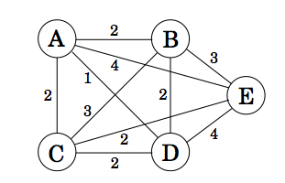
Consider the idea of walking a graph!
Remember these from discrete math?

Slide 23
Breadth First Search
Make a “worklist”, starting with the start symbol
While the worklist isn't empty:
Remove an element from the worklist.
If it matches the target string, you're done.
Otherwise, for each possible string that can be derived in one step, add that string to the worklist

Slide 24
This generates TONS of elements, most of which can’t possibly work.
It grows exponentially based on the size of the program, because every possible permutation has to be tried.
Not realistic because of the size/time it takes.

Slide 25

Left Derivation to the rescue!

Slide 26
Leftmost Breadth First Search
worklist
E
E → T
E → T + E
T → int
T → ( E )
target program:
int + int

Slide 27
Leftmost Breadth First Search
worklist
E
E → T
E → T + E
T → int
T → ( E )
target program:
int + int

Slide 28
Leftmost Breadth First Search
worklist
E
T
T + E
E → T
E → T + E
T → int
T → ( E )
target program:
int + int

Slide 29
Leftmost Breadth First Search
worklist
T
T + E
E → T
E → T + E
T → int
T → ( E )
target program:
int + int

Slide 30
Leftmost Breadth First Search
worklist
T + E
T
Neither can work!
int
(E)
E → T
E → T + E
T → int
T → ( E )
target program:
int + int

Slide 31
Leftmost Breadth First Search
worklist
T + E
int + E
(E) + E
E → T
E → T + E
T → int
T → ( E )
target program:
int + int

Slide 32
Leftmost Breadth First Search
worklist
int + E
E → T
E → T + E
T → int
T → ( E )
target program:
int + int

Slide 33
Leftmost Breadth First Search
worklist
int + E
int + T
int + T + E
E → T
E → T + E
T → int
T → ( E )
target program:
int + int

Slide 34
Leftmost Breadth First Search
worklist
int + T
int + T + E
E → T
E → T + E
T → int
T → ( E )
target program:
int + int

Slide 35
Leftmost Breadth First Search
worklist
int + T
int + T + E
int + T
int + int
int + ( E )
E → T
E → T + E
T → int
T → ( E )
target program:
int + int

Slide 36
And this was the efficient way?
Really?

Slide 37
Yes! Now consider the pathological case –
A → Aa | Ab | c
target: caaaaaaaaa
A → Aa → Aaa → Aaaa → Aaaaa → Aaaaaa
This will never terminate because left recursion
in a leftmost breadth first tree parse will never terminate

Slide 38
Problems with Leftmost BFS
● Grammars like this can make parsing take exponential time.
● Also uses exponential memory.
● What if we search the graph with a different algorithm?

Slide 39
Leftmost DFS
● Idea: Use depth-first search.
● Advantages:
Lower memory usage: Only considers one branch at a time.
High performance: On many grammars, runs very quickly.
Easy to implement: Can be written as a set of mutually recursive functions.

Slide 40
Leftmost DFS
Leftmost DFS works with a stack instead of a worklist
E
E → T
E → T + E
T → int
T → ( E )
target program:
int + int

Slide 41
Leftmost DFS
Leftmost DFS works with a stack instead of a worklist
E
T
E → T
E → T + E
T → int
T → ( E )
target program:
int + int

Slide 42
Leftmost DFS
Leftmost DFS works with a stack instead of a worklist
E
T
int
No non-terminals, not right
answer. Pop and discard
E → T
E → T + E
T → int
T → ( E )
target program:
int + int

Slide 43
Leftmost DFS
Leftmost DFS works with a stack instead of a worklist
E
T
(E)
First symbol doesn’t match. Pop and discard
E → T
E → T + E
T → int
T → ( E )
target program:
int + int

Slide 44
Leftmost DFS
Leftmost DFS works with a stack instead of a worklist
E
T
Exhausted alternatives
for T. Pop and discard
E → T
E → T + E
T → int
T → ( E )
target program:
int + int

Slide 45
Leftmost DFS
Leftmost DFS works with a stack instead of a worklist
E
T + E
E → T
E → T + E
T → int
T → ( E )
target program:
int + int

Slide 46
Leftmost DFS
Leftmost DFS works with a stack instead of a worklist
E
T + E
int + E
E → T
E → T + E
T → int
T → ( E )
target program:
int + int

Slide 47
Leftmost DFS
Leftmost DFS works with a stack instead of a worklist
E
T + E
int + T
E → T
E → T + E
T → int
T → ( E )
target program:
int + int

Slide 48

Leftmost DFS
Leftmost DFS works with a stack instead of a worklist
E
T + E
int + int
E → T
E → T + E
T → int
T → ( E )
target program:
int + int

Slide 49

Problem with Leftmost DFS
A
Aa
Aaa
Aaaa
Aaaaa
Aaaaaa
Aaaaaaa
A → Aa
A → c

Slide 50
Summary of Leftmost BFS/DFS
Breadth First (BFS) | Depth First (DFS)
Leftmost BFS works on all grammars. | Leftmost DFS works on grammars without left recursion.
Worst-case runtime is exponential. | Worst-case runtime is exponential.
Worst-case memory usage is exponential. | Worst-case memory usage is linear.
Rarely used in practice. | Often used in a limited form as recursive descent.

Slide 51
Bottom Up Parsing
Remember:
Beginning with the user's program, try to apply productions in reverse to convert the program back into the start symbol.

Slide 52
Bottom Up Parsing is almost always done:
By a generated automaton;
more on these later in the course
With some amount of look ahead

Slide 53
⇒ int + (int + int + int)
⇒ T + (int + int + int)
⇒ E + (int + int + int)
⇒ E + (T + int + int)
⇒ E + (E + int + int)
⇒ E + (E + T + int)
⇒ E + (E + int)
⇒ E + (E + T)
⇒ E + (E)
⇒ E + T
⇒ E
E → T
E → E + T
T → int
T → (E)

Slide 54
In this course, we will be creating a top-down parser using recursive descent.

