Slide 1



OpenCL
GPU programming for the Rest of Us (non-NVIDIA)

Slide 2
Nomenclature
Concept | CUDA | OpenCL
code for the GPU | kernel | kernel
code ready to run | thread | work-item
all threads w/ same code | grid | multi-dimension range
subgroup of threads | block | work-group
hardware to execute code | streaming multiprocessor (SM) | SIMD
division of threads all on the same hardware | warp (32) | wave
Logical Organization
Hardware Organization
I will be using CUDA/NVIDIA OpenCL for now

Slide 3
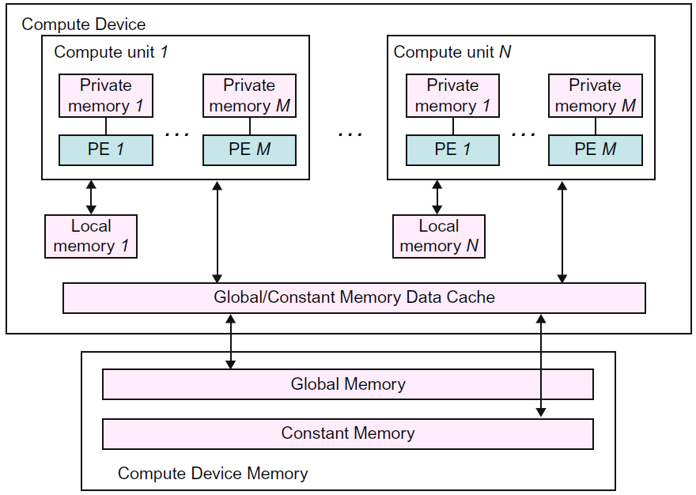
Registers in CUDA
Streaming Processors in CUDA
Shared Memory in CUDA

Slide 4
One simpler thing in OpenCL
In CUDA, to get an index, we had to determine our threadId (in 1/2/3D), then our blockId (in 1/2/3D) and do some math to get an idea of which kernel we are.
In OpenCL, the IDs are not sub-divided.
get_global_id(0) gets our threadID in the X dimension. 1 and 2 for Y,Z.
No math or multiplication.

Slide 5
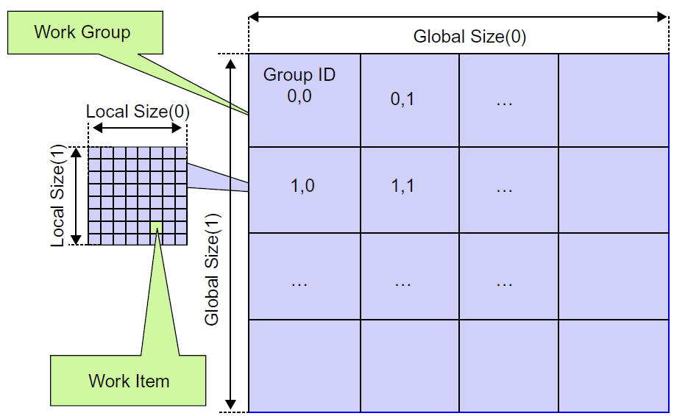

Slide 6
Our simple C=A+B example in OpenCL
__kernel void addKernel (
__global const float *a,
__global const float *b,
__global const float *c)
{
int x = get_global_id(0); // so nice…
c[x] = a[x] + b[x];
}

Slide 7
Building in OpenCL
CUDA, being NVIDIA only, has an advantage – it will always be compiled by NVIDIA’s compiler for NVIDIA graphics cards. Of course, this is also a disadvantage – the resultant code only runs on NVIDIA cards.
OpenCL is different – it is designed to be cross platform. There are some disadvantages to this.
One difficult issue is dealing with many compilers and many different devices (Intel/AMD/others)

Slide 8
The code is text?
Needing to work with any compiler means that the OpenCL system takes your kernel code as text. It compiles it on the system that it is to run on. This compilation generates assembly that can then be run on the device.
More recently, OpenCL introduced a binary format (byte code) called “SPIR-V”. This byte code can be pre-compiled and is either run directly on the device or the OpenCL system converts it to the format for the device.

Slide 9
Get the platform
The first real step in working with OpenCL is to find out what platforms and devices are available and picking one to work with.
cl_platform_id platform_id = NULL;
cl_uint num_platforms;
cl_int ret = clGetPlatformIDs(1, &platform_id, &num_platforms);
Platform – a type of processor that can execute OpenCL in your system
Consider a system with a GPU and a CPU
In this code, we are getting only the first available platform

Slide 10
Get my device
Device – an actual device in the system.
Consider a system with 2 GPUs. We have to pick which one to run on.
cl_uint ret_num_devices;
cl_device_id device_id = NULL;
ret = clGetDeviceIDs(platform_id, CL_DEVICE_TYPE_DEFAULT,
1, &device_id, &ret_num_devices);
Again, we will accept the first device (the first device of the first platform).

Slide 11
We make a context and a command queue
A context is a data structure that specified which device we are using.
A command queue holds the list of work for the device to do.
const cl_context context = clCreateContext(NULL, 1, &device_id, NULL, NULL, &ret);
const cl_command_queue command_queue = clCreateCommandQueueWithProperties(context, device_id, 0, &ret);

Slide 12
Define the program
We define our kernel as a string. C sees the following as a single line, so you can’t use // for comments. You could break it up using \n.
const char* source_str = " __kernel void addKernel ( \ __global const float *a, \
__global const float *b, \
__global float *c) \
{ \
int x = get_global_id(0); \
c[x] = a[x] + b[x];
\}
\";

Slide 13
Create and build the program
const cl_program program = clCreateProgramWithSource(context, 1,
(const char**)&source_str, (const size_t*)&source_size, &ret);
ret = clBuildProgram(program, 1, &device_id, NULL, NULL, NULL);
if (ret != CL_SUCCESS) {
size_t buildLogLen; // Get the length of the error
cl_int errcode = clGetProgramBuildInfo(program, device_id, CL_PROGRAM_BUILD_LOG, 0, NULL, &buildLogLen);
char* buffer = malloc(buildLogLen); // allocate space for error
// now go get the actual error
errcode = clGetProgramBuildInfo(program, device_id, CL_PROGRAM_BUILD_LOG, buildLogLen, buffer, NULL);
fprintf(stderr, "Build log: \n%s\n", buffer); // print to stderr
exit(1); // If our kernel doesn’t compile, no point in going on
}

Slide 14
Allocate memory on the device
Much like in CUDA, we must allocate memory on the device. Copying the data to that memory is a queued work item. Note that A,B,C have been allocated on the host elsewhere & A/B populated:
cl_mem a_mem_obj = clCreateBuffer(context, CL_MEM_READ_ONLY,
LIST_SIZE * sizeof(int), NULL, &ret);
cl_mem b_mem_obj = clCreateBuffer(context, CL_MEM_READ_ONLY,
LIST_SIZE * sizeof(int), NULL, &ret);
cl_mem c_mem_obj = clCreateBuffer(context, CL_MEM_WRITE_ONLY,
LIST_SIZE * sizeof(int), NULL, &ret);
ret = clEnqueueWriteBuffer(command_queue, a_mem_obj, CL_TRUE, 0,
LIST_SIZE * sizeof(int), A, 0, NULL, NULL);
ret = clEnqueueWriteBuffer(command_queue, b_mem_obj, CL_TRUE, 0,
LIST_SIZE * sizeof(int), B, 0, NULL, NULL);

Slide 15
Create the kernel
A kernel is the program tied to the parameters.
// Create the OpenCL kernel
const cl_kernel kernel = clCreateKernel(program, "addKernel", &ret);
// Set the arguments of the kernel
ret = clSetKernelArg(kernel, 0, sizeof(cl_mem), (void *)&a_mem_obj);
ret = clSetKernelArg(kernel, 1, sizeof(cl_mem), (void *)&b_mem_obj);
ret = clSetKernelArg(kernel, 2, sizeof(cl_mem), (void *)&c_mem_obj);

Slide 16
Actually execute the code!
// Execute the OpenCL kernel on the list
const size_t global_item_size = LIST_SIZE;
const size_t local_item_size = 64
ret = clEnqueueNDRangeKernel(command_queue, kernel, 1, NULL,
&global_item_size, &local_item_size, 0, NULL, NULL);
Then get the results back:
ret = clEnqueueReadBuffer(command_queue, c_mem_obj, CL_TRUE, 0,
LIST_SIZE * sizeof(int), C, 0, NULL, NULL);

Slide 17
Don’t forget to clean up!
ret = clFlush(command_queue);
ret = clFinish(command_queue);
ret = clReleaseKernel(kernel);
ret = clReleaseProgram(program);
ret = clReleaseMemObject(a_mem_obj);
ret = clReleaseMemObject(b_mem_obj);
ret = clReleaseMemObject(c_mem_obj);
ret = clReleaseCommandQueue(command_queue);
ret = clReleaseContext(context);

Slide 18
Error checking
It is very important to check for errors. This process has a lot of steps. When it doesn’t work, if you don’t have good error checking, finding the issue can be a daunting task.
While it is tedious, the best defense is to check all the return statuses.

Slide 19
The general workflow
On program startup: Find platforms and devices.
Choose a device.
Compile your program(s).
When you need a result: Create memory on the device
Copy data to the device
Create your kernel and set arguments
Enqueue the kernel
Get the results back
Release your kernel and memory objects
When you end the program: Release your program, context, command queue

Slide 20
That is ridiculously complex compared to CUDA
CUDA optimizes for the common case – only one GPU. When you have more than one, there are similar calls for selecting the device.
CUDA only works on NVIDIA GPUs. OpenCL works on many different platforms, so you must pick which one.
CUDA works with only one compiler and has extensions; OpenCL works on every compiler.
The C++ interface to OpenCL is much nicer, if you know C++…

Slide 21
Summary
OpenCL is the primary choice for working with non-NVIDIA GPUs
Many of the concepts from CUDA apply to OpenCL
OpenCL abstracts away the GPU specific material nicely.

