Slide 1
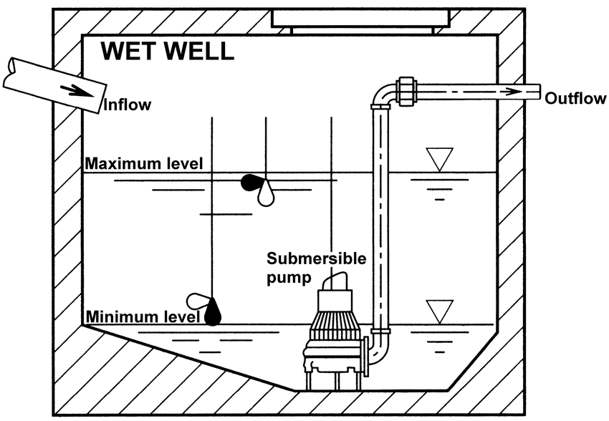
MESCC – CSLAB
Water Pumping System (WPS)
+
Remote Status Station (RSS)
Ricardo Mendes & Arthur Gerbelli

Slide 2
CONTENT
Requirement Specification
  System requirements
  Hazard Analysis
  Traceability
Implementation:
  CCSYA - Assembly
  RTAES - Concurrency and RealTime Scheduling
  COMCS - Communication Infrastructure
Prototype

Slide 3
REQUIREMENTS SPECIFICATION – System Requirements
WPS:
SN-1.1 
SN-1.2 
SN-1.3 
SN-1.4 
SN-1.5 
SN-1.6 
RSS:
SN-2.1  The status of all WPS shall be displayed on all RSS.
SN-2.2 
SN.2.3  The RSS shall have an independent power supply from the WPS
SN.2.4  The alarm on the RSS shall have an independent power supply
Web Server:
SN-3.1 

Slide 4
REQUIREMENTS SPECIFICATION – Hazards Analysis
H-1 
H-2 
H-3  A pump doesn't turn OFF when the water level in bellow minimum.
H-4 
H-5  Independent power supplies
H-6 
H-7  RSS stops working.
H-8  Control Unit stops working.
H-9  Rapid wear of the first water pump.

Slide 5
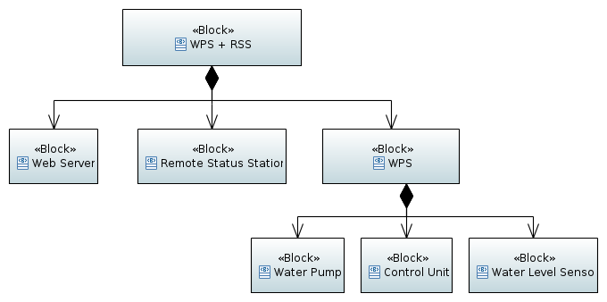
REQUIREMENTS SPECIFICATION – Traceability

Slide 6
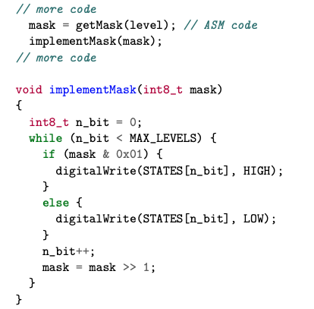
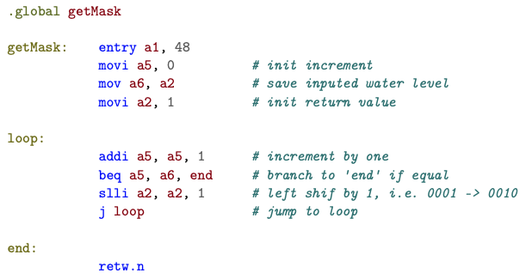
IMPLEMENTATION – CCSYS Assembly

Slide 7
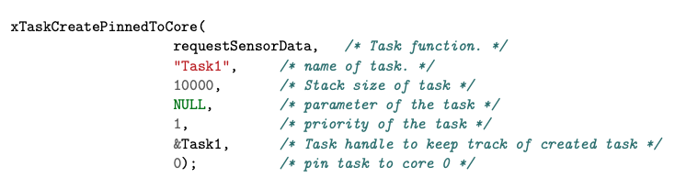
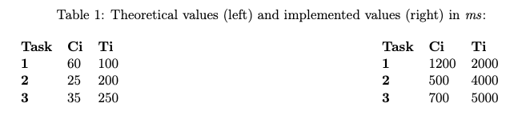
IMPLEMENTATION – RTAES RT Scheduling
20 x

Slide 8
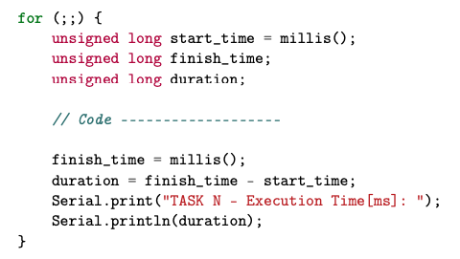
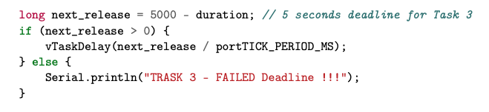
IMPLEMENTATION – RTAES RT Scheduling
Calculate Execution time:
Warning when deadline fails:

Slide 9
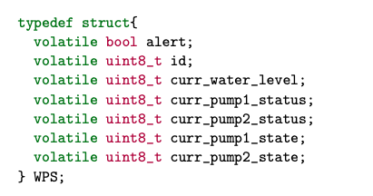
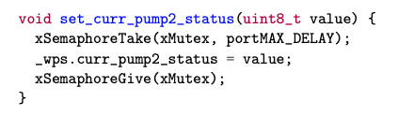
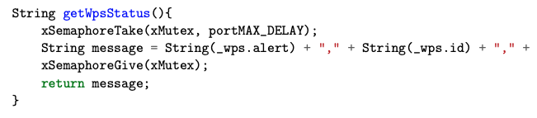
IMPLEMENTATION – RTAES Concurrency
WPS status:
Update WPS status:
Read WPS status:

Slide 10
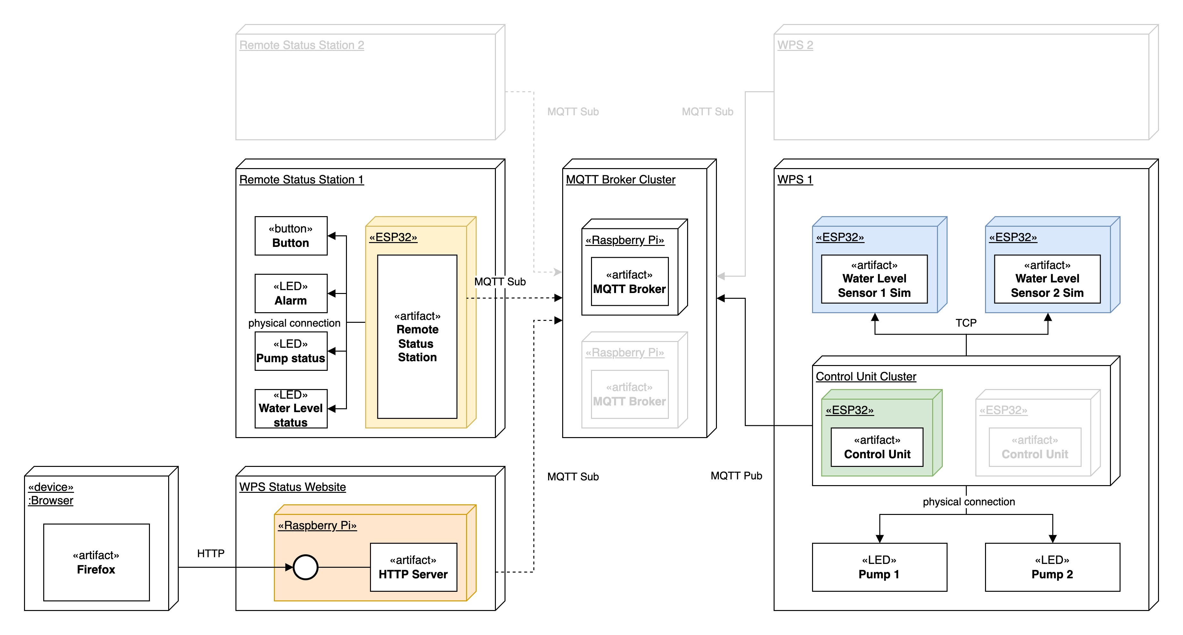
IMPLEMENTATION – COMCS Communication

Slide 11
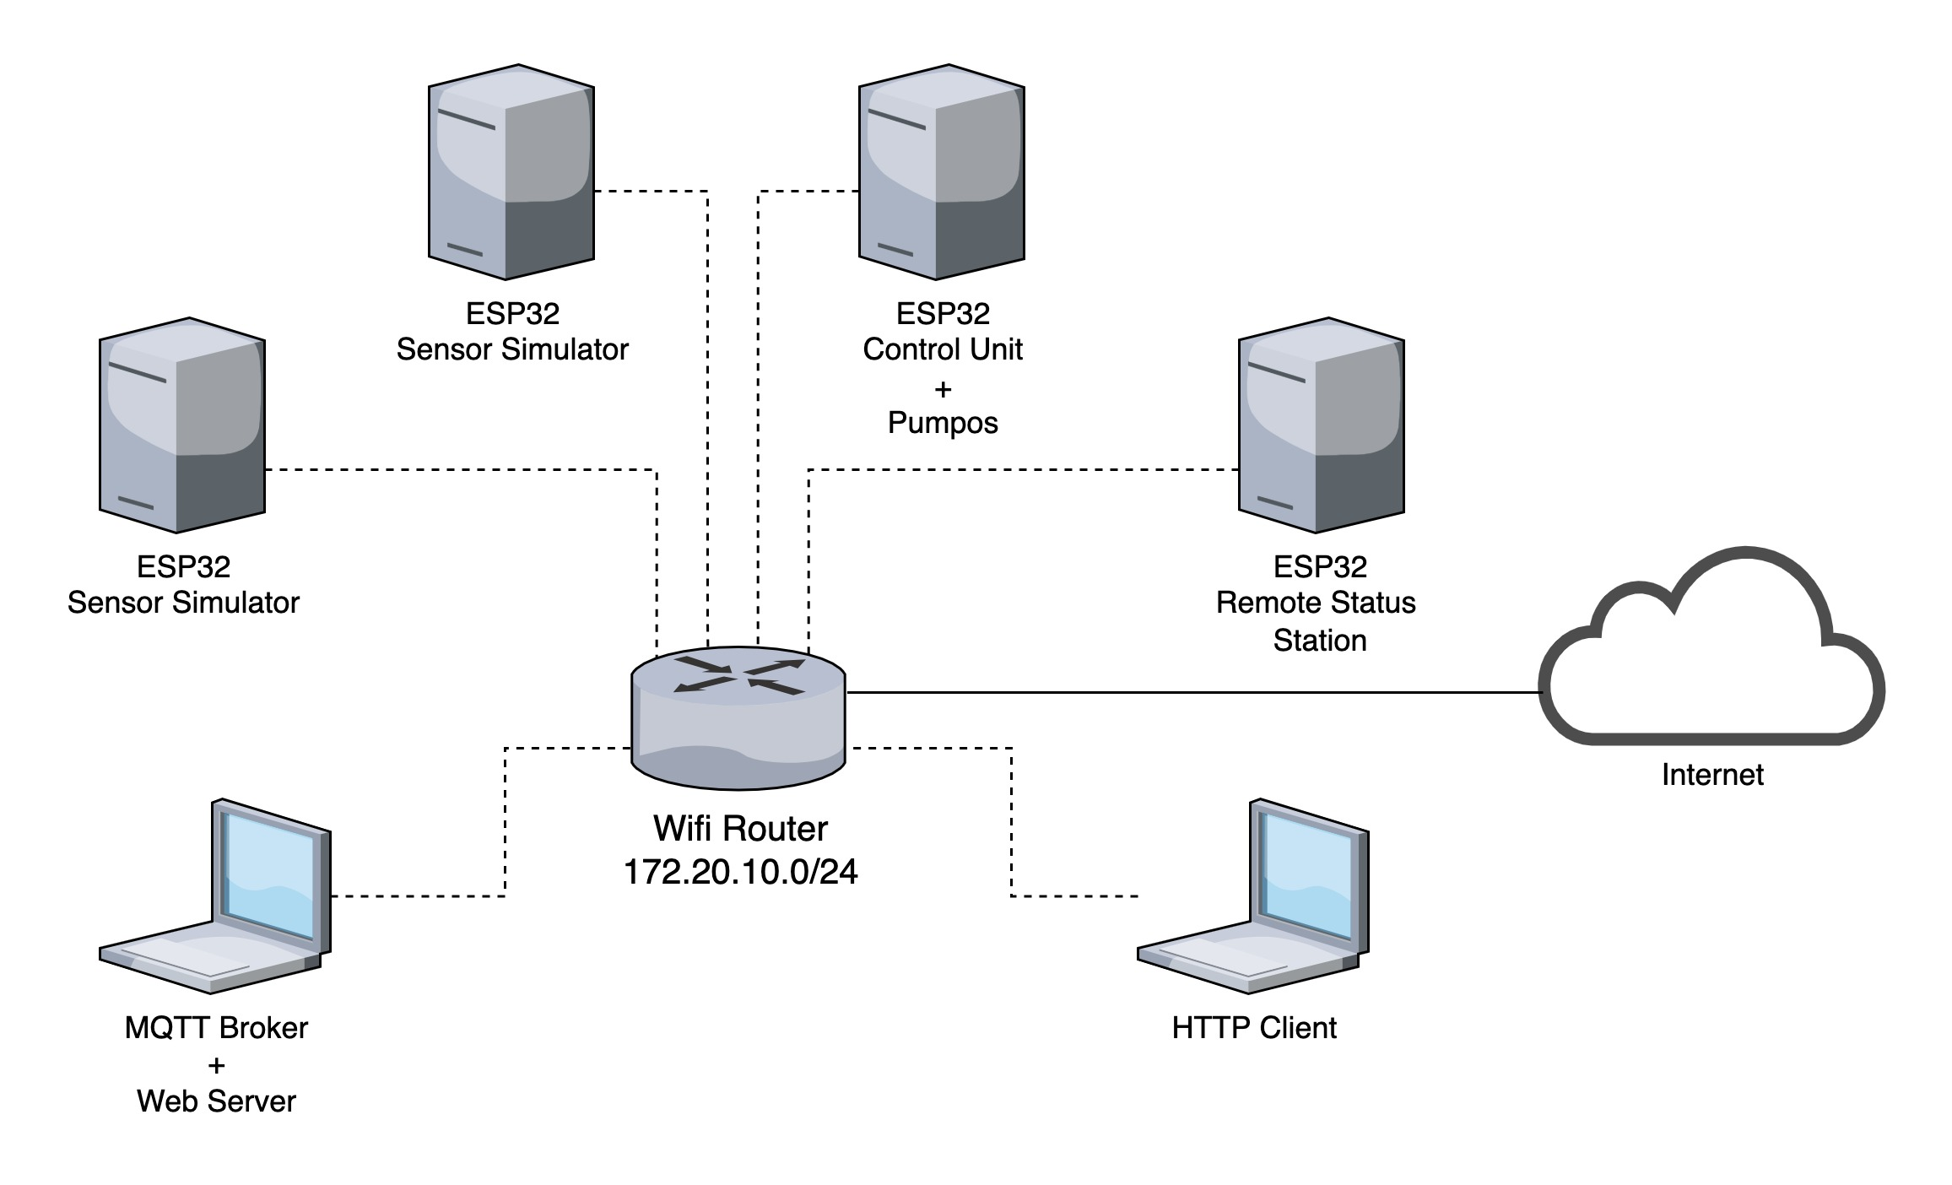
PROTOTYPE – Network diagram

Slide 12
PROTOTYPE – Test Cases
SR-1.1 While the water level is above the minimum level, WPS shall have a pump working.
SR-1.2 When the water level is below the minimum level, WPS shall have all pumps stopped.
SR-1.3 If the water level is above the maximum level, then the WPS shall trigger an alarm at the Remote Status Station (RSS).
SR-1.4 A second pump shall be turned on only when the water level is above 2/3 the maximum water level.

Slide 13
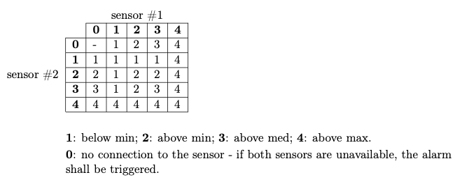
PROTOTYPE – Test Cases
SR-1.5 When only one pump is available, the maximum water level shall be reduced to 2/3.
SR-1.6 If the readings of the sensor are uneven, the system shall choose the worst case scenario, following the table below:

Slide 14
PROTOTYPE – Test Cases
SR-2.2 If the alarm is ON, the button in the RSS shall only disable it.
SR-3.1 The status of all WPS shall be visible on a web page.
H-2 Both pumps stopped working.
H-6 RSS are not getting information from WPS.

