Slide 1
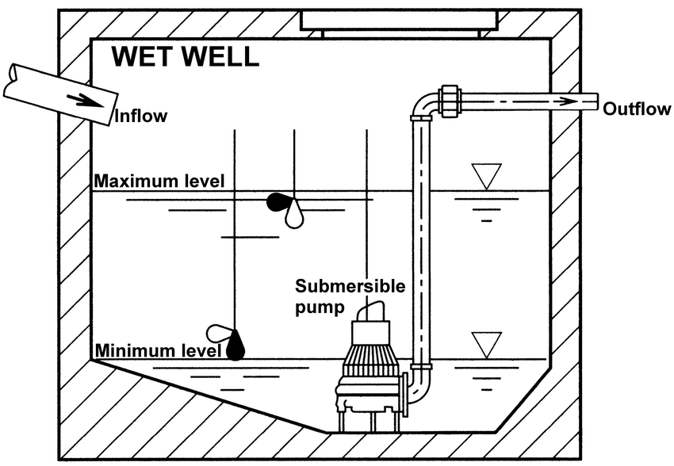
MESCC – CSLAB
Water Pumping System (WPS)
+
Remote Status Station (RSS)
Ricardo Mendes & Arthur Gerbelli

Slide 2
CONTENT
Requirement Specification [Update]
Implementation:
  Concorrency and RealTime Scheduling
  Communication Infrastructure
  Implementation using Assembly
Demo

Slide 3
REQUIREMENTS SPECIFICATION – Stakeholder Needs
SN-1.3 Every WPS will have two pumps and two water level sensors to achieve a certain level of redundancy and reliability on the system.
SN-1.4 To improve the system’s performance, and given that we have one unused water pump, this pump should be used when the water level is above 2/3 of the well max capacity.
SN-1.5 In case that only one water pump is operational, the max capacity of the WPS shall be reduced.

Slide 4
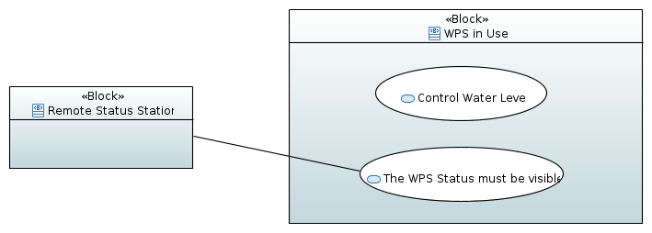
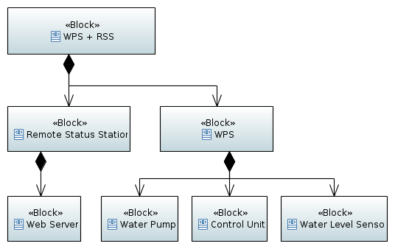
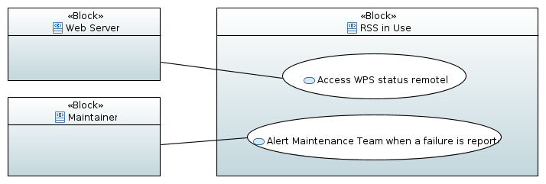
REQUIREMENTS SPECIFICATION – Use Cases & System’s Structure

Slide 5
REQUIREMENTS SPECIFICATION – Hazards Analysis
Description: The two level sensors give contradictory readings.
Cause: Sensor malfunction, connection issues.
Effect: Inappropriate system behavior.
Mitigation: If the reading of both sensor are too unequal, there must be a way to distinguish between the wrong and the correct data. There are three possible ways to deal with the issues: choose a master and a slave sensor, retain the previous input and compare it with the current one, or choose the worst case. Trigger the alarm if the system in unable to achieve a consensus.
Description: Control Unit stops working.
Cause: Malfunction, bug.
Effect: Total failure of the system.
Mitigation: Implement redundancy by having a cluster of nodes running the Control Unit. If the number of nodes is 3 we can implement a voting system and run the same process with the same input in parallel. This would improve the system’s fault tolerance.

Slide 6
REQUIREMENTS SPECIFICATION – Requirements Update
1.4: A second pump shall be turned on only when the water level is above 2/3 the maximum water level.
1.5: When only one pump is available, the maximum water level shall be reduced to 2/3.
1.6: If the readings of the sensor are uneven to a level of 20cm, the system should choose the worst case scenario.
2.3: The RSS shall have an independent power supply from the WPS.
2.4: The alarm on the RSS shall have an independent power supply from the RSS itself and from the WPS.
4.1: To improve the system ́s communication reliability, a cluster of 2 MQTT brokers shall be deployed.

Slide 7
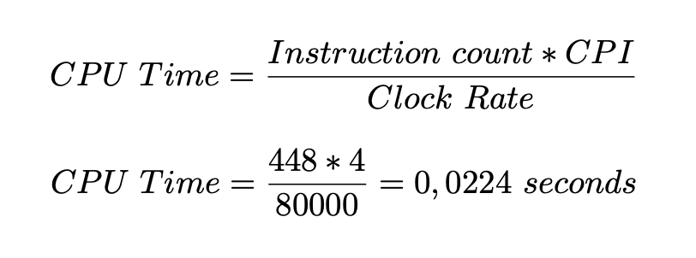
IMPLEMENTATION – Concorrency and Real Time Scheduling
Hardware specification for an ESP-WROOM-32:
• Clock rate: 80 to 240 MHz
• Clock cycle per instruction (CPI): 2 clock cycles — for instructions following ALU and branch instructions. 4 clock cycles — in other cases.
$ avr-objdump -m avr -S control-unit.ino.cpp.o | wc -l
output –> 448

Slide 8
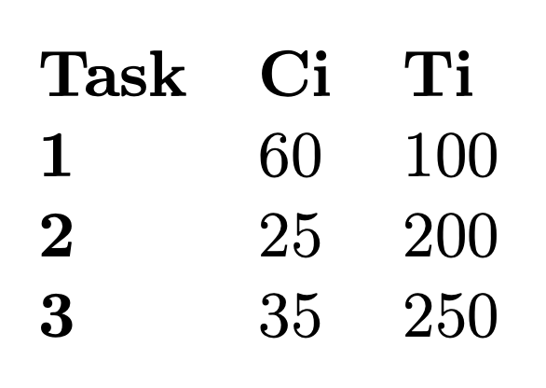
IMPLEMENTATION – Concorrency and Real Time Scheduling
The Control Unit will run three tasks:
• T1: Retrieve data from sensors (TCP Client);
• T2: Process data and give instructions to pumps;
• T3: Publish WPS status to MQTT broker (MQTT client).
… and share one specific resource: a data structure with the WPS status, pump status, water level status and alert status.

Slide 9
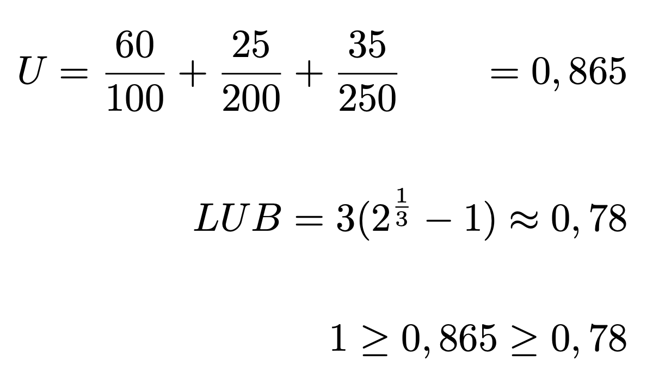
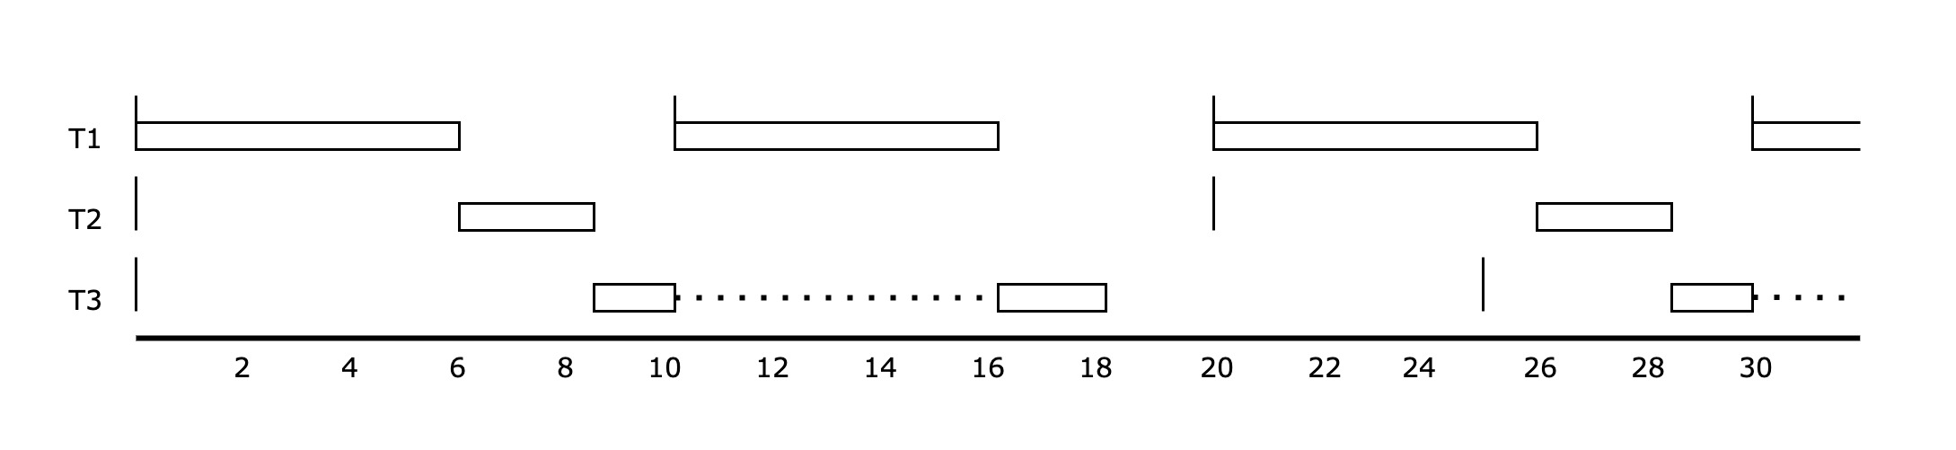
IMPLEMENTATION – Concorrency and Real Time Scheduling
CPU utilization doesn′t exceed 100%
but cannot confirm that it is schedulable!

Slide 10
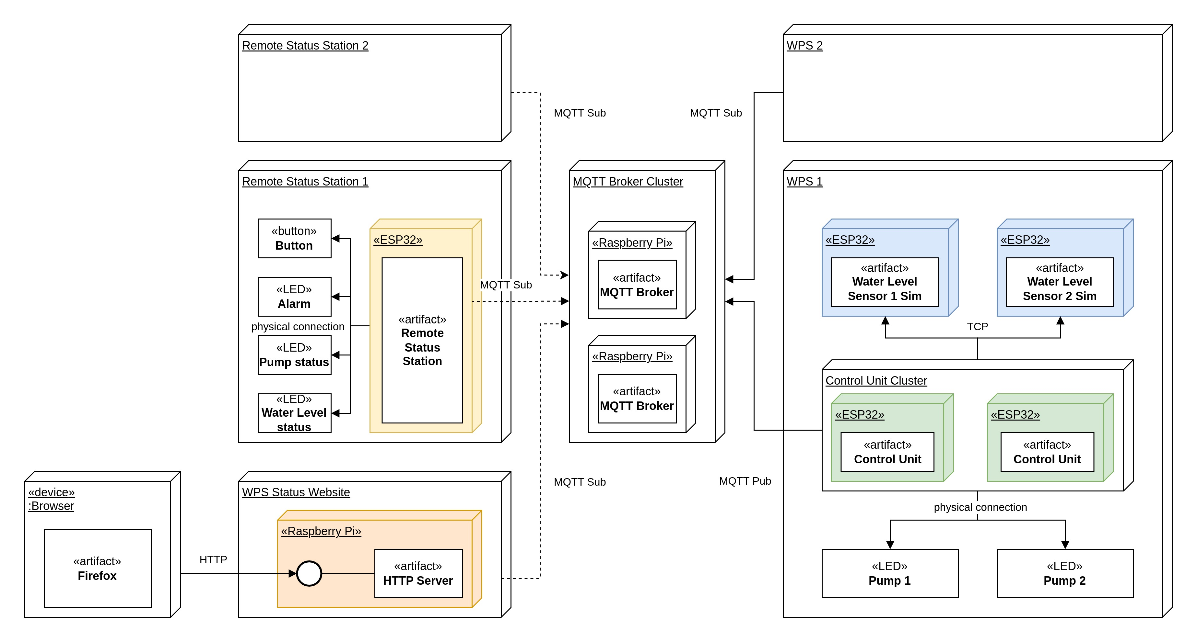
IMPLEMENTATION – Communication Infrastructure

Slide 11
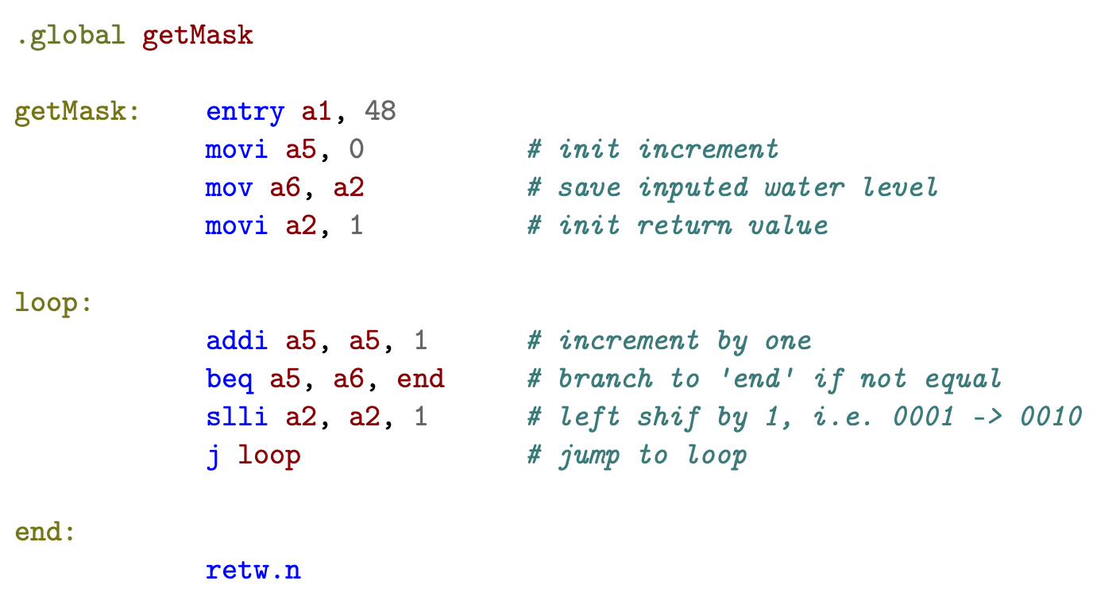
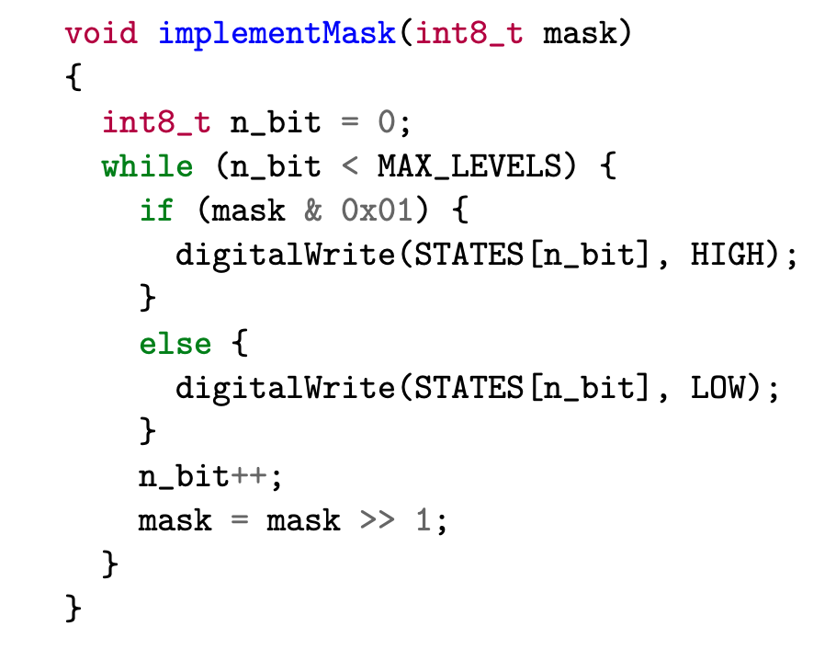
IMPLEMENTATION – Assembly Implementation

Slide 12
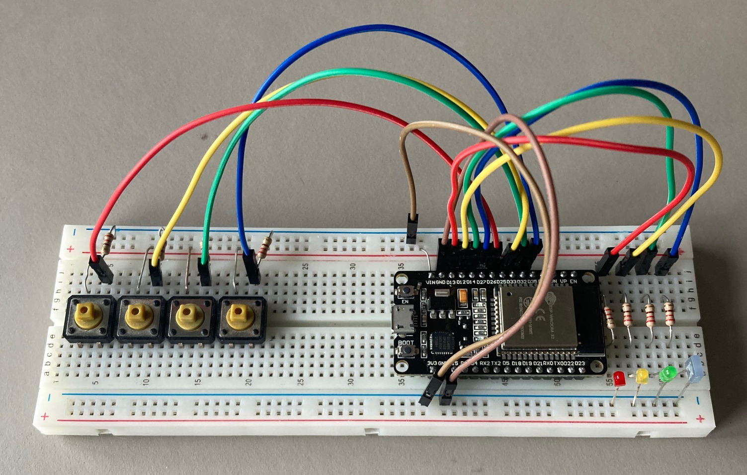
DEMO
VIDEO TIME !

