Slide 1






meshlesS Pressure from Image veloCimetrY
P. Sperotto
former Politecnico di Torino, von Karman Institute, and currently at Dantec Dynamics
M. Ratz,
former TU Ilmenau,
currently at von Karman Institute
Sandra Pieraccini
Politecnico di Torino
M. A. Mendez
von Karman Institute

Slide 2
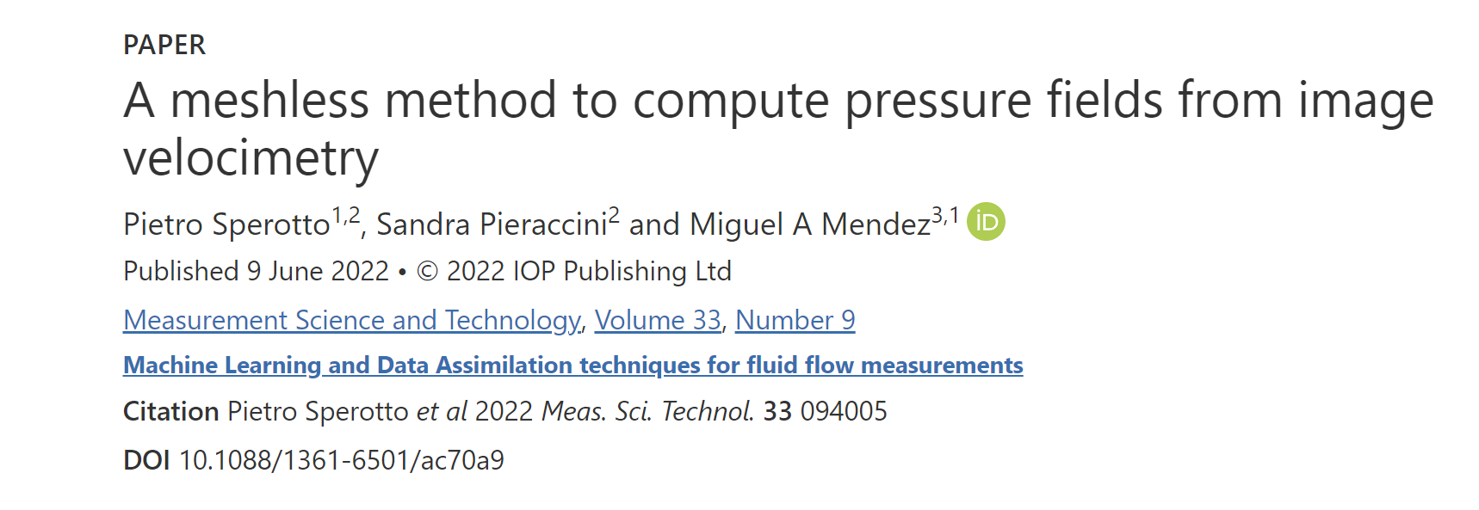
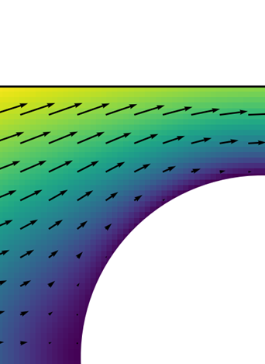
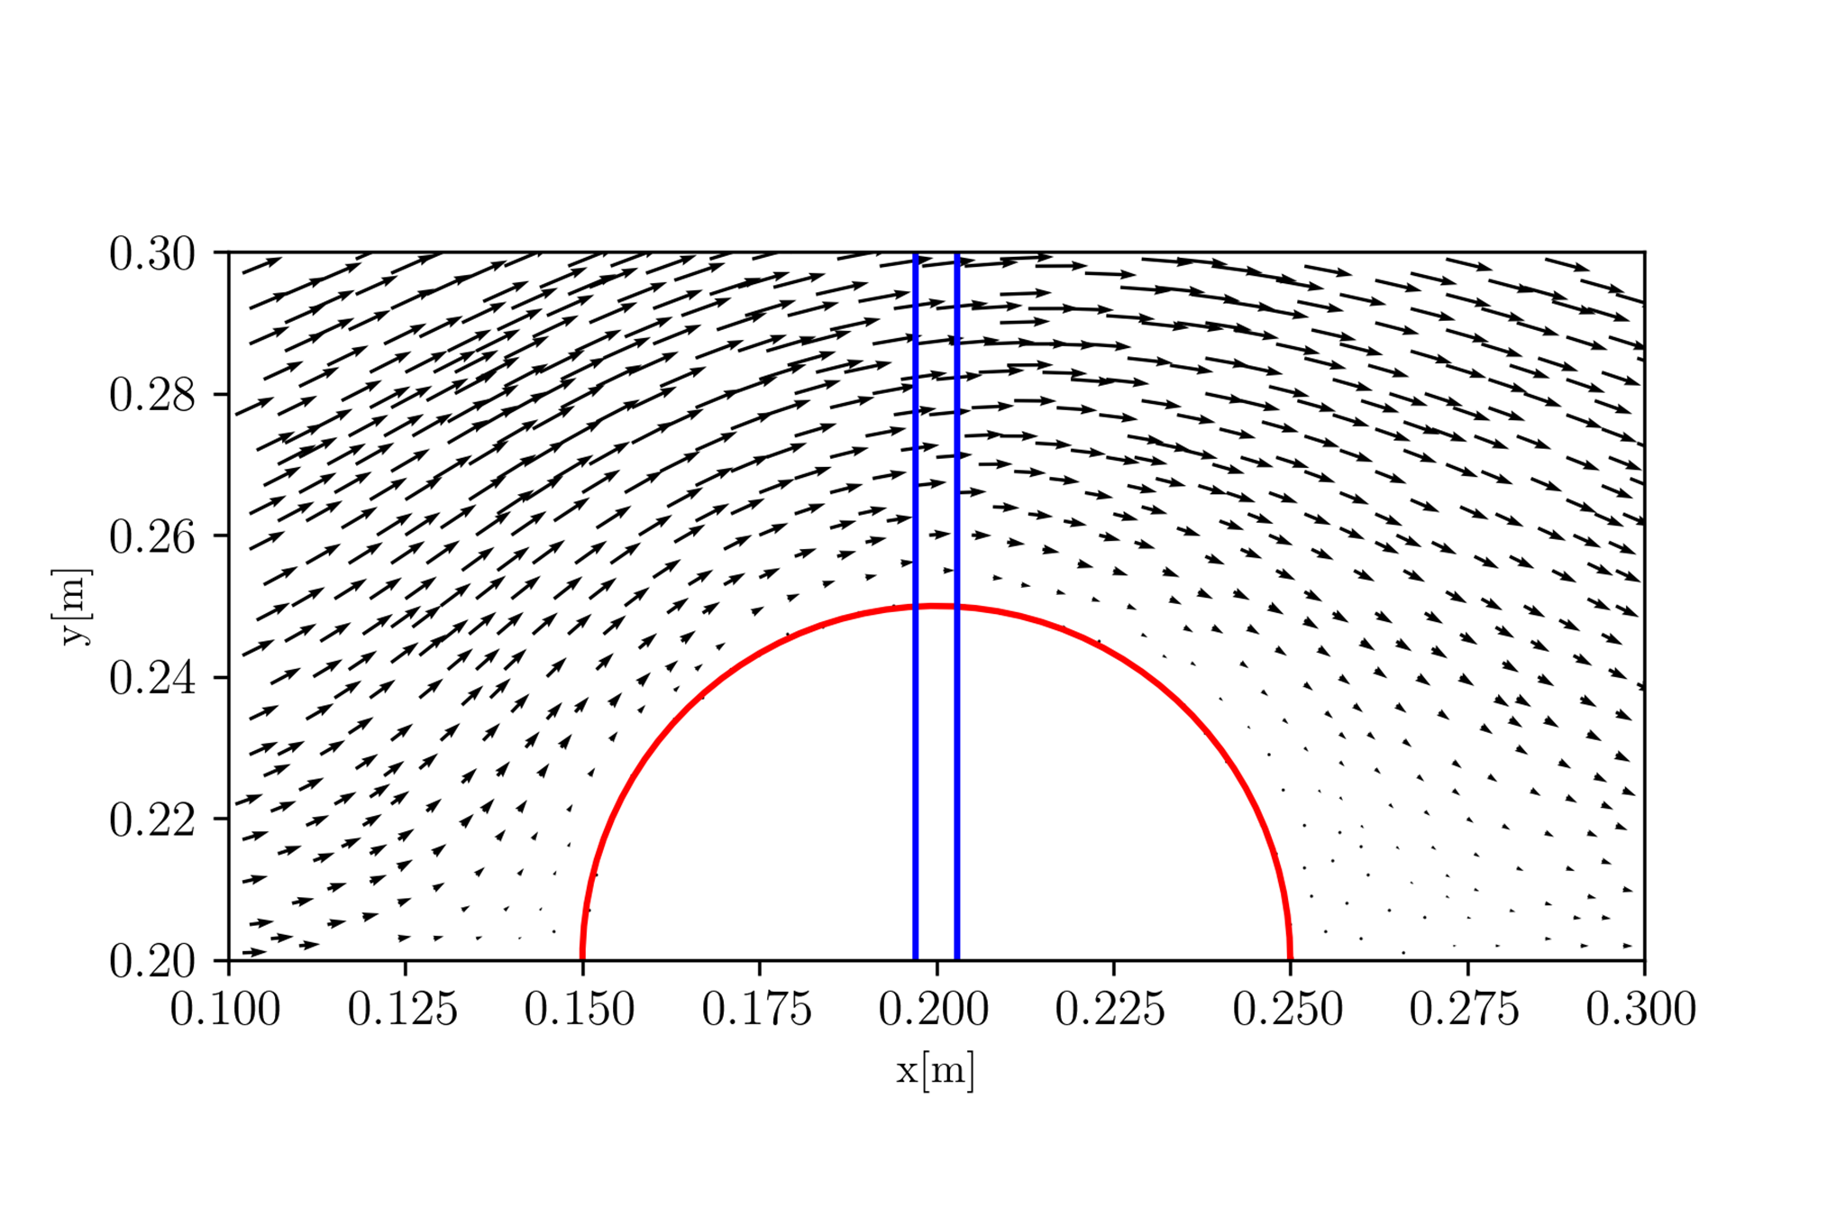
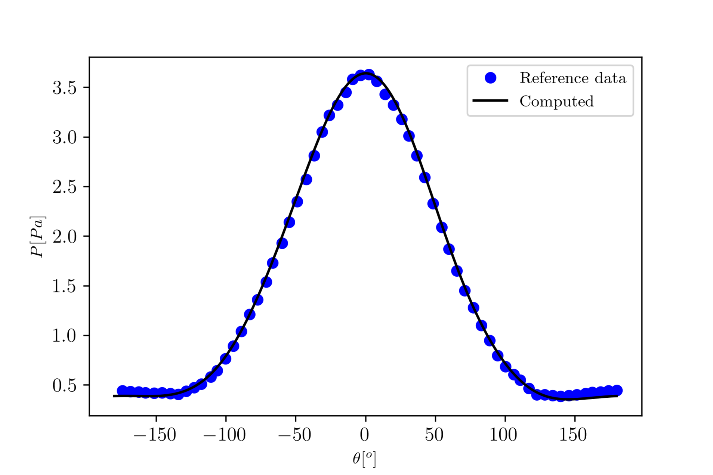


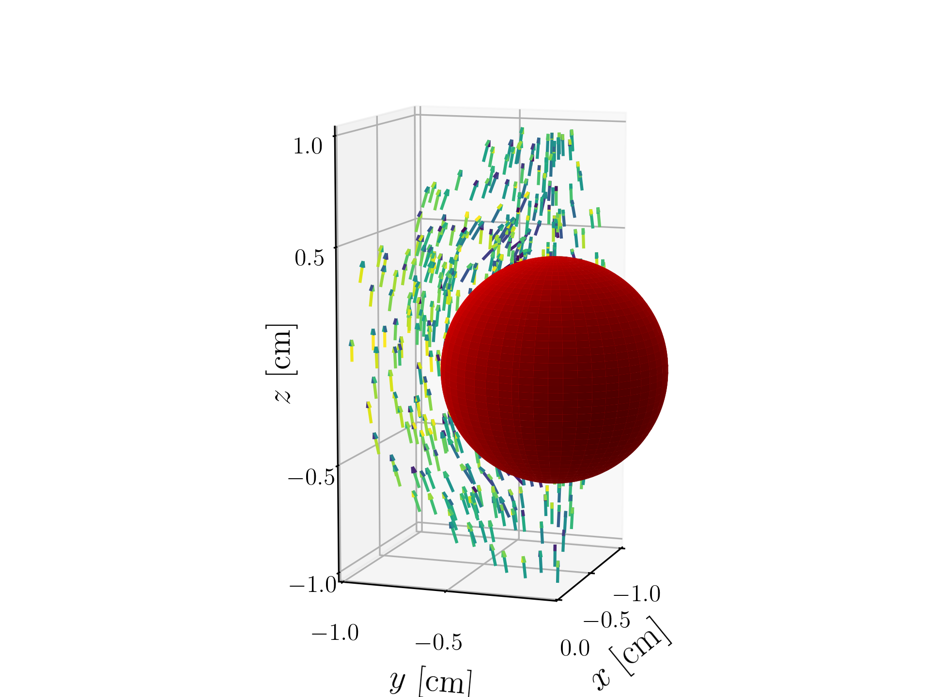
Scattered velocity data
Analytical pressure field
Pressure around the cylinder
Pressure reconstruction from scattered velocity data on a 2D cylinder flow (left) and a 3D Stokes flow (right)

Slide 3
Table of Contents
Theory of constrained RBF Regression and Meshless PDE Integration
An overview of the SPICY class in Python
Tutorial 1: the Laplace equation in 2D
Tutorial 2: Penalized regression of a vector field in 2D
Tutorial 3: Form constrained velocity regression to pressure computation
Tutorial 4: A 3D case of data assimilation -the Stokes flow
Ongoing works and perspectives (by Manuel Ratz)

