Slide 1
Case Studies
Stefan Wagner

Slide 2
Migrating to Microservices
Notes:
Many companies evaluate whether it is useful for them to jump on the microservices bandwagon and break down more monolithic software architectures into small services. When this is useful and which what challenges this comes is mostly unknown.

Slide 3
Research Objective
Our overarching research objective is to analyze the migration process from monolithic architectures to Microservices on the basis of real-world systems in industry practice.

Slide 4
Research Questions
RQ1: What are intentions for migrating existing systems to Microservices?
RQ2: Which Microservices migration strategies and decomposition approaches do companies apply?
RQ3: What are the major technical and organizational
challenges during a Microservices migration?

Slide 5
Data Collection
16 semi-structured interviews about 14 different industrial systems
Interviews were recorded and transcribed.

Slide 6
Data Analysis
Qualitative coding
Main categories: Intentions, Strategies, Challenges
Followed constant comparison of Grounded Theory

Slide 7
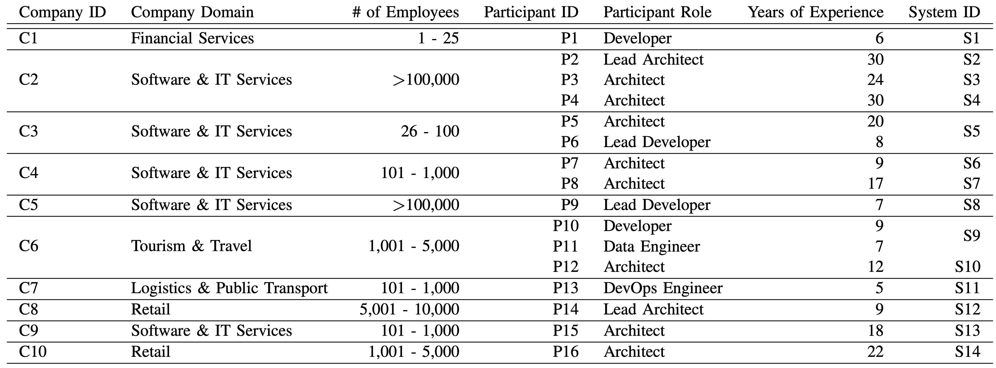
Companies and Participants

Slide 8
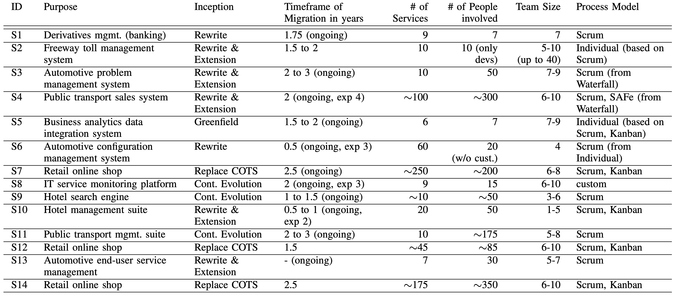
Systems and Projects

Slide 9
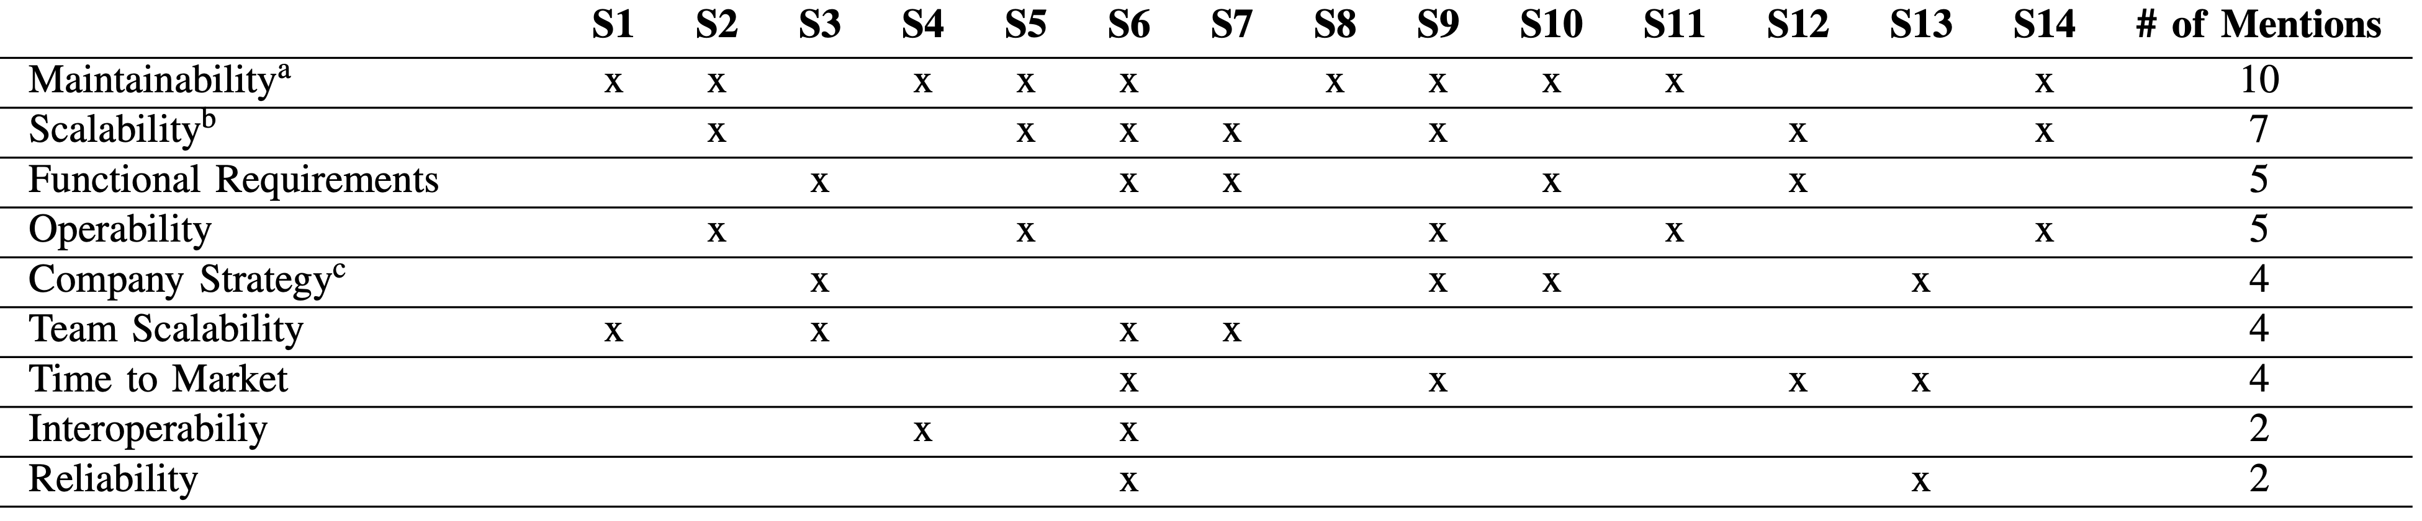
Intentions

Slide 10
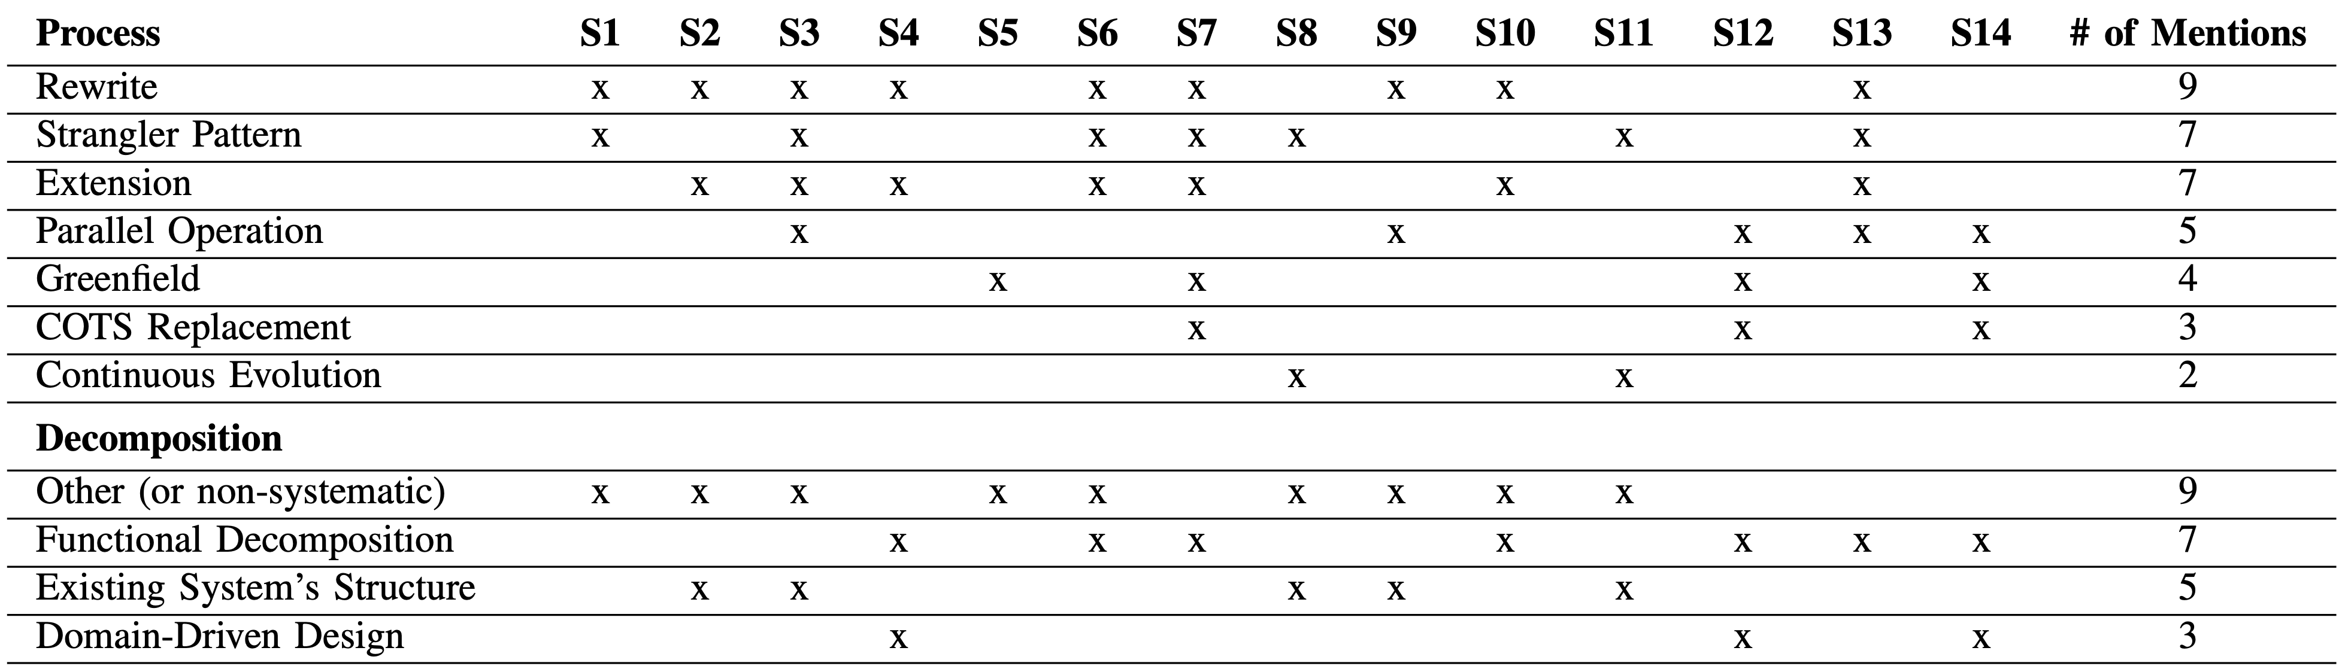
Strategies

Slide 11
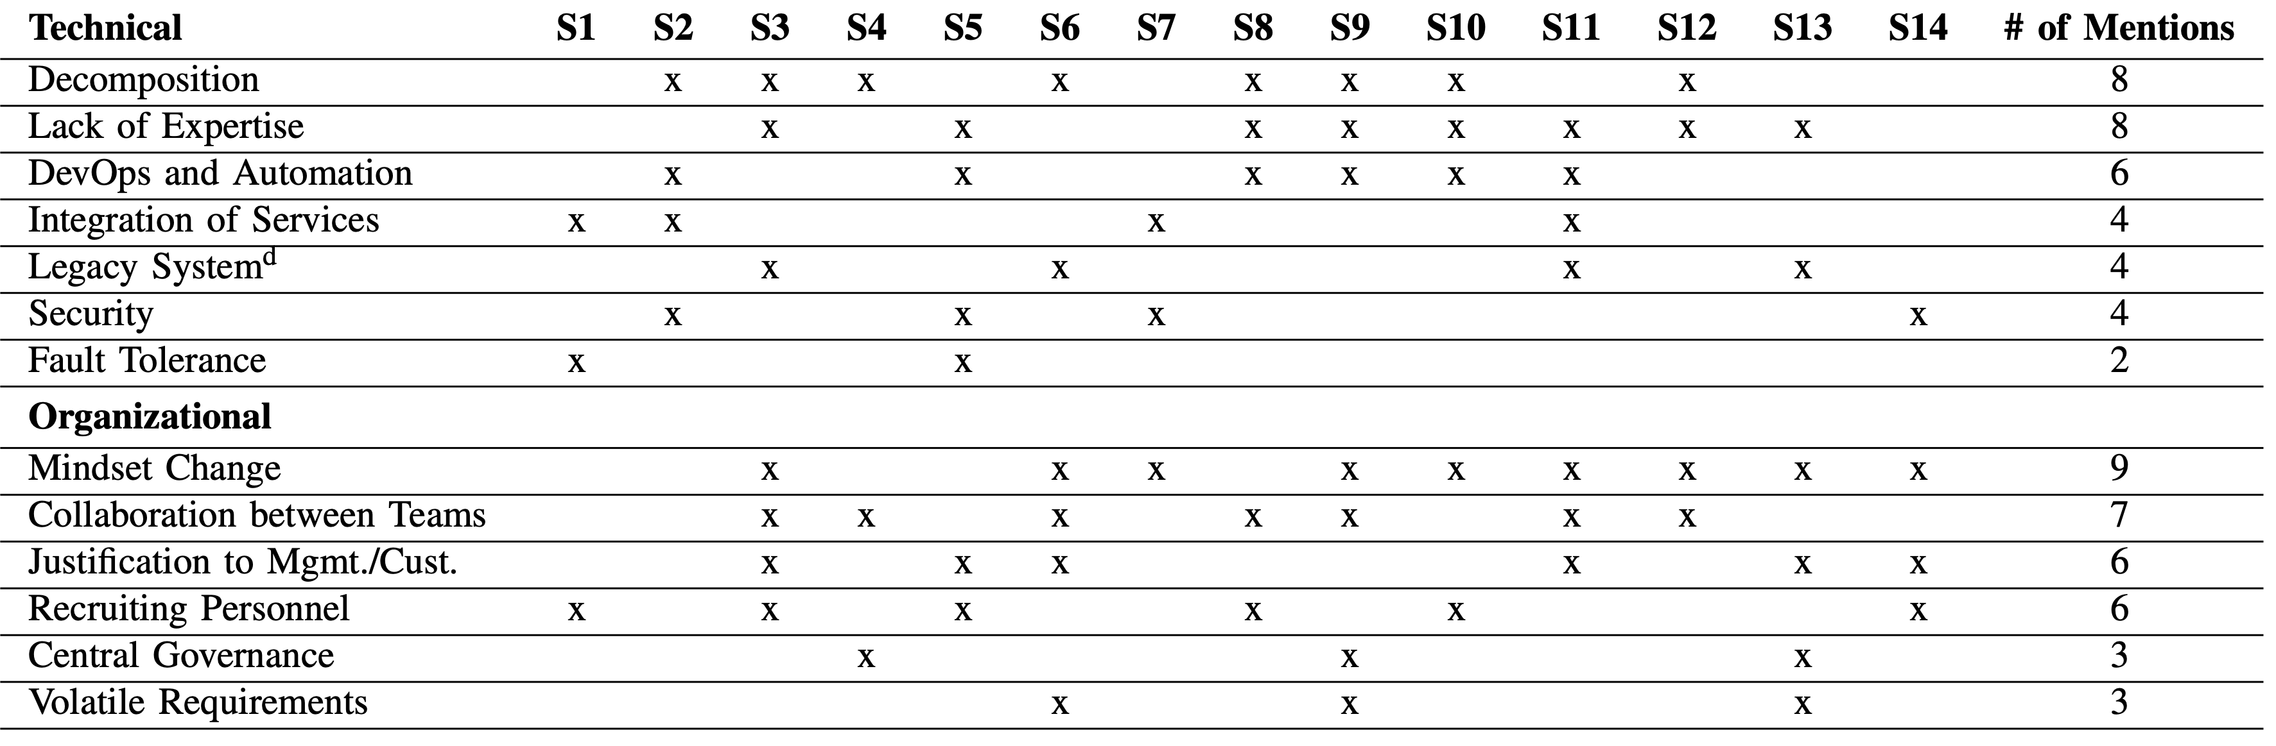
Challenges

Slide 12
Case Study – Definitions
Empirical inquiry, in which …
a contemporary phenomenon is investigated within its real-life context
boundaries between phenomenon and its context are not clearly evident
Notes:
Definition from Perry DE, Sim SE, Easterbrook S (2005) Case studies for software engineers, 29th Annual IEEE/NASA Software Engineering Workshop—Tutorial Notes pp 96–159

Slide 13
Case Study – Definitions
Empirical inquiry, which …
copes with the technical distinctive situation in which there will be many more variables of interest than data points,
relies on multiple sources of evidence (data needs to be converged) and
benefits from prior development of theoretical propositions to guide data collection and analysis (or generates a new theory).
Notes:
Definition based on Perry DE, Sim SE, Easterbrook S (2005) Case studies for software engineers, 29th Annual IEEE/NASA Software Engineering Workshop—Tutorial Notes pp 96–159.
Runeson et al. (2012) add that there is a „lack of experimental control“.

Slide 14
Smaller sample
Less control
Realistic environment
Experiment
Survey
Much smaller sample
Wider range of data collection
Potentially direct observation
Case Study
Less focus on change
Action Research
Notes:
There are several other research methods that are close to case study research. We have already discussed experiments in detail. They are focused on finding cause-effect relationships in a controlled setting. A case study is in a realistic setting and, therefore, cannot be as controlled. Hence, we can still look for potential cause-effect relationships but we cannot show them as with an experiment. Furthermore, the sample size is typically smaller.
We will discuss surveys a bit later on. They are used to collect data from a complete population or a large sample of it. It is usually performed using questionnaires. The goal is usually to get an overview. A case study, in contrast, focuses on a few cases using a wider range of data collection methods, sometimes involving direct observation. Hence, we look into depth instead of breadth.
Finally, action research is very close to case study research. Some even see action research as a special case of a case study. In action research, the focus in on the change in the phenomenon (in SE often meaning process improvement). This does not have to be the case in case study research.

Slide 15
Types of Case Studies
Improving
The studied phenomenon is improved in some way
Close to action research
Example: Does the introduction of user stories lead to less effort in requirements engineering?
Example: Does this new hazard analysis technique find more hazardous scenarios?
Exploratory
Criteria or parameters instead of purpose
Example: Are static analysis tools used and if yes, why?
Example: What do CMM level 3 organisations have in common?
Notes:
This classification is as described in Runeson et al. (2012).

Slide 16
Types of Case Studies
Explanatory
Adjudicates between competing explanations
Example: Does the usage of static analysis tools reduce the number of field defects?
Rival theories: existing architectures are useful for anchoring, vs. existing architectures are over-constraining during RE
Descriptive
Describes sequence of events and underlying mechanisms
Example: How does pair programming actually work?
Example: How is static analysis used in practice?
Notes:
This classification is as described in Runeson et al. (2012).

Slide 17
Overview of Research Strategy Characteristics
 | Experiment | Survey | Case Study | Action Research
Primary Objective | Explanatory | Descriptive | Exploratory | Improving
Primary Data | Quantitative | Quantitative | Qualitative | Qualitative
Design Type | Fixed | Fixed | Flexible | Flexible
Notes:
The table is from Runeson et al. (2012). It oversimplifies a bit because, as we already saw, case studies can have different objectives. They can also use quantitative or mixed-method data. Experiments could also use qualitative data. And there are many more examples that would contradict the table. Nevertheless, in many instances, the research designs follow this general direction.

Slide 18
Survey
After establishing a phenomenon,
study it in more detail for a better understanding,
e.g. explanations.
in-vitro
Experiment
After showing cause-effect relationships, investigate influencing factors in practice or whether it can improve practice.
Case Study
in-vivo
Notes:
Case studies can be included in a larger research process in many ways. A standard way would be to first run experiments investigating a phenomenon to understand cause-effect relationships. After we established those effects in the lab (also called in-vitro), we go into the real practice of software development to investigate the phenomenon there (also called in-vivo). It is potentially possible to run in-vivo experiments, but in software engineering, we have usually difficulties getting a large enough sample and control all variables while still being in a realistic environment. The case study method is the solution to that problem. We give up control and try to make up on that by being more comprehensive and flexible in the data collection and analysis.

Slide 19
Example
Let’s assume we have found our new static analysis tool in our experiments to be quite effective and efficient in our experiments.
Now we want to understand static analysis and especially our new tool in a realistic setting.
Therefore, we need to perform a case study that helps us to understand what are current problems with static analysis and how well developers could work with our tool.

Slide 20
Study idea
Case Study Process
Questionnaires, interview guidelines, …
Case study design
Preparation for data collection
Conclusions
Collecting evidence
Analysis of collected data
Study design
Reporting
Study data
Case study report
Notes:
Similar as for experiments, we have a process for performing a case study. Here, we have more flexibility and, hence, there might be even more iterations than in an experiment.

Slide 21
Rationale and Objective of the Study
Rationale: A research gap or practical problem
Objective: What do we want to achieve with the study?

Slide 22
Theory
Deduction
Hypothesis
Induction
Case Study
Comparison
Observation
Notes:
In our first lecture, we have already discussed the deductive and inductive method to approach research. Experiments were clearly on the deductive side trying to test hypothesis based on observation.
Case studies are now an example for a research method that can be used in an inductive or a a deductive way. „An exploratory case study has inductive characteristics, while an explanatory case study has deductive characteristics.“ (Runeson et al. 2012)

Slide 23
Single-case study
Multiple-case study
Context
Context 1
Context 2
Case = Unit of Analysis
Case 1 = Unit of Analysis 1
Case 2 = Unit of Analysis 2
Holistic case study
From: Runeson et al. (2012) which is based on Yin (2003)
Context
Context 1
Context 2
Case
Case 1
Case 2
Unit of Analysis 1.1
Unit of Analysis 2.1
Unit of Analysis 1
Unit of Analysis 2
Embedded case study
Unit of Analysis 1.2
Unit of Analysis 2.2
Notes:
One important decision in the design is: What is the case and what the unit of analysis? The usual candidate for case is a software project. We often cannot comprehensively investigate a whole project (or even several ones). Therefore, we can also choose smaller units of analysis such as specific developers or specific activities of the developers (e.g. applying static analysis). We speak of holistic case studies, if it would be hard to separate the case into smaller units of analysis. For example, if we investigate the introduction of a new development process, we probably need to look at the whole project.
If we have cases from several contexts, we speak of multiple-case studies.

Slide 24
Theoretical Framework
What is the theoretical frame of reference?
Literature study
Cognitive theories
Social theories
Organisational theories
…
Notes:
We will come back to the topic of theories and theory building in a later lecture. „However, defining the theoretical frame of reference of the study makes the context of the case study research clear, and helps both those conducting the research and those reviewing its results. As theories are underdeveloped in software engineering, the frame of reference may alternatively be expressed in terms of related work which the study builds upon, the viewpoint taken in the research and the background of the researchers.“ (Runeson, 2012)

Slide 25
Research Questions and Hypotheses
Every case study should have research questions.
But not every case study can have hypotheses.
Notes:
As we saw for experiments, explicit research questions guide us in choosing the right study design. Hypotheses are more refined implementations of these research questions. It might, however, not be possible or appropriate to formulate concrete hypotheses already in the design of a case study (e.g. exploratory studies).

Slide 26
Case Selection
Extreme/deviant: To obtain information on unusual cases, which can be especially problematic or especially good in a more closely defined sense.
Maximum variation: To obtain information about the significance of various circumstances for case process and outcome (e.g., three to four cases that are very different on one dimension: size, form of organisation, location, budget).
Critical: To achieve information that permits logical deductions of the type, “If this is (not) valid for this case, then it applies to all (no) cases.”
Paradigmatic: To develop a metaphor or establish a school for the domain that the case concerns.
From: Flyvbjerg (2007) as cited in Runeson et al. (2012)

Slide 27
Triangulation
Interviews
Repository Mining
Expert for Phenomenon
Neutral Person
Direct Observations of Developers
Method Expert
Data Triangulation
Observer Triangulation
Quantitative Data Collection
Qualitative Data Collection with Observations
Cognitive Load
Stress
Qualitative Data Collection with Interviews
Organisational
Methodological Triangulation
Theory Triangulation
Notes:
We briefly mention triangulation already as a solution to some validity threats. It is described, for example, in Runeson et al. (2012) and Stake (1995):
Data (Source) Triangulation – using more than one data source or collecting the same data at different occasions.
Observer Triangulation – using more than one observer in the study.
Methodological Triangulation – combining different types of data collection methods, for example, qualitative and quantitative methods.
Theory Triangulation – using alternative theories or viewpoints.

Slide 28
Threats to Validity
Threat to | Case study tactic | Phase of research in which tactic occurs
Construct Validity | Use multiple sources of evidence Establish chain of evidence Have key informants review draft report | Data collection Data collection Composition
Internal Validity | Do pattern-matching Do explanation-building Address rival explanations Use logic models | Data analysis Data analysis Data analysis Data analysis
External Validity | Use theory in single-case studies Use replication logic in multiple-case studies | Research design Research design
Reliability | Use case study protocol Develop case study database | Data collection Data collection
Notes:
Conclusion validity is not explicitly mentioned because we cannot show a causal relationship in a case study. Instead, we try to make the data collection and analysis as reliable as possible to gain confidence in the validity of the results.

Slide 29
Design Checklist
What is the case and its units of analysis?
Are clear objectives, preliminary research questions, hypotheses (if any) defined in advance?
Is the theoretical basis – relation to existing literature or other cases –defined?
Are the authors’ intentions with the research made clear?
Is the case adequately defined (size, domain, process, subjects…)?
Is a cause-effect relation under study? If yes, is it possible to distinguish the cause from other factors using the proposed design?
Does the design involve data from multiple sources (data triangulation), using multiple methods (method triangulation)?
Is there a rationale behind the selection of subjects, roles, artefacts, viewpoints, etc.?
Is the specified case relevant to validly address the research questions (construct validity)?
Is the integrity of individuals/organisations taken into account?
Notes:
Checklist from Runeson, P. and Höst, M. (2009). Guidelines for conducting and reporting case study research in software engineering. Emp. Softw. Engg. 14, 2 (April 2009), 131-164.

Slide 30
Refactoring
Let’s assume that our experiment on the effects of specific refactorings did not show any statistically significant results. Yet, there are many practitioners advocating it. Hence, we want to understand its usage and effects in practice!
Make a rough case study design!

Slide 31
Data Collection Methods
Convergance of Evidence
Documents
Focus Group
Archival Records
qualitative, quantitative, combination
triangulation “to bring the data together”
Fact
Observations
Interviews
Based on slide deck „Empirical Software Engineering Lecture“ by Andreas Jedlitschka published under CC BY-SA-NC

Slide 32
Principles of Data Collection
Use multiple data sources: Triangulation, i.e. searching convergent findings from different sources (→ Increase construct validity)
Create a case study database
Content
Case study notes (clear & available for later use)
Case study documents
Tabular materials (collected & created)
Narratives (initial open-ended answers to the study questions suggested by investigators)
Separate from the final report to be written

Slide 33
Principles of Data Collection
Maintain a chain of information: Explicit documentation of the traceability between research questions and case study procedures.
Ensure the collection of all data required for answering the research questions.
Justify the collection of each data item.
Design and use the case study protocol for supporting data collection and analysis.
Storage of actual data in the data base for later reviews including elicitation circumstances.
Explicit citation of data sources and data base location in the final report and conclusions

Slide 34
Classification of Data Sources
Interviews
Focus groups
First degree
Observations with „think aloud“
Second degree
Screen capturing
Third degree
Analysis of work artefacts
Repository mining
Notes:
Data sources of the first degree are methods in which the researcher is in direct contact with the people and processes in the case. Second degree data sources are collecting specific data but not directly interacting with participants. This is in our context often screen recordings. Sometimes there are also video recordings of meetings. Third degree data sources are independent analyses of artefacts produced in the development process such as requirements specifications or also mining the existing software repositories. Data sources of the third degree have the big advantage that they are there already but the big disadvantage that they were not produced to be analysed in the case study and, therefore, we have no control over them.

Slide 35
Interviews
 | Unstructured | Semistructured | Fully Structured
Typical Foci | How individuals qualitatively experience the phenomenon | How individuals qualitatively and quantitatievely experience phenomenon | Researcher seeks to find relations between constructs
Interview Questions | Interview guide with areas to focus on | Mix of open and closed questions | Closed questions
Objective | Exploratory | Descriptive and explanatory | Descriptive and explanatory
From: Runeson et al. (2012)
Notes:
Interviews are a prime means in case study research to collect data. We are flexibel in the kind of information we want to collect and from whom. We use unstructured, semistructured or fully structured interviews. Open questions are of the kind „How do you use static analysis in your daily work?“ or „How have you used static analysis in your last project?“. Closed questions give concrete answer options.

Slide 36
Postinterview Activities
Consolidate notes and/or transcribe recording
Give notes/transcription to interviewee for feedback

Slide 37
Observations
Screen capturing
Observations with „think aloud“
Video recordings

Slide 38
Archival Data
Meeting minutes
Requirements specifications
Test specifications
Source code
Project plan
Organisational charts
Financial records
Reports

Slide 39
Metrics
Sales figures
Defect counts
Time sheets
Integration times and failures
Project costs
Notes:
Besides all the qualitative data we have covered so far, quantitative data can also be interesting in a case study.

Slide 40
Data Collection Checklist
Is a case study protocol for data collection and analysis derived (what, why, how, when)? Are procedures for its update defined?
Are multiple data sources and collection methods planned (triangulation)?
Are measurement instruments and procedures well defined (measurement definitions, interview questions)?
Are the planned methods and measurements sufficient to fulfil the objective of the study?
Is the study design approved by a review board, and has informed consent obtained from individuals and organisations?
Is data collected according to the case study protocol?
Is the observed phenomenon correctly implemented (e.g. to what extent is a design method under study actually used)?
Is data recorded to enable further analysis?
Are sensitive results identified (for individuals, the organisation or the project)?
Are the data collection procedures well traceable?
Does the collected data provide ability to address the research question?
Checklist from Runeson, P. and Höst, M. (2009). Guidelines for conducting and reporting case study research in software engineering. Emp. Softw. Engg. 14, 2 (April 2009), 131-164.

Slide 41
Refactoring
How could we apply these different data collection techniques in our refactoring case study?
Develop an interview guide that you would use for interviewing developers in a company!

Slide 42
Data analysis
Inductive
research
Deductive
research
Hypothesis generating
Hypothesis confirmation
Notes:
The kind of data analysis depends heavily on the type of research I am conducting (and actually also on the data collection). In „classical“ deductive research, I should define hypotheses already in the study design and do an analysis that shows us whether the hypotheses can be confirmed or not. In case of inductive research, the hypotheses are generated based on the data. It would be a misconception, however, that inductive research is only a step before we do deductive research. While generating the hypotheses, we also analyse and collect evidence for these hypotheses.

Slide 43
Quantitative data analysis
Descriptive statistics
Inductive statistics
Predictive models

Slide 44
Qualitative data analysis
Grounded Theory
Qualitative content analysis
…
Hermeneutics
Discourse analysis
Ethnography
Notes:
There are many different ways to perform qualitative analysis. All of them have at their core a coding process as you have seen in the lecture on quantitative vs. qualitative analysis. As we will discuss Grounded Theory (a popular technique in software engineering research) later when we look into theory building in detail, we will use qualitative content analysis as an example in the following.

Slide 45
Qualitative Content Analysis
Proposed by Mayring
Its aim is to analyze protocols of communication
It can be applied in various disciplines, such as psychology, sociology, and linguistics.
Depending on the discipline, the unit of analysis may be quite different. In SE, we usually start at the phrase or sentence level.

Slide 46
Qualitative Content Analysis
Definition of the material
Analysis of the situation of origin
Formal characteristics of the material
Direction of the analysis
Theoretical differentiation of subcomponents of the problem
Determination of techniques of analysis and establishment of a concrete procedural model
From: Mayring (2014)
Definition of content analytical units
Analytical steps taken by means of the category systems: summary/inductive category formation, explication/context analysis, structuring/deductive, mixed
Re-checking the category system by applying it to theory and material
Interpretation of the results in relation to the main problem and issue
Application of content-analytical quality criteria

Slide 47
What exactly is part of the text
to analyse?
Who was the author? Which background?
How did we get to the text (e.g. transcription)?
On what level should the output of the analysis be?
Can we theoretically structure the problem?
In which concrete steps do we plan to perform the analysis?
Do we look at single words, phrases, sentences, pages?
Does the category system fit to the theory and the material?
Are there differences between different coders?
From: Mayring (2014)

Slide 48
Basic Forms of Interpretation
Summary: The objective of the analysis is to reduce the material in such a way that the essential contents remain, to create through abstraction a comprehensive overview of the base material which is nevertheless still an image of it.
Explication: The objective of the analysis is to provide additional material on individual doubtful text components (terms, sentences…) with a view to increasing understanding, explaining, interpreting the particular passage of text.
Structuring: The objective of the analysis is to filter out particular aspects of the material, to give a cross-section through the material according to pre-determined ordering criteria, or to assess the material according to certain criteria.
From: Mayring (2014)

Slide 49
Summarizing
Step 1
Determination of the units of analysis
Step 2
Paraphrasing of the content-bearing text passages
Step 3
Determining the envisaged level of abstraction, generalization of paraphrases below this level of abstraction
Step 4
First reduction through selection, erasure of semantically identical paraphrases
From: Mayring (2014)
Step 5
Second reduction through binding, construction, integration of paraphrases on the envisaged level of abstraction
Step 6
Collation of the new statements as a category system
Step 7
Re-testing of the new statements as a category system

Slide 50
Summarizing
Case | Page | Paraphrase | Generalisation | Reduction
A | 43 | P1: Dev. was shocked by the many warnings presented to her after running the tool. | Overwhelmed by number of warnings | C1: Developer is overwhelmed by the number, diversity and summaries from the static analysis report.
A | 44 | P2: Dev. did not know where to start understanding the warnings from FindBugs. | Overwhelmed by diversity of warnings
A | 44 | P3: Dev. could not make sense of lengthy summaries | Overwhelmed by the summaries of warnings

Slide 51
Context Analysis
Step 1
Determination of evaluation unit, i.e., establishing the portion of text to be interpreted
Step 2
Lexical-grammatical definition of the portion of text involved
Step 3
Determining the additional explication material permissible
Step 4
Collation of the material
Narrow context analyis: direct text environment
Broad context analysis: additional material beyond the limits of the text
Step 5
Phrasing of interpretative paraphrase(s)
Step 6
Testing the sufficiency of the explication
From: Mayring (2014)
Notes:
„Whereas the goal of summarizing content analysis and inductive category formation was the reduction of the material, the tendency of explication is exactly the reverse. Individual parts of text in need of interpretation are enriched by additional material aimed at explaining them, making them comprehensible, subjecting them to comment and illustration.“ (Mayring, 2014)

Slide 52
Deductive Category Assignment
Step 1
Research question, theoretical background
Step 2
Definition of the category system (main categories and subcategories) from theory
Step 3
Definition of the coding guideline (definitions, anchor examples and coding rules)
Step 4
Material run-through, preliminary codings, adding anchor examples and coding rules
From: Mayring (2014)
Step 5
Revision of the categories and coding guideline after 10–50 % of the material
Step 6
Final working through the material
Step 7
Analysis, category frequencies and contingencies interpretation

Slide 53
Deductive Category Assignment
Variable | Value | Definition | Anchor sample | Coding rules
Static analysis usage | U1: high level of usage | Frequent daily use of several static analysis tools | „I check every change with FindBugs before I commit.“ | Both aspects must be met.
 | U2: medium level of usage | Use of some tool at least every week | „I apply Coverity before I present my work to the PO.“
 | U3: low level of usage | Use of some tool from time to time | „We don’t check our code regularly but before we release.“
 | U4: usage not inferable | No clear statement from the developer | „We do have some static analysis tools.“

Slide 54
Inter-Coder Agreement
Give text to be analysed to second person and compare outcome.
A second coder gets all the category definitions and rules for a recoding.
Light-weight: Review of the coding of the first coder
We can also calculate the inter-coder agreement, e.g. with Cohen’s kappa.
Based on: Mayring (2014)

Slide 55
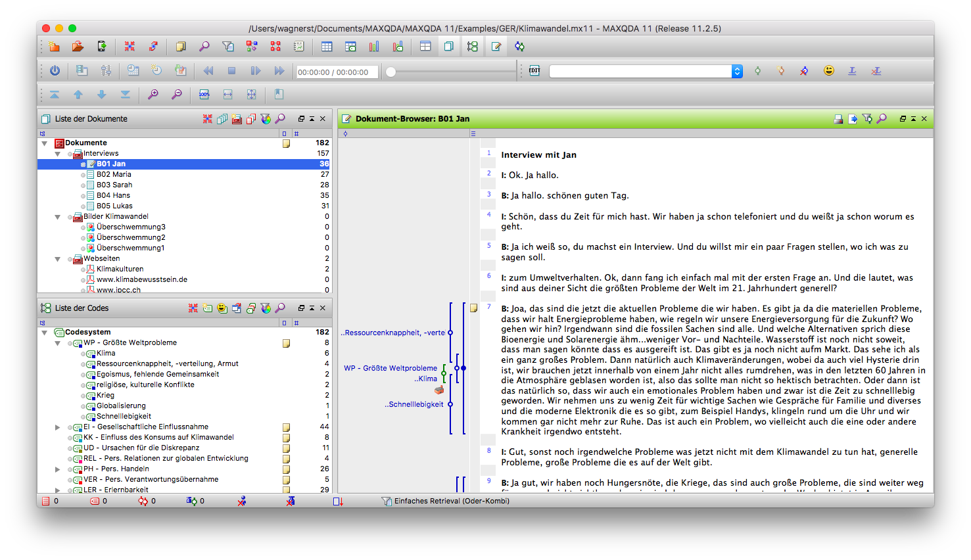
Notes:
There are several tools that support in qualitative data analysis. This is a screenshot of MaxQDA. The tools help us to add codes to the text or videos and manage the resulting code system.

Slide 56
Analysis Checklist
Is the analysis methodology defined, including roles and review procedures?
Is a chain of evidence shown with traceable inferences from data to research questions and existing theory?
Are alternative perspectives and explanations used in the analysis?
Is a cause-effect relation under study? If yes, is it possible to distinguish the cause from other factors in the analysis?
Are there clear conclusions from the analysis, including recommendations for practice/further research?
Are threats to the validity analyzed in a systematic way and countermeasures taken? (Construct, internal, external, reliability) question?
Notes:
Checklist from Runeson, P. and Höst, M. (2009). Guidelines for conducting and reporting case study research in software engineering. Emp. Softw. Engg. 14, 2 (April 2009), 131-164.

Slide 57
Refactoring
We have a transcript of one interview with one developer regarding her use of refactorings in her last project. Try to do a summarizing qualitative analysis on it.

Slide 58
Reporting the Context
Facet | Element
Product | Maturity Quality Size System type Customization Programming language
Processes | Activities Workflow Artifacts
Practices, tools, technique | CASE tools Practices and techniques
People | Roles Experience
Organization | Model of overall organization Organizational unit Certification Distribution
Market | Number of customers Market segments Strategy Constraints
Notes:
A framework for reporting context from Petersen and Wohlin (2007).

Slide 59
Reporting Checklist
Are the case and its units of analysis adequately presented?
Are the objective, the research questions and corresponding answers reported?
Is the report suitable for its audience, easy to read and well structured?
Notes:
Checklist from Runeson, P. and Höst, M. (2009). Guidelines for conducting and reporting case study research in software engineering. Emp. Softw. Engg. 14, 2 (April 2009), 131-164.

Slide 60
Desired Skills of the Investigators
Mastering the art of asking insightful questions and skillfully interpreting the answers, empowering you with a deeper understanding of the subject matter.
Being a good listener without being trapped by preconceptions or ideologies.
Being adaptive and flexible, perceiving newly encountered situations as opportunities rather than threats, and being open to change.
Having a good grasp of the issue being studied and not missing essential clues.
Understanding when a deviation is acceptable.
Not mechanically recording data, but interpreting information in real-time and being able to react to contradictions among sources of evidence.
Avoiding bias and not using a case study to substantiate a preconceived position.
Being open to contrary findings.

Slide 61
Criticism
Please remember the following points:
Criticism: Lack of systematic handling of data (Lack of rigor!)
Response: It is crucial to address this concern by systematically reporting all data and procedures involved in the research.
Criticism: Little basis for scientific generalization!
Response: The purpose of the research is to generalize to theoretical propositions, and not to a population as in statistical research. This involves analytic generalization rather than statistical generalization.
Criticism: Takes too long, resulting in massive, unreadable documents.
Response: The time taken for the research process depends on the specific research question at hand. The analysis and documentation will be carried out based on the choices made by the investigators.
Notes:
Typical criticism towards case studies and answers

Slide 62
References
B. Flyvbjerg. Five misunderstandings about case-study research. In Qualitative Research Practice. SAGE, 2007.
P. Mayring. Qualitative Content Analysis. Theoretical Foundation, Basic Procedures and Software Solution. Beltz, 2014.
K. Petersen and C. Wohlin. Context in industrial software engineering research. In Proceeding of the 3rd International Symposium on Empirical Software Engineering and Measurement. IEEE, 2009.
P. Runeson, M. Höst, A. Rainer, B. Regnell. Case Study Research in Software Engineering. Guidelines and Examples. Wiley, 2012.
R. E. Stake. The Art of Case Study Research. SAGE, 1995.
R. K. Yin. Case Study Research. Design and Methods. 3rd edition. SAGE, 2003.

