Slide 1
PROJECT DEFENSE ON ICT COURSE
SCHOOL MANAGEMENT SYSTEM
Group: SE-2019
Team: 6
Student: Temir Mendigali

Slide 2
Abstract
Project field
Education
Project name
School management system
Project objectives
Learn core principles of database architecture
Get better at writing SQL queries
Understand what is database normalization
Practice at designing entity-relationship diagrams
Create complete database

Slide 3
Analysis of the subject area
Company name
Karagandy “Bilim-Innovation” lyceum #1
Sector
Education
Problems of the company
Lots of paperwork
Sometimes documents with important information can be lost
It is difficult to keep statistics and records of all students
In addition to lessons, teachers have to create and format data for a long time using Microsoft Word and Microsoft Excel

Slide 4
Plan for creating database
Determine all entities contained in the project.
List the business rules to be followed in the project.
Design ER diagram including all the attributes for each entity and relationships.
Create all entities, relationships and attributes in the database using SQL.

Slide 5
Entities
User
Lesson
Club
Club role
Class
Classroom
Book
Competition
Teacher
Address
Lesson schedule
Club schedule
Country
City

Slide 6
Business rules
A user can be associated with a class multiple times and have different roles in that class.
A club can have many roles.
Each teacher can teach one lesson.
A student can join several clubs.
A student can get an unlimited number of achievements in different competitions.
A student can take only one prize place within one competition.
At one competition, a student can participate in only one lesson.
The student can borrow several books from the library.
Each class has its own classroom.
The club may have several scheduled classes.
The user can only specify one address.
Each class can attend several lessons.
Each lesson can be in the lesson schedule several times.
Different lessons from the lesson schedule can take place in a classroom.
Each city can only be in one country.
Each address can be linked to one city.
The competition can only be held in one city.
Teacher can have zero or one category.

Slide 7
Attributes
User can have full name, date of birth, gender, email, password, phone number, and address.
Address consists of city, street name, and house number.
Country has name.
City has name and unique number of country where it is located.
Teacher has lessons that he teaches, start date of his career, and his category.
Class has a graduation year, parallel, classroom, and users who have particular roles in the class.
Classroom has capacity of students, floor, number, and labeled if it has camera or not.
Competition has title, description, level, location city, and date.
Book has title, author, publish year, and if it is classbook, then it has a class number for which it is intended.
Club has name, description and roles.
Lesson has name.
Lesson schedule consists of class, lesson, classroom, time of lesson, day of the week.
Club schedule consists of club, time of meeting, and day of the week.

Slide 8


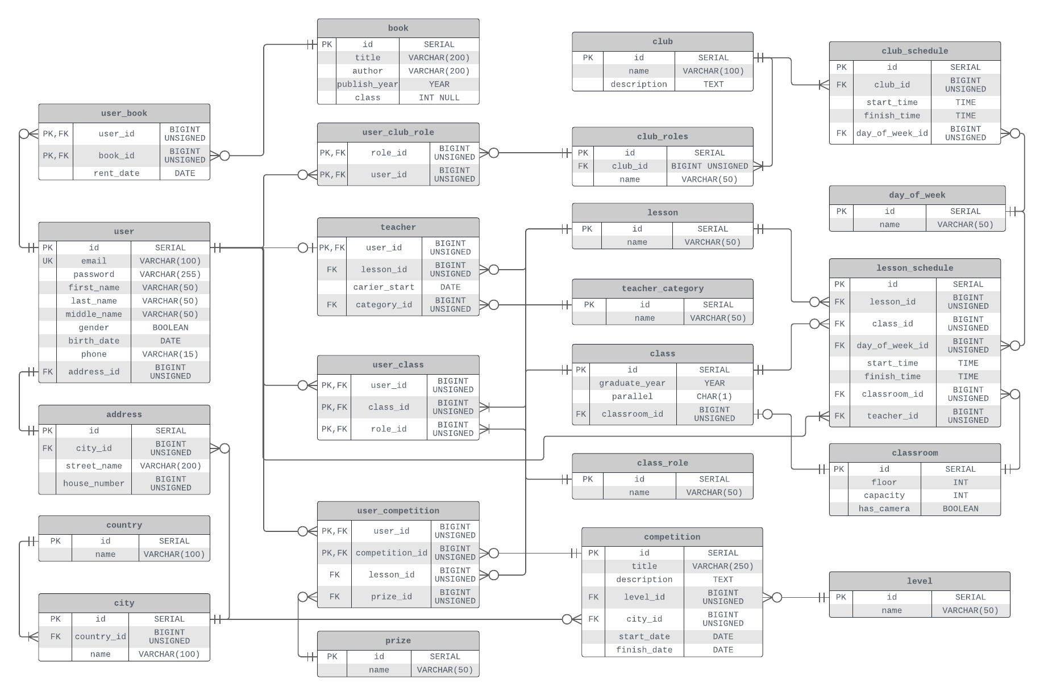


Slide 9
Example use cases
Show list of the teachers and lesson that each of them teach
Show list of classes and their classrooms
Show lesson schedule for class with specific id
Show achievements of every student on any competition
Show competitions with specific level
Show information about each headman in school
Show number of participants for each club
Show different lessons that are attended by students who will graduate in specific year
Show minimum and maximum capacity of students that can fit in one classroom which has no camera inside
Show list of teachers who teach 3 lessons in which students win the most prizes in competition
Show details about teachers who teach lessons at some particular time

Slide 10
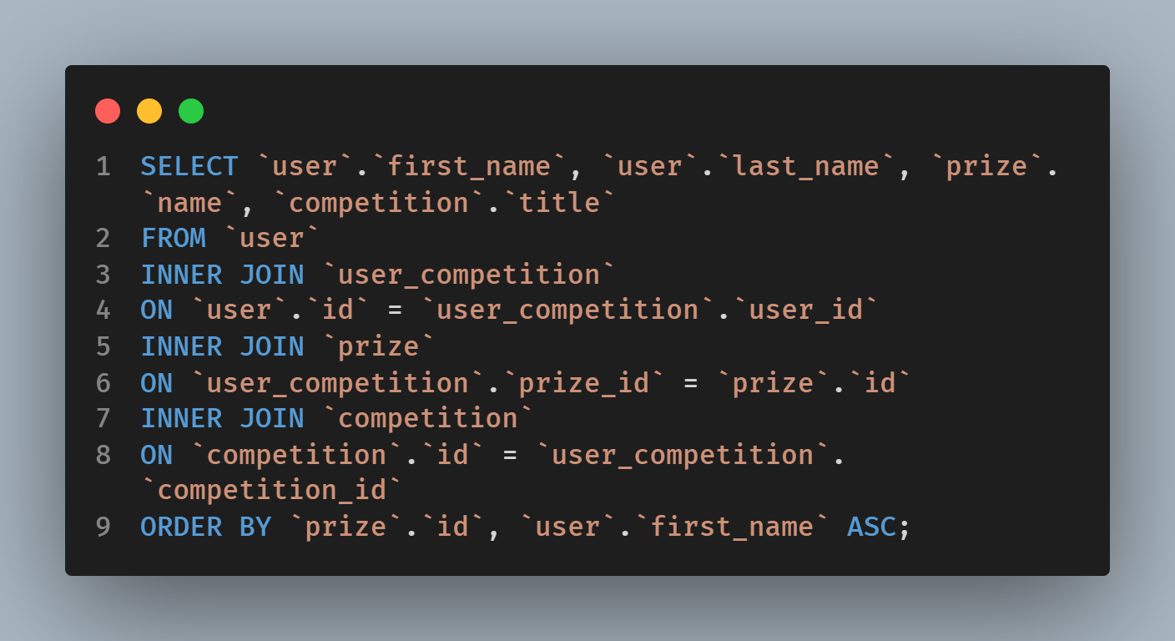
Example query #1
Show achievements of every student on any competition

Slide 11
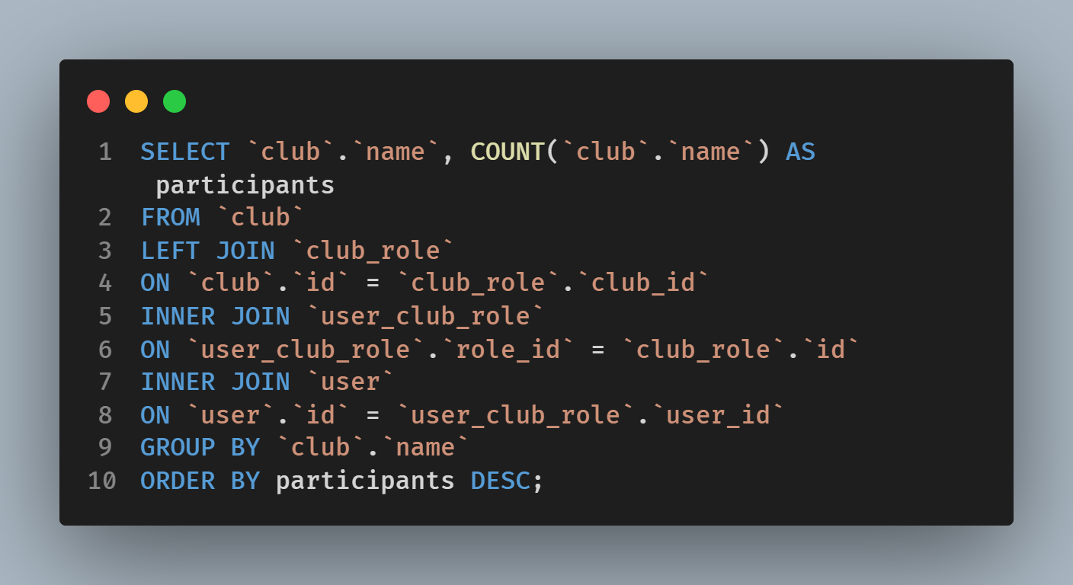
Example query #2
Show number of participants for each club
Show number of participants for each club

Slide 12
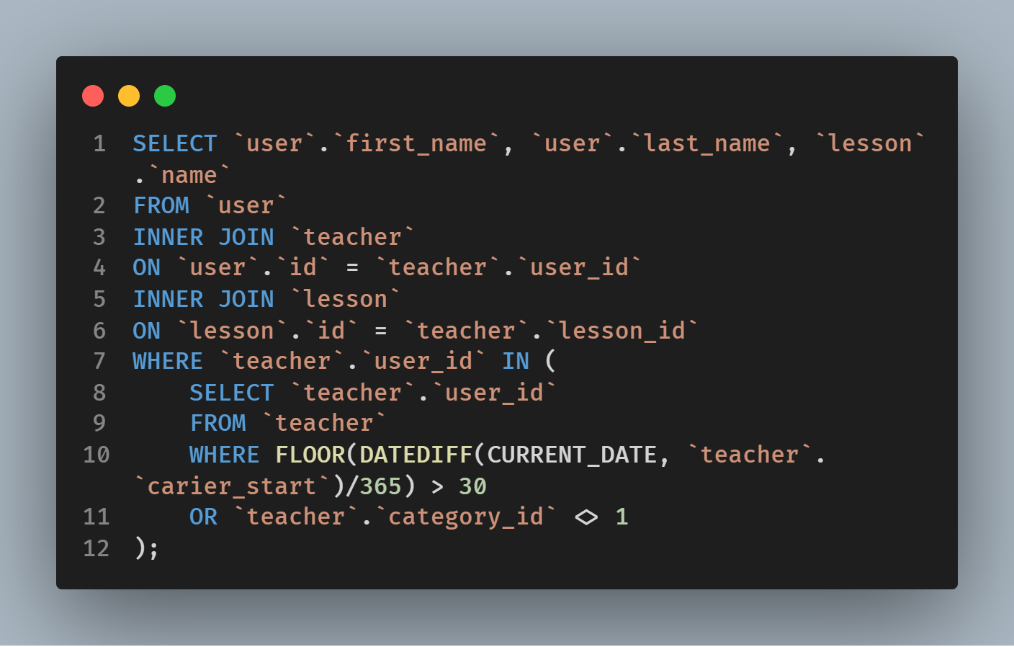
Example query #3
Show the most experienced teachers

Slide 13
What can be improved in the future?
School blog
Football league schedule and results
Sixth graders enrollment
Calendar of upcoming events
Multiple languages
More normal forms

Slide 14
Conclusion
Register user accounts
Add user information
Divide into roles such as teacher, student, curator etc
Lessons and schedule
Clubs and schedule
Club participants with different roles
Participate in competitions
Take books from library

Slide 15
Thanks for your attention!

