Slide 1







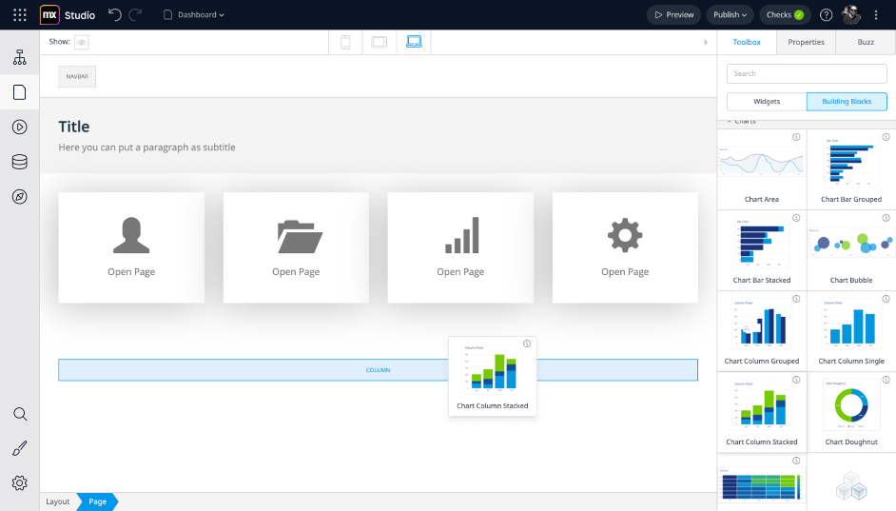


App Name
<Story >
Business Benefits
Efficiency ….
€ XXX.XXX
Error avoidance ….
€ XXX.XXX
€ XX.XXX
IT Value: Software Development and Maintenance
Efficiency Improvements per Year
Cheaper Maintenance
€ XX.XXX
One-time software realization advantage with Mendix low-code
€ XX
Non tangible Benefits
Quality Improvements…
Benefit 2 …
Customer Loyalty

