Slide 1
MedExpress
We bring healthcare to you.

Slide 2
Background
MedExpress
There is a disconnect between patients and healthcare clinics. Patient wait times are uncertain and the post appointment follow up is almost non-existent.

Slide 3
Our Solution
SMS Chatbot
Transparent Wait Times
NLP Speech Transcription

Slide 4
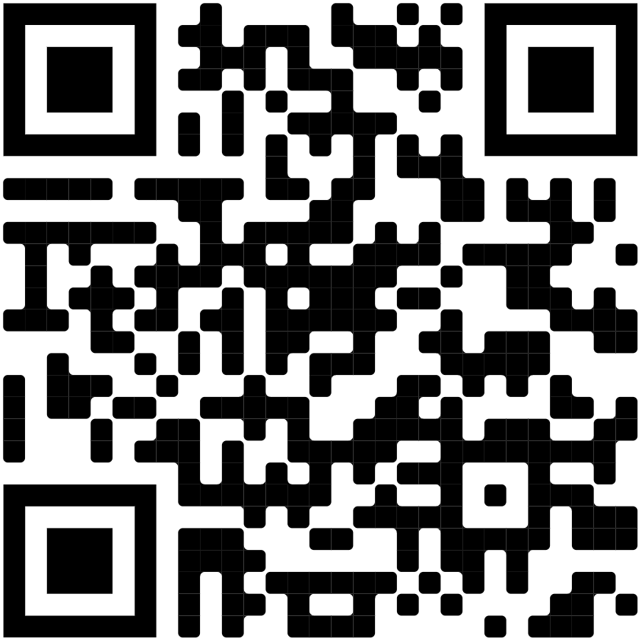
Demo
Try out our mobile web app!

Slide 5
THANKS!
snike2610@gmail.com
Does anyone have any questions?
mendozanmartin@gmail.com
kshnik@gmail.com
ahmedmoiz854@gmail.com

