Slide 1
FVS
EEY 4189 Group Project

Slide 2
Contents
Group Members (Slide 3)
Introduction: Purpose and Scope (Slide 4)
Functional Requirements (Slides 5 & 6)
Non-Functional Requirements (Slide 7)
Project Architecture Diagram (Slide 8)
Use-case Diagram (Slide 9)
Wireframes (Slides 10 & 11)
Progress of the Project (Slide 12)
Jira Board Screenshot (Slide 13)
GIT Account (Slide 14)
Monthly Retrospective (Slide 15)
Project Limitations and Problem Encounters (Slide 16)

Slide 3
Group Members
D.A.T.M Abenayaka - 219213375
Role: Convener / Project lead
P.M Abeyrathna - 221426574
Role: QA/Testing lead
G.D.D Senath - 222515500
Role: Business Analyst lead
N. W. L. U. R. D. Nanayakkara - 321424374
Role: UI/UX

Slide 4
Introduction:
Purpose and Scope
Goal: Provide a secure, efficient, and user-friendly voting solution.
Current voting systems face fraud, impersonation, and accessibility issues.
FVS aims to create a secure, tamper-proof, and user-friendly system using biometric fingerprint recognition.
Improve accuracy, reduce fraud risk, and enhance efficiency and accessibility of voting.
Develop and implement a biometric-based voting system.
Address voter fraud, and impersonation.

Slide 5
Functional Requirements
User Registration
Register with personal details and fingerprint; store securely.
User Authentication
Authenticate via fingerprint to access voting.
Vote Casting
Select, confirm, and encrypt vote; display confirmation.
Vote Verification
Authenticate to view vote status.
System Administration
Manage users, settings, and monitor system.
Reporting
Generate reports on results, activity, and performance.

Slide 6
Functional Requirements
Error Handling
Display error messages with resolution suggestions.
Data Archival
Securely archive and retain data for legal compliance.

Slide 7
Non-Functional Requirements
Performance: The system must handle 15,000 concurrent users with sub-second response times.
Compatibility: The system must be compatible with Android and iOS devices, Firebase, and Node.js.
Security: The system must implement robust security measures, including data encryption, secure communication protocols, and access controls.
Usability: The system must be user-friendly and accessible, with support for multiple languages and audio instructions for visually impaired users.
Scalability: The system must be designed to accommodate future growth in user base and data volume.

Slide 8
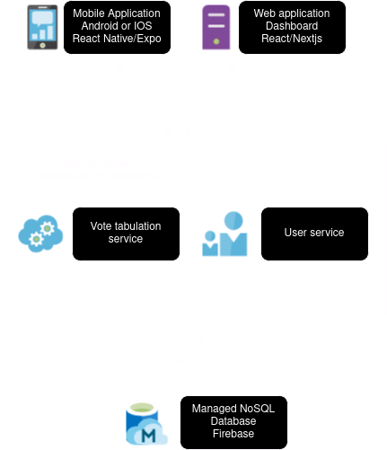
Project Architecture Diagram

Slide 9
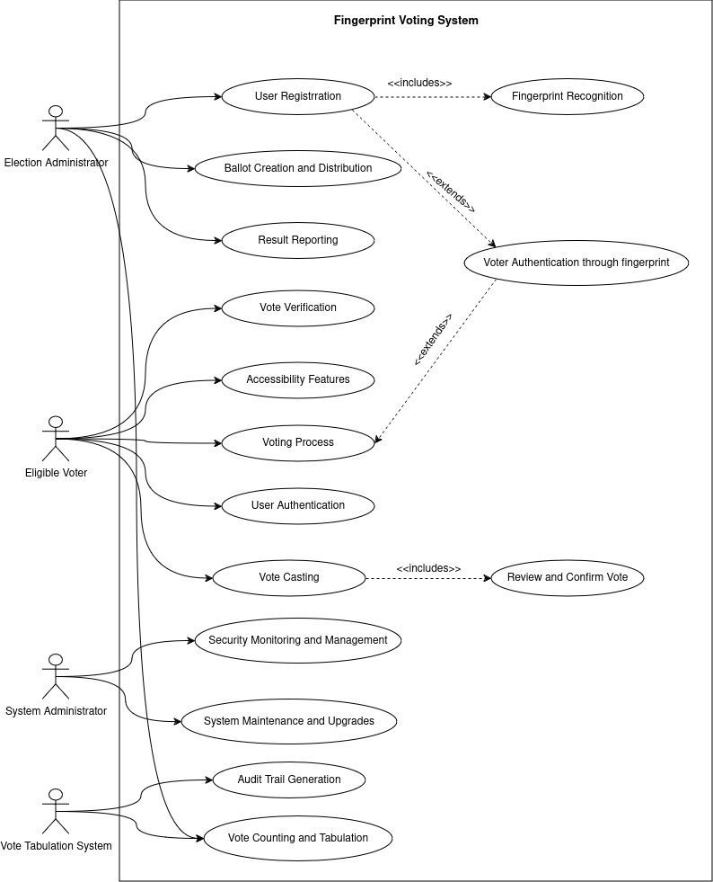
Use-case diagram

Slide 10
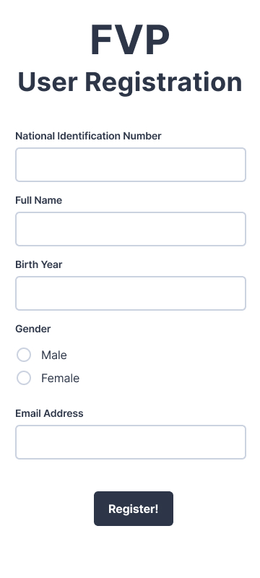
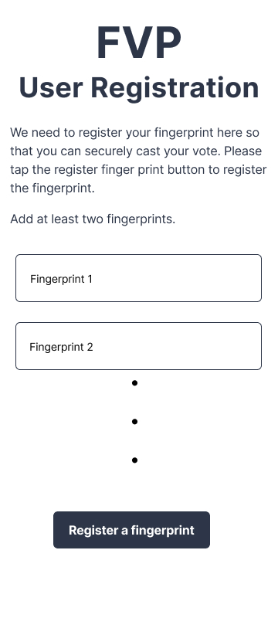
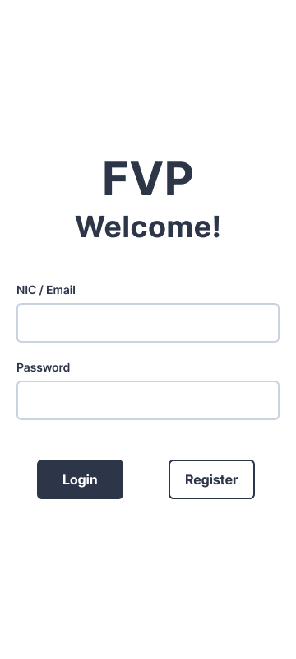
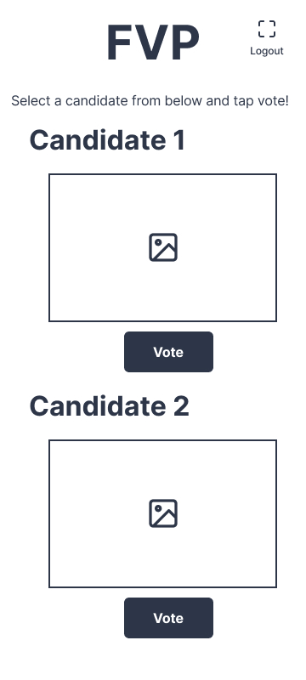
Wireframes

Slide 11
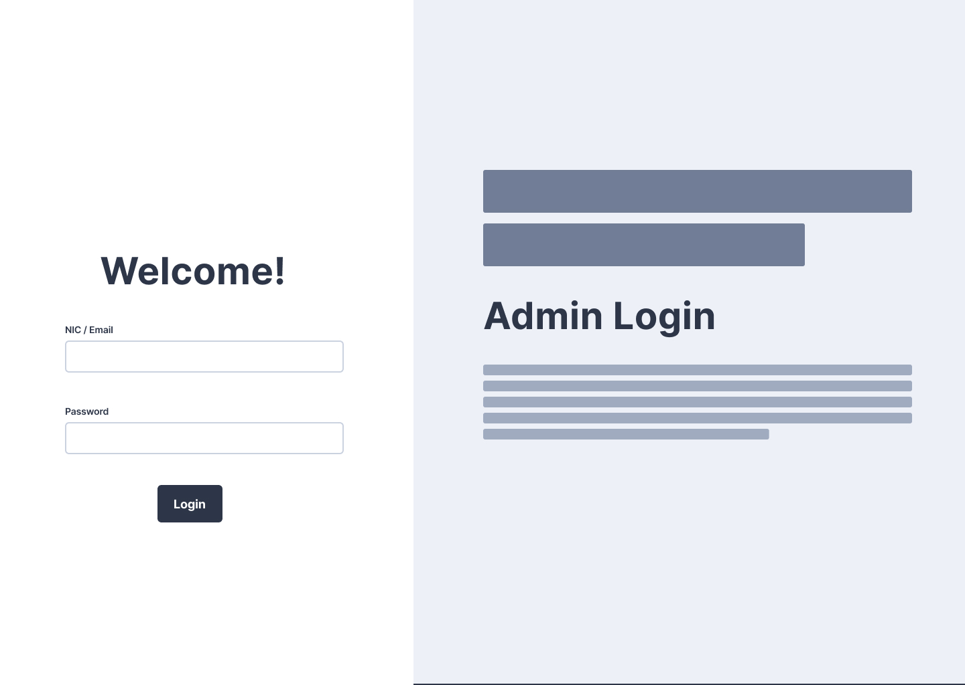
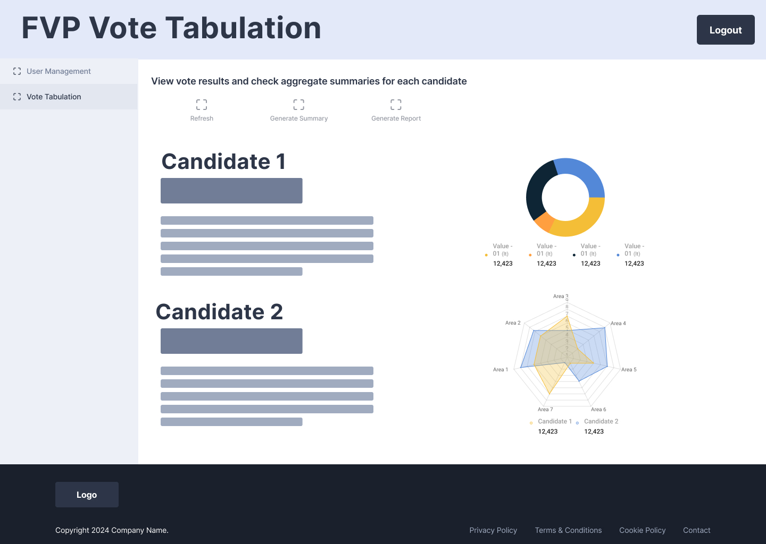
Wireframes

Slide 12
Progress of the project
Our team has worked together to complete the following tasks:
Complete initial documentation
Brainstorming features for use cases/functional requirements
Finalized tech stack
On-boarded team on Jira and Git
Drafted and finalized wireframes for mobile app
Drafted and finalized wireframes for the web application
Initialized repo with Expressjs project
Working on user login and user authentication
Working on prototype for vote casting feature

Slide 13
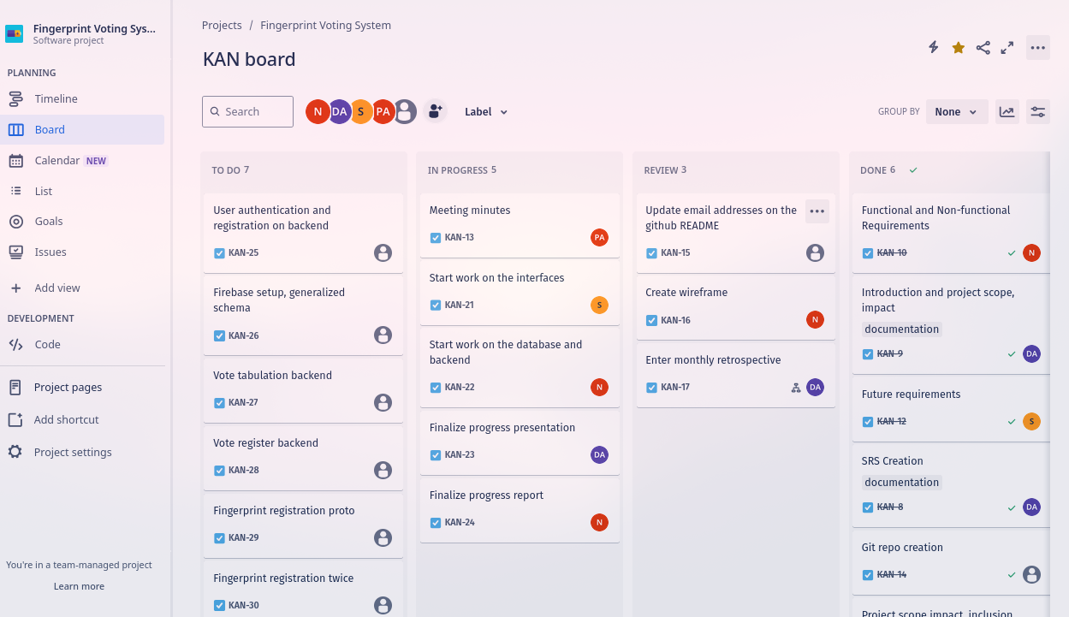
Jira Board Screenshot

Slide 14
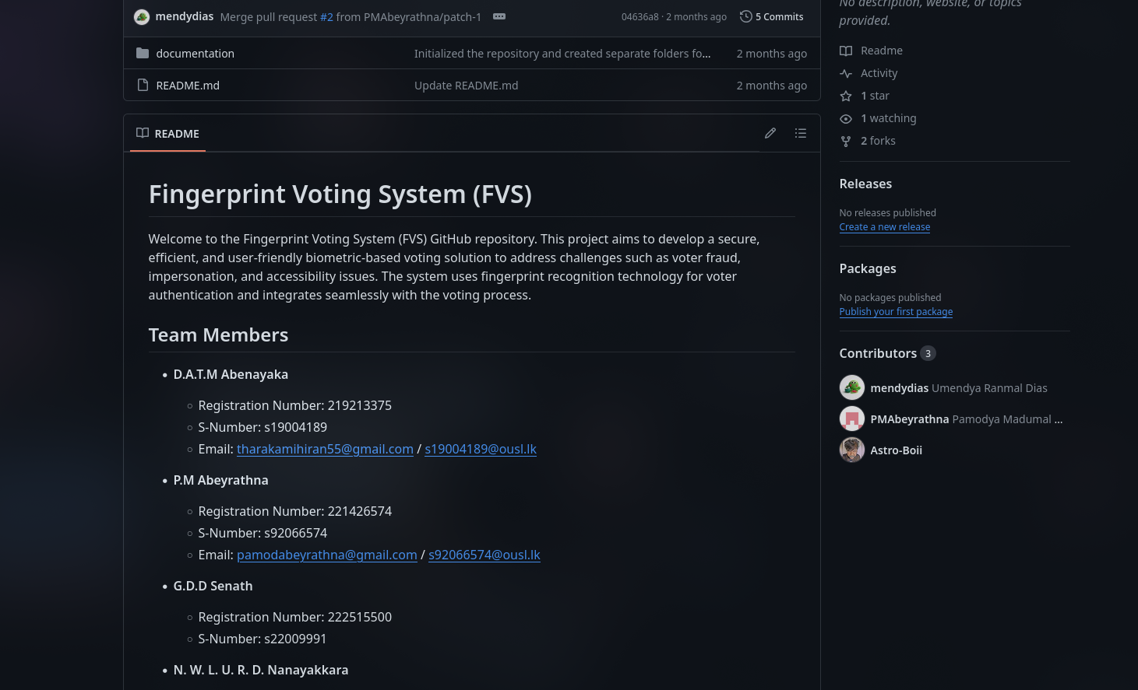
GIT Account

Slide 15
Monthly Retrospective June
Project Initiation and Documentation
Successes:
The team successfully completed the initial documentation, including the project scope, objectives, and functional requirements.
The tech stack was finalized, and team members were onboarded with Jira for project management and Git for version control.
Challenges:
Initial brainstorming sessions revealed some discrepancies in the understanding of functional requirements, requiring additional meetings to clarify.
Improvements:
Better communication and alignment during brainstorming sessions could have prevented the initial confusion regarding functional requirements.

Slide 16
Monthly Retrospective July
User Interface Design and Backend Initialization
Successes:
The team drafted and finalized wireframes for both the mobile and web applications, laying a strong foundation for the UI/UX design.
The repository was initialized with an Express.js project, marking the beginning of backend development.
Challenges:
There were delays in wireframing due to varying levels of familiarity with design tools like Figma among team members.
Improvements:
Earlier training or workshops on design tools could have streamlined the wireframing process, avoiding delays.

Slide 17
Project limitations and Problem encounters
Not all phones may have biometric scanners.
Option in the future to include separate biometric scanner devices.
Not all teammates are familiar with all aspects of the tech stack.
All team members are working, so difficult to find time when everyone is all free.
Setting up fingerprint recognition on mobile devices is a little tricky since cross platform is required.

