Slide 1
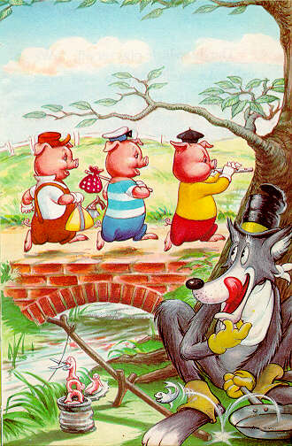
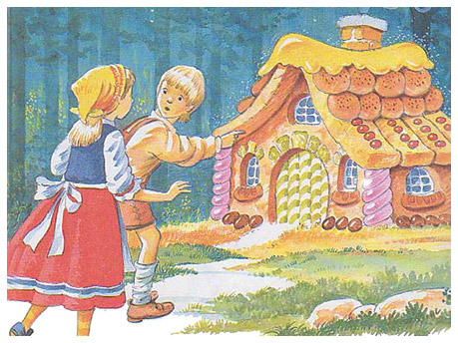
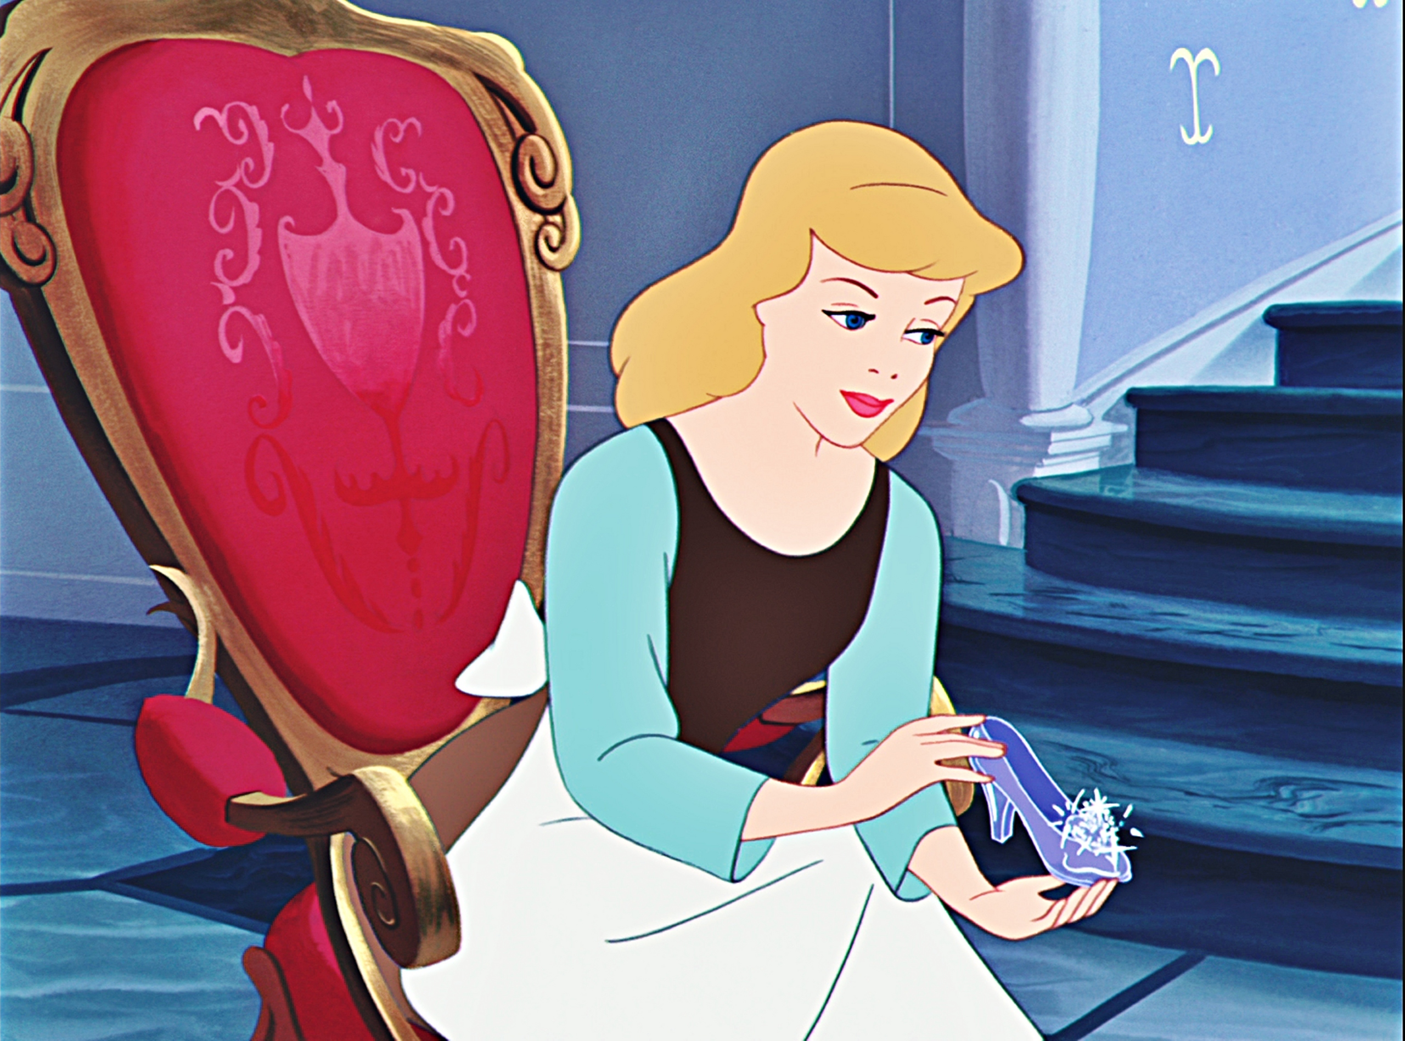
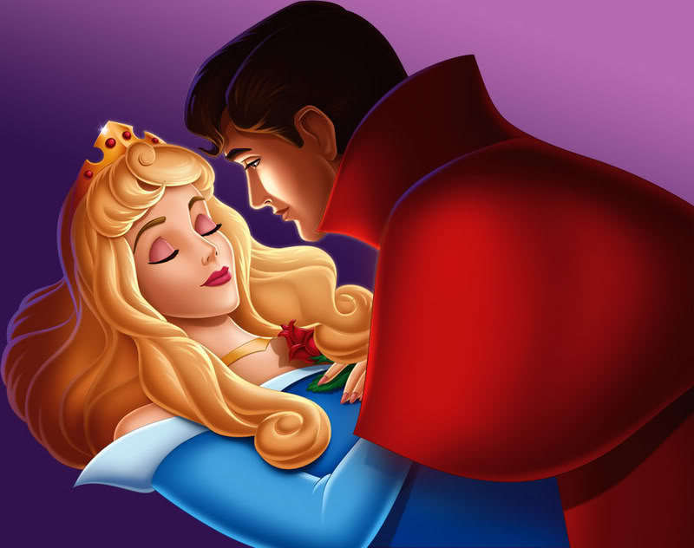
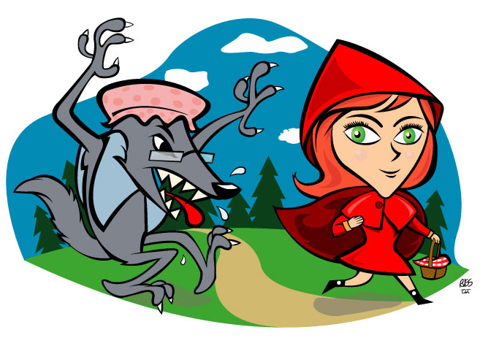
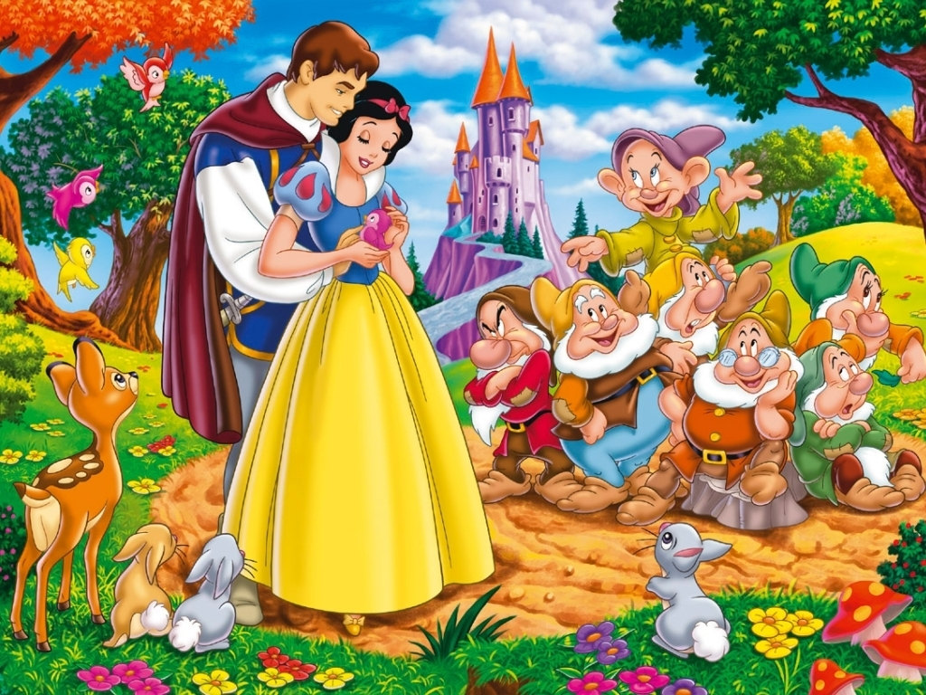
Fairy Tales

Slide 2
Three Little Pigs

Slide 3
Hansel and Gretel

Slide 4
Cinderella

Slide 5
Snow White and the Seven Dwarves

Slide 6
Sleeping Beauty

Slide 7
Little Red Riding Hood

Slide 8
Can you think of any other fairy tales?

