Slide 1
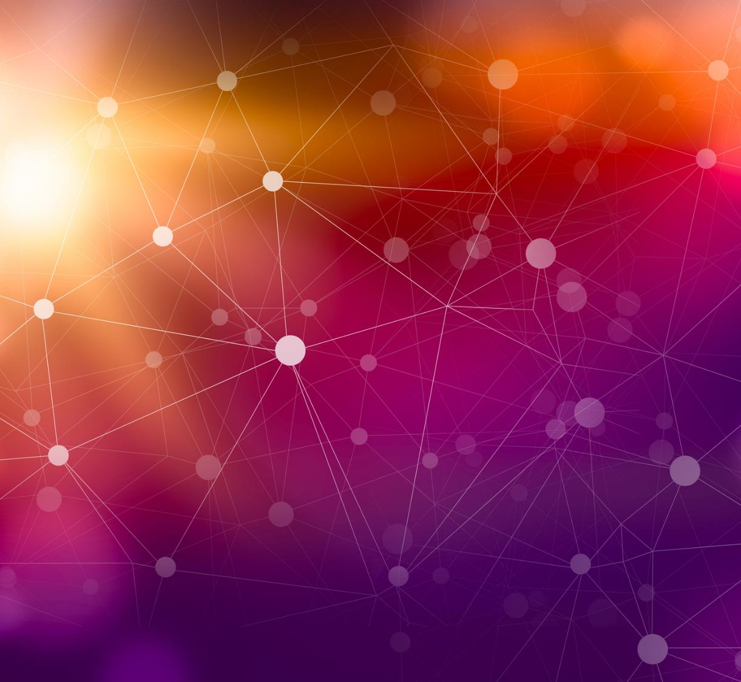
Deep Learning
Prof: Gianakopoulos Theodoros
Asimoglou Menelaos (ID: 2022202200001)

Slide 2
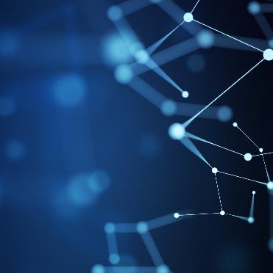
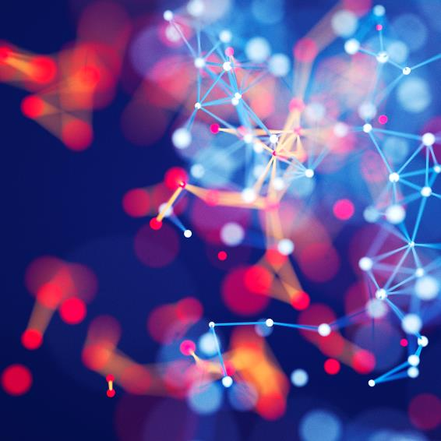

Agenda
Introduction
Overview of ASV and Spoofing Attacks
Deep Learning in ASV Anti Spoofing
Methodology
Experimental Setup
Results

Slide 3




Introduction
Automatic Speaker Verification (ASV) is a system that uses biometric verification to confirm the identity of a speaker based on unique patterns and features of their voice.
Spoofing is one such deceptive practice where an impostor attempts to mimic the voice of a genuine speaker with the intention to fool the ASV system.

Slide 4

Introduction
Automatic Speaker Verification (ASV) is a system that uses biometric verification to confirm the identity of a speaker based on unique patterns and features of their voice.
Spoofing is one such deceptive practice where an impostor attempts to mimic the voice of a genuine speaker with the intention to fool the ASV system.

Slide 5
2. Overview of ASV and Spoofing Attacks
Automatic Speaker Verification (ASV) systems operate based on the unique vocal characteristics of an individual. They function on two primary processes: enrollment and verification.
Spoofing attacks pose a significant threat to ASV systems. These attacks involve an impostor attempting to mimic the voice of a genuine speaker or using sophisticated voice conversion or synthesis techniques to deceive the system.
Anti-spoofing mechanisms are designed to detect unusual patterns or discrepancies that could indicate a spoofing attempt.

Slide 6
3. Deep Learning in ASV Anti-Spoofing
Convolutional Neural Networks (CNNs) are a class of deep learning models particularly effective in analyzing visual and audio input. CNNs are designed to automatically and adaptively learn spatial hierarchies of features directly from data. Spoofing is one such deceptive practice where an impostor attempts to mimic the voice of a genuine speaker with the intention to fool the ASV system.
Generative Adversarial Networks (GANs) are a type of machine learning system introduced by Ian Goodfellow and his colleagues in 2014. GANs consist of two parts: a generator, which creates new data instances, and a discriminator
CNNs and GANs bring several advantages to ASV anti-spoofing. They can model complex and non-linear relationships, which can be beneficial for tasks like speaker verification.

Slide 7
4. Methodology
The ASVspoof 2021 dataset.
CNN-based ASV system, the primary task is to classify whether a given speech sample belongs to a claimed speaker or not. The output layer of the CNN gives a score indicating the likelihood that the speech sample belongs to the claimed speaker.
GANs for generating spoofed speech samples. GAN learns to produce synthetic speech samples that mimic the features of genuine speech.
The anti-spoofing system learns features that can discriminate between genuine and spoofed speech. The output layer of the CNN gives a score indicating the likelihood that the speech sample is genuine.

Slide 8
5. Exersise Setup
Raw audio signals are transformed into spectrograms, which serve as the input for the CNNSpoofing is one such deceptive practice where an impostor attempts to mimic the voice of a genuine speaker with the intention to fool the ASV system.
CNN is trained on the training data of the ASVspoof 2021 dataset with the spectrograms of audio samples.
After the CNN is tested based on metrics.
The CNN is designed to classify an audio sample as either genuine or spoofed.
The CNN is trained on the labeled training dataset
The trained CNN is then tested on the testing dataset to evaluate its performance.

Slide 9
Chart

Slide 10

The way to get started is to quit talking and begin doing.
Walt Disney

Slide 11

6. Results

Slide 12
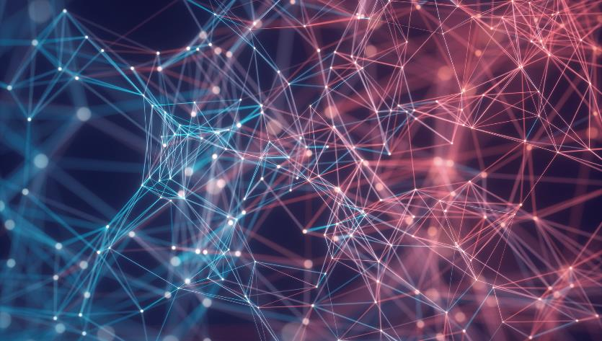
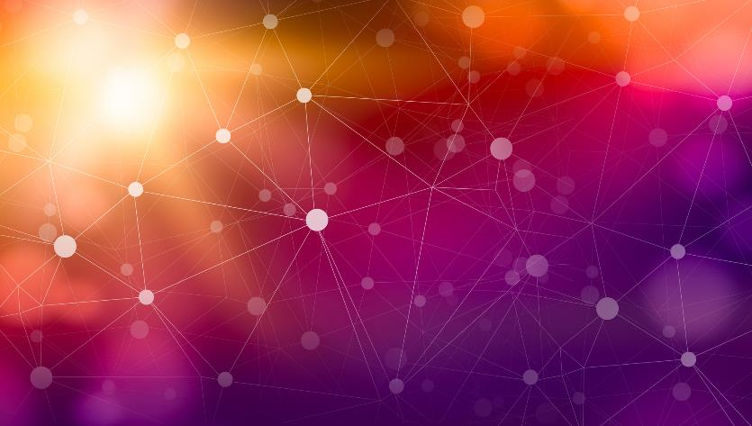
Thank You
Asimoglou Menelaos
menelaosasim@gmail.com

