Slide 1
Bounded Analyses for
Concurrent Programs
Author: Gennaro Parlato, University of Southampton, UK

Slide 2
Concurrency for better performace
Clock rates are stalling, but Moore’s Law is still alive…
  no longer feasible to increase the speed of individual processors
  additional gates turned into (caches and) multiple cores
⇒ For better performance programs must be concurrent!
⇒ Concurrency has become an important aspect for
many areas of computer science:
  algorithms, data structures, programming languages,
  software engineering, testing, verification, …

Slide 3
Writing concurrent programs is DIFFICULT
Programmers have to guarantee
  correctness of sequential execution
  of each individual thread
  under nondeterministic interferences
  from other threads (schedules)
Rare schedules result in errors that are difficult to find, reproduce, and repair
  developers / testers can spend weeks chasing a single bug
  huge productivity problem
communication mechanism
…
T₂
T₂
T_{N}
threads

Slide 4
Writing concurrent programs is DIFFICULT
//shared variable
int n=0;
int P(void) {
int tmp, i=1;
while (i<=10) {
tmp = n;
n = tmp + 1;
i++;
}
}
int main (void)
id1 = thread_create(P);
id2 = thread_create(P);
join( id1 );
join( id2 );
printf(“The value of n is %d”, n);
}
The value of n is ???

Slide 5
Verifying concurrent programs
Finite nb of threads + shared variables (no recursive calls)
bounded data domain => finite product of finite state systems
  reachability is decidable and PSPACE-complete [Kozen’77]
  product grows exponentially in # threads and # variables
Unbounded (parametric/dynamic) nb of threads (no recursive calls)
anonymous threads (no way to refer to their identities) + bounded data domain => counting abstraction
  Reachability is reducible to coverability in VASS/Petri Nets (EXPSPACE-complete)

Slide 6
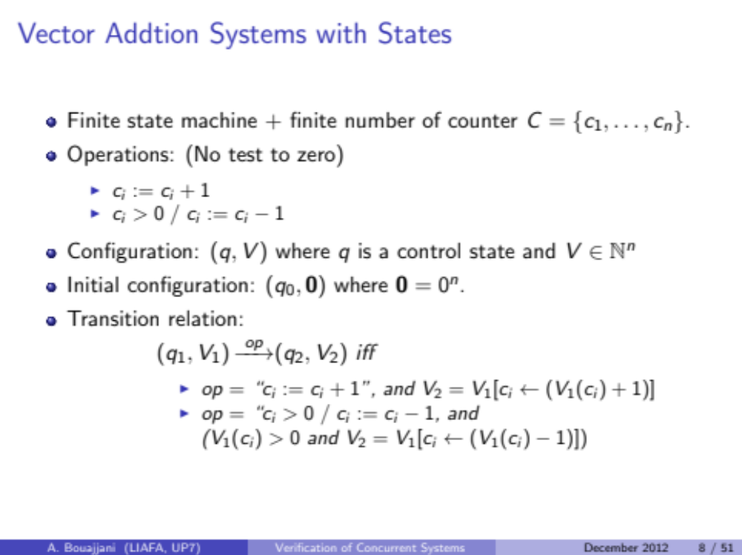
Vector addition systems with states

Slide 7
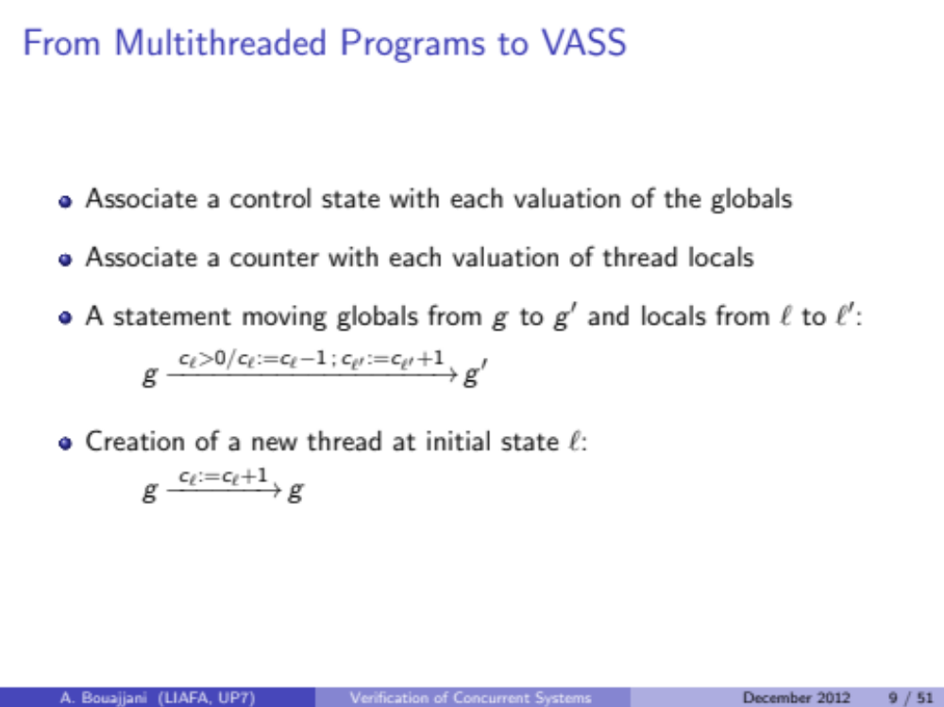
From Concurrent Programs to VASS

Slide 8
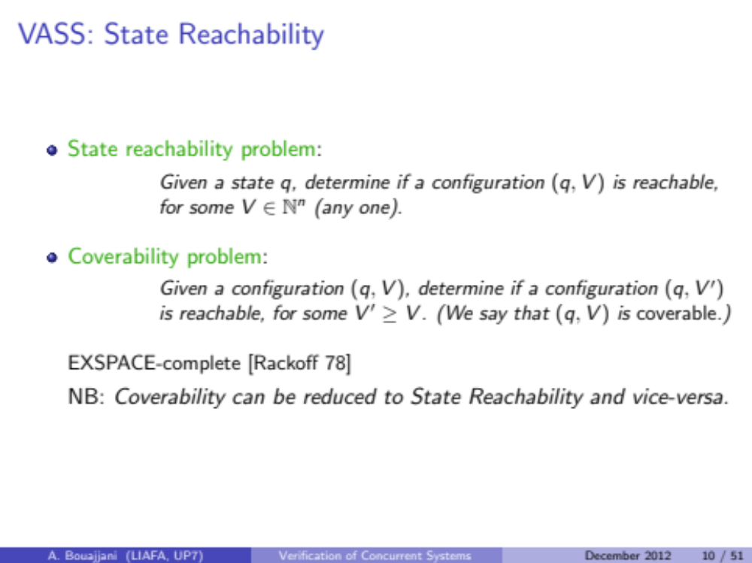
VASS Reachability/Coverability

Slide 9
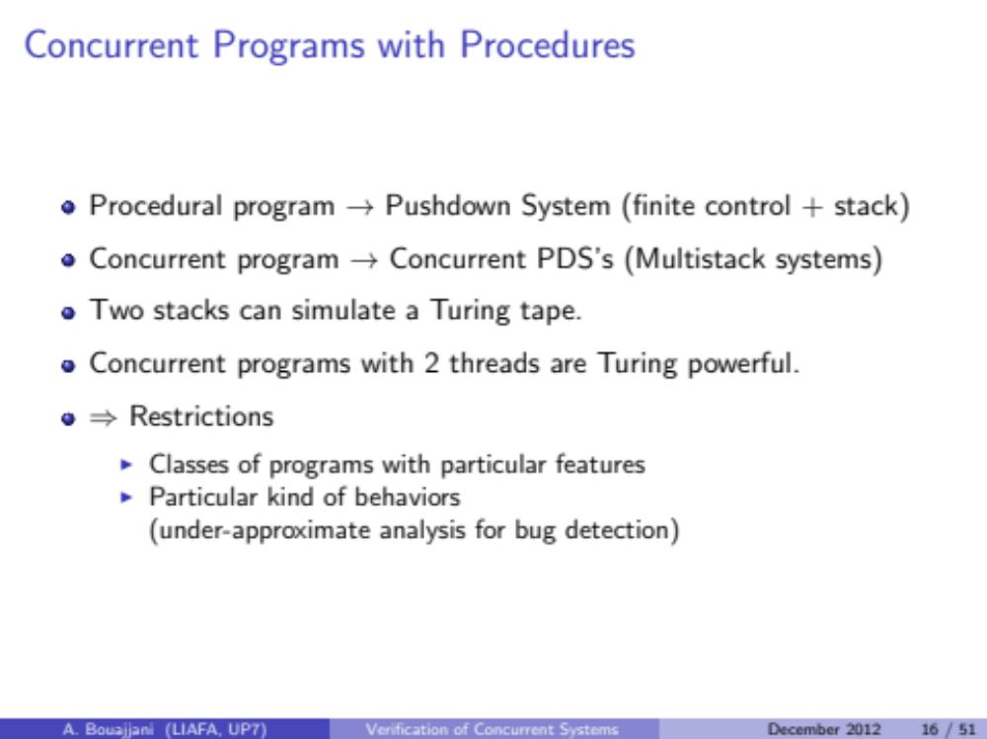
Concurrent Programs with Procedures

Slide 10
Concurrent Programs with Procedures

Slide 11
Concurrent Programs with Procedures

Slide 12
Anatomy of an execution (context switches)
T₁
T₂
( l₁’,s₁ )
( l, s₁ )
( l₂’,s₂ )
( l, s₂ )

Slide 13
Bounded context switch analysis
Blackboard

Slide 14
  Sequentialization

Slide 15
Sequentialization: motivations
Building verification tools for full-fledged concurrent languages is difficult and expensive...
… but scalable verification techniques exist for sequential languages
  Abstraction
  SAT/SMT techniques (i.e., bounded model checking)
  …
  Can we leverage these?

Slide 16
Sequentialization as a code-to-code translation
Code-to-code translation from multithreaded recursive programs to sequential programs that preserves reachability
Conc.
program
“equivalent”
Sequential
program
with non
determinism
shared variables
…
T₁
T₂
T_{N}
Use existing automatic verification techniques designed for sequential programs to analyze concurrent programs

Slide 17
From concurrent to sequential
Always possible but can be inefficient
  simulate the global behavior (track all locals of each thread)
  current techniques do not work
What do we want?
  avoid the extreme blow-up
  track at any point only the locals of one thread
What we want is not always possible
But it is possible if we restrict behaviors
  Bug-finding

Slide 18
Sequentialization: advantages
  Keep focus on the concurrency aspects of programs, delegate sequential reasoning to an existing analysis tool
  code-to-code translation is much easier to implement than a full-fledged analysis tool
  simplifies experimentation with different approaches
  can be designed to target multiple backends for sequential program analysis

Slide 19
Concurrent (shared-memory) Programs
Formed of sequential programs T₁ , … , T_{N}
(each possibly with recursive function calls)
shared variables
…
T₁
T₂
T_{N}
threads
  each program T_{i} can read and write shared vars
  we assume sequential consistency (SC)
    (writes are immediately visible to all the other programs)
an execution is an interleaving of the executions of each T_{i}

Slide 20
  Keep It Simple and Sequential
  Sequentialization

Slide 21
A first sequentialization: KISS
KISS: Keep It Simple and Sequential
[Quadeer-Wu, PLDI’04]
Under-approximation (subset of interleavings)
Thread creation → function call
  at context-switches either:
    the active thread is terminated or
    a not yet scheduled thread is started
    (by calling its main function)
  when a thread is terminated either:
    the thread that has called it is resumed (if any) or
    a not yet scheduled thread is started

Slide 22
KISS schedules
T₁
T₂
T₃
T₁
T₂
T₃
T₁
T₂
T₃
(l₂,s₁)
(l₄,s₂)
(l₁,s₁)
(l₃,s₂)
(l₅,s₃)
(l₁,s₃)
Scheduling 2:
1. start T₁
2. start T₂
3. start T₃
4. terminate T₃
5. resume T₂
6. terminate T₂
7. resume T₁
Scheduling 3:
1. start T₁
2. start T₂
3. terminate T₂
4. resume T₁
5. start T₃
6. terminate T₃
7. resume T₁
Scheduling 1:
1. Start T₁
2. Start T₂
3. Terminate T₂
4. start T₃
5. terminate T₃
6. Resume T₁
Notes:
Fix box

Slide 23
KISS sequentialization
[ S ] => schedule();
if (*) { raise = true; return; }
S;
[ x = f() ] => schedule();
if (*) { raise = true; return; }
x = f();
if (raise) return;
[ asynch f() ] => schedule();
if (*) { raise = true; return; }
if (size(ts) < MAX) put( f() )
else {
f()
raise = false;
}
[ return ] => schedule(); return;
Recursively for composed statements
Sequentialization(S) => raise = false; ts = empty; [ S ]; schedule();
schedule() {
while(*) {
if (size(ts) > 0) {
f = get(ts);
[ f ]();
raise = false;
}
}
}
Notes:
Fix box

Slide 24
More on KISS
  Allows dynamic thread creation in form of asynchronous calls
Bounds the number of threads that have been created but not started yet
  scheduler nondeterministically starts a thread from this set, or
  resumes the last suspended thread (if any)
State space: no cross product
Context-switches:
  does allow an unbounded number of context-switches
  does not allow a bounded number context-switches between any two threads (for more than 1 interaction)

Slide 25
Bounded Context-Switching (CS) is essential
  Switching between threads is allowed only a bounded number of times [Qadeer-Rehof, TACAS’05]
  Systematic bounded CS is useful for bug hunting:
    most concurrency related bugs manifest themselves within few CS [Musuvathi-Qadeer, PLDI’07]
  Efficient sequentializations for bounded CS
    Eager approach [Lal-Reps, CAV’08]
    Lazy approach [La Torre-Madhusudan-Parlato, CAV’09]

Slide 26
  LR Sequentialization
[ Lal-Reps, CAV’08 ]

Slide 27
LR sequentialization:
Bounded Round-Robin schedules
round 1
round 2
round 3
…
…
T₁
T₂
T_{N-1}
T_{N}
…
round k
Bounded Round- Robin captures bounded context-switches
Schedule: T₂ T₃ T₄ T₁ T₃ T₂ T₁; minimal number of rounds ???

Slide 28
LR sequentialization: simulation
T₁
T₂
T₃
Sequential program (k-rounds)
  Guess a₂, …, a_{k}
  Execute T₁ to completion
    Computes
      local states l₁, .., l_{k}, and
      global states b₁, …, b_{k}
(l₁,b₁)
(l₁,a₂)
(l₂,b₂)
(l₂,a₃)
(l₃,b₃)

Slide 29
LR sequentialization: simulation
T₁
T₂
T₃
Sequential program (k-rounds)
  Guess a₂,…,a_{k}
  Execute T₁ to completion
  Pass b₁,…,b_{k} to T₂
b₁
(l₁,b₁)
(l₁,a₂)
b₂
(l₂,b₂)
(l₂,a₃)
b₃
(l₃,b₃)

Slide 30
LR sequentialization: simulation
T₁
T₂
T₃
Sequential program (k-rounds)
  Guess a₂,…,a_{k}
  Execute T₁ to completion
  Pass b₁,…,b_{k} to T₂
    We can dismiss locals of T₁
b₁
a₂
b₂
a₃
b₃

Slide 31
LR sequentialization: simulation
T₁
T₂
T₃
(l₀’,b₁)
Sequential program (k-rounds)
  Guess a₂,…,a_{k}
  Execute T₁ to completion
  Pass b₁,…,b_{k} to T₂
  Execute T₂ to completion
    Dismiss locals of T₂
    Dismiss b₁,…,b_{k}
b₁
(l₁’,c₁)
a₂
(l₁’,b₂)
b₂
(l₂’,c₂)
a₃
(l₂’,b₃)
b₃
c₃

Slide 32
LR sequentialization: simulation
T₁
T₂
T₃
Sequential program (k-rounds)
  Guess a₂,…,a_{k}
  Execute T₁ to completion
  Pass b₁,…,b_{k} to T₂
  Execute T₂ to completion
b₁
c₁
a₂
b₂
c₂
a₃
b₃
c₃

Slide 33
LR sequentialization: simulation
T₁
T₂
T₃
(l₀’’, c₁)
Sequential program (k-rounds)
  Guess a₂,…,a_{k}
  Execute T₁ to completion
  Pass b₁,…,b_{k} to T₂
  Execute T₂ to completion
  Pass c₁,…,c_{k} to T₃
  Execute T₃ to completion
    Dismiss locals of T₃
    Dismiss c₁,…,c_{k}
b₁
c₁
(l₁’,d₁)
a₂
(l₁’,c₂)
b₂
c₂
(l₁’,d₂)
a₃
(l₁’,c₃)
b₃
c₃
d₃
Notes:
Check the local state for thread 2

Slide 34
LR sequentialization: simulation
T₁
T₂
T₃
Sequential program (k-rounds)
  Guess a₂,…,a_{k}
  Execute T₁ to completion
  Pass b₁,…,b_{k} to T₂
  Execute T₂ to completion
  Pass c₁,…,c_{k} to T₃
  Execute T₃ to completion
b₁
c₁
d₁
a₂
b₂
c₂
d₂
a₃
b₃
c₃
d₃
Notes:
Check the local state for thread 2

Slide 35
LR sequentialization: simulation
T₁
T₂
T₃
Sequential program (k-rounds)
  Guess a₂,…,a_{k}
  Execute T₁ to completion
  Pass b₁,…,b_{k} to T₂
  Execute T₂ to completion
  Pass c₁,…,c_{k} to T₃
  Execute T₃ to completion
  Computation iff d_{i} = a_{i+1}
  ∀i ∈ [1,k-1]
b₁
c₁
d₁
a₂
b₂
c₂
d₂
a₃
b₃
c₃
d₃
Notes:
Check the local state for thread 2

Slide 36

LR sequentialization: simulation
T₁
T₂
T₃
Sequential program (k-rounds)
  Guess a₂,…,a_{k}
  Execute T₁ to completion
  Pass b₁,…,b_{k} to T₂
  Execute T₂ to completion
  Pass c₁,…,c_{k} to T₃
  Execute T₃ to completion
  Computation iff d_{i} = a_{i+1}
  ∀i ∈ [1,k-1]
  Report an error if a bug occurs during the simulation
b₁
c₁
d₁
a₂
b₂
c₂
d₂
a₃
b₃
c₃
d₃
Notes:
Check the local state for thread 2

Slide 37
  LR seq. as a code-to-code translation
  for C programs + Pthread
  CSeq website: users.ecs.soton.ac.uk/gp4/cseq/
[Fischer-Inverso-Parlato, ASE’13]

Slide 38
LR sequentialization as a code-to-code translation
T₁
…
Concurrent program
T₂
T_{N}
Sequentialization
(code-to-code translation)
translates
translates
…
translates
“equivalent”
Sequential program
with non determinism
…
F₁()
F₂()
F_{N}()
main()
Simulation functions

Slide 39
LR sequentialization as a code-to-code translation
considers round-robin schedules
with k rounds
  thread → function, run to completion
global memory copy for each round
  scalar → array
context switch → round counter++
first thread starts with
nondeterministic memory contents
  other threads continue with content left by predecessor
...
S_{0,1}
S_{0,2}
...
S_{0,N}
S_{1,1}
S_{1,2}
...
S_{1,N}
S_{2,1}
S_{2,2}
...
S_{2,N}
...
...
S_{K-1,1}
S_{K-1,2}
S_{K-1,N}
T₁
T₂
T_{N}

Slide 40
LR sequentialization as a code-to-code translation
considers round-robin schedules
with k rounds
  thread → function, run to completion
global memory copy for each round
  scalar → array
context switch → round counter++
first thread starts with
nondeterministic memory contents
  other threads continue with content left by predecessor
checker prunes away inconsistent simulations
  assume(S_{i+1,0} == S_{i,N});
  requires second set of memory copies
  errors can only be checked at end of simulation
    requires explicit error checks
...
S_{0,1}
S_{0,2}
...
S_{0,N}
S_{1,1}
S_{1,2}
...
S_{1,N}
S_{2,1}
S_{2,2}
...
S_{2,N}
...
...
S_{k-1,1}
S_{k-1,2}
S_{k-1,N}
T₁
T₂
T_{N}

Slide 41
LR sequentialization as a code-to-code translation
//shared vars
type_{g1} g1; type_{g2} g2; …
//thread functions
t(){
type_{x1} x1; type_{x2} x2; …
stmt₁ ;
stmt₂ ;
…
} …
main(){
…
}
//shared vars
type_{g1} g1[K]; type_{g2} g2[K]; …
uint round=1; bool ret=0; //aux vars
// context-switch simulation
cs() {
unsigned int j; j= nondet();
assume(round +j < K); round+=j;
if (round==K-1 && nondet()) ret=1;
}
//thread functions
t(){
type_{x1} x1; type_{x2} x2; …
cs(); if ret return; stmt₁[round];
cs(); if ret return; stmt₂[round];
…
} …
main_thread(){
…
}
main(){ … } //next slide

Slide 42
LR sequentialization as a code-to-code translation
main(){
type_{g1} _g1[K]; type_{g2} _g2[K]; …
// first thread starts with non-deterministic memory contents
for (i=1;i++;i<K){
_g1[i] = g1[i] = nondet();
_g2[i] = g2[i] = nondet();
…
}
// thread simulations
t[0] = main_thread;
born[0] = ACTIVE;
for (i=0;i++;i<N){
if(born[i]>NO_ACTIVE){
ret=0;
round = born[i];
t[i](); }
}
// consistency check
for (i=0;i++;i<K-1){
assume(_g1[i+1] == g1[i]);
assume(_g2[i+1] == g2[i]);
…
}
// error detection
assert(err ==0); }

Slide 43
Implementations of variants of LR schema (SMT-based)
Corral (SMT-based analysis for Boogie programs)
    [ Lal–Qadeer–Lahiri, CAV’12 ]
    [ Lal–Qadeer, FSE’14 ]
CSeq (code-to-code translation for C + PThread)
    [ Fischer–Inverso–Parlato, ASE’13 ]
Rek (for Real-time Embedded Software Systems)
    [ Chaki–Gurfinkel–Strichman, FMCAD’11 ]
Storm: implementation for C programs
    [ Lahiri–Qadeer–Rakamaric, CAV’09 ]
    [Rakamaric, ICSE’10]
General eager translation representing thread interactions using bounded DAGs [Bouajjani-Emmi-Parlato, SAS’11]

Slide 44
LR sequentialization is “eager”
T₁
T₂
T₃
a₂ is guessed
a₂ may be unreachable
EAGER
b₁
a₂
b₂
a₃
Notes:
Check the local state for thread 2

Slide 45
LR sequentialization does not preserve assertions
// shared variables
bool blocked=true;
int x=0, y=0;
Inv: y != 0
void thread1()
{
while (blocked);
x = x/y;
if (x%2==1)
ERROR;
}
void thread2()
{
x=12; y=2;
//unblock thread2
blocked=false;
}
blocked=false
guess x=13
y=0
blocked=true
Notes:
Check the local state for thread 2

Slide 46
A lazy transformation is desirable
A lazy sequential program explores only reachable states of the concurrent program
Why is it desirable?
  In model-checking it can drastically reduce the explored state-space
  Better invariants for deductive verification / abstract interpretation
We now illustrate a lazy transformation:
[La Torre-Madhusudan-Parlato, CAV’09]
Notes:
Check the local state for thread 2

Slide 47
[ Inverso–Tomasco–Fischer–La Torre–Parlato, CAV’14 ]
  Lazy-CSeq: Schema Overview

Slide 48
Schema Overview
main()
T₀
…
bounded concurrent program
T₁
T_{N}
Sequentialization
(code-to-code translation)
translates
translates
…
translates
“equivalent”
Sequential program
with non determinism
…
F₀
F₁
F_{N}
main()
Sequentialized functions
Driver
Notes:
In our schema,
the concurrent bounded program P is converted into a non-deterministic sequential program P’ that simulates all possible computations within R round-robin schedules of P.
P is loop-free and has N+1 threads, exactly 1 function each thread.
The sequentialized program has the same number of functions (to simulate threads) plus one extra function to simulate context-switching,
we call this function “the main driver”. Now I’ll first describe how this function works, and then how the sequentiaslization of each thread is accomplihed.

Slide 49
Naïve Lazy Sequentialization: CROSS PRODUCT SIMULATION
a global pc for each thread
thread locals → thread global
main driver
pc₀=0; ... pc_{N}=0;
local₀; ... local_{k};
main() {
for (r=0; r<K; r++)
for (i=0; i<N; i++)
// simulate T_{i}
if (active_{i})
F_{i}();
}
Notes:
…however this solution is very disruptive for the backend.
The control-flow gets very complex, the way the program is encoded to SAT/SMT makes the formula size explode.
Furthermore at each context-switch point we need a source of non-determinism, an assignment and a return that make again the control-flow more complex.
We have identified this as the main reasons of why this should be avoided.

Slide 50
Naïve Lazy Sequentialization: CROSS PRODUCT SIMULATION
for each round
for each thread T_{i}
    simulate T_{i}
main driver
pc₀=0; ... pc_{N}=0;
local₀; ... local_{k};
main() {
for (r=0; r<K; r++)
for (i=0; i<N; i++)
// simulate T_{i}
if (active_{i})
F_{i}();
}
Notes:
…however this solution is very disruptive for the backend.
The control-flow gets very complex, the way the program is encoded to SAT/SMT makes the formula size explode.
Furthermore at each context-switch point we need a source of non-determinism, an assignment and a return that make again the control-flow more complex.
We have identified this as the main reasons of why this should be avoided.

Slide 51
Naïve Lazy Sequentialization: CROSS PRODUCT SIMULATION
F_{i}()
switch(pc_{k}) {
case 0: goto 0;
case 1: goto 1;
case 2: goto 2; ...
case M: goto M;
}
1: CS(0); stmt0;
2: CS(1); stmt1;
3: CS(2); stmt2;
. .
. E XE .
. .
M: CS(M); stmt_{M;}
main driver
pc₀=0; ... pc_{N}=0;
local₀; ... local_{k};
main() {
for (r=0; r<K; r++)
for (i=0; i<N; i++)
// simulate T_{i}
if (active_{i})
F_{i}();
}
Notes:
…however this solution is very disruptive for the backend.
The control-flow gets very complex, the way the program is encoded to SAT/SMT makes the formula size explode.
Furthermore at each context-switch point we need a source of non-determinism, an assignment and a return that make again the control-flow more complex.
We have identified this as the main reasons of why this should be avoided.

Slide 52
Naïve Lazy Sequentialization: CROSS PRODUCT SIMULATION
F_{i}()
switch(pc_{i}) {
case 0: goto 0;
case 1: goto 1;
case 2: goto 2; ...
case M: goto M;
}
1: CS(0); stmt0;
2: CS(1); stmt1;
3: CS(2); stmt2;
. .
. E XE .
. .
M: CS(M); stmt_{M;}
main driver
context-switch resume mechanism
pc₀=0; ... pc_{N}=0;
local₀; ... local_{k};
main() {
for (r=0; r<K; r++)
for (i=0; i<N; i++)
// simulate T_{i}
if (active_{i})
F_{i}();
}
...
...
Notes:
…however this solution is very disruptive for the backend.
The control-flow gets very complex, the way the program is encoded to SAT/SMT makes the formula size explode.
Furthermore at each context-switch point we need a source of non-determinism, an assignment and a return that make again the control-flow more complex.
We have identified this as the main reasons of why this should be avoided.

Slide 53
Naïve Lazy Sequentialization: CROSS PRODUCT SIMULATION
F_{i}()
switch(pc_{k}) {
case 0: goto 0;
case 1: goto 1;
case 2: goto 2; ...
case M: goto M;
}
1: CS(1); stmt0;
2: CS(2); stmt1;
3: CS(3); stmt2;
. .
. E XE .
. .
M: CS(M); stmt_{M;}
main driver
pc₀=0; ... pc_{N}=0;
local₀; ... local_{k};
main() {
for (r=0; r<K; r++)
for (i=0; i<N; i++)
// simulate T_{i}
if (active_{i})
F_{i}();
}
...
...
...
Context-switch simulation:
#define CS(j)
if (*) { pc_{i}=j; return; }
Notes:
…however this solution is very disruptive for the backend.
The control-flow gets very complex, the way the program is encoded to SAT/SMT makes the formula size explode.
Furthermore at each context-switch point we need a source of non-determinism, an assignment and a return that make again the control-flow more complex.
We have identified this as the main reasons of why this should be avoided.

Slide 54
Naïve Lazy Sequentialization: CROSS PRODUCT SIMULATION
F_{i}()
switch(pc_{k}) {
case 0: goto 0;
case 1: goto 1;
case 2: goto 2; ...
case M: goto M;
}
1: CS(1); stmt0;
2: CS(2); stmt1;
3: CS(3); stmt2;
. .
. E XE .
. .
M: CS(M); stmt_{M;}
main driver
pc₀=0; ... pc_{N}=0;
local₀; ... local_{k};
main() {
for (r=0; r<K; r++)
for (i=0; i<N; i++)
// simulate T_{i}
if (active_{i})
F_{i}();
}
...
...
...
Notes:
…however this solution is very disruptive for the backend.
The control-flow gets very complex, the way the program is encoded to SAT/SMT makes the formula size explode.
Furthermore at each context-switch point we need a source of non-determinism, an assignment and a return that make again the control-flow more complex.
We have identified this as the main reasons of why this should be avoided.

Slide 55
CSeq-Lazy Sequentialization: CROSS PRODUCT SIMULATION
F_{i}()
switch(pc_{k}) {
case 0: goto 0;
case 1: goto 1;
case 2: goto 2; ...
case M: goto M;
}
1: CS(0); stmt0;
2: CS(1); stmt1;
3: CS(2); stmt2;
. .
. E XE .
. .
M: CS(M); stmt_{M;}
main driver
pc₀=0; ... pc_{N}=0;
local₀; ... local_{k};
nextCS;
main()
for (r=0; r<K; r++)
for (i=0; i<N; i++)
// simulate T_{i}
if (active_{i})
nextCS = nondet;
assume(nextCS>=pc_{i})
F_{i}();
pc_{i} = nextCS;
...
#define CS(j) NEW
if (j<pc_{i} || j>=nextCS) goto j+1;
Notes:
…however this solution is very disruptive for the backend.
The control-flow gets very complex, the way the program is encoded to SAT/SMT makes the formula size explode.
Furthermore at each context-switch point we need a source of non-determinism, an assignment and a return that make again the control-flow more complex.
We have identified this as the main reasons of why this should be avoided.

Slide 56
CSeq-Lazy Sequentialization: CROSS PRODUCT SIMULATION
resuming + context-switch
1: CS(1); stmt1;
2: CS(2); stmt2;
3: CS(3); stmt3;
EXECUTE
M: CS(M); stmt_{M;}
skip
...
pc_{i}
nextCS
skip
...
#define CS(j) NEW
if (j<pc_{i} || j>=nextCS) goto j+1;
Notes:
The last

Slide 57
Individual Threads Sequentialization
1: CS(1); stmt1;
2: CS(2); stmt2;
3: CS(3); stmt3;
EXECUTE
M: CS(M); stmt_{M;}
...
inject light-weight, non-invasive control code
no non-determinism
no assignments
no return
...
#define CS(j)
if (j<pc_{i} || j>=next_CS) goto pc+1;
Notes:
The last

Slide 58
[ Tomasco–Inverso–Fischer–La Torre–Parlato, TACAS’15 ]
  Sequentialization based on
  Memory Unwinding

Slide 59
Interleaving semantics
T1 T2 T3
run
wx
wy
rx
wy
rx
ry
wx
wx
rx
ry
wy
rx

Slide 60
From interleavings to memory unwinding
T1 T2 T3
run
wx
wy
rx
wy
rx
ry
wx
wx
rx
ry
wy
rx
accesses to
shared memory
wx
wy
rx
wy
rx
ry
wx
rx
ry
wy
rx
MEMORY
UNWINDING
writes
wx
wy
wx
wy
wy
wx
wy
wy
wx
wy
⇒ Memory unwinding models thread interaction history by data

Slide 61

Memory unwindings as thread interfaces
bounding parameter: # of shared write operations
  most concurrency bugs exposed by few interactions [Lu, Park, Seo, Zhou – ASPLOS 2008]
TASK 1
TASK 2
T1
T2
T1
Assume-guarantee reasoning style decomposition of verification

Slide 62

Assume-guarantee reasoning
TASK 1
TASK 2
T1
T2
Task 1:
Task 2:
Thread T1
assumes:
MU writes of other threads
guarantees:
its own MU writes
Thread T2
assumes:
MU writes of other threads
guarantees:
its own MU writes
∧

Slide 63
Verification using MU
Checking assume-guarantee condition for each thread:
for each write check:
        - right thread id
  - right variable
  - right value
ensure all writes are matched
  for each read:
  - pick value from write in right range
y=1
….
a=x+5
.....
x=1
….
x=2
y=1
y=1
z=2
x=3
y=8
x=1

Slide 64
Simulating a thread against an MU
Global variable write – check against current MU entry
void write(uint t, uint v, int val) {
mc[t] = th_nxt_wr[t][mc[t]];
assume(var[mc[t]] == v);
assume(val[mc[t]] == val);
}
void write(uint t, uint v, int val) {
mc[t] = th_nxt_wr[t][mc[t]];
}
pc
y=1
….
a=x+5
.....
x=1
….
pc
mc
x=2
y=1
mc
y=1
z=2
x=3
y=8
x=1

Slide 65
Simulating a thread against an MU
Local statement (no global variables) – update pc, keep mc
y=1
….
a=x+5
.....
x=1
….
pc
pc
x=2
y=1
mc
y=1
z=2
x=3
y=8
x=1

Slide 66
Simulating a thread against an MU
Global variable read – “pick write position in range”
non-deterministic assignment
int read(uint t, uint v) {
if (thr_terminated()) return 0;
if (var_fst_wr[v]==0) return 0;
uint r_from = *;
assume((r_from <= last_wr_pos)
&& (r_from < th_nxt_wr[t][mc[t]]));
assume(var[r_from] == v);
if (r_from < mc[t])
assume(var_nxt_wr[r_from] > mc[t]);
else {
if (r_from < var_fst_wr[v]) return 0;
mc[t] = r_from;
};
return value[r_from];
}
y=1
….
a=x+5
.....
x=1
….
pc
x=2
y=1
mc
y=1
z=2
x=3
y=8
x=1

Slide 67
Simulating a thread against an MU
Global variable read – “pick write position in range”
Check in unwinding...
...before next write of thread...
int read(uint t, uint v) {
if (thr_terminated()) return 0;
if (var_fst_wr[v]==0) return 0;
uint r_from = *;
assume((r_from <= last_wr_pos)
&& (r_from < th_nxt_wr[t][mc[t]]));
assume(var[r_from] == v);
if (r_from < mc[t])
assume(var_nxt_wr[r_from] > mc[t]);
else {
if (r_from < var_fst_wr[v]) return 0;
mc[t] = r_from;
};
return value[r_from];
}
y=1
….
a=x+5
.....
x=1
….
pc
x=2
y=1
mc
y=1
z=2
x=3
y=8
x=1

Slide 68
Simulating a thread against an MU
Global variable read – “pick write position in range”
...before next write of thread...
int read(uint t, uint v) {
if (thr_terminated()) return 0;
if (var_fst_wr[v]==0) return 0;
uint r_from = *;
assume((r_from <= last_wr_pos)
&& (r_from < th_nxt_wr[t][mc[t]]));
assume(var[r_from] == v);
if (r_from< mc[t])
assume(var_nxt_wr[nxt_mc] > mc[t]);
else {
if (r_from< var_fst_wr[v]) return 0;
mc[t] = r_from;
};
return value[r_from];
}
y=1
….
a=x+5
.....
x=1
….
pc
x=2
y=1
mc
y=1
z=2
x=3
y=8
...right variable...
x=1

Slide 69
Simulating a thread against an MU
Global variable read – “pick write position in range”
int read(uint t, uint v) {
if (thr_terminated()) return 0;
if (var_fst_wr[v]==0) return 0;
uint r_from = *;
assume((r_from <= last_wr_pos)
&& (r_from < th_nxt_wr[t][mc[t]]));
assume(var[r_from] == v);
if (r_from < mc[t])
assume(var_nxt_wr[r_from] > mc[t]);
else {
if (r_from < var_fst_wr[v]) return 0;
mc[t] = r_from;
};
return value[r_from];
}
y=1
….
a=x+5
.....
x=1
….
pc
x=2
y=1
mc
y=1
z=2
x=3
y=8
...right variable...
x=1
...next write of variable in future...

Slide 70
Simulating a thread against an MU
Global variable read – “pick write position in range”
int read(uint t, uint v) {
if (thr_terminated()) return 0;
if (var_fst_wr[v]==0) return 0;
uint r_from = *;
assume((r_from <= last_wr_pos)
&& (r_from < th_nxt_wr[t][mc[t]]));
assume(var[r_from] == v);
if (r_from < mc[t])
assume(var_nxt_wr[r_from] > mc[t]);
else {
if (r_from < var_fst_wr[v]) return 0;
mc[t] = r_from;
};
return value[r_from];
}
y=1
….
a=x+5
.....
x=1
….
pc
x=2
y=1
mc
pc
y=1
z=2
mc
x=3
y=8
x=1
...before next write of variable...
...else update mc.
Return value.

Slide 71
Simulating a thread against an MU
Handling errors – “flag that an error occurs”
y=1
….
a=x+5
.....
x=1
….
assert(b);
x=2
y=1
y=1
z=2
x=3
y=8
pc
x=1
translates to if (! b) _error = 1;
(computation might not be feasible)

Slide 72

Our apporach: sequentialization by MU
T₀
…
Concurrent program
T₁
T_{N}
Sequentialization
(code-to-code translation)
translates
translates
…
translates
Sequential program
…
F₀
F₁
F_{N}
main()
Simulation functions

Slide 73
Main Sequential Program
Thread creation
main
void main(void){
memory_init(W);
ct := mem_thread_create();
F₀();
thread_terminate(ct);
all_thread_simulated();
assert(_error == 0)
}
instantiate memory unwinding
register main thread
simulation starts from main thread
all writes of the thread are executed
all writes of the MU are executed
error check

