Slide 1
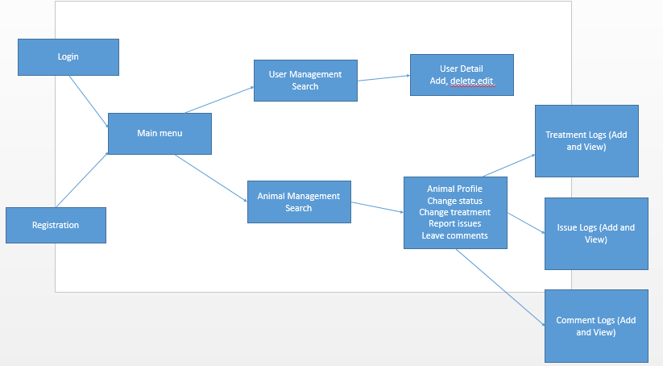
UI Flow

Slide 2
Admin Dashboard
Manage Users
Manage Animals
Review Issues
Review Treatments
Review Comments

Slide 3
Manage Users (for Admin/Teacher)
Search
Type/Role
Name
Status (Blocked/Unblocked)
Add
Edit (+ reset password)
Block/ (Unblock new user)

Slide 4
Manage Animals
Search
By Name
Breed
Owner
Status
Profile
Treatment Logs
Issue Logs
Comment Logs
Change Status
Change Status

