Slide 1
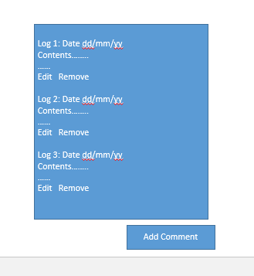
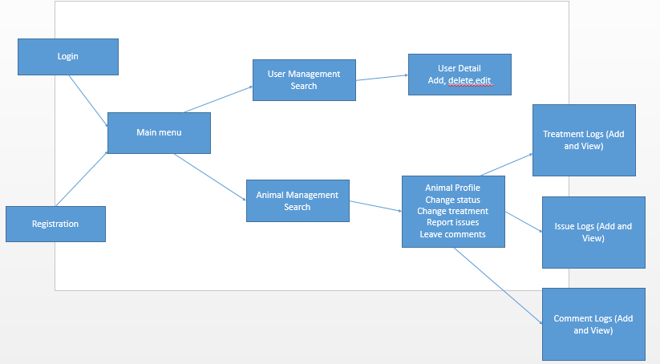
UI Flow
Logs-
Date,
User who made
Comment
Buttons for add/edit/remove

Slide 2
Admin Dashboard
Manage Users
Manage Animals
Review Issues
Review Treatments
Review Comments

Slide 3
Manage Users (for Admin/Teacher)
Search
Type/Role
Name
Status (Blocked/Unblocked)
Add
Edit (+ reset password)
Block/ (Unblock new user)

Slide 4
Manage Animals
Search
By Name
Breed
Owner
Status
Profile
Treatment Logs
Issue Logs
Comment Logs
Change Status
Change Status

Slide 5
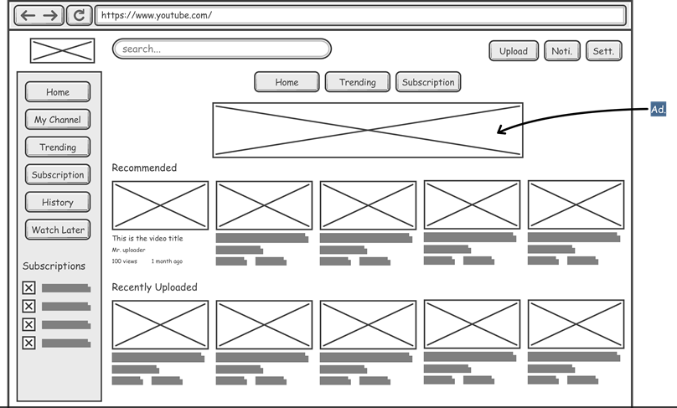
For reference

Slide 6
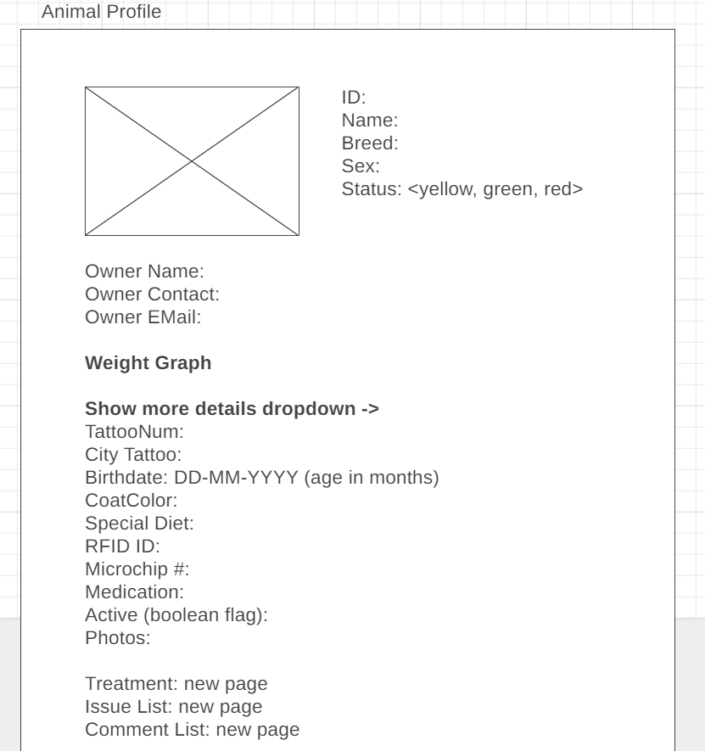
Animal Profile

Slide 7
Animal Care Attendant

