Slide 1
Wire Frames
for vet application

Slide 2
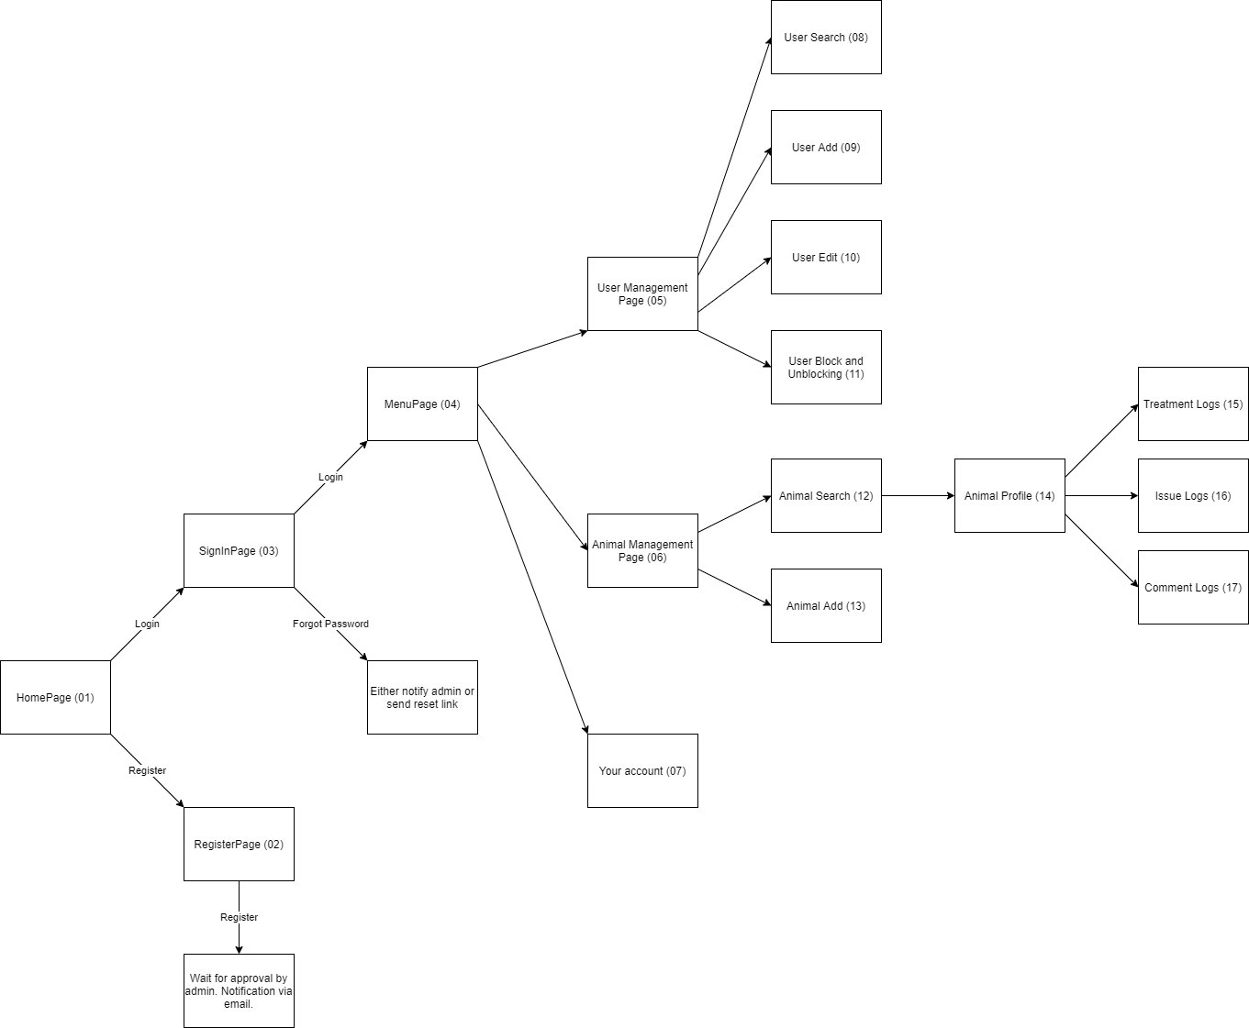
Flow

Slide 3
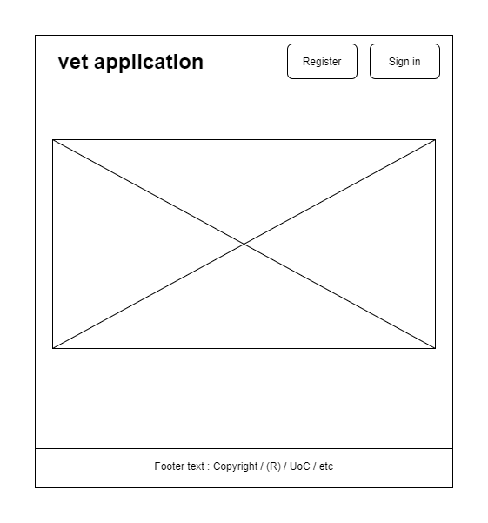
Home Page
Landing page

Slide 4
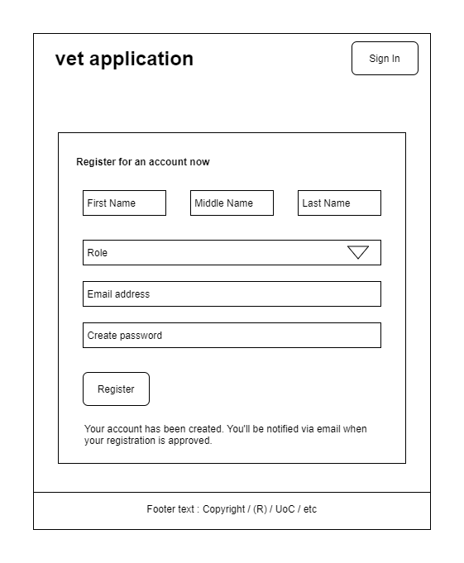
Register Page
Admin must unblock the account after its account creation.

Slide 5
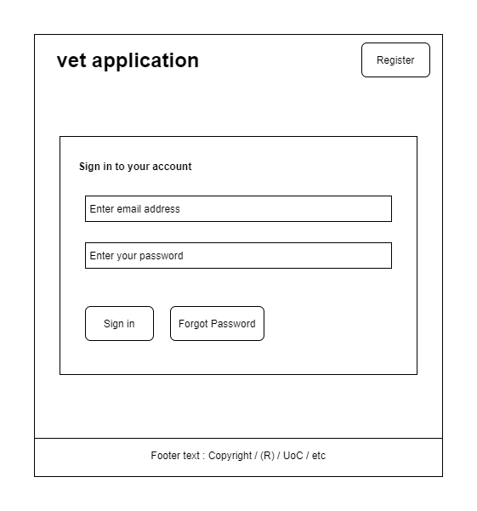
Sign-In Page

Slide 6
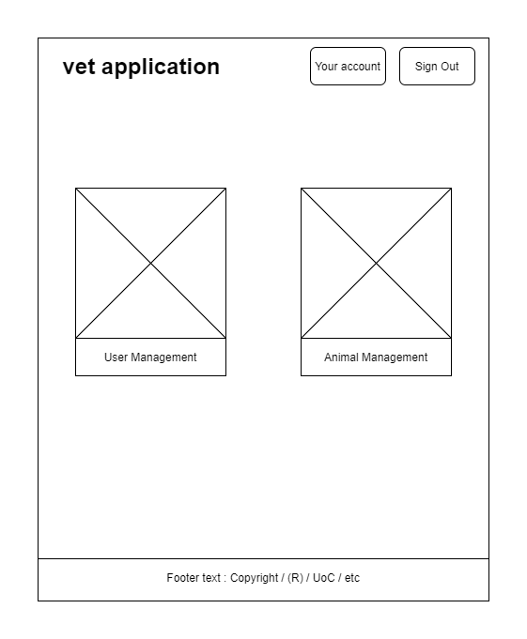
Main-Menu Page
Only admin would see the “User Management” option

Slide 7
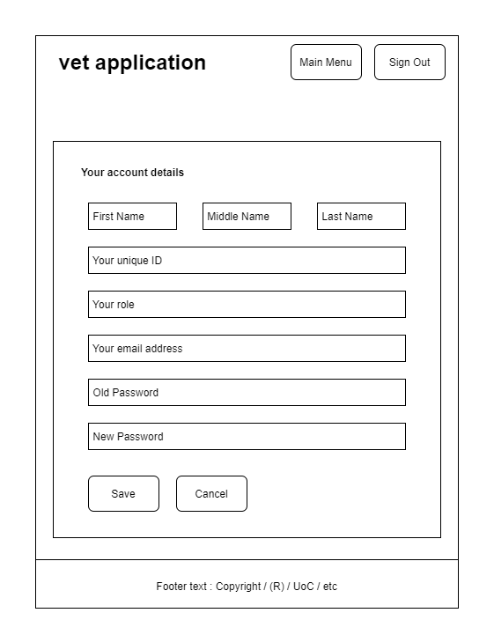
Your-Account Page
Only password can be changed by the user. Rest of the details are read-only.

Slide 8
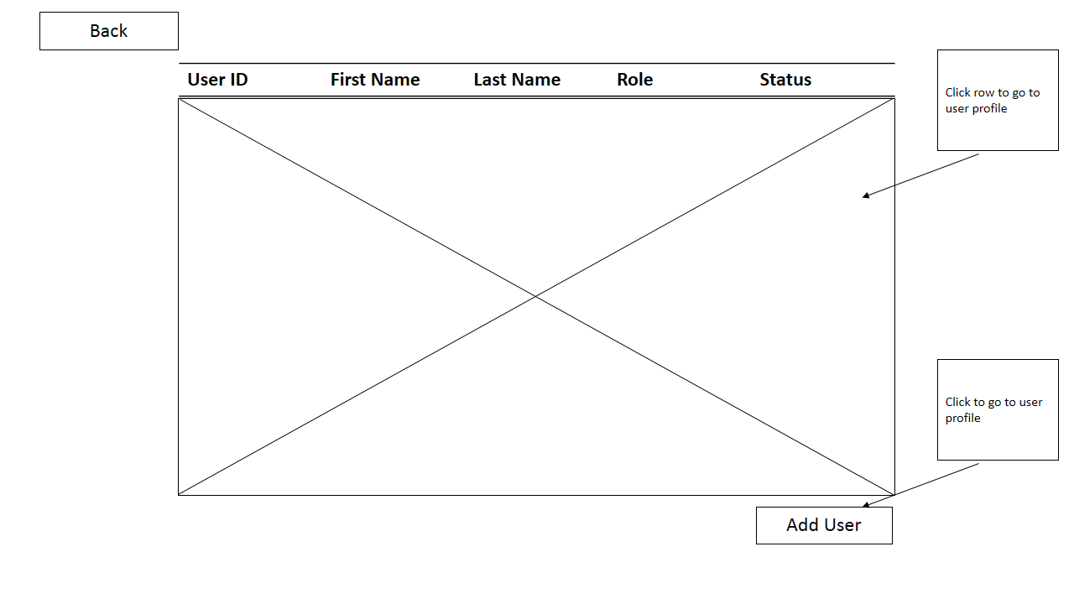
User Management

Slide 9
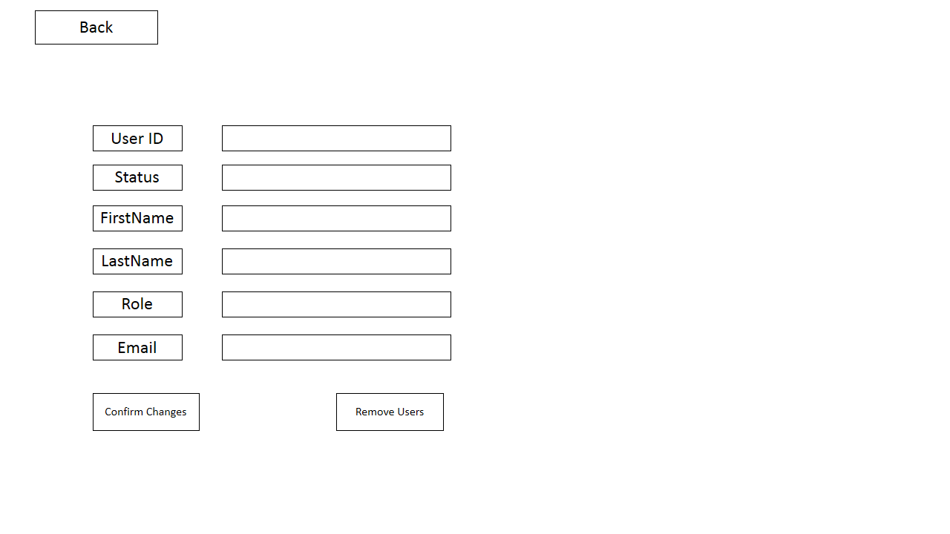
User Detail

Slide 10
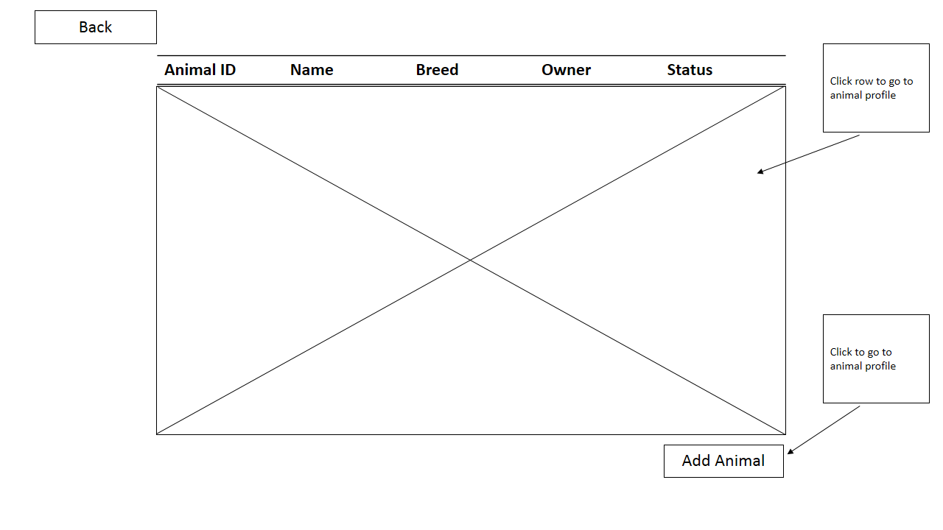
Animal Management

Slide 11
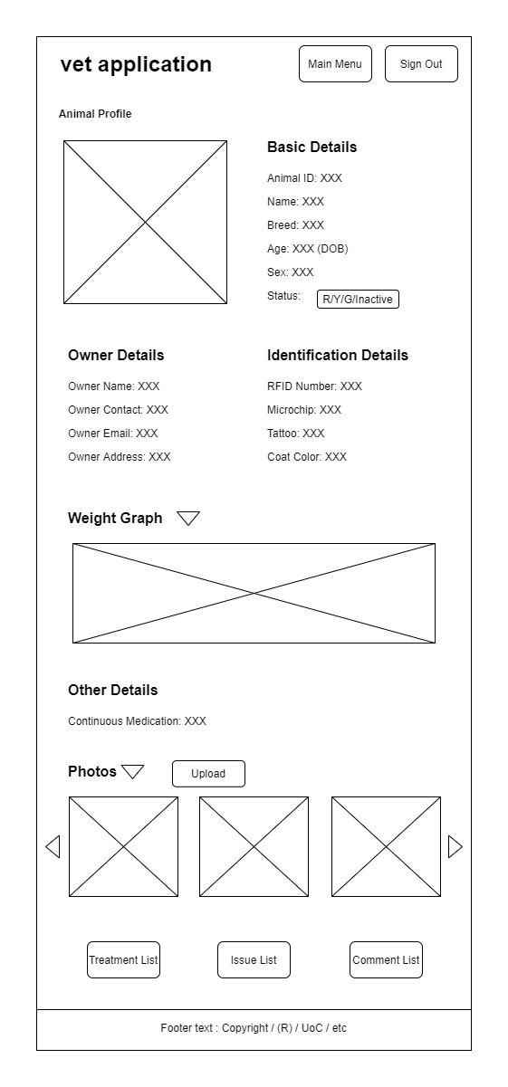
Animal Profile
Students don’t have access to change status button

Slide 12
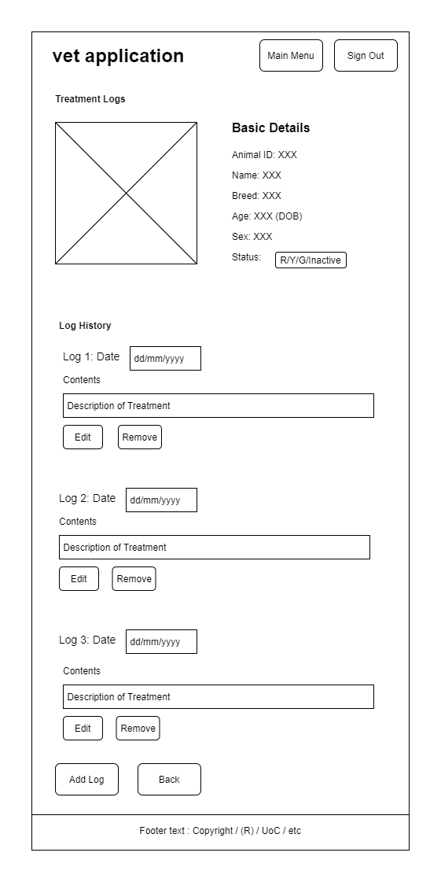
Animal Treatment Logs
Student: Have access to “Edit” but not “Remove” buttons at bottom of Log.
All other users: Have access to both buttons

Slide 13
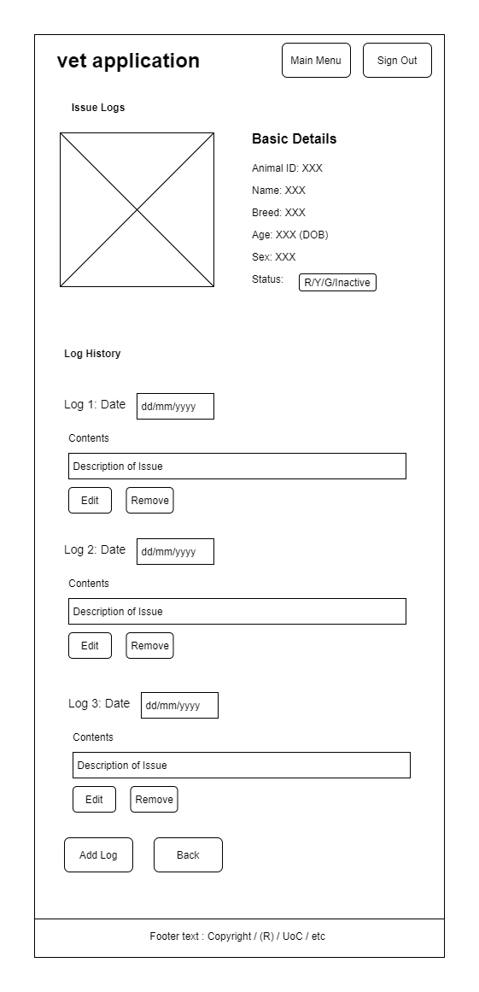
Animal Issue Logs
Student: Have access to “Edit” but not “Remove” buttons at bottom of Log.
All other users: Have access to both buttons

Slide 14

Animal Comment Logs
Student: Have access to “Edit” but not “Remove” buttons at bottom of Log.
All other users: Have access to both buttons

