Slide 1
Agile Planning: Step-by-Step Guide
Agile Planning Onion

Slide 2
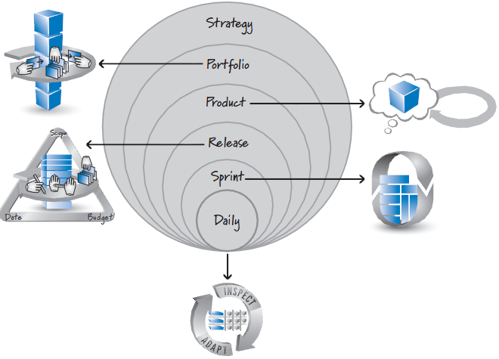
Multiple Levels of Planning…

Slide 3
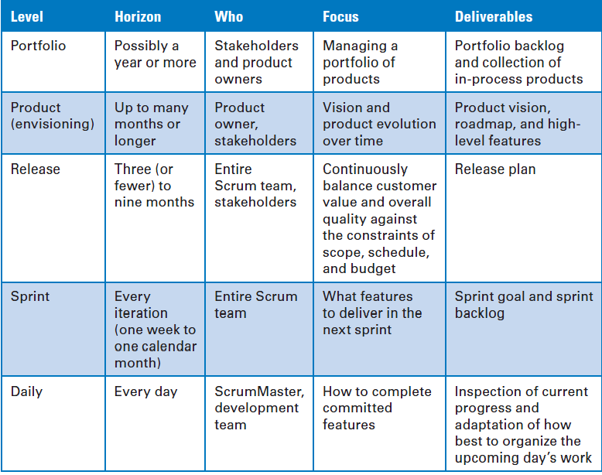
Multiple Levels of Planning…

Slide 4
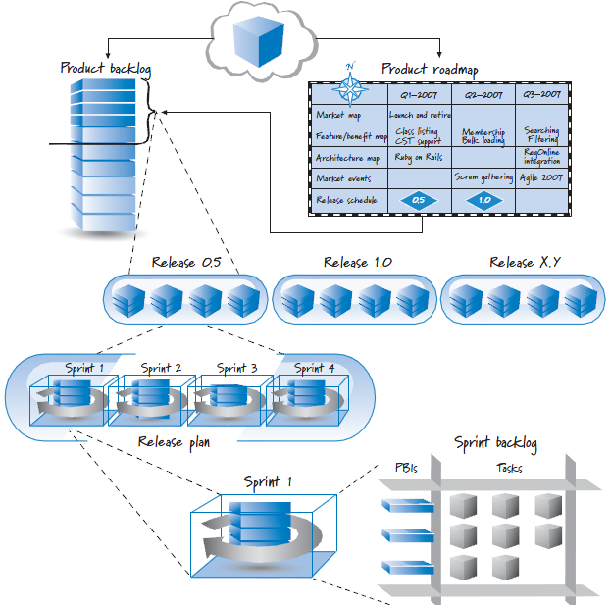
Multiple Levels of Planning…

Slide 5

References
Kenneth S. Rubin, Essential Scrum: A Practical Guide to the Most Popular Agile Process, 2012, Addison-Wesley

