Slide 1
Agile Planning: Step-by-Step Guide
Product Planning (Envisioning)

Slide 2
Product Planning: Why (Goal)
The goals of product-level planning (or envisioning) are to capture the essence of a potential product and to create a rough plan for the creation of that product.

Slide 3
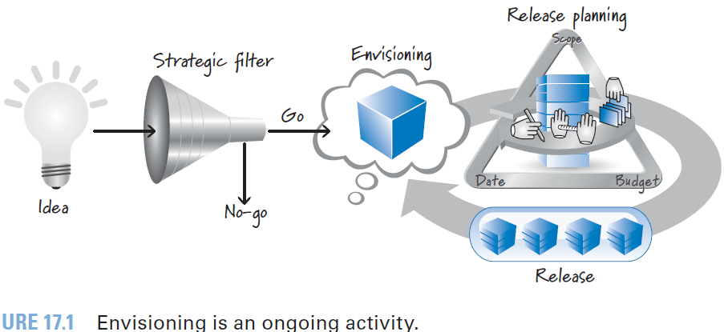
Product Planning: When

Slide 4
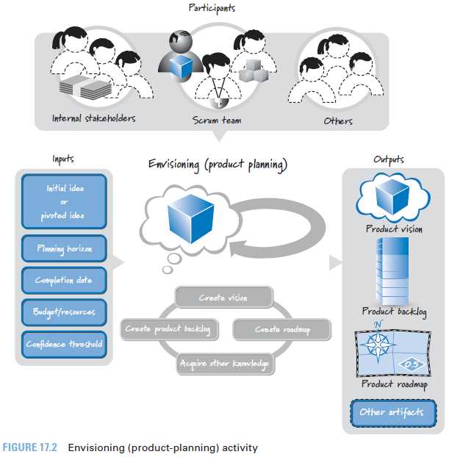
Product Planning: Who

Slide 5
Product Planning: How
Envisioning
begins with the creation of a vision,
followed by the creation of a high-level product backlog and
frequently a product roadmap.

Slide 6
Product Planning: Overview
Activities

Slide 7
Product Planning: Steps

Slide 8
Product Planning: Outputs
Vision
The product vision provides a clear description of the areas in which the stakeholders, such as users and customers, get value.

Slide 9
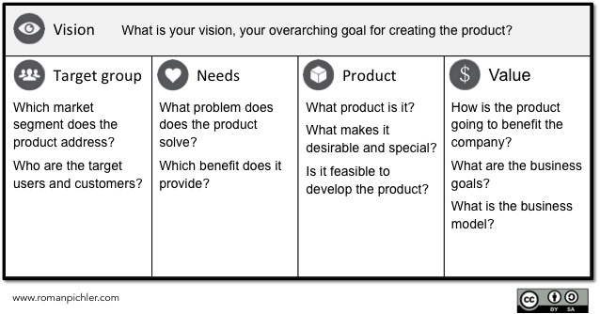
Product Vision

Slide 10
High-Level Product Backlog
High-Level Product Backlog
Generate an initial high-level version of the product backlog.
Feature /Capability Level
25- 50 items

Slide 11
High-Level Product Backlog
As a typical user I want to teach SR4U what types of reviews to discard so that SR4U will know what characteristics to use when discarding reviews on my behalf.
As a typical user I want a simple, Google-like interface for requesting a review search so that I don’t have to spend much time describing what I want.
As a typical user I want to have SR4U monitor the Internet for new reviews on products or services of interest and automatically filter and report them to me so that I don’t have to keep asking SR4U to do it for me.
As a sophisticated user I want to tell SR4U which sources to use when searching on my behalf so that I don’t get back reviews from sites I don’t like or trust.
As a product vendor I want to be able to show an SR4U-branded review summary for my product on my website so that people can immediately see what the marketplace thinks of my product as determined by a trusted source like SR4U.

Slide 12
Product Roadmap
Product roadmap sometimes referred to as a release roadmap
-

Slide 13
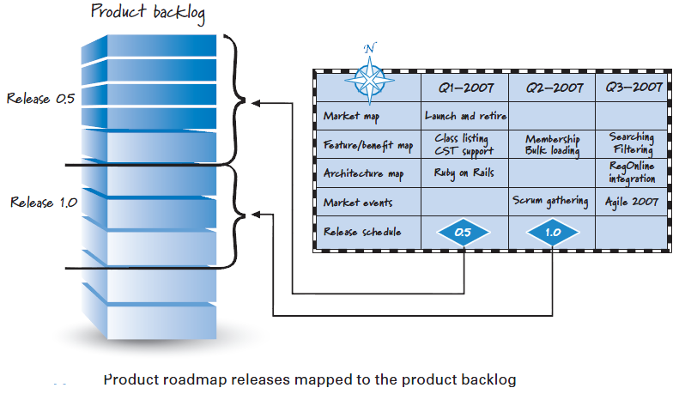
Product Roadmap to Product Backlog

Slide 14
Envisioning Other Activities: Example

Slide 15

References
Kenneth S. Rubin, Essential Scrum: A Practical Guide to the Most Popular Agile Process, 2012, Addison-Wesley

