Slide 1
Agile Planning: Step-by-Step Guide
Release Planning

Slide 2
Release Planning: Why
where we are in the development effort,
when we will finish,
what features we will get,
what the cost will be.

Slide 3
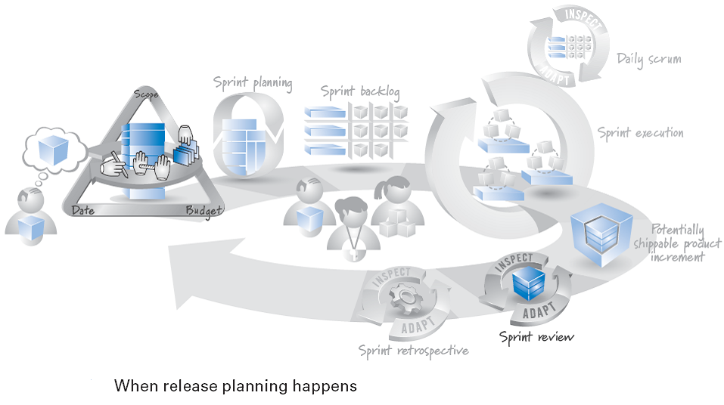
Release Planning: When
Timing
a frequent, every-sprint activity.

Slide 4
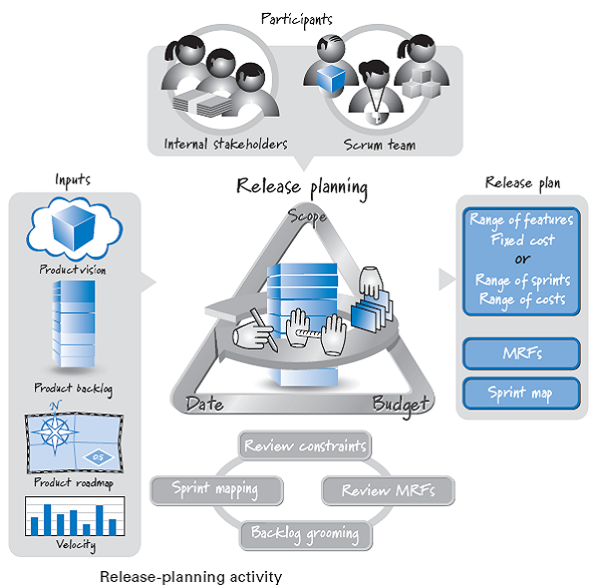
Release Planning: Who

Slide 5
Release Planning: Overview

Slide 6
Release Planning: Steps

Slide 7
Release Planning (Longer-Term Planning)
every sprint, every few sprints, or continuously deployment we need longer-term, higher-level planning.
Synonyms are
Release planning
Longer-term planning
Milestone-driven planning

Slide 8
Release Planning: Time + Participant

Slide 9
Release Planning – Process…
The inputs
outputs of product planning
the product vision,
high-level product backlog,
and product roadmap.
velocity of the team
Activities
Confirm the release constraints of scope, date, and budget
Product backlog grooming, creating, estimating, and prioritizing more detailed PBIs from high-level product backlog items.

Slide 10
Release Planning – Process…
Each release should have a well-defined set of minimum releasable features (MRFs).
produce a sprint map,
in which sprint some or many of PBIs might be created.
The outputs of release planning are collectively referred to as the release plan.
where we are in the development effort,
when we will finish,
what features we will get,
what the cost will be.

Slide 11
Fixed-Date Release Planning

Slide 12
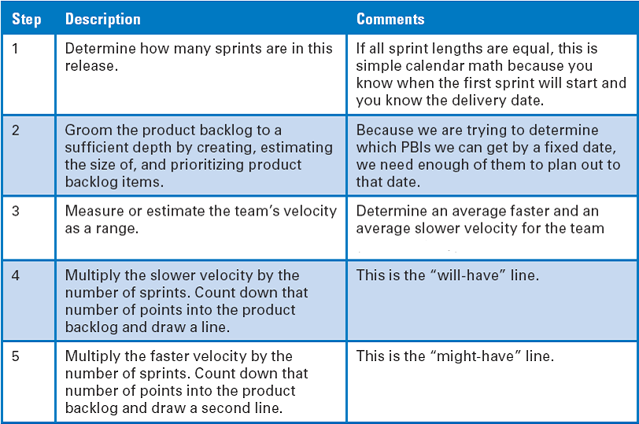
Fixed-Date Release Planning Steps

Slide 13
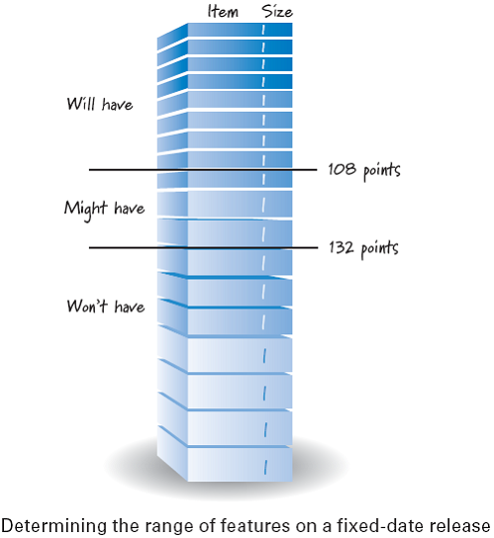
Product Backlog Size vs. Team Capacity
Team Capacity:
Average faster velocity * number of Sprint = 132 Points
Average slower velocity * number of Sprint = 108 Points

Slide 14
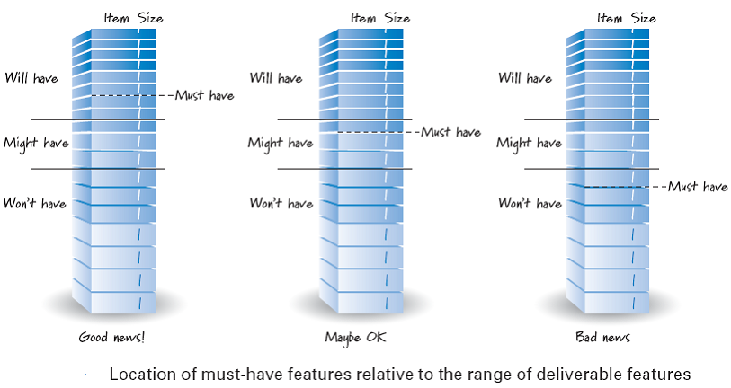
Must-have Size vs. Team Capacity

Slide 15
Fixed-Scope Release Planning

Slide 16
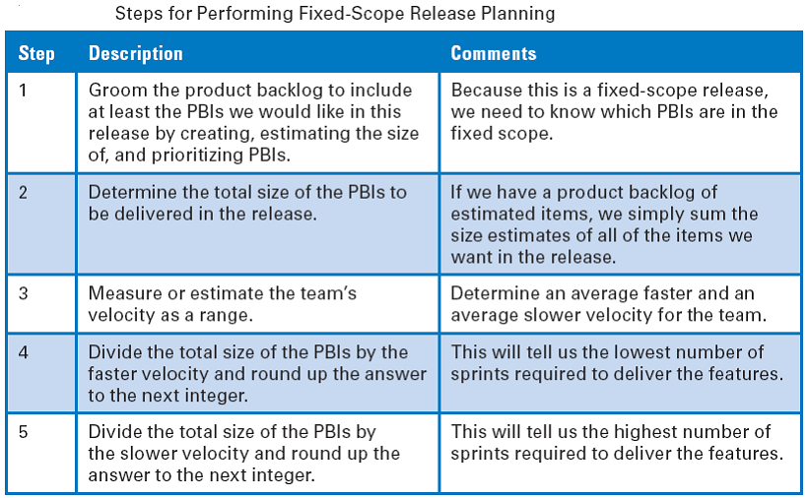
Fixed-Scope Release Planning Steps

Slide 17
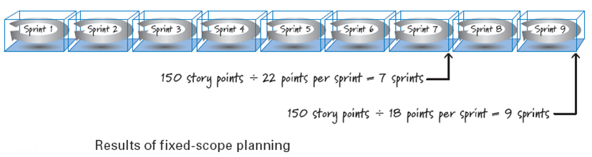
Fixed-Scope Planning Result
Notice that once again we give a range answer to the question we are being asked.
The question is:
“How many sprints will you need to complete a release with 150 points of work?”
The answer will be 7 to 9 sprints.
Because of two-week sprints, the answer also could be stated as 14 to 18 weeks.

Slide 18
Release Planning Communicating

Slide 19
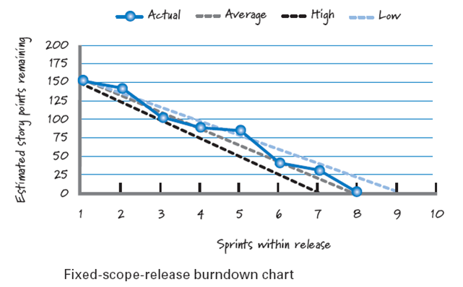
Fixed-Scope Burndown Chart…

Slide 20

References
Kenneth S. Rubin, Essential Scrum: A Practical Guide to the Most Popular Agile Process, 2012, Addison-Wesley

