Slide 1
Agile Planning: Step-by-Step Guide
Advanced Release Planning

Slide 2
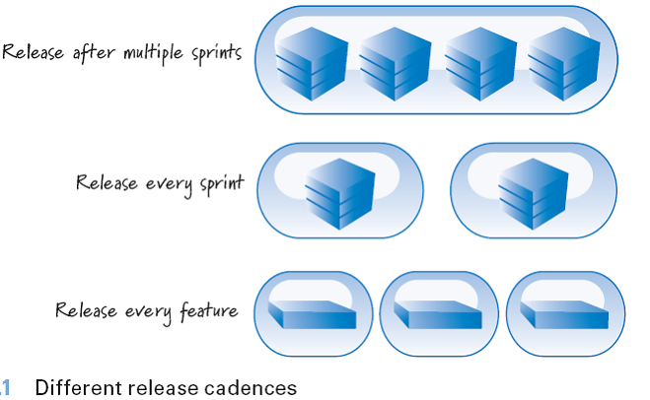
Release Cadence (Rhythm)
Every organization must determine the proper cadence for releasing features to its customers

Slide 3
Release Planning (Longer-Term Planning)
every sprint, every few sprints, or continuously deployment we need longer-term, higher-level planning.
Synonyms are
Release planning
Longer-term planning
Milestone-driven planning

Slide 4
Development Constraint Combinations
Project Type | Scope | Date | Budget
Fixed Everything | Fixed | Fixed | Fixed
Fixed Scope and Date | Fixed | Fixed | Flexible
Fixed Scope | Fixed | Flexible | Fixed (not really)
Fixed Date | Flexible | Fixed | Fixed

Slide 5
Release Planning Communicating

Slide 6
Burndown Chart…
Burndown Chart
A burndown chart for release shows the total amount of unfinished work that remains each sprint to achieve the current release goal.
update this chart at the end of each sprint
Velocity or Actual:
The difference between the amount of work remaining at the beginning of a sprint and the work remaining at the end of the sprint represents the sprint velocity.
This is plotted as the “Actual” line

Slide 7
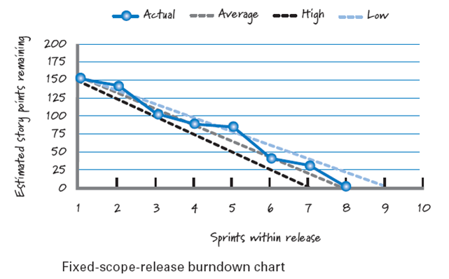
Fixed-Scope Burndown Chart…

Slide 8
Burnup Chart…
Burnup Chart
A burnup chart for a release shows the total amount of work in a release as a goal or target line and our progress each sprint toward achieving that goal
Some people prefer to use the burnup format because it can easily show a change in scope for the release.
Notes:
For example, if we add more scope in the current release (so the release really isn’t fixed scope!), in the sprint where the new scope is added we simply move the target line up to indicate that a new, higher target exists from this point forward.

Slide 9
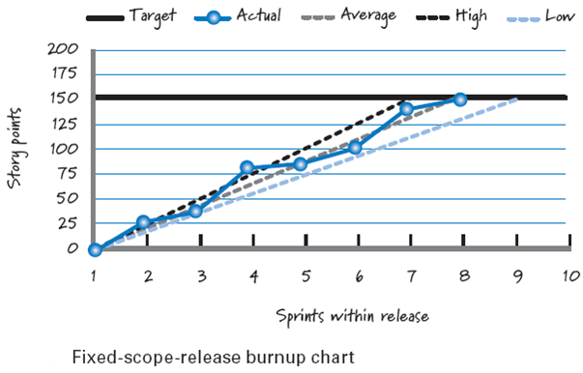
Fixed-Scope Burnup Chart

Slide 10
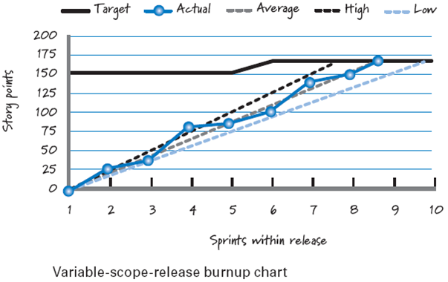
Burnup Chart- Fixed-Scope Where and Number of new Scope

Slide 11
Fixed-Date Specialized Burnup Chart…
The traditional burndown and burnup charts aren’t effective tools for fixed-date planning because they assume you know how much total scope you have to burn down or burn up.

Slide 12
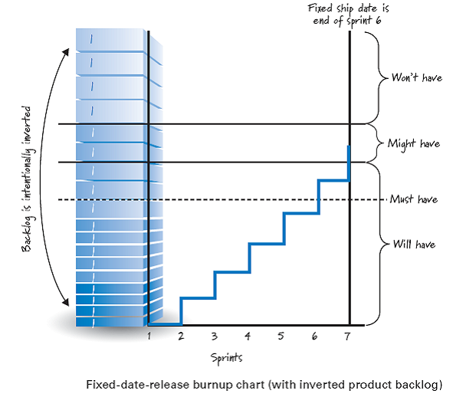
Fixed-Date Specialized Burnup Chart

