Slide 1
Agile Planning: Step-by-Step Guide
Sprint Planning

Slide 2
Sprint Planning: Why
A time when the Scrum team gathers to agree on a sprint goal and determine what subset of the product backlog it can deliver during the forthcoming sprint.

Slide 3
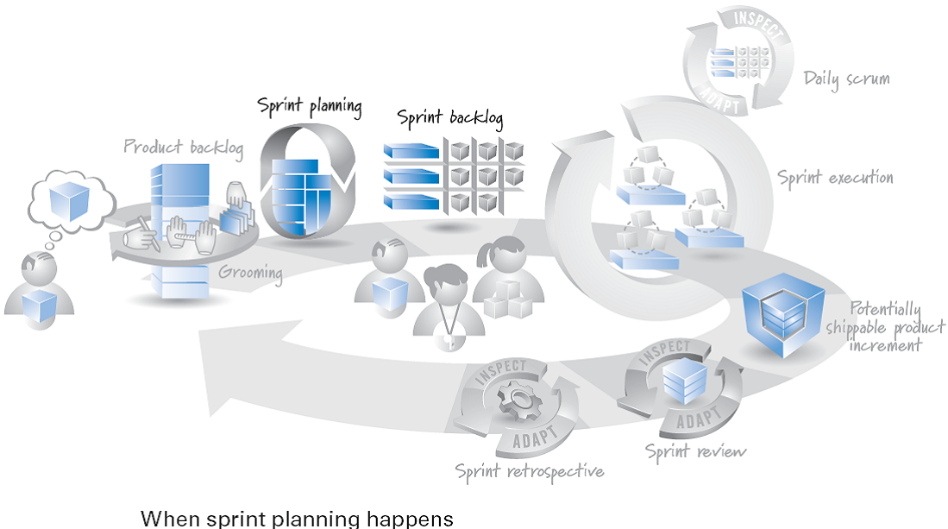
Sprint Planning: When
For a two-week to month-long sprint, sprint planning should take no longer than four to eight hours to complete.

Slide 4
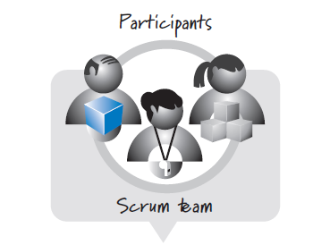
Sprint Planning: Who

Slide 5
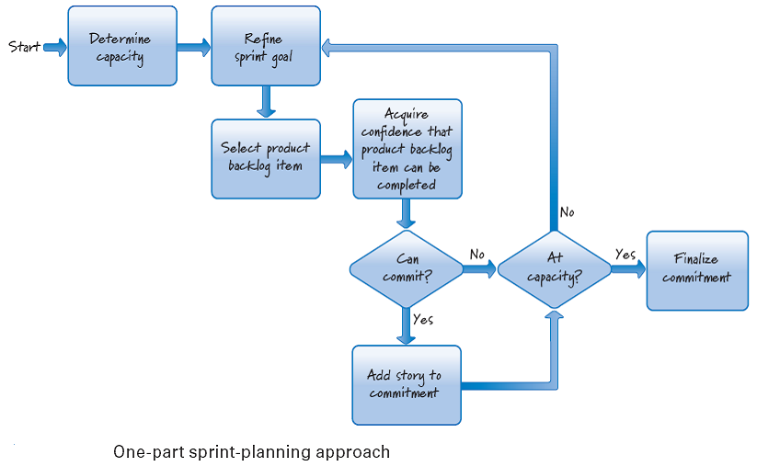
Sprint Planning: How (One-Part Sprint Planning)

Slide 6
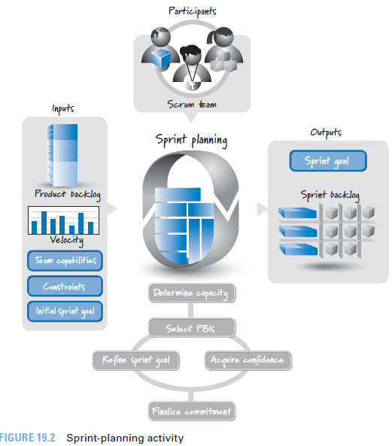
Sprint Planning: Overview

Slide 7

References
Kenneth S. Rubin, Essential Scrum: A Practical Guide to the Most Popular Agile Process, 2012, Addison-Wesley

