Slide 1
Agile Planning: Step-by-Step Guide
Advanced Sprint Planning

Slide 2
Sprint Planning Approaches

Slide 3
Sprint Planning…
Process
The first and most crucial input to sprint planning is a product backlog that has been groomed prior to sprint planning so that the topmost items meet the Scrum team’s definition of ready
Engaged POs also enter having a good idea of what they want the team to deliver by the end of the sprint.
They might have a specific set of high-priority product backlog items in mind—“I’d really like to get the top five product backlog items done this sprint”—or they might have a more general notion—“At the end of this sprint I want a typical user to be able to submit a simple keyword query.”
Knowing the sprint goal helps the team balance competing priorities.

Slide 4
Sprint Planning…
Inputs
Product backlog
Prior to sprint planning, the topmost product backlog items have been groomed into a ready state.
Team velocity
The team’s historical velocity is an indicator of how much work is practical for the team to complete in a sprint.
Constraints
Business or technical constraints that could materially affect what the team can deliver are identified.
Team capabilities
Capabilities take into account which people are on the team, what skills each team member has, and how available each person will be in the upcoming sprint.
Initial sprint goal
This is the business goal the product owner would like to see accomplished during the sprint.

Slide 5
Sprint Planning Approaches
Tow Approaches

Slide 6
Two-Part Sprint Planning…
Part I: What Part
During part 1 the development team determines its capacity to complete work and then forecasts the product backlog items that it believes it can deliver by the end of the sprint(ex. 40 story points)
Part II: How Part
During part 2 the team acquires confidence in its ability to complete the items that it forecasted in part 1 by creating a plan.
Most teams create this plan by breaking the PO items into a set of tasks and then estimating (in hours) the effort required to complete each task.
The team then compares the estimate of task hours against its capacity, in terms of hours, to see if its initial commitment was realistic.

Slide 7
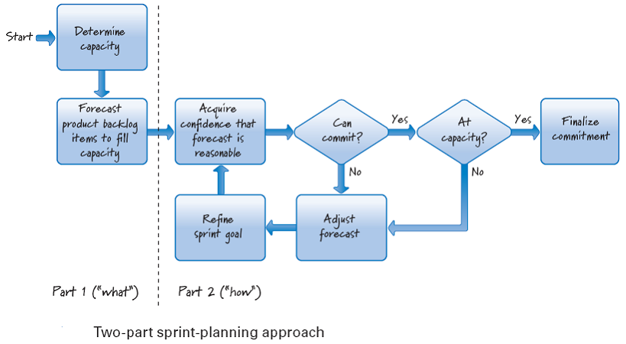
Two-Part Sprint Planning

Slide 8
One-Part Sprint Planning…
Interleaves selecting an item and acquiring confidence that it can be delivered.
Using this approach, the development team begins by determining its capacity to complete work. Based on available capacity, the sprint goal may need to be refined.
Next the team selects a product backlog item and then acquires confidence that the selected item will reasonably fit within the sprint, given other items already included in the team’s evolving commitment.
This cycle is then repeated until the team is out of capacity to do any more work. At that point the commitment is finalized and sprint planning is over.

Slide 9
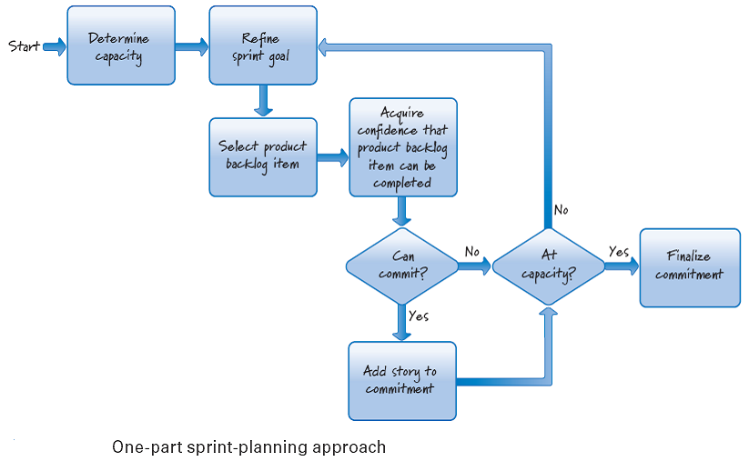
One-Part Sprint Planning

Slide 10
Team Capacity

Slide 11
Team Capacity…
Importance of Team Capacity
An important first activity during sprint planning is determining the available capacity of the team to perform work during the sprint.
Knowledge of capacity guides the Scrum team in determining what it can deliver.
The various factors that influence a team’s capacity to work on product backlog items during an upcoming sprint.
Time needed for other Scrum activities, non-sprint-related commitments, personal time off, and the need for a buffer.

Slide 12
Team Activities during an Sprint…
Sprint Planning Reserved Capacity
We know, for instance, that on a two-week sprint about a day of that time needs to be reserved collectively for sprint-planning, sprint review, and sprint retrospective activities.
Backlog Grooming
We also know that the team should reserve up to 10% of its time to assist the product owner with product backlog grooming (writing and refining, estimating, and prioritizing product backlog items) to help ensure that the items are ready.
Maintaining and Supporting
The team must also determine how much time it should reserve for work outside the sprint, things like supporting the current product, maintaining another product, or other work unrelated to the current sprint.

Slide 13
Team Activities during an Sprint
Organization Citizenship
There is some overhead required to be a good citizen of the organization—attending meetings, responding to emails, interruptions, and so on.
Personal Time off
Next, the team needs to know if people have personal time off scheduled during a sprint because that also reduces overall team capacity.
Reserved Buffer
From this total capacity we should reserve some buffer against things not going quite as planned.
For example, any estimating we do won’t be perfect, so items might turn out to be a bit larger than we thought.
Or something can (and usually does) go wrong. Having a bit of buffer against unexpected problems is wise.

Slide 14
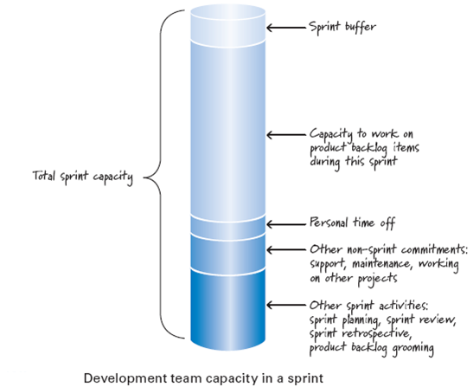
Team Capacity …

Slide 15
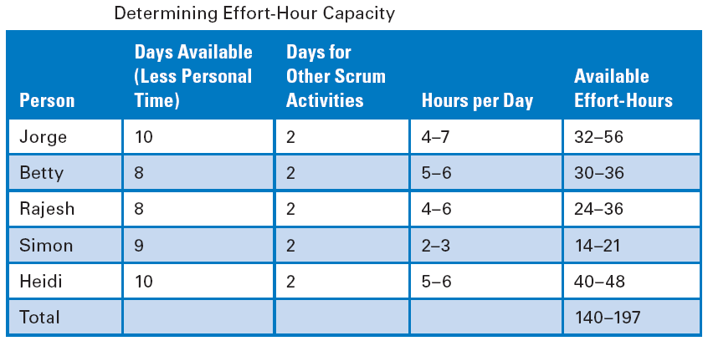
Sample Team Capacity

Slide 16
Selecting Product Backlog Items

Slide 17
Selecting Product Backlog Items
Selection can be done in several ways.
If we have a sprint goal, we would select product backlog items that align with that goal.
If there is no formal sprint goal, our default is to select items from the top of the product backlog.
start-only-what-you-can-finish rule
we don’t start what we can’t finish.
if the next product backlog item is too big to complete:
give the other items
OR
try to break down the item into two or more smaller items
start-only-what-you-can-finish rule is based on WIP limitation(starting something and not finishing it generates a variety of forms of waste)

Slide 18
Refine the Sprint Goal

Slide 19
No Goal-Altering Changes Rule …
What is a Sprint Goal
Each sprint can be summarized by a sprint goal that describes the business purpose and value of the sprint.
No Goal-Altering Changes Rule
once the sprint goal has been established and sprint execution has begun, no change is permitted that can materially affect the sprint goal(Scrum Rule).
Conflict with Agile Principles
the no-goal-altering-change rule is in direct conflict with the core Scrum/Agile principle that we should embrace change.

Slide 20
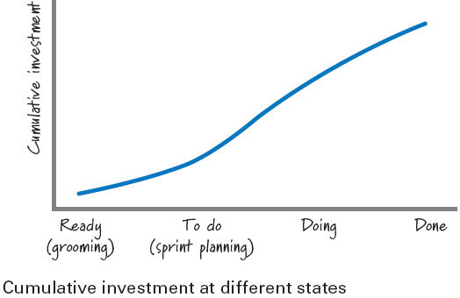
No Goal-Altering Changes Rule …
We do embrace change, but we want to embrace it in a balanced, economically sensible way.
Once a sprint starts, our investment in those product backlog items has increased (because we spent time during sprint planning to discuss and plan them at a task level).
-
to do = work not yet started
doing = work in process done = work completed

Slide 21
No Goal-Altering Changes Rule …
Swap out feature X and substitute feature Y in Current Sprint
A: If we haven’t started working on feature X
planning waste.
If feature X might have dependencies with other features in the sprint, so a change that affects feature X could affect one or more other features, thus amplifying the effect on the sprint goal.
B: If work on feature X has already begun
Waste of part A +
If all of the work already performed on feature X might have to be thrown away.
the additional waste of removing the partially completed work on feature X
C: if feature X is already completed,
we might have wasted the full investment we made in feature X.
Team motivation and trust affected by changes
When the product owner violates a commitment to not alter the goal, the team naturally will be demotivated
violating the commitment can harm the trust within the team (stick to commitments)

Slide 22
No Goal-Altering Changes Rule …
Being Pragmatic
The no-goal-altering-change rule is just that—a rule, not a law.
We must act in an economically sensible way.
if the economic consequences of the change are far less than the economic consequences of deferring the change, making the change is the smart business decision.

Slide 23
Refine the Sprint Goal
The product owner should come to sprint planning with an initial sprint goal.
That initial goal can be refined during the course of sprint planning according to what can realistically be delivered.
No Goal-Altering Changes
No Goal-Altering Changes
once the sprint goal has been established and sprint execution has begun, no change is permitted that can materially affect the sprint goal.
It’s RULE not LAW

Slide 24

References
Kenneth S. Rubin, Essential Scrum: A Practical Guide to the Most Popular Agile Process, 2012, Addison-Wesley

