Slide 1
Agile Planning: Step-by-Step Guide
Sprint Execution

Slide 2
Sprint Execution: Why
Sprint execution is like a mini project unto itself—all of the work necessary to deliver a potentially shippable product increment is performed.

Slide 3
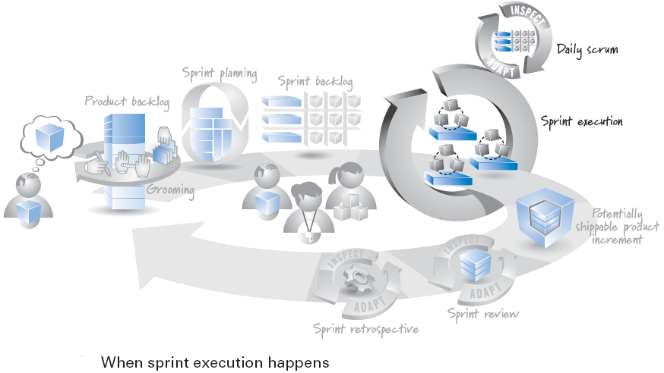
Sprint Execution: When
It begins after sprint planning and
It ends when the sprint review starts
On a two-week-long sprint, sprint execution might account for about eight out of the ten days.

Slide 4
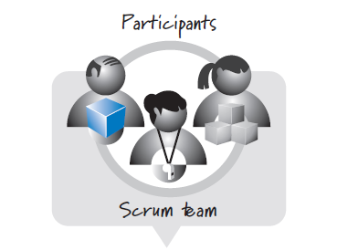
Sprint Execution: Who

Slide 5
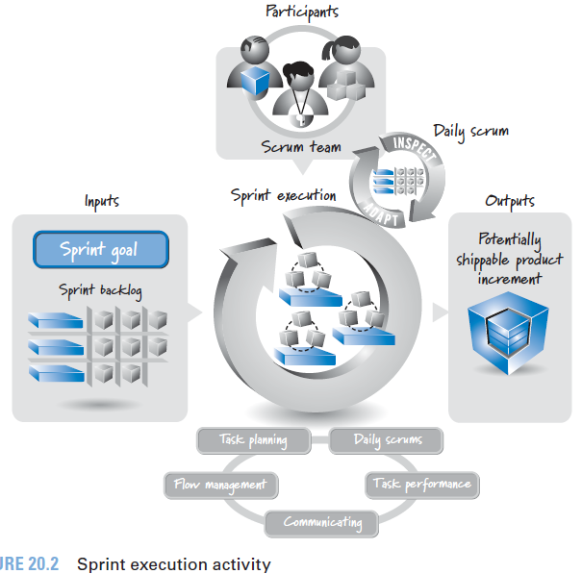
Sprint Execution: Overview

Slide 6
Communicating

Slide 7
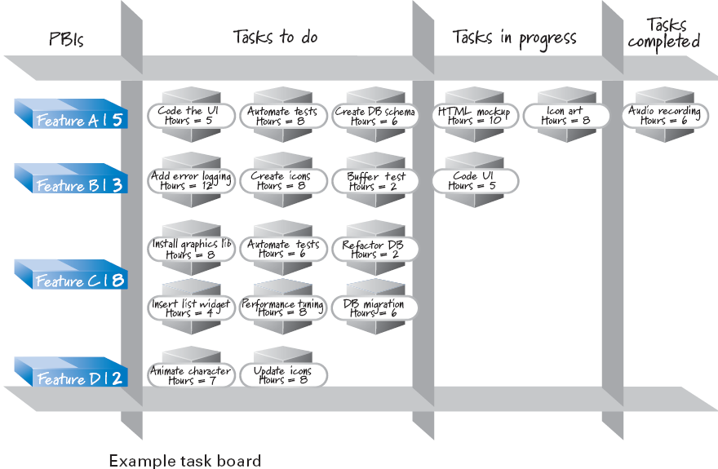
Task Board

Slide 8
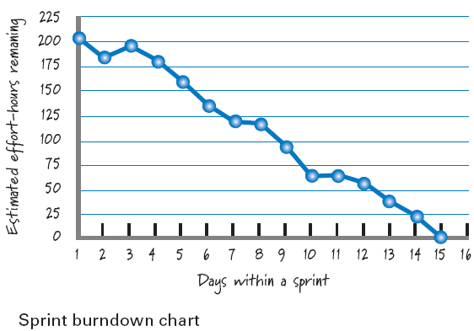
Sprint Burndown Chart

Slide 9

References
Kenneth S. Rubin, Essential Scrum: A Practical Guide to the Most Popular Agile Process, 2012, Addison-Wesley

