Slide 1
Agile Planning: Step-by-Step Guide
Advanced Sprint Execution

Slide 2
Flow Management

Slide 3
Flow Management
It’s the team’s responsibility to manage the flow of work during sprint execution to meet the sprint goal.
It must make decisions such as
how much work the team should do in parallel,
when work should begin on a specific item,
how the task-level work should be organized,
what work needs to be done,
who should do the work.

Slide 4
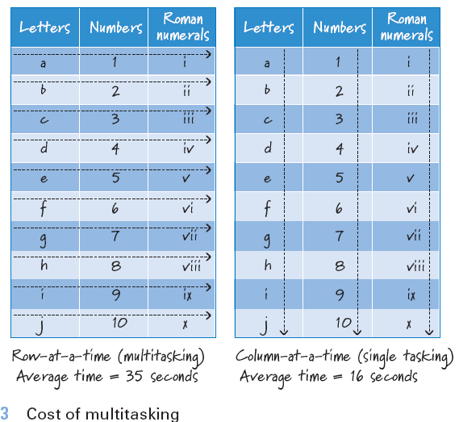
Parallel Work and Swarming

Slide 5
Which Work to Start
Which Work to Start
Next highest priority sprint backlog item
The simplest way to select the next product backlog item is to choose the next highest-priority item as specified by the product owner (via the item’s position in the product backlog)
any items not completed during the sprint must be of lower priority than the ones that are completed.
It won’t always work
because technical dependencies or skills capacity constraints might dictate that items be selected in a different order.
The development team needs the ability to opportunistically make this selection as it sees fit.

Slide 6

Who Does the Work?...
T-Shaped Skills
Flexible development teams are composed of members with T-shaped skills
It’s unrealistic to believe that every person on a team could work on every task.
Managers should focus on forming teams that have the best set of T-shaped skills that are possible with available personnel! (how?!)

Slide 7
Who Does the Work?
Who should work on each task?
the person best able to quickly and correctly get it done.
What if that person is unavailable?
Perhaps she is already working on another, more important task, or maybe she is out sick and the task needs to get done immediately.
it’s the collective responsibility of the team members to consider factors and make a good choice.
When team members have T-shaped skills,
several people on the team have the ability to work on each task.
When some skills overlap among team members, the team can swarm people to the tasks that are inhibiting the flow of a product backlog item through sprint execution, making the team more efficient.

Slide 8
Communicating

Slide 9
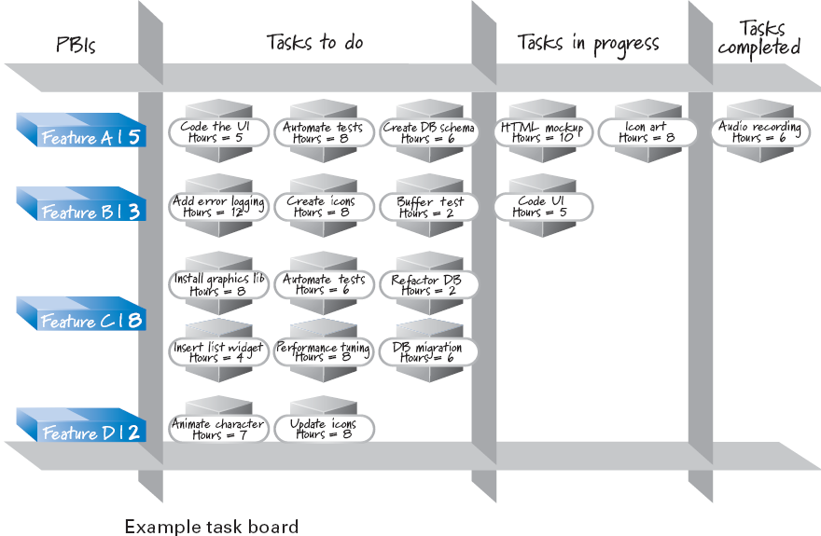
Task Board

Slide 10
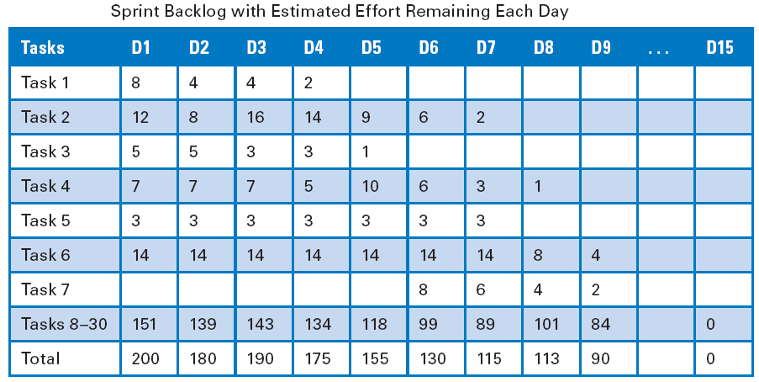
Sprint Burndown Chart…
Usage
Each day during sprint execution team members update the estimate of how much effort remains for each uncompleted task.
We could create a table to visualize this data.
-

Slide 11
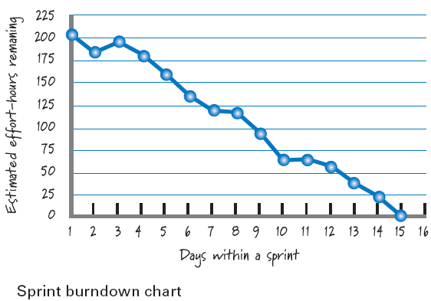
Sprint Burndown Chart

Slide 12
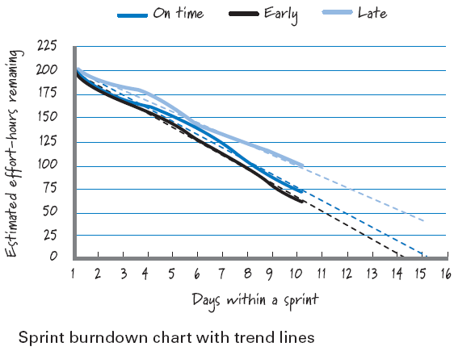
Sprint Burndown Chart …
Notes:
In this figure, three different burndown lines are superimposed to illustrate
distinct situations. When the trend line intersects the horizontal axis close to the
end of the sprint duration, we can infer that we’re in reasonable shape (“On time”).
When it lands significantly to the left, we should probably take a look to see if we can
safely take on additional work (“Early”). But when it lands significantly to the right
(“Late”), that raises a flag that we’re not proceeding at the expected pace or that we’ve
taken on too much work (or both!). When that happens, we should dig deeper to see
what’s behind the data and what, if anything, needs to be done. By projecting the
trend lines, we have another important set of data that adds to our knowledge of how
we are managing flow within our sprint.

Slide 13
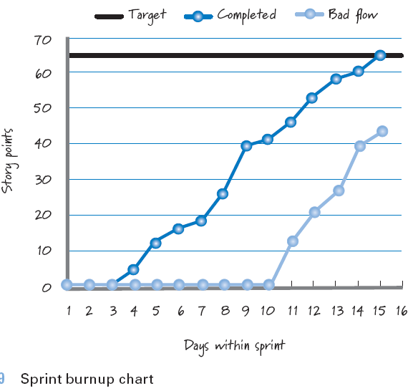
Sprint Burnup Chart

Slide 14

References
Kenneth S. Rubin, Essential Scrum: A Practical Guide to the Most Popular Agile Process, 2012, Addison-Wesley

