Slide 1
Agile Planning: Step-by-Step Guide
Sprint Review

Slide 2
Sprint Review: Why
During sprint planning we plan the work.
During sprint execution we do the work.
During sprint review we inspect (and adapt) the result of the work (the potentially shippable product increment).

Slide 3
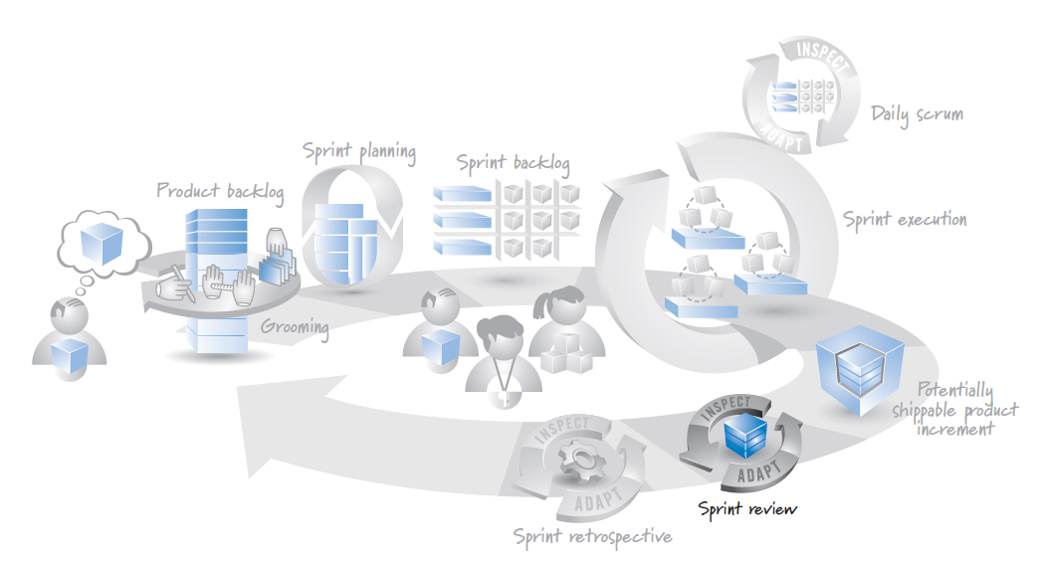
Sprint Review: When
The sprint review occurs near the end of each sprint cycle, just after sprint execution and just before (or occasionally after) the sprint retrospective

Slide 4

Sprint Review: Who
Scrum team | The product owner, ScrumMaster, and development team should all be present so that they can all hear the same feedback and be able to answer questions regarding the sprint and the product increment.
Internal stakeholders | Business owners, executives, and managers should see the progress firsthand so that they can suggest course corrections. For internal product development, internal users, subject matter experts, and the operations manager of the business function to which the product relates should attend.
Other internal teams | Sales, marketing, support, legal, compliance, and other Scrum and non-Scrum development teams might want to attend sprint reviews to provide area-specific feedback or to sync their own groups’ work with the Scrum team.
External stakeholders | External customers, users, and partners can provide valuable feedback to the Scrum team and other attendees.

Slide 5
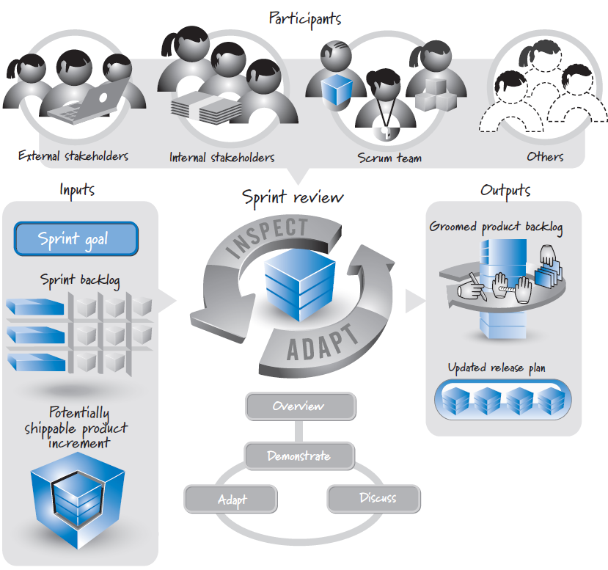
Sprint Review: Overview

Slide 6
Approach

Slide 7
Summarize
The sprint review kicks off with a Scrum team member (frequently the product owner) presenting the sprint goal, the product backlog items associated with the sprint goal, and an overview of the product increment that was actually achieved during the sprint.
This information provides a summary or synopsis of how the sprint results compare with the sprint goal.
If the results don’t match, the Scrum team provides an explanation.
It is important that the sprint review be a blame-free environment.

Slide 8
Demonstrate
The sprint review is frequently mislabeled the “sprint demo” or just “the demo.”
Although a demonstration is quite helpful in the sprint review, the demo is not the aim of the sprint review.
The most important aspect of the sprint review is in-depth conversation and collaboration among the participants to enable productive adaptations to surface and be exploited. The demonstration of what actually got built is simply a very efficient way to energize that conversation around something concrete.

Slide 9
Discuss
Demonstrating the product increment becomes the focal point for having an in-depth conversation.
Observation, comments, and reasonable discussion regarding the product and direction are strongly encouraged among the participants.
The sprint review, however, is not the place for deep problem solving; that type of work should be deferred to another meeting.

Slide 10
Adapt
Through demonstration and discussion, the team is able to ask and answer questions, including the following:
the stakeholders like what they see?
they want to see changes?
Is what we’re building still a good idea in the marketplace or to our internal customers?
Are we missing an important feature?
Are we overdeveloping/investing in a feature where we don’t have to?
Asking and answering these questions provides input on how to adapt the product backlog and release plans.

Slide 11

References
Kenneth S. Rubin, Essential Scrum: A Practical Guide to the Most Popular Agile Process, 2012, Addison-Wesley

